Slide 1
Transparency conversion from sRGB to Linear color space
https://github.com/sotanmochi/TransparencyConverter
Soichiro Sugimoto
Latest update: 2022/05/08
Create: 2022/04/24

Slide 2
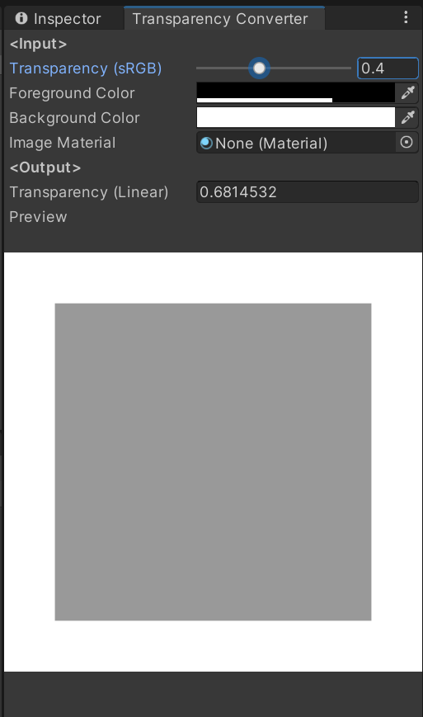
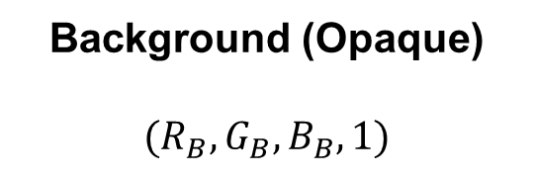
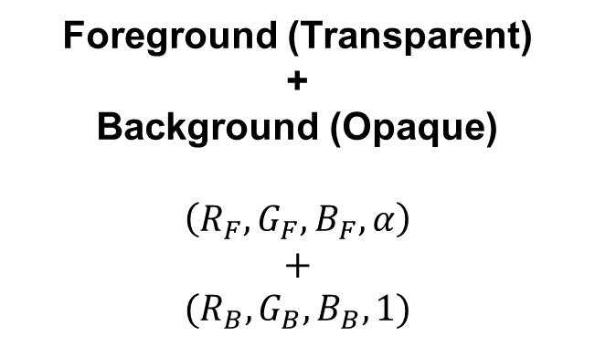
Transparency conversion from sRGB color space to linear color space
Foreground (Transparent)
+
Background (Opaque)
$$\left(R_{F}, G_{F}, B_{F}, α\right)$$
$$+$$
$$(R_{B}, G_{B}, B_{B}, 1)$$
Background (Opaque)
$$(R_{B}, G_{B}, B_{B}, 1)$$

Slide 3


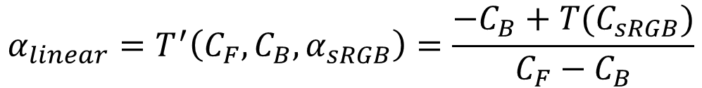


Transparency conversion from sRGB color space to linear color space
$$C_{output}=C_{F}α+C_{B}(1−α)$$
where $0≤c_{F}≤1$, $0≤c_{B}≤1$ and $0≤α≤1$.
$$C_{linear}=C_{F}α_{linear}+C_{B}(1−α_{linear})$$
$$C_{sRGB} =C_{F}α_{sRGB} +C_{B}(1−α_{sRGB})$$
$$C_{linear}=T(C_{sRGB})$$
where $T(x)$ is transfer function from sRGB color space to linear color space.
$$C_{F}α_{linear}+C_{B}(1−α_{linear})=T(C_{sRGB})$$
$$α_{linear}=T^{′}\left(C_{F}, C_{B}, α_{sRGB}\right)=\frac{−C_{B}+T(C_{sRGB})}{C_{F}−C_{B}}$$
where $C_{F}≠C_{B}$and $C_{sRGB} =C_{F}α_{sRGB}+C_{B}(1−α_{sRGB})$.

Slide 4





$$C_{output}=C_{F}α+C_{B}(1−α)$$
where $0≤c_{F}≤1$, $0≤c_{B}≤1$ and $0≤α≤1$.
$$R_{output}=R_{F}α+R_{B}(1−α)$$
$$G_{output}=G_{F}α+G_{B}(1−α)$$
$$B_{output}=B_{F}α+B_{B}(1−α)$$
$$α_{linear}=T^{′}\left(R_{F}, R_{B}, α_{sRGB}\right)=T^{′}\left(G_{F}, G_{B}, α_{sRGB}\right)=T^{′}\left(B_{F}, B_{B}, α_{sRGB}\right)$$
$$α_{linear}=T^{′′}\left(α_{sRGB},R_{F}, R_{B},G_{F}, G_{B},B_{F}, B_{B}\right)$$
$$=\frac{1}{3}\left[T^{′}\left(R_{F}, R_{B}, α_{sRGB}\right)+T^{′}\left(G_{F}, G_{B}, α_{sRGB}\right)+T^{′}\left(B_{F}, B_{B}, α_{sRGB}\right)\right]$$

Slide 5

Considering the constraint $0≤α_{linear}≤1$
$$α_{linear}=\frac{T^{′′}\left(α_{sRGB},R_{F}, R_{B},G_{F}, G_{B},B_{F}, B_{B}\right)−T_{MIN}^{′′}}{T_{MAX}^{′′}−T_{MIN}^{′′}}$$
When $T^{′′}\left(α_{sRGB},R_{F}, R_{B},G_{F}, G_{B},B_{F}, B_{B}\right)=T_{MAX}^{′′} → α_{linear}=1$
When$T^{′′}\left(α_{sRGB},R_{F}, R_{B},G_{F}, G_{B},B_{F}, B_{B}\right)=T_{MIN}^{′′} → α_{linear}=0$
When $T^{′′}\left(α_{sRGB},R_{F}, R_{B},G_{F}, G_{B},B_{F}, B_{B}\right)=\left(T_{MAX}^{′′}+T_{MIN}^{′′}\right)/2 → α_{linear}=0.5$
$T\left(R_{F}, R_{B}, α_{sRGB}\right),T\left(G_{F}, G_{B}, α_{sRGB}\right),T\left(B_{F}, B_{B}, α_{sRGB}\right)$ are monotonically increasing for $α_{sRGB}$.
The function $T^{′′}\left(α_{sRGB},R_{F}, R_{B},G_{F}, G_{B},B_{F}, B_{B}\right)$ is monotonically increasing for $α_{sRGB}$.
where $R_{F}≠R_{B}, G_{F}≠G_{B}, B_{F}≠B_{B}$
$$T_{MAX}^{′′}=T^{′}\left(R_{F}, R_{B}, 1\right)+T^{′}\left(G_{F}, G_{B}, 1\right)+T^{′}\left(B_{F}, B_{B}, 1\right)$$
$$T_{MIN}^{′′}=T^{′}\left(R_{F}, R_{B}, 0\right)+T^{′}\left(G_{F}, G_{B}, 0\right)+T^{′}\left(B_{F}, B_{B}, 0\right)$$

Slide 6
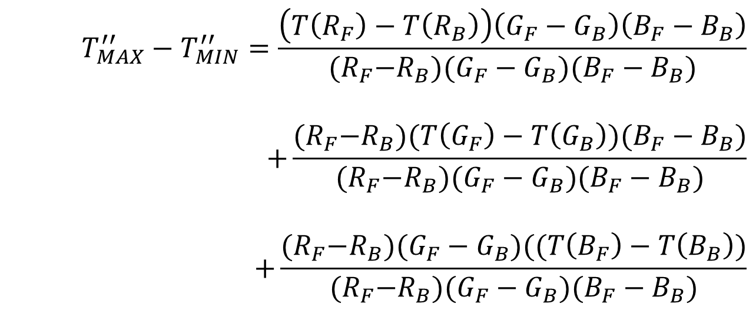
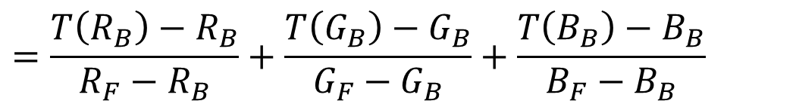
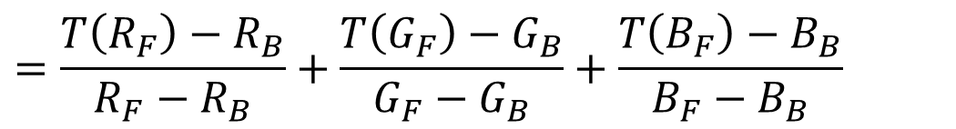
$$T_{MAX}^{′′}=T^{′}\left(R_{F}, R_{B}, 1\right)+T^{′}\left(G_{F}, G_{B}, 1\right)+T^{′}\left(B_{F}, B_{B}, 1\right)$$
$$=\frac{T\left(R_{F}\right)−R_{B}}{R_{F}−R_{B}}+\frac{T\left(G_{F}\right)−G_{B}}{G_{F}−G_{B}}+\frac{T\left(B_{F}\right)−B_{B}}{B_{F}−B_{B}}$$
$$T_{MIN}^{′′}=T^{′}\left(R_{F}, R_{B}, 0\right)+T^{′}\left(G_{F}, G_{B}, 0\right)+T^{′}\left(B_{F}, B_{B}, 0\right)$$
$$=\frac{T\left(R_{B}\right)−R_{B}}{R_{F}−R_{B}}+\frac{T\left(G_{B}\right)−G_{B}}{G_{F}−G_{B}}+\frac{T\left(B_{B}\right)−B_{B}}{B_{F}−B_{B}}$$
$$T_{MAX}^{′′}−T_{MIN}^{′′}=\frac{T\left(R_{F}\right)−T\left(R_{B}\right)}{R_{F}−R_{B}}+\frac{T\left(G_{F}\right)−g\left(G_{B}\right)}{G_{F}−G_{B}}+\frac{T\left(B_{F}\right)−T\left(B_{B}\right)}{B_{F}−B_{B}}$$
$$T_{MAX}^{′′}−T_{MIN}^{′′}=\frac{\left(T\left(R_{F}\right)−T\left(R_{B}\right)\right)\left(G_{F}−G_{B}\right)\left(B_{F}−B_{B}\right)}{{(R}_{F}−R_{B})(G_{F}−G_{B})(B_{F}−B_{B})}$$
$$+\frac{{(R}_{F}−R_{B})(T\left(G_{F}\right)−T\left(G_{B}\right))(B_{F}−B_{B})}{{(R}_{F}−R_{B})(G_{F}−G_{B})(B_{F}−B_{B})}$$
$$+\frac{{(R}_{F}−R_{B})(G_{F}−G_{B})((T\left(B_{F}\right)−T\left(B_{B}\right))}{{(R}_{F}−R_{B})(G_{F}−G_{B})(B_{F}−B_{B})}$$

Slide 7
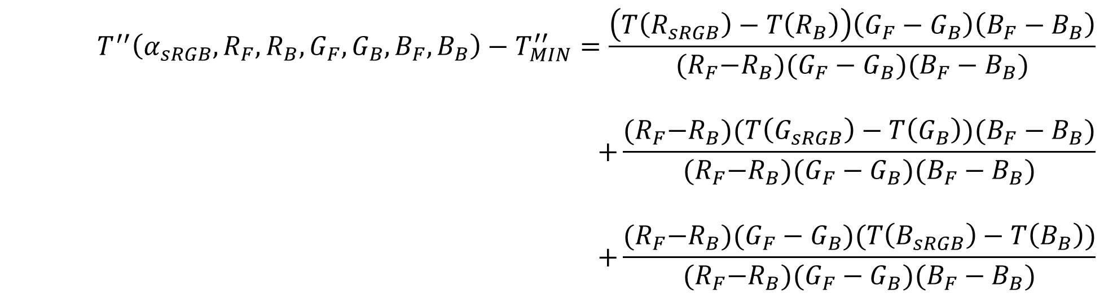
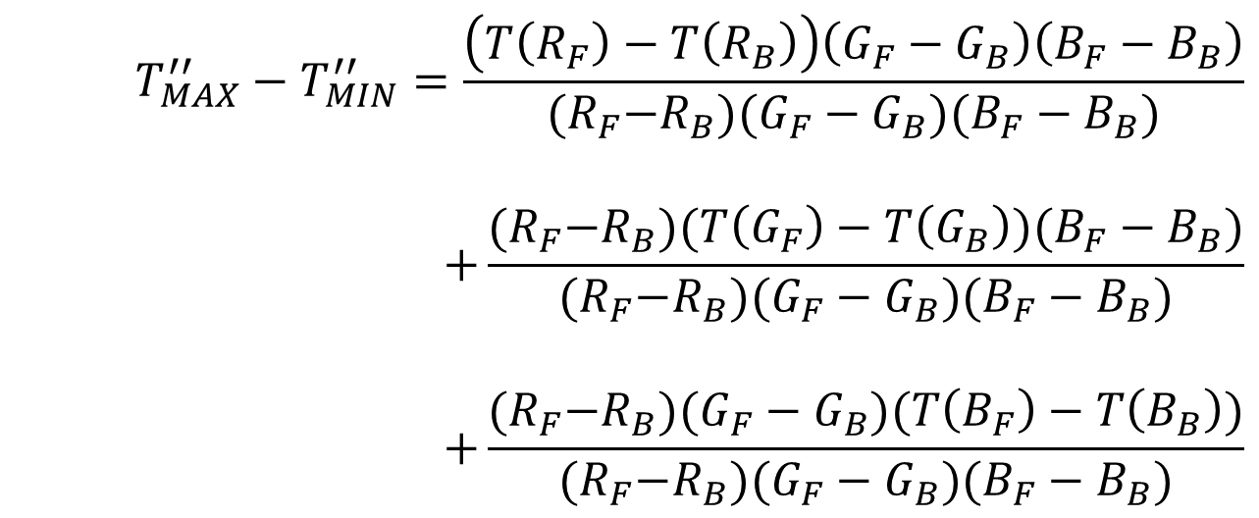



$$T_{MAX}^{′′}−T_{MIN}^{′′}=\frac{\left(T\left(R_{F}\right)−T\left(R_{B}\right)\right)\left(G_{F}−G_{B}\right)\left(B_{F}−B_{B}\right)}{{(R}_{F}−R_{B})(G_{F}−G_{B})(B_{F}−B_{B})}$$
$$+\frac{{(R}_{F}−R_{B})(T\left(G_{F}\right)−T\left(G_{B}\right))(B_{F}−B_{B})}{{(R}_{F}−R_{B})(G_{F}−G_{B})(B_{F}−B_{B})}$$
$$+\frac{{(R}_{F}−R_{B})(G_{F}−G_{B})(T\left(B_{F}\right)−T\left(B_{B}\right))}{{(R}_{F}−R_{B})(G_{F}−G_{B})(B_{F}−B_{B})}$$
$$T^{′′}\left(α_{sRGB},R_{F}, R_{B},G_{F}, G_{B},B_{F}, B_{B}\right)−T_{MIN}^{′′}=\frac{\left(T\left(R_{sRGB}\right)−T\left(R_{B}\right)\right)\left(G_{F}−G_{B}\right)\left(B_{F}−B_{B}\right)}{{(R}_{F}−R_{B})(G_{F}−G_{B})(B_{F}−B_{B})}$$
$$+\frac{{(R}_{F}−R_{B})(T\left(G_{sRGB}\right)−T\left(G_{B}\right))(B_{F}−B_{B})}{{(R}_{F}−R_{B})(G_{F}−G_{B})(B_{F}−B_{B})}$$
$$+\frac{{(R}_{F}−R_{B})(G_{F}−G_{B})(T\left(B_{sRGB}\right)−T\left(B_{B}\right))}{{(R}_{F}−R_{B})(G_{F}−G_{B})(B_{F}−B_{B})}$$
$$R_{sRGB}=R_{F}α_{sRGB}+R_{B}(1−α_{sRGB})$$
$$G_{sRGB}=G_{F}α_{sRGB}+G_{B}(1−α_{sRGB})$$
$$B_{sRGB}=B_{F}α_{sRGB}+B_{B}(1−α_{sRGB})$$

Slide 8

$$α_{linear}=\frac{\left(T\left(R_{sRGB}\right)−T\left(R_{B}\right)\right)\left(G_{F}−G_{B}\right)\left(B_{F}−B_{B}\right)+{(R}_{F}−R_{B})(T\left(G_{sRGB}\right)−T\left(G_{B}\right))(B_{F}−B_{B})+{(R}_{F}−R_{B})(G_{F}−G_{B})(T\left(B_{sRGB}\right)−T\left(B_{B}\right))}{\left(T\left(R_{F}\right)−T\left(R_{B}\right)\right)\left(G_{F}−G_{B}\right)\left(B_{F}−B_{B}\right)+{(R}_{F}−R_{B})(T\left(G_{F}\right)−T\left(G_{B}\right))(B_{F}−B_{B})+{(R}_{F}−R_{B})(G_{F}−G_{B})(T(B_{F})−T(B_{B}))}$$
where $R_{F}≠R_{B}, G_{F}≠G_{B}, B_{F}≠B_{B}$
$$R_{sRGB}=R_{F}α_{sRGB}+R_{B}(1−α_{sRGB})$$
$$G_{sRGB}=G_{F}α_{sRGB}+G_{B}(1−α_{sRGB})$$
$$B_{sRGB}=B_{F}α_{sRGB}+B_{B}(1−α_{sRGB})$$

