Slide 1
Derivation of formula for transparency converter
https://github.com/sotanmochi/TransparencyConverter
Soichiro Sugimoto
Latest update: 2022/04/27
Create: 2022/04/24

Slide 2
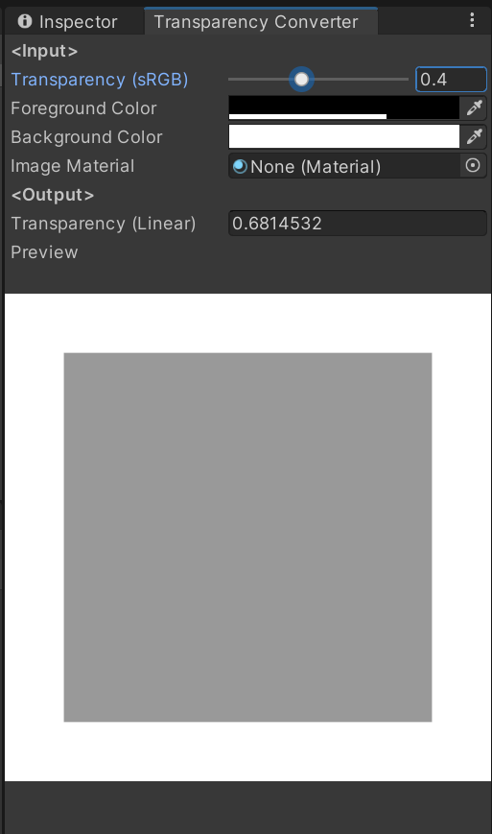
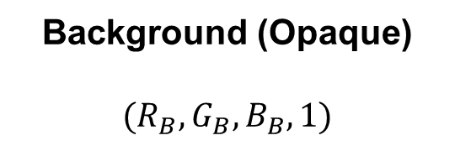
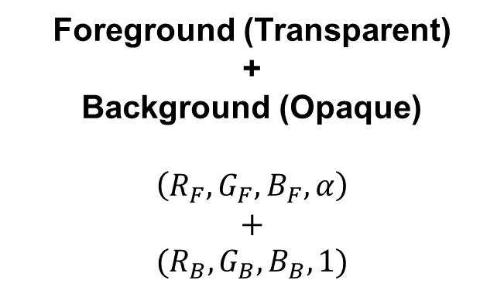
Transparency conversion from sRGB color space to linear color space
Foreground (Transparent)
+
Background (Opaque)
$$\left(R_{F}, G_{F}, B_{F}, α\right)$$
$$+$$
$$(R_{B}, G_{B}, B_{B}, 1)$$
Background (Opaque)
$$(R_{B}, G_{B}, B_{B}, 1)$$

Slide 3


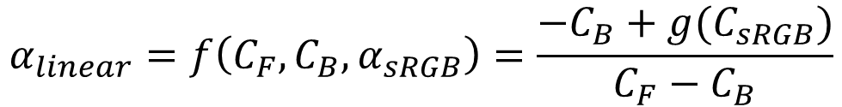


Transparency conversion from sRGB color space to linear color space
$$C_{output}=C_{F}α+C_{B}(1−α)$$
where $0≤c_{F}≤1$, $0≤c_{B}≤1$ and $0≤α≤1$.
$$C_{linear}=C_{F}α_{linear}+C_{B}(1−α_{linear})$$
$$C_{sRGB} =C_{F}α_{sRGB} +C_{B}(1−α_{sRGB})$$
$$C_{linear}=g(C_{sRGB})$$
where $g(x)$ is conversion function from sRGB color space to linear color space.
$$C_{F}α_{linear}+C_{B}(1−α_{linear})=g(C_{sRGB})$$
$$α_{linear}=f\left(C_{F}, C_{B}, α_{sRGB}\right)=\frac{−C_{B}+g(C_{sRGB})}{C_{F}−C_{B}}$$
where $C_{F}≠C_{B}$and $C_{sRGB} =C_{F}α_{sRGB}+C_{B}(1−α_{sRGB})$.

Slide 4
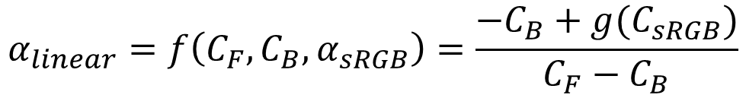
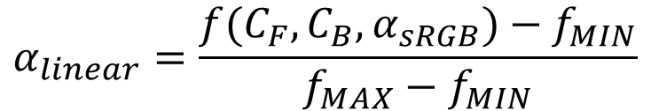

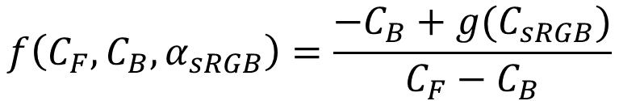
$$α_{linear}=f\left(C_{F}, C_{B}, α_{sRGB}\right)=\frac{−C_{B}+g(C_{sRGB})}{C_{F}−C_{B}}$$
where $C_{F}≠C_{B}$and $C_{sRGB}=C_{F}α_{sRGB}+C_{B}(1−α_{sRGB})$.
Considering the following constraints.
$$0≤α_{linear}≤1$$
$$α_{linear}=\frac{f(C_{F},C_{B},α_{sRGB})−f_{MIN}}{f_{MAX}−f_{MIN}}$$
$$f\left(C_{F}, C_{B}, α_{sRGB}\right)=\frac{−C_{B}+g(C_{sRGB})}{C_{F}−C_{B}}$$
$f\left(C_{F},C_{B},α_{sRGB}\right)=f_{MAX} → α_{linear}=1$
$f\left(C_{F},C_{B},α_{sRGB}\right)=f_{MIN} → α_{linear}=0$
$f\left(C_{F},C_{B},α_{sRGB}\right)=\left(f_{MAX}+f_{MIN}\right)/2 → α_{linear}=0.5$

Slide 5
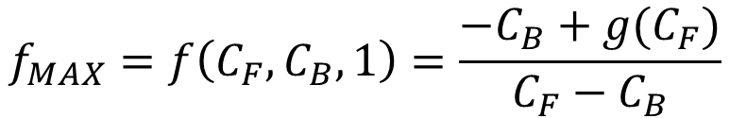
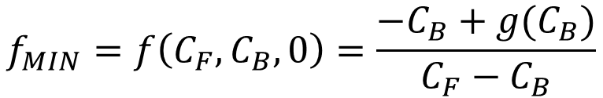
The conversion function $g(x)$ is monotonically increasing function.
When $C_{F}>C_{B}$, the funcfion $g\left(C_{sRGB}\right)=g\left(C_{F}α_{sRGB}+C_{B}\left(1−α_{sRGB}\right)\right)$ is monotonically increasing for $α_{sRGB}$.
When $C_{F}<C_{B}$, the funcfion $g\left(C_{sRGB}\right)=g\left(C_{F}α_{sRGB}+C_{B}\left(1−α_{sRGB}\right)\right)$ is monotonically decreasing for $α_{sRGB}$.
The funcfion $f\left(C_{F}, C_{B}, α_{sRGB}\right)$ is monotonically increasing for all $α_{sRGB}$.
$$f_{MAX}=f\left(C_{F},C_{B},1\right)=\frac{−C_{B}+g(C_{F})}{C_{F}−C_{B}}$$
$$f_{MIN}=f\left(C_{F},C_{B},0\right)=\frac{−C_{B}+g(C_{B})}{C_{F}−C_{B}}$$

Slide 6
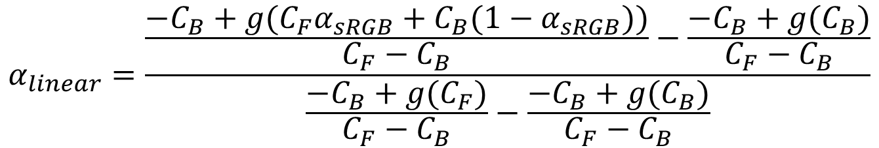
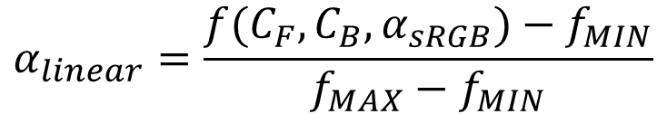
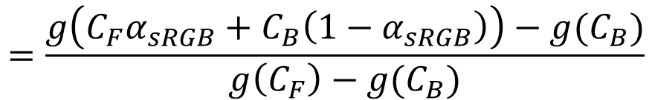
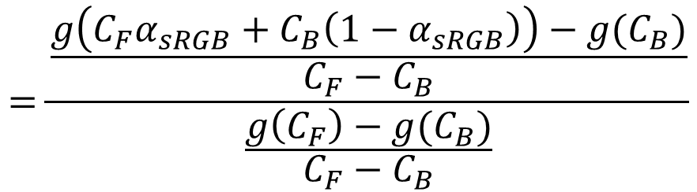
$$α_{linear}=\frac{f(C_{F},C_{B},α_{sRGB})−f_{MIN}}{f_{MAX}−f_{MIN}}$$
$$α_{linear}=\frac{\frac{−C_{B}+g(C_{F}α_{sRGB}+C_{B}(1−α_{sRGB}))}{C_{F}−C_{B}}−\frac{−C_{B}+g(C_{B})}{C_{F}−C_{B}}}{\frac{−C_{B}+g(C_{F})}{C_{F}−C_{B}}−\frac{−C_{B}+g(C_{B})}{C_{F}−C_{B}}}$$
$$=\frac{\frac{g\left(C_{F}α_{sRGB}+C_{B}\left(1−α_{sRGB}\right)\right)−g(C_{B})}{C_{F}−C_{B}}}{\frac{g\left(C_{F}\right)−g(C_{B})}{C_{F}−C_{B}}}$$
$$=\frac{g\left(C_{F}α_{sRGB}+C_{B}\left(1−α_{sRGB}\right)\right)−g(C_{B})}{g\left(C_{F}\right)−g(C_{B})}$$

Slide 7

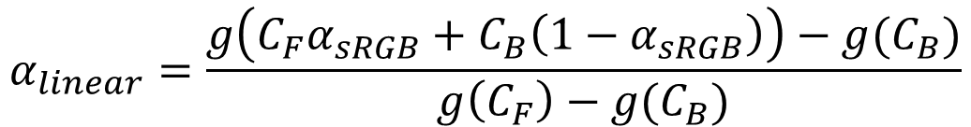
Therefore,
$$α_{linear}=\frac{g\left(C_{F}α_{sRGB}+C_{B}\left(1−α_{sRGB}\right)\right)−g(C_{B})}{g\left(C_{F}\right)−g(C_{B})}$$
where $0≤c_{F}≤1$, $0≤c_{B}≤1$, $0≤α_{sRGB}≤1$
and $g(x)$ is conversion function from sRGB color space to linear color space.

Slide 8
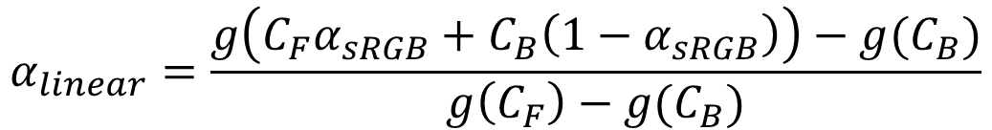

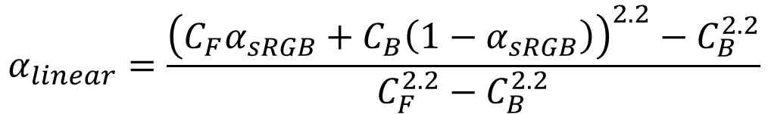





Transparency conversion from sRGB color space to linear color space
$$α_{linear}=\frac{g\left(C_{F}α_{sRGB}+C_{B}\left(1−α_{sRGB}\right)\right)−g(C_{B})}{g\left(C_{F}\right)−g(C_{B})}$$
where $0≤c_{F}≤1$, $0≤c_{B}≤1$, $0≤α_{sRGB}≤1$
and $g(x)$ is conversion function from sRGB color space to linear color space.
When $g\left(x\right)=x^{2.2}$,
$$α_{linear}=\frac{{\left(C_{F}α_{sRGB}+C_{B}\left(1−α_{sRGB}\right)\right)}^{2.2}−C_{B}^{2.2}}{C_{F}^{2.2}−C_{B}^{2.2}}$$
Special cases
$$α_{linear}=1−{\left(1−α_{sRGB}\right)}^{2.2}$$
when $C_{F}=0$ (black), $C_{B}=1$ (white)
$$α_{linear}=α_{sRGB}^{2.2}$$
when $C_{F}=1$ (white), $C_{B}=0$ (black)

Slide 9
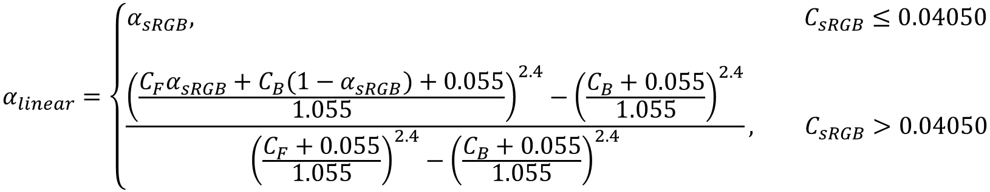
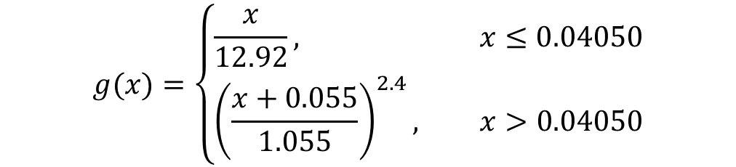
Transparency conversion from sRGB color space to linear color space
$$α_{linear}=\frac{g\left(C_{F}α_{sRGB}+C_{B}\left(1−α_{sRGB}\right)\right)−g(C_{B})}{g\left(C_{F}\right)−g(C_{B})}$$
where $0≤c_{F}≤1$, $0≤c_{B}≤1$, $0≤α_{sRGB}≤1$
and $g(x)$ is conversion function from sRGB color space to linear color space.
For the following $g\left(x\right)$ (Refer to https://en.wikipedia.org/wiki/SRGB#Transformation)
$$g(x)=\left\{\begin{aligned}\frac{x}{12.92}, x≤0.04050 \\ {\left(\frac{x+0.055}{1.055}\right)}^{2.4}, x>0.04050\end{aligned}\right.$$
$$α_{linear}=\left\{\begin{aligned}α_{sRGB}, C_{sRGB}≤0.04050 \\ \\ \frac{{\left(\frac{C_{F}α_{sRGB}+C_{B}(1−α_{sRGB})+0.055}{1.055}\right)}^{2.4}−{\left(\frac{C_{B}+0.055}{1.055}\right)}^{2.4}}{{\left(\frac{C_{F}+0.055}{1.055}\right)}^{2.4}−{\left(\frac{C_{B}+0.055}{1.055}\right)}^{2.4}}, C_{sRGB}>0.04050\end{aligned}\right.$$

Slide 10

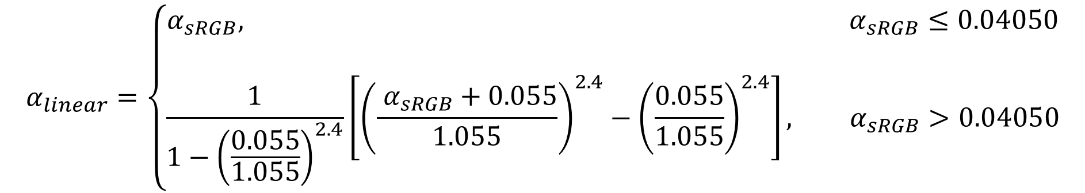
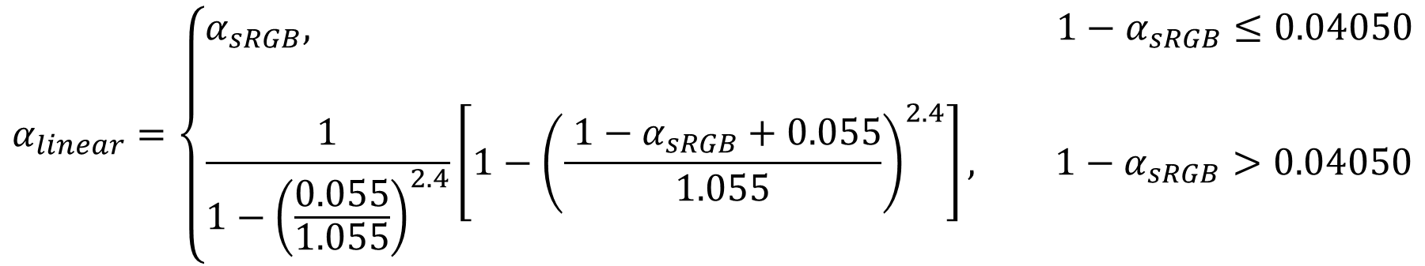
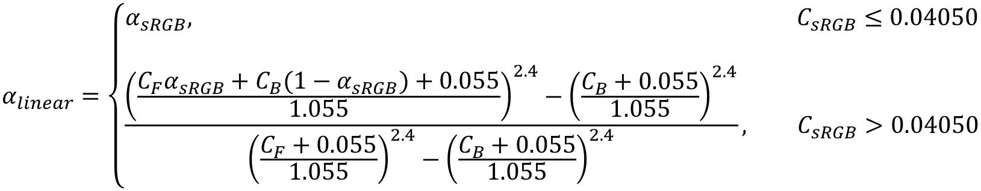


Transparency conversion from sRGB color space to linear color space
$$α_{linear}=\left\{\begin{aligned}α_{sRGB}, C_{sRGB}≤0.04050 \\ \\ \frac{{\left(\frac{C_{F}α_{sRGB}+C_{B}(1−α_{sRGB})+0.055}{1.055}\right)}^{2.4}−{\left(\frac{C_{B}+0.055}{1.055}\right)}^{2.4}}{{\left(\frac{C_{F}+0.055}{1.055}\right)}^{2.4}−{\left(\frac{C_{B}+0.055}{1.055}\right)}^{2.4}}, C_{sRGB}>0.04050\end{aligned}\right.$$
where $C_{sRGB} =C_{F}α_{sRGB} +C_{B}(1−α_{sRGB})$.
Special cases
If $C_{F}=0$ (black) and $C_{B}=1$ (white),
$$α_{linear}=\left\{\begin{aligned}α_{sRGB}, 1−α_{sRGB}≤0.04050 \\ \\ \frac{1}{1−{\left(\frac{0.055}{1.055}\right)}^{2.4}}\left[1−{\left(\frac{ 1−α_{sRGB}+0.055}{1.055}\right)}^{2.4}\right], 1−α_{sRGB}>0.04050\end{aligned}\right.$$
If $C_{F}=1$ (white) and $C_{B}=0$ (black),
$$α_{linear}=\left\{\begin{aligned}α_{sRGB}, α_{sRGB}≤0.04050 \\ \\ \frac{1}{1−{\left(\frac{0.055}{1.055}\right)}^{2.4}}\left[{\left(\frac{ α_{sRGB}+0.055}{1.055}\right)}^{2.4}−{\left(\frac{0.055}{1.055}\right)}^{2.4}\right], α_{sRGB}>0.04050\end{aligned}\right.$$

Slide 11

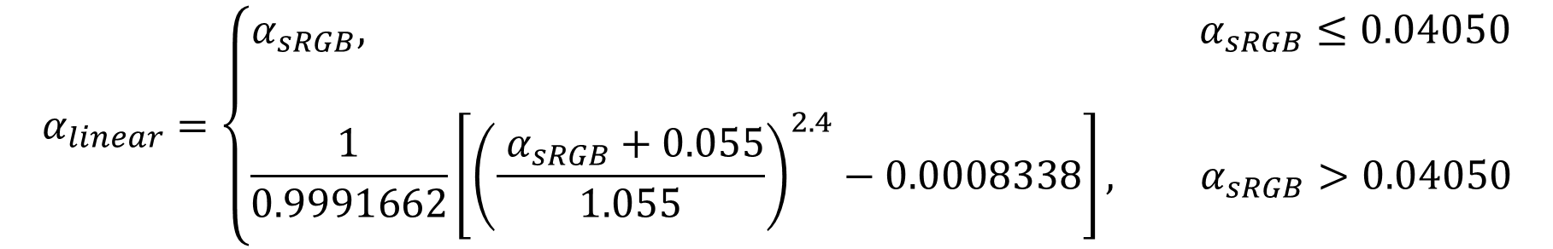
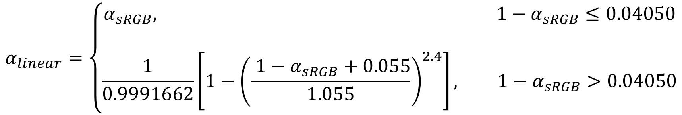
Transparency conversion from sRGB color space to linear color space
$$α_{linear}=\left\{\begin{aligned}α_{sRGB}, C_{sRGB}≤0.04050 \\ \\ \frac{{\left(\frac{C_{F}α_{sRGB}+C_{B}(1−α_{sRGB})+0.055}{1.055}\right)}^{2.4}−{\left(\frac{C_{B}+0.055}{1.055}\right)}^{2.4}}{{\left(\frac{C_{F}+0.055}{1.055}\right)}^{2.4}−{\left(\frac{C_{B}+0.055}{1.055}\right)}^{2.4}}, C_{sRGB}>0.04050\end{aligned}\right.$$
where $C_{sRGB} =C_{F}α_{sRGB} +C_{B}(1−α_{sRGB})$.
Special cases
If $C_{F}=0$ (black) and $C_{B}=1$ (white),
$$α_{linear}=\left\{\begin{aligned}α_{sRGB}, 1−α_{sRGB}≤0.04050 \\ \\ \frac{1}{0.9991662}\left[1−{\left(\frac{ 1−α_{sRGB}+0.055}{1.055}\right)}^{2.4}\right], 1−α_{sRGB}>0.04050\end{aligned}\right.$$
If $C_{F}=1$ (white) and $C_{B}=0$ (black),
$$α_{linear}=\left\{\begin{aligned}α_{sRGB}, α_{sRGB}≤0.04050 \\ \\ \frac{1}{0.9991662}\left[{\left(\frac{ α_{sRGB}+0.055}{1.055}\right)}^{2.4}−0.0008338\right], α_{sRGB}>0.04050\end{aligned}\right.$$

