Slide 1
Trees
Chapter 7

Slide 2
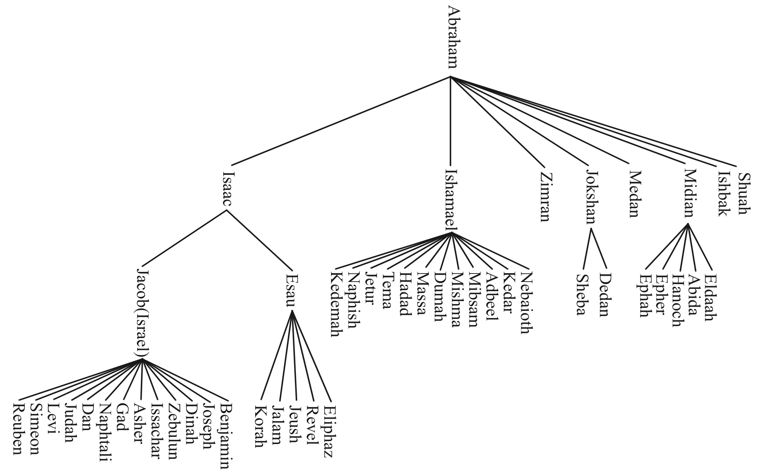
Family Tree

Slide 3

Organizational Structure

Slide 4
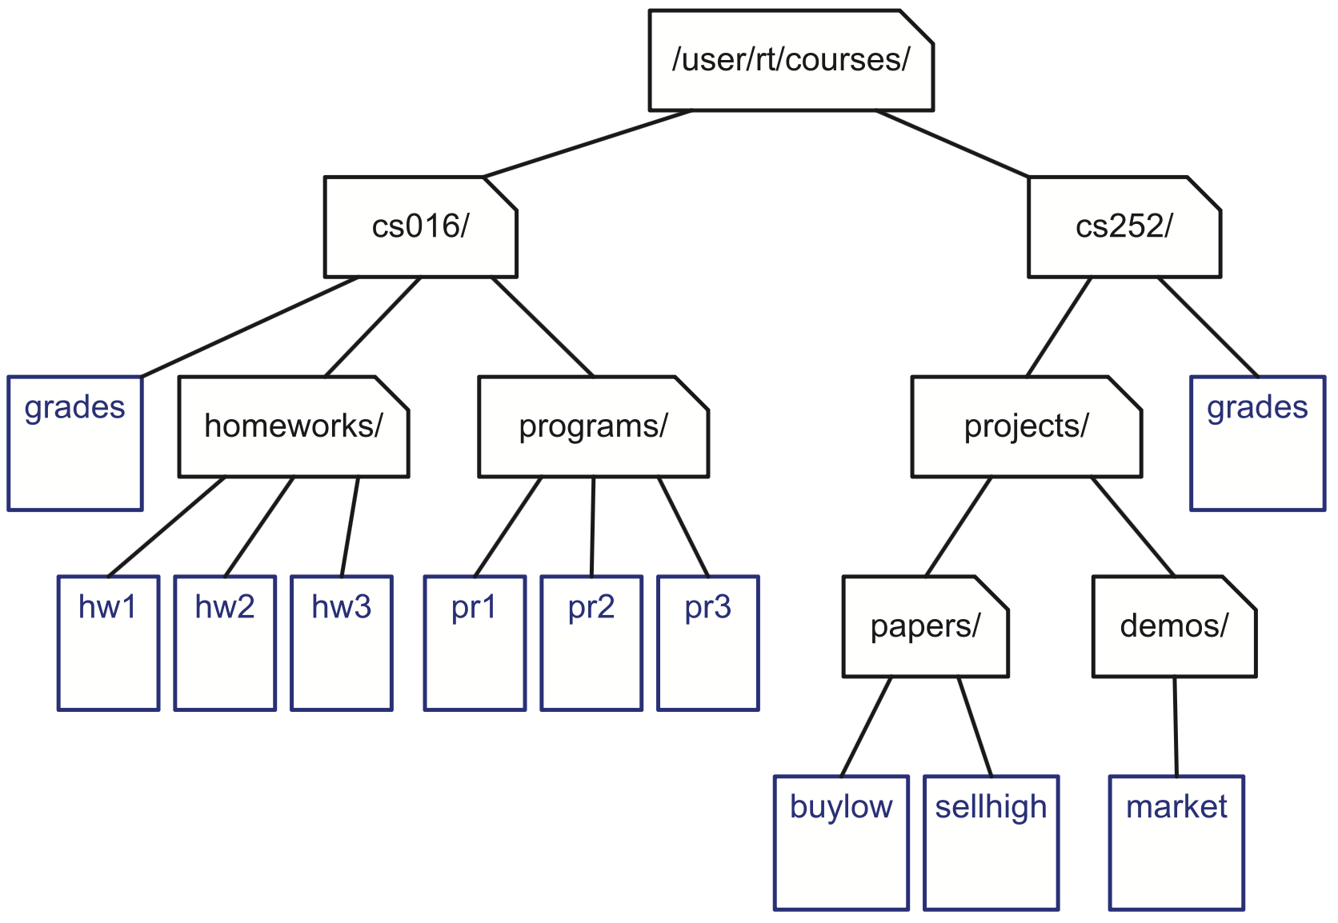
File System

Slide 5
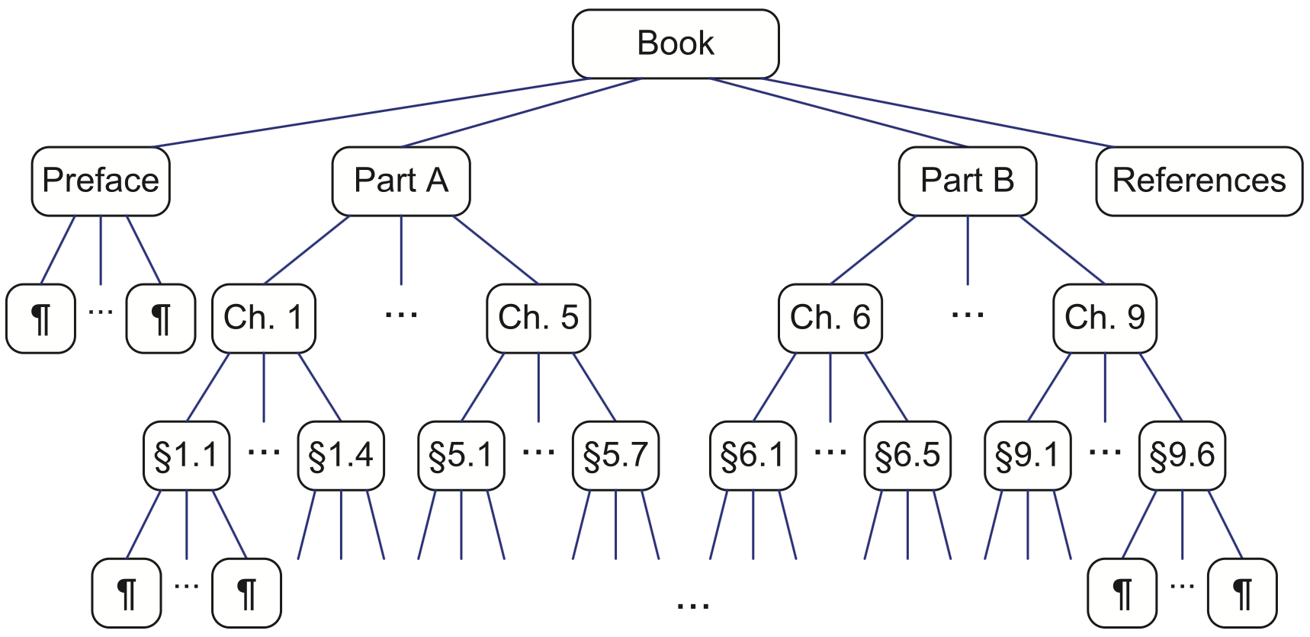
Book Structure

Slide 6
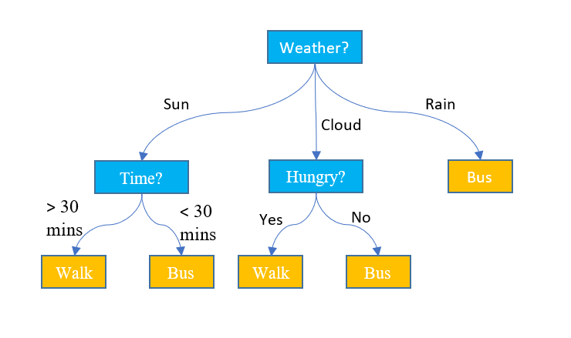
Decision Tree

Slide 7
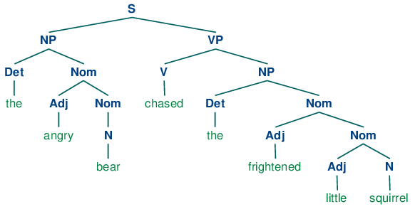
Parse Tree

Slide 8
Parse Tree
+
3
*
3 + (5 + 9) * 2
+
2
5
9

Slide 9
Definition of a Tree
A tree T is a set of nodes storing elements in a parent-child relationship with the following properties:
If T is nonempty, it has a special node, called the root of T , that has no parent.
Each node v of T different from the root has a unique parent node w; every node with parent w is a child of w.
(textbook p. 269)

Slide 10

Definition of a Tree
A is the parent of B, D, C
B, D, C are children of A
B, D, C are siblings (have the same parent)
Root node
A
A tree T is a set of nodes storing elements on a parent-child relationship with the following properties:
If T is nonempty, it has a special node, called the root of T , that has no parent.
Each node v of T different from the root has a unique parent node w; every node with parent w is a child of w.
(textbook p. 269)
B
D
C
F
G
E
An external node is a node with no children.
External nodes are also call leaves, or leaf nodes.
An internal node has 1 or more children.

Slide 11
Definition of a Tree
Is this a tree?
A
A tree T is a set of nodes storing elements on a parent-child relationship with the following properties:
If T is nonempty, it has a special node, called the root of T , that has no parent.
Each node v of T different from the root has a unique parent node w; every node with parent w is a child of w.
(textbook p. 269)
B
D
C
F
G
E

Slide 12
Definition of a Tree
Is this a tree?
A
A tree T is a set of nodes storing elements on a parent-child relationship with the following properties:
If T is nonempty, it has a special node, called the root of T , that has no parent.
Each node v of T different from the root has a unique parent node w; every node with parent w is a child of w.
(textbook p. 269)
B
D
C
F
G
E
Not a tree: C does not have a parent; a tree can have only one root.

Slide 13
Definition of a Tree
Is this a tree?
A
A tree T is a set of nodes storing elements on a parent-child relationship with the following properties:
If T is nonempty, it has a special node, called the root of T , that has no parent.
Each node v of T different from the root has a unique parent node w; every node with parent w is a child of w.
(textbook p. 269)
B
D
C
F
G
E

Slide 14
Definition of a Tree
Is this a tree?
A
A tree T is a set of nodes storing elements on a parent-child relationship with the following properties:
If T is nonempty, it has a special node, called the root of T , that has no parent.
Each node v of T different from the root has a unique parent node w; every node with parent w is a child of w.
(textbook p. 269)
B
D
C
F
G
E
Not a tree: G has two parents, but in a tree non-root nodes must have one parent.

Slide 15

File System
This shows a subtree rooted at cs106/

Slide 16

File System
This shows a path from the root to hw2:
/user/rt/courses/cs016/homeworks/hs2

Slide 17

Family Tree
Node a is an ancestor of node b if either a = b, or a is an ancestor of the parent of b.
Recursive definition!
Abraham is an ancestor of Sheba.
Sheba is a descendant of Abraham.

Slide 18
Organizational Structure
A path is a sequence of nodes such that any two adjacent nodes on the path are connected by an edge.
Example path
Sales, International, Overseas, Asia

Slide 19
Book Structure
Ordered tree
order of the leaves matters

Slide 20

Tree Depth
+
The depth of a tree node p is the number of ancestors of p, excluding p itself.
E.g. middle + has depth 2
Root of tree always has depth 0
Recursive definition
If p is the root, then the depth of p is 0.
Otherwise, the depth of p is 1 plus the depth of the parent of p
3
*
+
2
5
9

Slide 21
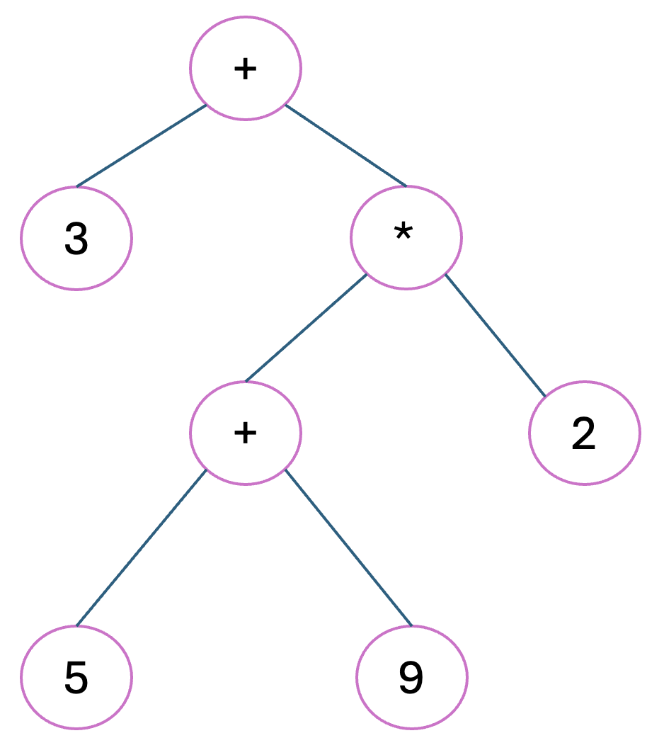

Tree Depth
Depth(T, p) starts at p and “walks” up to the root.
The depth of a tree node p is the number of ancestors of p, excluding p itself.
E.g. middle + has depth 2
Root of tree always has depth 0
Recursive definition
If p is the root, then the depth of p is 0.
Otherwise, the depth of p is 1 plus the depth of the parent of p
p
Worst-case running time ???
Depth(T, p)
if isRoot(p) then return 0
else
return 1 + depth(T, parent(p))

Slide 22
Tree Depth
Depth(T, p) starts at p and “walks” up to the root.
The depth of a tree node p is the number of ancestors of p, excluding p itself.
E.g. middle + has depth 2
Root of tree always has depth 0
Recursive definition
If p is the root, then the depth of p is 0.
Otherwise, the depth of p is 1 plus the depth of the parent of p
p
Worst-case running time O(height of tree)
Depth(T, p)
if isRoot(p) then return 0
else
return 1 + depth(T, parent(p))

Slide 23
Tree Depth
What’s the maximum possible depth of a node in a tree with n nodes?
The depth of a tree node p is the number of ancestors of p, excluding p itself.
Root of tree always has depth 0
Recursive definition
If p is the root, then the depth of p is 0.
Otherwise, the depth of p is 1 plus the depth of the parent of p
Worst-case running time O(height of tree)
Depth(T, p)
if isRoot(p) then return 0
else
return 1 + depth(T, parent(p))

Slide 24
Tree Depth
What’s the maximum possible depth of a node in a tree with n nodes?
The depth of a tree node p is the number of ancestors of p, excluding p itself.
Root of tree always has depth 0
Recursive definition
If p is the root, then the depth of p is 0.
Otherwise, the depth of p is 1 plus the depth of the parent of p
Worst-case running time O(height of tree)
Depth(T, p)
if isRoot(p) then return 0
else
return 1 + depth(T, parent(p))

Slide 25
Tree Depth
What’s the maximum possible depth of a node in a tree with n nodes?
0
1
n=5 nodes leaf node has depth 4
The depth of a tree node p is the number of ancestors of p, excluding p itself.
Root of tree always has depth 0
Recursive definition
If p is the root, then the depth of p is 0.
Otherwise, the depth of p is 1 plus the depth of the parent of p
2
3
4
Worst-case running time O(height of tree) O(n) for a tree with n nodes
Depth(T, p)
if isRoot(p) then return 0
else
return 1 + depth(T, parent(p))

Slide 26
Tree Height
+
The height of a node p in a tree is:
If p is a leaf, then the height of p is 0
Otherwise, the height of p is 1 plus the maximum height of a child of p
The height of a tree T is the the height of T’s root node.
3
*
A leaf node is an external node, i.e. a node with no children.
+
2
5
9

Slide 27
Tree Height
Trick: to get the height of all the nodes of a tree, label all the leaves as 0, then work upwards, setting parents to be 1 more than max heighted child.
+
The height of a node p in a tree is:
If p is a leaf, then the height of p is 0
Otherwise, the height of p is 1 plus the maximum height of a child of p
The height of a tree T is the the height of T’s root node.
3
*
0
+
2
0
5
9
0
0

Slide 28
Tree Height
Trick: to get the height of all the nodes of a tree, label all the leaves as 0, then work upwards, setting parents to be 1 more than max heighted child.
+
The height of a node p in a tree is:
If p is a leaf, then the height of p is 0
Otherwise, the height of p is 1 plus the maximum height of a child of p
The height of a tree T is the the height of T’s root node.
3
*
0
1
+
2
0
5
9
0
0

Slide 29
Tree Height
Trick: to get the height of all the nodes of a tree, label all the leaves as 0, then work upwards, setting parents to be 1 more than max heighted child.
+
3 = height of tree
The height of a node p in a tree is:
If p is a leaf, then the height of p is 0
Otherwise, the height of p is 1 plus the maximum height of a child of p
The height of a tree T is the the height of T’s root node.
2
3
*
0
1
+
2
0
5
9
0
0

Slide 30

Tree Height
Worst-case running time of height2 on a tree with n nodes:
???
The height of a node p in a tree is:
If p is a leaf, then the height of p is 0
Otherwise, the height of p is 1 plus the maximum height of a child of p
The height of a tree T is the the height of T’s root node.
Algorithm height2(T, p) if is_leaf(p) then
return 0
else
h = 0
for each c in children(p) do
h = max(h, height2(T, c))
return 1 + h

Slide 31
Tree Height
Worst-case running time of height2 on a tree with n nodes:
O(n)
Because max called on each child node (and only root is not a child)
The height of a node p in a tree is:
If p is a leaf, then the height of p is 0
Otherwise, the height of p is 1 plus the maximum height of a child of p
The height of a tree T is the the height of T’s root node.
Algorithm height2(T, p) if is_leaf(p) then
return 0
else
h = 0
for each c in children(p) do
h = max(h, height2(T, c))
return 1 + h

Slide 32
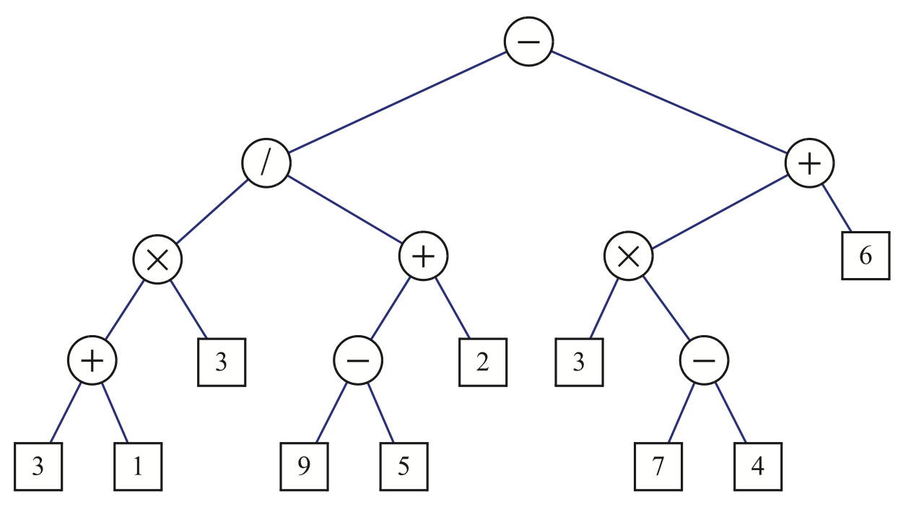
Binary Trees
A binary tree is an ordered tree where each node has:
Every node has at most children
Each child is labelled as left or right
The left child comes before the right child in the ordering of nodes

Slide 33
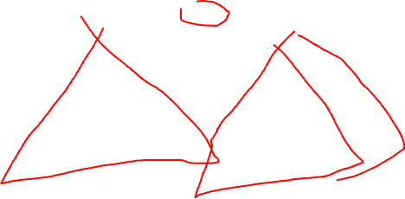
Binary Trees
A binary tree is an ordered tree where each node has:
Every node has at most children
Each child is labelled as left or right
The left child comes before the right child in the ordering of nodes
Recursive Definition
A binary tree T is either empty or consists:
A node called the root of T
A binary tree called the left subtree of T
A binary tree called the right subtree of T

Slide 34
Binary Tree Facts
A binary tree is called proper if every node has either 0 children or 2 children (no nodes have 1 child).
Every internal node in a proper binary tree has exactly 2 children.
See proposition 7.10 (p. 287 – 288) for a list of useful facts about binary trees.
Roughly speaking:
A binary tree with n nodes has min height log n and max height n
So an algorithm (like height or depth) that does O(height) work is somewhere between O(log n) and O(n)
At worst, O(n) … but if you can somehow ensure the tree is short, you can get O(log n) performance
Foreshadowing!

Slide 35
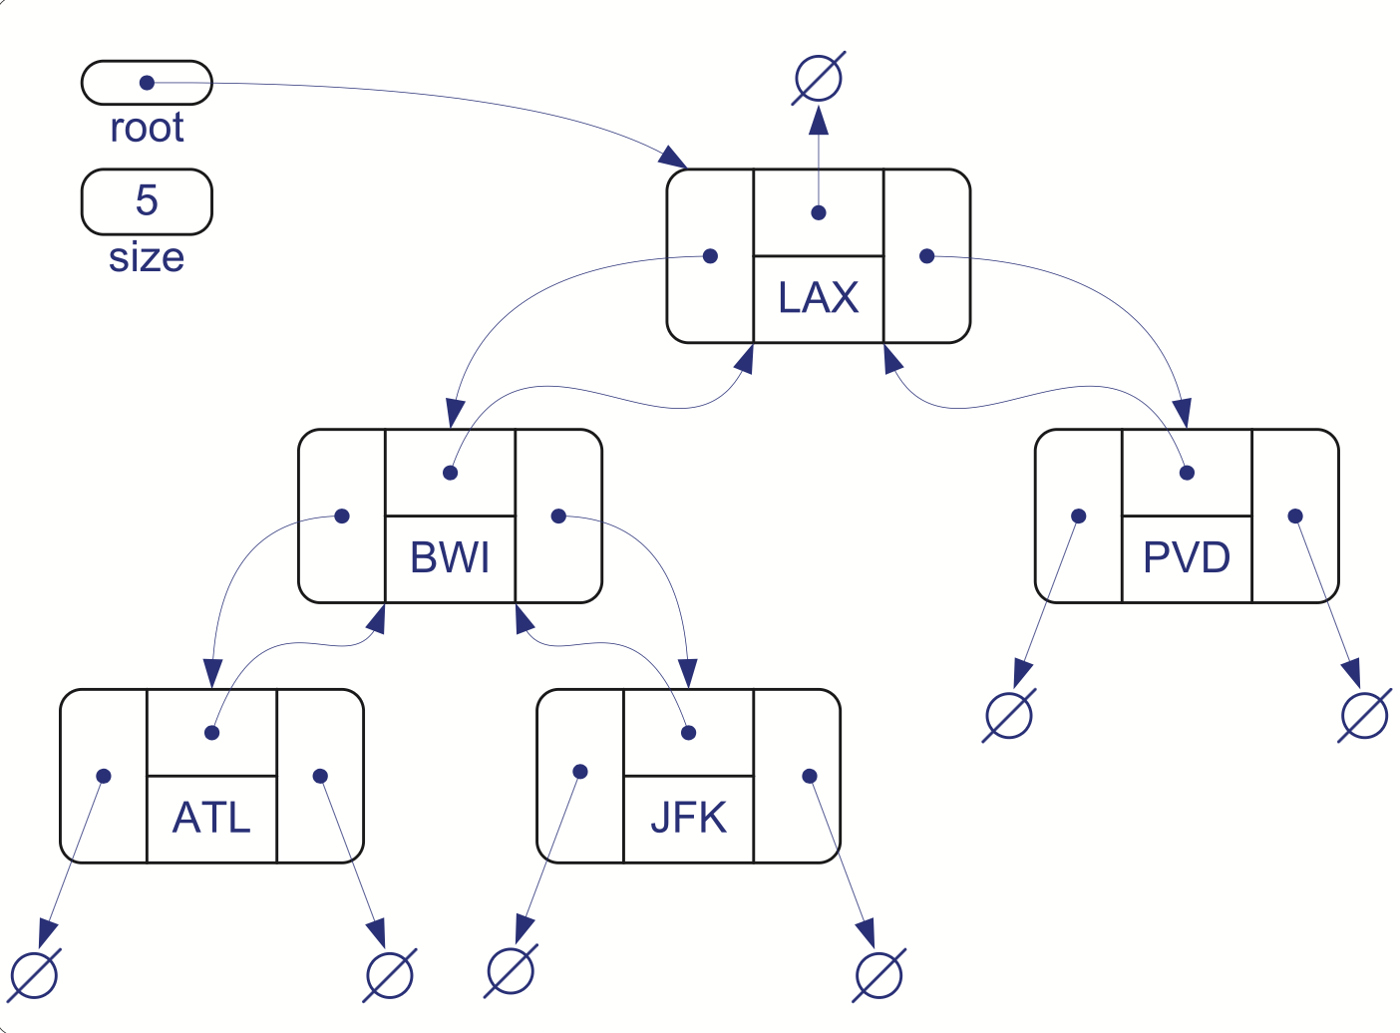
Binary Trees
This is a typical node structure for a linked binary tree. Some implementations skip the parent pointer.
struct BTnode { string data; // data could be any type BTnode* parent; BTnode* left; BTnode* right; };
BTnode root;

Slide 36
Binary Tree Code
See notes for binary tree implementation code …
Make sure you know how to visit the nodes of a binary tree using preorder traversal, inorder traversal, and postorder traversal!

Slide 37
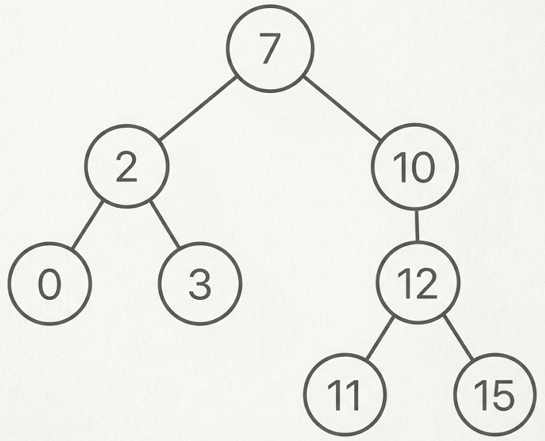
Try this!
Is it a binary tree?
Is it a proper tree?
What are its leaves?
What is the height of each node?
The height of a node p in a tree is:
If p is a leaf, then the height of p is 0
Otherwise, the height of p is 1 plus the maximum height of a child of p
The height of a tree T is the the height of T’s root node.

Slide 38
Try this!
3
1
2
Is it a binary tree?
yes
Is it a proper tree?
No (node 10 has 1 child)
What are its leaves?
0, 3, 11, 15
What is the height of each node?
see the tree
1
0
0
0
0
The height of a node p in a tree is:
If p is a leaf, then the height of p is 0
Otherwise, the height of p is 1 plus the maximum height of a child of p
The height of a tree T is the the height of T’s root node.

Slide 39
Try this!
Preorder traversal
Inorder traversal
Postorder traversal

Slide 40
Try this!
Preorder traversal
7, 2, 0, 3, 10, 12, 11, 15
Inorder traversal
0, 2, 3, 7, 10, 11, 12, 15
Postorder traversal
0, 3, 2, 11, 15, 12, 10, 7

