Slide 1
What are some things you disliked about C++ arrays?

Slide 2
Arrays are Complex
Arrays and lists are great, but indexing them is sometimes painful

Slide 3
Arrays are Complex
Arrays and lists are great, but indexing them is sometimes painful
Is arr[i] correct? Or should it be arr[i-1] or arr[i+1]?
When reading/writing an element in an array of size 100, there are 99 wrong elements to read/write
Arrays always put items in a particular location even if you don’t really care about it
In a bag of potatoes, do you care about the exact location of any particular potato?
There are three kinds of programmers: those who make off by 1 errors, and those who don’t.

Slide 4
Arrays are Complex
Arrays and lists are great, but indexing them is sometimes painful
Is arr[i] correct? Or should it be arr[i-1] or arr[i+1]?
When reading/writing an element in an array of size 100, there are 99 wrong elements to read/write
Arrays always put items in a particular location even if you don’t really care about it
In a bag of potatoes, do you care about the exact location of any particular potato?
Could we make an array-like data structure that:
Has only add(item) and remove() methods?
Does not require us to use indexing?
There are three kinds of programmers: those who make off by 1 errors, and those who don’t.

Slide 5
The Simplest Useful Collection?
Imagine S is a collection data structure that you create like this:
S = makeEmptyCollection() // in C++ you would use a constructor

Slide 6
The Simplest Useful Collection?
Imagine S is a collection data structure that you create like this:
S = makeEmptyCollection() // in C++ you would use a constructor
You can add elements to the collection like this:
S.add(3)
S.add(7)
S.add(4)
When we add an item we don’t need to say where to add it!

Slide 7
The Simplest Useful Collection?
Imagine S is a collection data structure that you create like this:
S = makeEmptyCollection() // in C++ you would use a constructor
You can add elements to the collection like this:
S.add(3)
S.add(7)
S.add(4)
And you can remove elements from the collection like this:
S.remove()
S.remove()
S.remove()
When we add an item we don’t need to say where to add it!

Slide 8
The Simplest Useful Collection?
Imagine S is a collection data structure that you create like this:
S = makeEmptyCollection() // in C++ you would use a constructor
You can add elements to the collection like this:
S.add(3)
S.add(7)
S.add(4)
And you can remove elements from the collection like this:
S.remove()
S.remove()
S.remove()
When we add an item we don’t need to say where to add it!
Problem: which item should be removed when remove() is called?

Slide 9
The Simplest Useful Collection?
Imagine S is a collection data structure that you create like this:
S = makeEmptyCollection() // in C++ you would use a constructor
You can add elements to the collection like this:
S.add(3)
S.add(7)
S.add(4)
And you can remove elements from the collection like this:
S.remove()
S.remove()
S.remove()
When we add an item we don’t need to say where to add it!
Ideas
A random one?
The newest one? i.e. the item added most recently
The oldest one? i.e. the item added least recently?
The smallest one?
Problem: which item should be removed when remove() is called?

Slide 10
The Simplest Useful Collection?
Imagine S is a collection data structure that you create like this:
S = makeEmptyCollection() // in C++ you would use a constructor
You can add elements to the collection like this:
S.add(3)
S.add(7)
S.add(4)
And you can remove elements from the collection like this:
S.remove()
S.remove()
S.remove()
When we add an item we don’t need to say where to add it!
If S uses this rule, it’s called a stack.
Ideas
A random one?
The newest one? i.e. the item added most recently
The oldest one? i.e. the item added least recently?
The smallest one?
Problem: which item should be removed when remove() is called?
If S uses this rule, it’s called a queue.
If S uses this rule, it’s easy to use it for insertion sort!

Slide 11
Another Way to Think about S
An array of size N has N different places where you can add/remove items

Slide 12
Another Way to Think about S
An array of size N has N locations where you can add/remove items
Idea: What if we restrict the number of locations where we can add/remove elements?
Suppose there is only one place we can add/remove elements:
add
remove

Slide 13
Adding/Removing at One End
add
remove
We usually draw it vertically …
add
remove

Slide 14
Adding/Removing at One End
We usually draw it vertically …
add
remove
S.add(3)
S.add(7)
S.add(4)
4
7
3

Slide 15
Adding/Removing at One End
We usually draw it vertically …
add
remove
S.add(3)
S.add(7)
S.add(4)
Top value is newest (most recently added)
4
7
3
Bottom value is oldest (least recently added)

Slide 16
Adding/Removing at One End
We usually draw it vertically …
add
remove
S.add(3)
S.add(7)
S.add(4)
Top value is newest (most recently added)
S.remove()
4
7
7
3
Bottom value is oldest (least recently added)
3

Slide 17
Adding/Removing at One End
We usually draw it vertically …
add
remove
Since we only add/remove form the top, remove() always removes the newest value.
S.add(3)
S.add(7)
S.add(4)
Top value is newest (most recently added)
S.remove()
4
7
7
3
Bottom value is oldest (least recently added)
3

Slide 18
Adding/Removing at One End
add
remove
S.add(x): x is added as the new top element of S and the items underneath keep their order
S.remove(): removes the current top element
E
A
B
C
D

Slide 19
Adding/Removing at One End
add
remove
S.add(x): x is added as the new top element of S and the items underneath keep their order
S.push(x)
S.remove(): removes the current top element
S.pop()
E
A
B
C
D

Slide 20
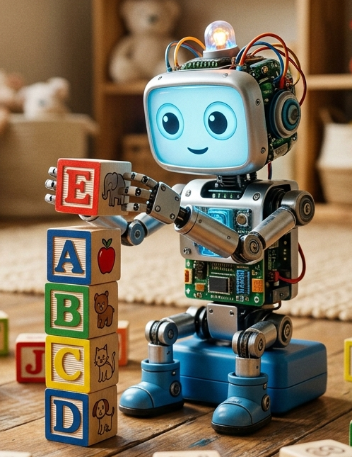
Adding/Removing at One End
add
remove
S.add(x): x is added as the new top element of S and the items underneath keep their order
S.push(x)
S.remove(): removes the current top element
S.pop()
E
A
B
C
D
This is called a stack … like a stack of blocks

Slide 21
Pushing Onto a Full Stack
Problem: What should happen if you push an item onto a full stack?
E
A
B
C
D

Slide 22
Pushing Onto a Full Stack
Problem: What should happen if you push an item onto a full stack?
E
A
Pushing an item onto a full stack has a name: stack overflow
B
C
Stack overflow is usually a serious problem … you’ve run out of storage! So throwing an exception (signaling an error) would be make sense.
D

Slide 23
Popping an Empty Stack
Another problem: What should happen if you pop an empty stack?

Slide 24
Popping an Empty Stack
Another problem: What should happen if you pop an empty stack?
Popping an empty stack is sometimes called: stack underflow
As with a stack overflow, probably best to throw an exception (signal an error).

Slide 25
Another Way to Think about S
An array of size N has N locations where you can add/remove items
Idea: What if we restrict the number of locations where we can add/remove elements?

Slide 26
Another Way to Think about S
An array of size N has N locations where you can add/remove items
Idea: What if we restrict the number of locations where we can add/remove elements?
Suppose there are only two places we can add/remove elements:
add
remove

Slide 27
Another Way to Think about S
An array of size N has N locations where you can add/remove items
Idea: What if we restrict the number of locations where we can add/remove elements?
Suppose there are only two places we can add/remove elements:
S.add(3)
S.add(7)
S.add(4)
add
remove

Slide 28
Another Way to Think about S
An array of size N has N locations where you can add/remove items
Idea: What if we restrict the number of locations where we can add/remove elements?
Suppose there are only two places we can add/remove elements:
S.add(3)
S.add(7)
S.add(4)
add
4
7
3
remove

Slide 29
Another Way to Think about S
An array of size N has N locations where you can add/remove items
Idea: What if we restrict the number of locations where we can add/remove elements?
Suppose there are only two places we can add/remove elements:
S.add(3)
S.add(7)
S.add(4)
add
4
7
3
remove
back newest
most recently added
front
oldest
least recently added

Slide 30
Another Way to Think about S
S.add(3)
S.add(7)
S.add(4)
add
4
7
3
remove
back oldest
most recently added
front
oldest
least recently added
S.remove()

Slide 31
Another Way to Think about S
S.add(3)
S.add(7)
S.add(4)
add
4
7
3
remove
back oldest
most recently added
front
oldest
least recently added
S.remove()
add
4
7
remove
back
front

Slide 32
Queues
S.add(3)
S.add(7)
S.add(4)
add
4
7
3
remove
back oldest
most recently added
front
oldest
least recently added
This data structure is called a queue:
S.add(x) puts x at the back of the queue (leaving the other elements as-is)
S.remove() removes the item at the front of the queue (the first one in line)
S.remove()
add
4
7
remove
back
front

Slide 33
Queues
S.add(3)
S.add(7)
S.add(4)
add
4
7
3
remove
back oldest
most recently added
front
oldest
least recently added
This data structure is called a queue:
S.add(x) puts x at the back of the queue (leaving the other elements as-is) S.enqueue(x) S.addBack(x)
S.remove() removes the item at the front of the queue (the first one in line) S.dequeue() S.removeFront()
S.remove()
add
4
7
remove
back
front

Slide 34
Stacks and Queues
Similar to a stack, should signal an error if you try to
Add to a full queue
Remove from an empty queue
Usually also add these methods to stacks an queues
is_empty(): returns true if the stack/queue is empty, false otherwise
peek(): returns a copy of the next value that would be removed (without removing it)
The C++ vector<T> class implements a stack:
v.push_back(x) adds x to the end (increasing size if needed)
v.back() returns a reference to the end element of v
v.pop_back() removes the last element of v (and returns nothing!)

Slide 35
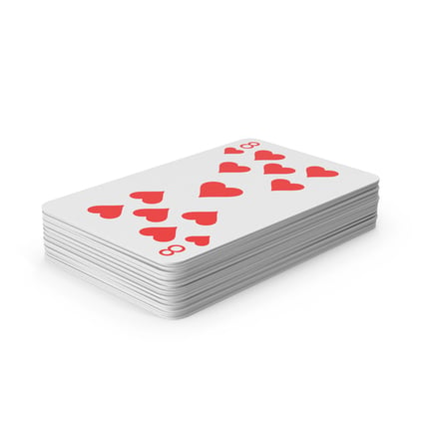
Deques
A deque is a doubled-ended queue
You can add/remove items at either end of a deque
addFront(x)
addBack(x)
removeFront()
removeBack()
Can be quite useful in practice, but we won’t go into details here
But make sure you know what it is, and can implement one!

Slide 36
What are stacks good for?
Tracking function calls in programming languages
Every call to a function is a push on the call stack
Every function return is a pop on the call stack
The contents of the stack show the exact sequence of function calls to get to the current point in a running program
Printing the call stack is quite useful for debugging
Works with recursive functions

Slide 37
What are stacks good for?
Implementing undo
E.g. in a word processor, every time you do an action (that can be undone) you push it onto the undo stack
E.g. making a word bold
If the user selects undo, the undo stack is popped and the item inverse of the action is applied
E.g. un-bolding the word

Slide 38
What are stacks good for?
Reversing things
Items you put into a stack come out in reverse order
If you want to reverse an array you could:
Push all the array items into the stack (in the order they are in the array)
Then when you pop the stack they come out in reverse order

Slide 39
What are stacks good for?
Matching brackets
Brackets are in matching pairs
C++ has at least ( ) , { } , [ ]
Similar idea can be used to match HTML tags, e.g. <p> and </p> are matching tags
function isBalanced(input):
stack = empty stack
for each character c in input:
if c is an open bracket:
push c onto stack
else if c is a close bracket:
if stack is empty:
return false // nothing to match against
top = pop from stack
if top does not match c: // e.g. '(' must pair with ')'
return false
return stack is empty // unmatched openers still on stack?
open brackets: ({[
close brackets: )}]
Balanced: { f(a[2]) }
Balanced: {}([][])
Balanced: (( )(())()( ))
Unbalanced: { f(a[2] }
Unbalanced: f(a[2]) }
Unbalanced: { f(a[2)] }

Slide 40
What are Queues Good For?
Anywhere things might need to line up in order
Process jobs on a computer, e.g. a computer with 16 CPUs could process 100 jobs by having 84 of them wait in a queue
Typically ordered by priority, how long they have run or expected to run, etc.
Web server requests: if a web server is getting too many requests it can keep them in a queue and process them in the order received
A video can queue future frames so that lag is just at the start
If you type too quickly on a keyboard, the keystrokes can be qued
Or mouse clicks

Slide 41
What are Queues Good For?
Simulations
Modelling line-up wait times at a bank, or planes landing at an airport, etc.
There is a branch of mathematics called queueing theory

Slide 42
Things You Can’t Do with Stacks and Queues
You cannot access the “middle” items of a stack or queue with calling pop/removeFront to get to it
In a C++ vector you can, but vectors implement operations far beyond a stack
You can’t easily re-arrange items of stacks/queue in arbitrary way
Although it’s easy with a queue to remove the front, add it to the back, remove the front, add it to the back, …
So you cannot efficiently search or sort a stack/queue
Of course, you could add specialy purpose methods to do so (like vector), but then it’s not really stack/queue any more
It’s a different data structure that you can, if you choose, treat as if it were a stack/queue

Slide 43
Some Problems to Think About
Using two extra stacks, is it possible to reverse the elements of a given stack S? (No tricks like using an array or list or string etc.)
Can you do it using only one extra stack?
Given queue Q and one extra queue called Extra, can you reverse the element of Q? (No tricks like using an array or list or string etc.)
Remember!
Don’t just look up the answer or ask AI to do it. The answer is out there and AI can surely do it! The point of these questions is to learn about stacks and queues, not how to do research answers and use AI. Try yourself!

Slide 44


Performance
For a stack:
Push(x)
$O(1)$ worst case
Pop()
$O(1)$ worst case
For a queue:
addFront(x)
$O(1)$ worst case
removeFront()
$O(1)$ worst case

Slide 45
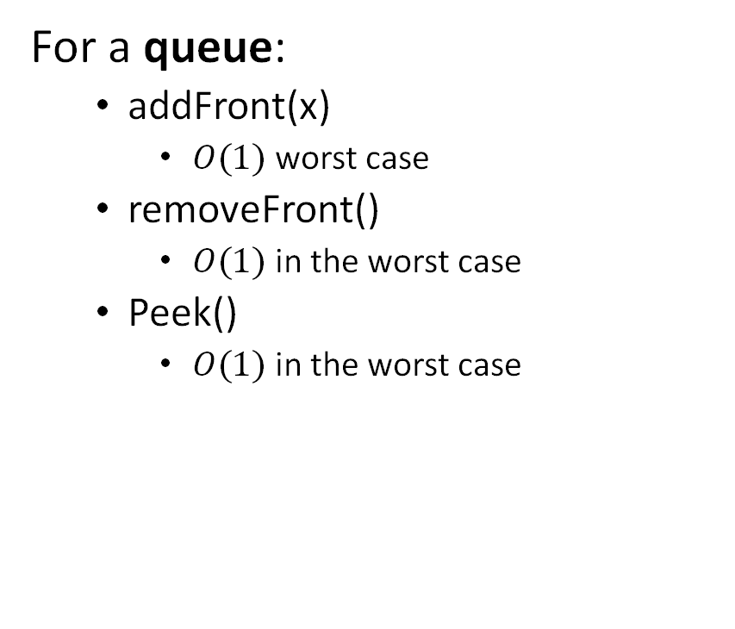

Implementation
For a stack:
Push(x)
$O(1)$ worst case
Pop()
$O(1)$ in the worst case
Peek()
$O(1)$ in the worst case
For a queue:
addFront(x)
$O(1)$ worst case
removeFront()
$O(1)$ in the worst case
Peek()
$O(1)$ in the worst case
Can be implemented with an array
Can be implemented with a linked list
Can be implemented with an array
Use a circular array for efficiency
Can be implemented with a linked list
Use a circular linked list

Slide 46
Abstract Data Types (ADTs)
An ADT is a mathematical model of a data structure that specifies the type of the data stored, the operations supported on them, and the types of the parameters of the operations.
(from textbook, p. 68)
Remember!
An ADT is a mathematical definition (and not terribly formal!). An ADT is not a class … but in C++ a class can be a good way to implement an ADT.

Slide 47
Stack ADT
An ADT is a mathematical model of a data structure that specifies the type of the data stored, the operations supported on them, and the types of the parameters of the operations.
(from textbook, p. 68)
void push(T x) put x at top of stack (keeping other elements as-is)
T pop() remove top element of stack
T peek() return a copy of the top element of stack
bool is_empty() returns true if the stack is empty, false otherwise
T is any data type that can be copied (because the ADT passes by value in push).
peek() is in practice often implemented to return a pointer or a reference instead of a copy (to increase performance).
This ADT says nothing about error-handling, but it could (errors are not well-defined math concept!).
There is not one standard or universally agreed upon definition of all the details of a basic stack. Depending upon the situation, operations may differ, other operations added, etc.

Slide 48
Queue ADT
An ADT is a mathematical model of a data structure that specifies the type of the data stored, the operations supported on them, and the types of the parameters of the operations.
(from textbook, p. 68)
void enqueue(T x) put x at back of queue (keeping other elements as-is)
T dequeue() remove front element of queue
T peekFront() return the front element of queue
bool is_empty() returns true if the queue is empty, false otherwise

Slide 49
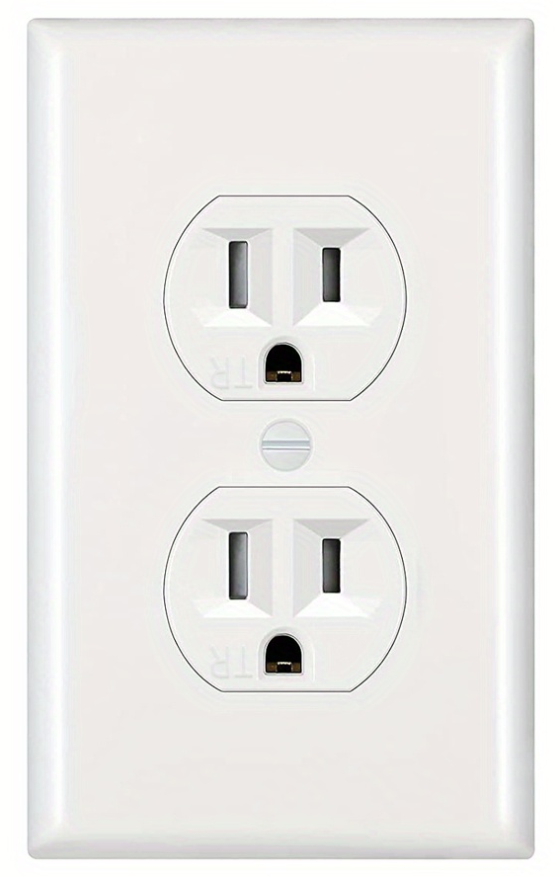
Abstract Data Types (ADTs)
Think of a wall outlet …
It has a precisely defined interface
Any plug should work in any socket
It promises to deliver electricity
But it says nothing about how that electricity is generated or where it comes from
If your city changes it’s source of electricity, you could still use the outlets
A toaster from the 1950s can work with this outlet!

Slide 50
Abstract Data Types (ADTs)
The idea of a software ADT is similar
A software ADT defines a precise interface
But leaves the implementation details largely up to the programmer
When well-done, ADTs allow for “plug and play”
If you write your code to rely on a stack ADT (instead of particular stack implementation), if someone creates a new and better implementation of your stack ADT then you can just “plug” it into your program with change much code.

Slide 51
Creating Good Interfaces is Tough (but worth the effort)
One reason for the success and longevity of the Unix operating system is it had a good interface for files:
open(path) // get a handle (file descriptor)
read(fd, buffer, n) // get bytes from the resource
write(fd, buffer, n) // send bytes to the resource
seek(fd, offset) // move the read/write position
close(fd) // release the handle
This interface has stayed as-is for decades! Many different things implement it: disk files, network sockets, pipes (memory buffers), …
But the implementations have varied over the years as computers and needs change.
E.g. the grep command-line tool is used for searching text files … but it can also search through the output of a device or the output of a running program thanks to this interface.

