Slide 1
Heaps and Priority Queues
Chapter 8: 8.1, 8.2, 8.3

Slide 2
Keys
struct Person { int key; string first_name; string last_name; Dept worksAt; };
When talking about data structures, we typically assume their data items have unique keys
A key is field (or combination of files) in a data item used to identify or order values
often a positive int
For the purposes of many data structures, items a and b are equal when a.key == b.key
For priority queues, we’ll assume keys are ints
{ 301, "Sarah”, "Lee", Dept("bakery") }
{ 574, "Sarah", "Lee", Dept("bakery") }
Even though all their data is the same, they are considered different because their keys are different.

Slide 3
Priority Queue
A priority queue is like a regular queue, except you can only remove the smallest item (instead of the oldest item).

Slide 4
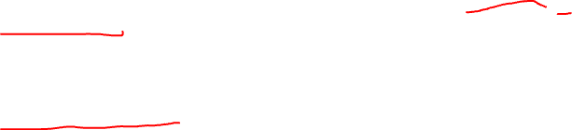
Priority Queue ADT (abstract data type)
int size()
Returns # of items
O(1) worst case
bool empty()
true if no items, false otherwise
O(1) worst case
void insert(T item)
Adds item to the queue (error if full)
T must be a type that can be compared like an int
O(?) worst case
T min()
Returns a copy of the smallest element (error if empty)
O(?) worst case
void removeMin()
Removes the smallest element (error if empty)
O(?) worst case

Slide 5
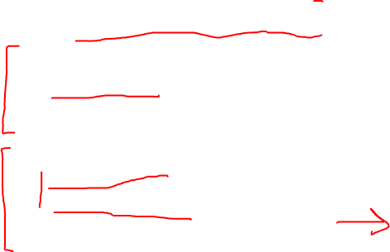
Sorting with a Priority Queue
Algorithm PriorityQueueSort(L)
PQ = makeEmptyPriorityQueue()
for i = 0 to len(L) – 1 do // add all items to queue
PQ.insert(L[i])
end
for i = 0 to len(L) – 1 do // read all items back into L
L[i] = PQ.min()
PQ.remove_min()
end
Algorithm performance
N * (cost of insert) + N * (cost of min/remove)
Depending how we implement PQ, we can get different performance.

Slide 6
Implementing with an unsorted list
void insert(T item)
Adds item to the queue (error if full)
O(1) worst case: append to the end of the list
T min()
Returns a copy of the smallest element (error if empty)
O(n) worst case: must search the list for min
void removeMin()
Removes the smallest element (error if empty)
O(n) worst case: must search the list for min

Slide 7
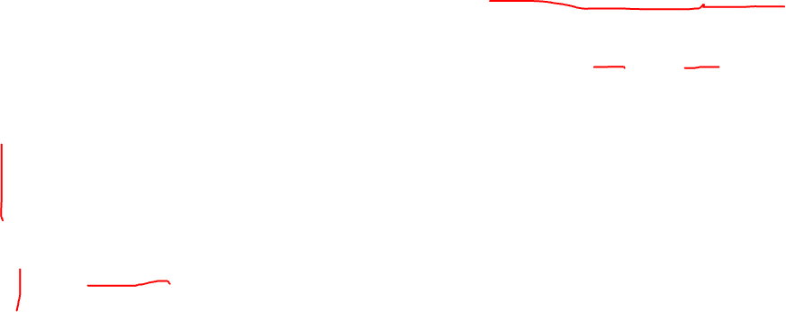


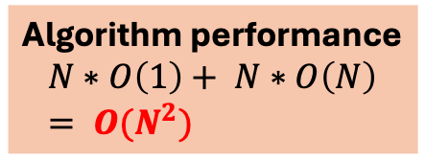
Sorting with a Priority Queue
Algorithm performance
N * (cost of insert) + N * (cost of min/remove)
Algorithm performance
$$N∗O\left(1\right)+ N∗O\left(N\right) \\ = O(N^{2})$$
Algorithm PriorityQueueSort(L)
PQ = makeEmptyPriorityQueue()
for i = 0 to len(L) – 1 do // add all items to queue
PQ.insert(L[i])
end
for i = 0 to len(L) – 1 do // read all items back into L
L[i] = PQ.min()
PQ.remove_min()
end
Unsorted list: insert is $O(1)$
Unsorted list: min is $O(N)$
This is essentially selection sort! Repeatedly rremove min from an unsorted lists of items.

Slide 8
Implementing with a sorted list
void insert(T item)
Adds item to the queue (error if full)
O(n) worst case: find insertion point and move elements to make space
T min()
Returns a copy of the smallest element (error if empty)
O(1) worst case: return first element
void removeMin()
Removes the smallest element (error if empty)
O(1) worst case: return first element

Slide 9


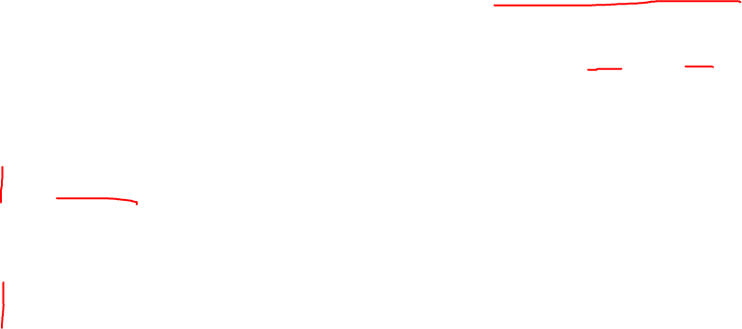
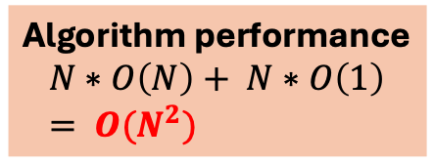
Sorting with a Priority Queue
Algorithm performance
N * (cost of insert) + N * (cost of min/remove)
Algorithm performance
$$N∗O\left(N\right)+ N∗O\left(1\right) \\ = O(N^{2})$$
Algorithm PriorityQueueSort(L)
PQ = makeEmptyPriorityQueue()
for i = 0 to len(L) – 1 do // add all items to queue
PQ.insert(L[i])
end
for i = 0 to len(L) – 1 do // read all items back into L
L[i] = PQ.min()
PQ.remove_min()
end
Sorted list: insert is $O(N)$
Sorted list: min is $O(1)$
This is essentially insertion sort! Insert each item into its properly sorted position (then copy it back into the the original list L).

Slide 10
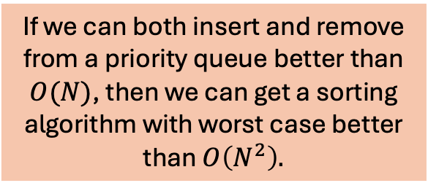

Sorting with a Priority Queue
Algorithm performance
N * (cost of insert) + N * (cost of min/remove)
If we can both insert and remove from a priority queue better than $O(N)$, then we can get a sorting algorithm with worst case better than $O\left(N^{2}\right).$
Algorithm PriorityQueueSort(L)
PQ = makeEmptyPriorityQueue()
for i = 0 to len(L) – 1 do // add all items to queue
PQ.insert(L[i])
end
for i = 0 to len(L) – 1 do // read all items back into L
L[i] = PQ.min()
PQ.remove_min()
end
There is a clever solution: heaps!

Slide 11
The Heap Data Structure
A heap is clever implementation of a priority queue that allows for both fast insertion and removal
It can be (relatively!) easily implemented as an array
But it is easier to think about heaps in terms of trees

Slide 12
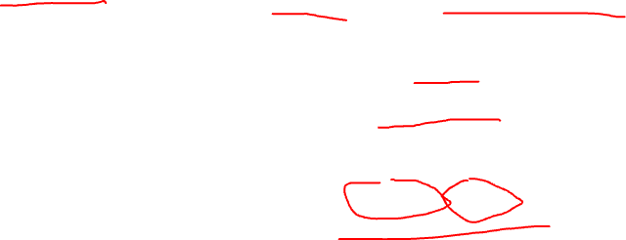
Heap-order Property (for a min heap)
A heap is a binary tree that is both complete and satisfies the heap order property.
Complete Tree Property
A binary tree is complete if every level has the maximum number of nodes, and on the last level the nodes are filled from left to right.

Slide 13
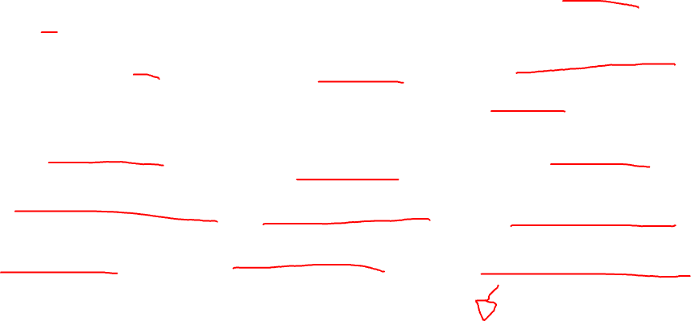
Complete Binary Trees
The first 7 complete binary trees.

Slide 14
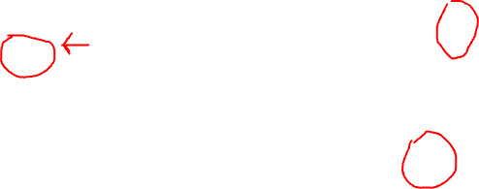
Some Not Complete Binary Trees

Slide 15

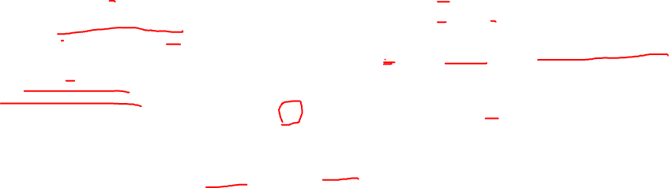
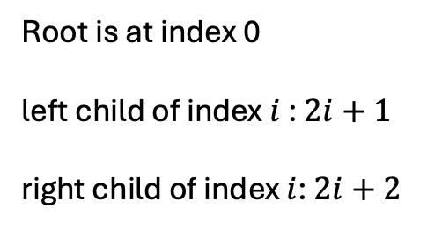


Complete Binary Trees
Complete binary trees can be stored level-by-level in an array.
0
a
1
b
2
c
0 | 1 | 2 | 3 | 4 | 5
a | b | c | d | e | f
3
d
4
e
5
f
Textbook starts at index 1 to get slightly simpler formulas.
$$i$$
Root is at index 0
left child of index $i$: $2i+1$
right child of index $i$: $2i+2$
$$2i+1$$
$$2i+2$$

Slide 16
Heap-order Property (for a min heap)
A heap is a binary tree that is both complete and satisfies the heap order property.
Complete Tree Property
A binary tree is complete if every level has the maximum number of nodes, and on the last level the nodes are filled from left to right.
Heap-Order Property
A binary tree satisfies the Heap-Order property if for every node v other than the root, v.key >= parent(v).key
Intuitively: every node (except for the root) is bigger than, or equal to, its parent.

Slide 17

Heap-Order Property
5
14
9
Heap-Order Property
A binary tree satisfies the Heap-Order property if for every node v other than the root, v.key >= parent(v).key
22
16
18
Intuitively: every node (except for the root) is bigger than, or equal to, its parent.

Slide 18
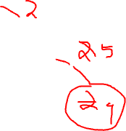
Heap-Order Property
5
14
9
Heap-Order Property
A binary tree satisfies the Heap-Order property if for every node v other than the root, v.key >= parent(v).key
22
16
18
Intuitively: every node (except for the root) is bigger than, or equal to, its parent.

Slide 19

Heap-Order Property
5
14
9
Heap-Order Property
A binary tree satisfies the Heap-Order property if for every node v other than the root, v.key >= parent(v).key
22
16
18
5
14
9
Intuitively: every node (except for the root) is bigger than, or equal to, its parent.
15
12
18

Slide 20
Heap-Order Property
5
14
9
Heap-Order Property
A binary tree satisfies the Heap-Order property if for every node v other than the root, v.key >= parent(v).key
22
16
18
5
14
9
Intuitively: every node (except for the root) is bigger than, or equal to, its parent.
15
12
18

Slide 21

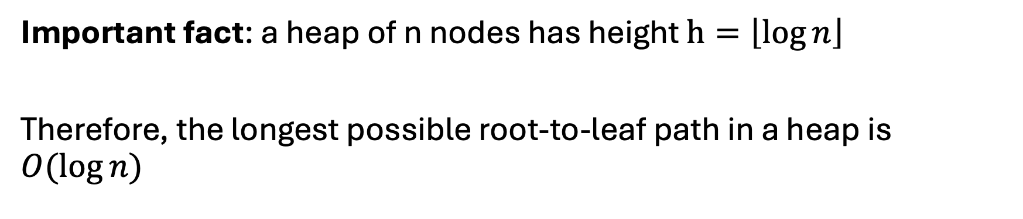
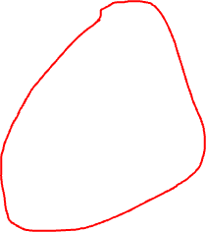
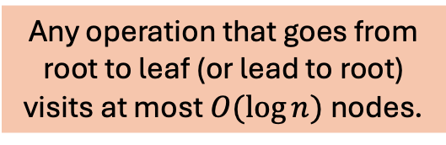
Height of a Heap
Important fact: a heap of n nodes has height $h=\left\lfloor \log{n}\right\rfloor$
Therefore, the longest possible root-to-leaf path in a heap is $O(\log{n)}$
A heap height is at most
$$O(\log{n)}$$
Any operation that goes from root to leaf (or lead to root) visits at most $O(\log{n)}$nodes.

Slide 22

Heap Insertion
The idea of inserting a new element x into a heap is the following
Put x at the next new leaf position (according to the rules of complete trees)
For an array implementation, this is appending to the end of the array
Repeatedly swap x up through the tree while x is less than its parent node
Stop at the root
Or when the parent node is smaller

Slide 23
Heap Insertion
Insert these numbers into a heap: 8, 9, 4, 1, 6, 7
8

Slide 24
Heap Insertion
Insert these numbers into a heap: 8, 9, 4, 1, 6, 7
9
8

Slide 25
Heap Insertion
Insert these numbers into a heap: 8, 9, 4, 1, 6, 7
9
8
8
9

Slide 26
Heap Insertion
Insert these numbers into a heap: 8, 9, 4, 1, 6, 7
9
4
8
8
9

Slide 27
Heap Insertion
Insert these numbers into a heap: 8, 9, 4, 1, 6, 7
9
4
8
8
8
9
9
4

Slide 28
Heap Insertion
Insert these numbers into a heap: 8, 9, 4, 1, 6, 7
9
4
8
8
8
4
9
9
4
9
8

Slide 29
Heap Insertion
Insert these numbers into a heap: 8, 9, 4, 1, 6, 7
9
4
1
8
8
8
4
9
9
4
9
8

Slide 30
Heap Insertion
Insert these numbers into a heap: 8, 9, 4, 1, 6, 7
9
4
1
8
8
8
4
4
9
9
4
9
8
9
8
1

Slide 31
Heap Insertion
Insert these numbers into a heap: 8, 9, 4, 1, 6, 7
9
4
1
8
8
8
4
4
9
9
4
9
8
9
8
1
1
4
8
9

Slide 32
Heap Insertion
Insert these numbers into a heap: 8, 9, 4, 1, 6, 7
9
4
1
8
8
8
4
4
9
9
4
9
8
9
8
1
6
1
4
8
9

Slide 33
Heap Insertion
Insert these numbers into a heap: 8, 9, 4, 1, 6, 7
9
4
1
8
8
8
4
4
9
9
4
9
8
9
8
1
6
1
1
4
8
4
8
9
6
9

Slide 34
Heap Insertion
Insert these numbers into a heap: 8, 9, 4, 1, 6, 7
9
4
1
8
8
8
4
4
9
9
4
9
8
9
8
1
7
6
1
1
4
8
4
8
9
6
9

Slide 35
Heap Insertion
Insert these numbers into a heap: 8, 9, 4, 1, 6, 7
9
4
1
8
8
8
4
4
9
9
4
9
8
9
8
1
7
6
1
1
1
4
8
4
8
4
8
9
6
7
9
6
9

Slide 36
Heap Insertion
Insert these numbers into a heap: 8, 9, 4, 1, 6, 7
9
4
1
8
8
8
4
4
9
9
4
9
8
9
8
1
7
6
1
1
1
4
8
4
8
4
8
9
6
7
9
6
9

Slide 37
Heap Insertion
Insert these numbers into a heap: 8, 9, 4, 1, 6, 7
9
4
1
8
8
8
4
4
9
9
4
9
8
9
8
1
7
6
1
1
1
1
4
7
4
8
4
8
4
8
9
6
8
9
6
7
9
6
9

Slide 38
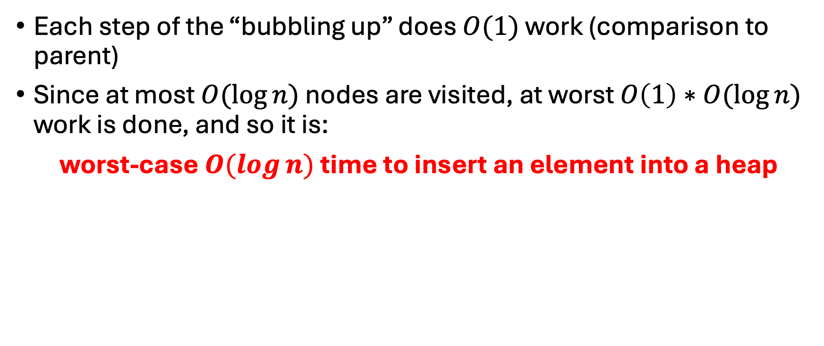
Heap Insertion
Each step of the “bubbling up” does $O(1)$ work (comparison to parent)
Since at most $O(\log{n})$ nodes are visited, at worst $O\left(1\right)∗O(\log{n})$ work is done, and so it is:
worst-case $O(\log{n})$ time to insert an element into a heap

Slide 39
Heap Removal
The idea of removing the min element of a heap is the following
Copy the min value of the root
Copy the value x of the last node on the bottom level into the root
In an array implementation, this is the last element of the array
If any of the children of x are less than x, then swap x with its smallest child
Stop when x is a leaf
Or when both children of x are >= x

Slide 40
Heap Removal
removeMin
1
8
4
4
7
4
7
8
7
9
6
8
9
6
8
9
6
4
6
7
9
8

Slide 41
Heap Removal
4
removeMin
8
6
6
7
6
7
8
7
9
8
9
8
9

Slide 42
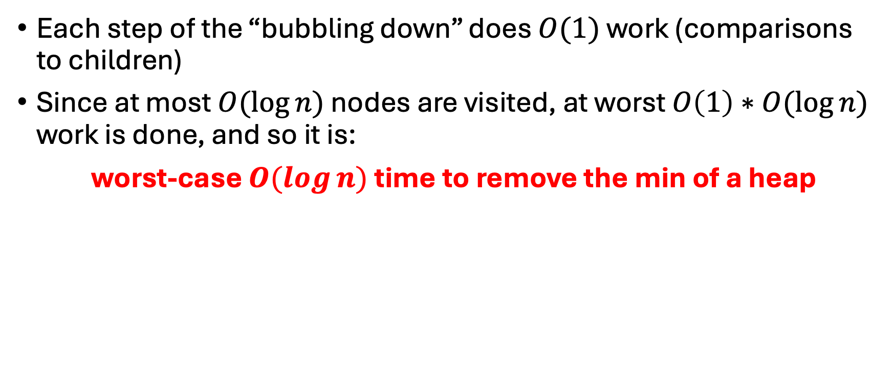
Heap Removal
Each step of the “bubbling down” does $O(1)$ work (comparisons to children)
Since at most $O(\log{n})$ nodes are visited, at worst $O\left(1\right)∗O(\log{n})$ work is done, and so it is:
worst-case $O(\log{n})$ time to remove the min of a heap

Slide 43

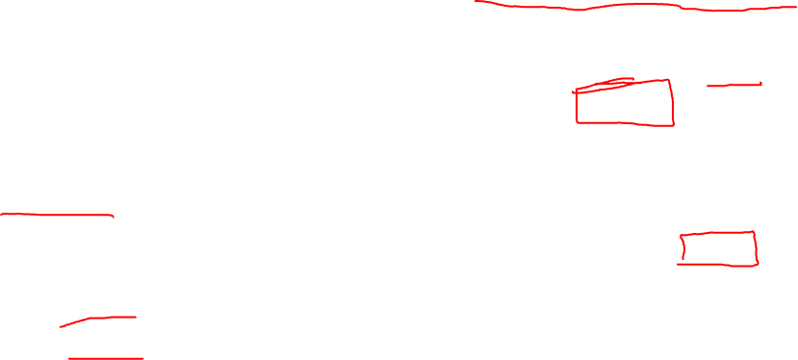

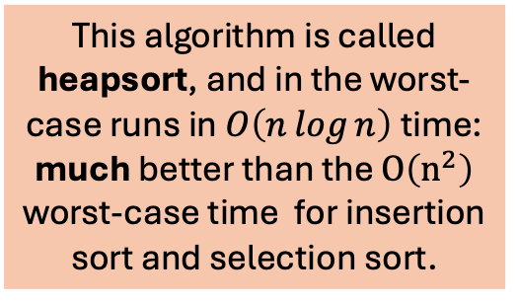
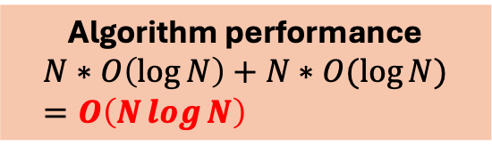
Sorting with a Priority Queue
Algorithm performance
N * (cost of insert) + N * (cost of min/remove)
Algorithm performance
$$N∗O\left(\log{N}\right)+N∗O(log⁡N) \\ =O\left(N\log{N}\right)$$
Algorithm PriorityQueueSort(L)
PQ = makeEmptyPriorityQueue()
for i = 0 to len(L) – 1 do // add all items to queue
PQ.insert(L[i])
end
for i = 0 to len(L) – 1 do // read all items back into L
L[i] = PQ.min()
PQ.remove_min()
end
Heap: insert is $O(log⁡n)$
This algorithm is called heapsort, and in the worst-case runs in $O\left(n\log{n}\right)$time: much better than the $O\left(n^{2}\right)$ worst-case time for insertion sort and selection sort.
Heap: removing min is $O(log⁡n)$

Slide 44
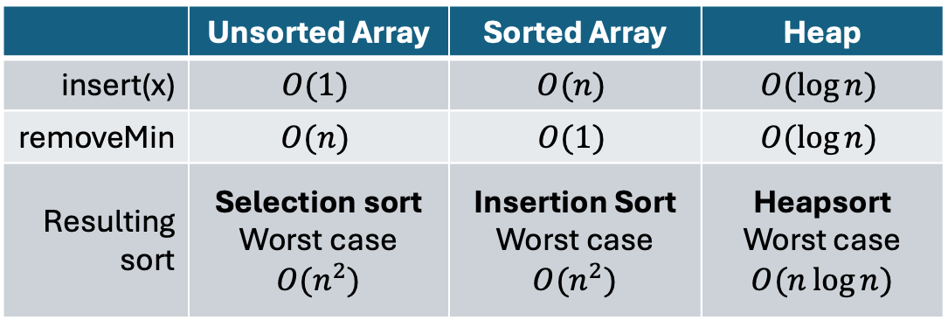
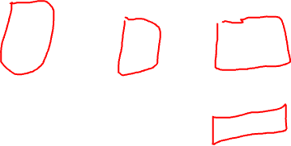
Priority Queue Implementations
 | Unsorted Array | Sorted Array | Heap
insert(x) | $$O(1)$$ | $$O(n)$$ | $$O(\log{n})$$
removeMin | $$O(n)$$ | $$O(1)$$ | $$O(\log{n})$$
Resulting sort | Selection sort Worst case $O(n^{2})$ | Insertion Sort Worst case $O(n^{2})$ | Heapsort Worst case $O(n\log{n})$

