Slide 1
Object-oriented Design Basics
CMPT 225, Summer 2026

Slide 2
Object-Oriented Design Principles
Modularity
Organize programs into individual components
Abstraction
Boil things down to the key ideas
Encapsulation
Intentionally hide details of implementation
Hierarchical decomposition
Organize hierarchically related components using inheritance

Slide 3
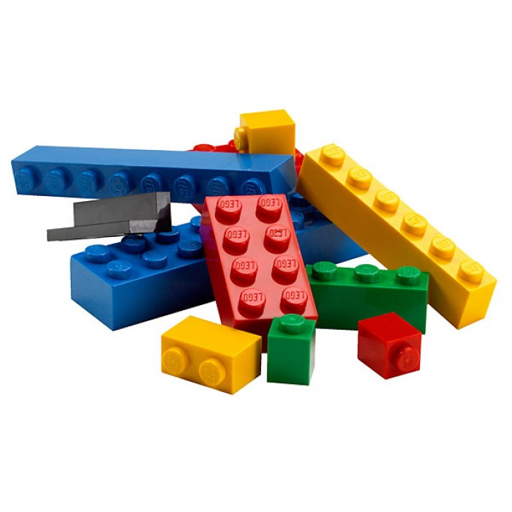
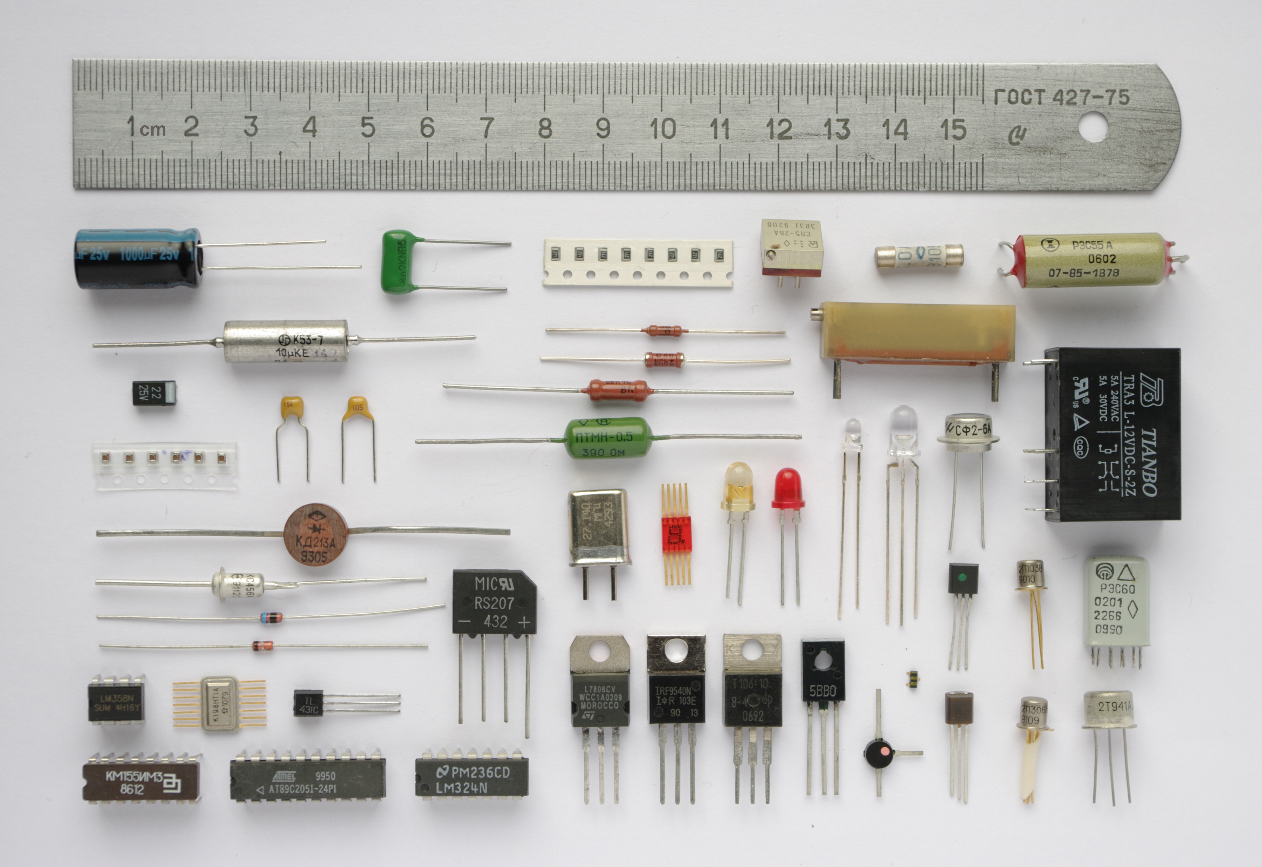
Modularity
Modularity is the idea of dividing a big thing into multiple small components.
E.g. Lego models are designed from small bricks.
E.g. Electronics uses standard modules like wires, resistors, capacitors etc.
E.g. Computers have the CPU, main memory, I/O, etc.
Finding the best way to modularize a system can be very challenging!

Slide 4
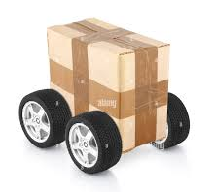
Abstraction
Abstraction is the process of removing inessential details from something until what remains are they key parts.
E.g. You can abstract a car to be a “box on wheels”.
E.g. Volume on a computer is abstract to “up” and “down”.
E.g. To get a hamburger at a restaurant you just ask the waiter for a hamburger.
Abstraction is one of the key ideas in math.
Abstracting data structures gives you ADTs.

Slide 5
Abstraction
Abstraction is the process of removing inessential details from something until what remains are they key parts.
Abstracting data structures gives you ADTs.
In object-oriented design, abstraction is often achieved through creating a simply public interface that is easy to use and understand.
The precise details of how the data structure is implemented is intentionally left unspecified. All that is specified is how the ADT works.

Slide 6

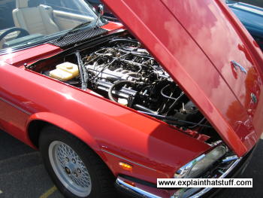
Encapsulation
Encapsulation is the idea that things should not reveal the details of they work.
E.g. A pill capsule contains medicine inside a capsule. You can’t touch the raw powder.
E.g. Computer CPUS, car engines, motors, etc. are often but into physical boxes. This stops people from poking into them and messing them or hurting themselves.

Slide 7
Encapsulation
Encapsulation is the idea that things should not reveal the details of they work.
Encapsulation in OOP is often achieved through use of private/public, or by providing just a .h header file and object code (and source code).
E.g. source code that defines how cout works might be not even on your computer.
Sometimes programmers argue that encapsulation can be bad because it hides details that you might need to know about for debugging: intentionally making some code harder to examine seems like a bad idea.

Slide 8
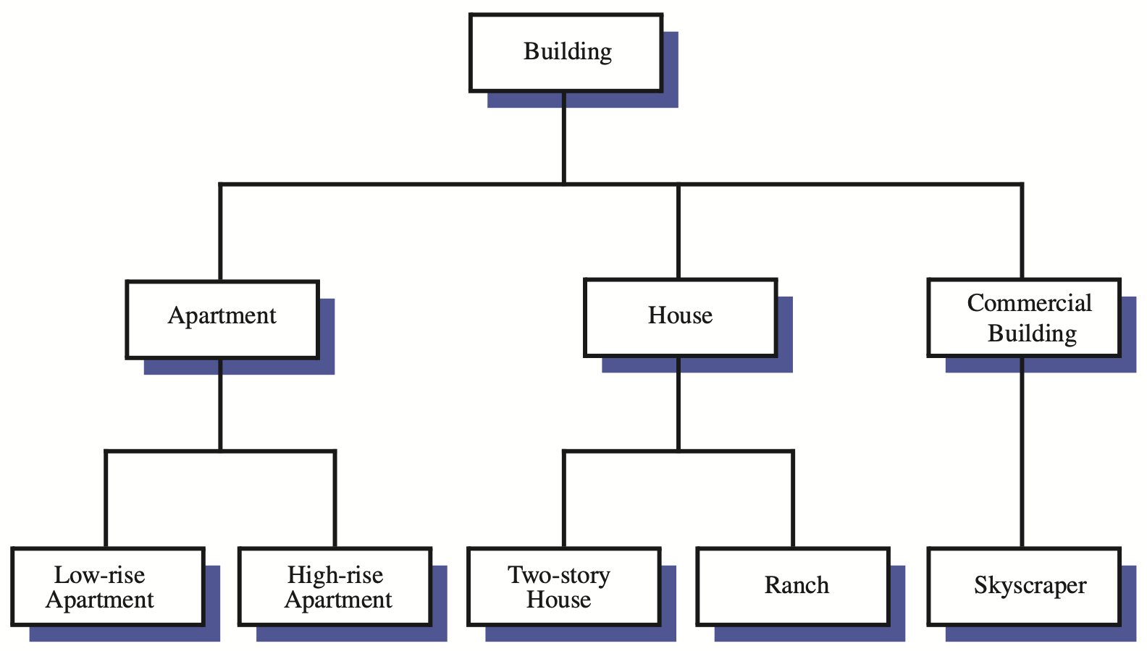
Hierarchical Organization
Sometimes it is useful to organize objects in a hierarchy, and OOP languages provide inheritance to help with this.
However, this is probably not as general a consideration as the other concepts: some system benefit from hierarchical organization, some don’t.
Some designers and programmers downplay the use of inheritance in general: only use inheritance if it makes sense and is a good solution to specific problem.

Slide 9
Abstraction, Encapsulation, Modularity
These ideas work together and must be balanced against each other and practical real-world constraints
aim for deep modules: simple (even minimalist) public interfaces with complexity underneath
aim for plug and play: modules shouldn’t know about the implementation details of other modules
aim to iterate: plan multiple versions, learning from each one and making improvements in future ones
Among other things, good designers tend to have a lot of experience and knowledge of possible options and their pros and cons, and often need make trade-offs

Slide 10
Example: Unix File API
What code should you use to read and write files?
Practically all programs use files, so how do you make everyone happy?
The Unix file API is a famously simple interface:
open, read, write, lseek, close
It has been around since the 1970s with no major change. But the underlying implementations have changed drastically.
Think about designing an interface for files: it is not obvious that these functions work so well in so many cases.

Slide 11
Example: lists
Different programming languages can have every different designs for lists … there is no one standard
E.g. Python list methods: append, clear, copy, count, extend, index, insert, pop, remove, reverse, sort
E.g. C++ vector methods: assign, at, back, begin, capacity, cbegin, cend, clear, crbegin, crend, data, emplace, emplace_back, empty, end, erase, front, get_allocator, insert, max_size, operator[], operator=, pop_back, push_back, rbegin, rend, reserve, resize, shrink_to_fit, size, swap

Slide 12
Inheritance
Class Diagram
shows inheritance relations
Creature
Cow
Duck
RobotDog

Slide 13
Inheritance
Class Diagram
shows inheritance relations
Creature
In general, it’s a good idea to make the base class (Creature) have pure virtual methods (no implementations).
C++ issue: always put virtual destructors is base class. If you don’t, inheriting classes can’t have their destructors properly called.
Cow
Duck
RobotDog

Slide 14
Inheritance
Class Diagram
shows inheritance relations
Creature
In general, it’s a good idea to make the base class (Creature) have pure virtual methods (no implementations).
C++ issue: always put virtual destructors is base class. If you don’t, inheriting classes can’t have their destructors properly called.
Cow
Duck
RobotDog
Liskov Substitution Principle
If a property P is true of all Creature objects, then P should also be true of all Cow, Duck, and RobotDog objects (and any other object of classes that inherit from Creature)
In other words: anywhere in your program where you see a Creature object, you should be able to sensible replace it by an object of a class that inherits from Creature.

Slide 15
Interfaces
Inheritance is often not as easy a tool to use at it might seem
Even simple examples can be tricky
Breaking the Liskov substitution principle creates real problems
Many languages and programmers now instead prefer interfaces
These are essentially classes with no implementation
E.g. in C++ these are abstract base classes
I.e. a list of method signatures
These act much more intuitively for most programmers and still give good designs
C++ Rule of thumb: don’t put implementations in base classes (i.e. don’t inher

