Slide 1
Graph Algorithms
Chapter 13.1 – 13.6

Slide 2
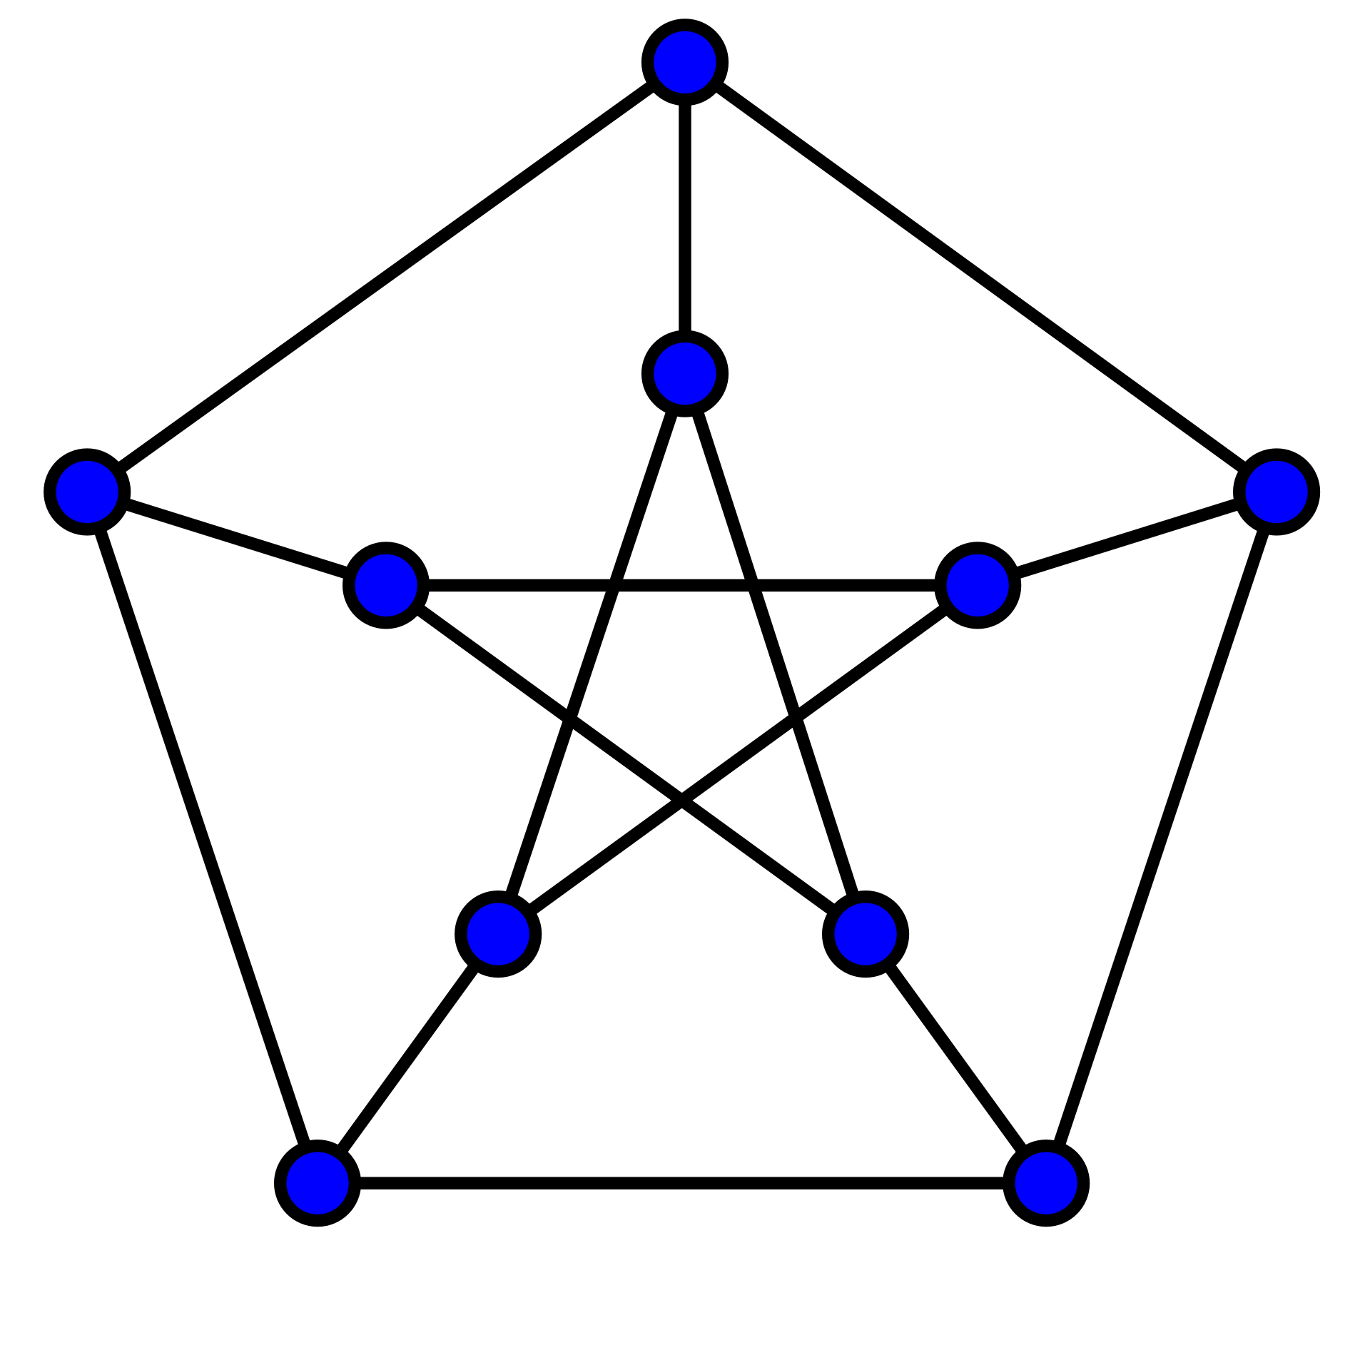
Graph Theory
Graph theory is major branch of mathematics with many applications in computer science and programming.
The key idea is that graphs consists of vertices (nodes), and pairs of vertices can be connected by an edge.
For instance, linked lists and trees are graphs.

Slide 3
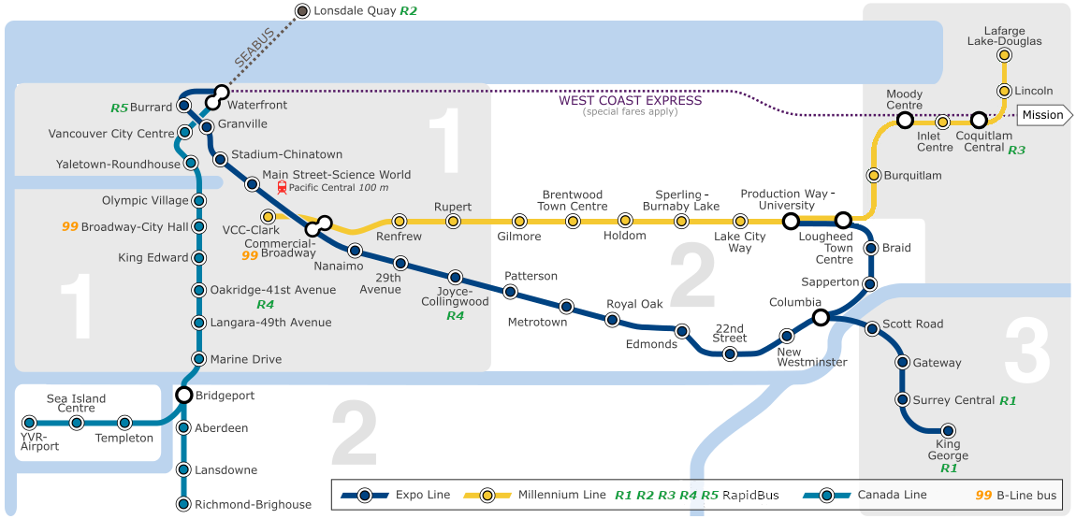
Example: Transit Map

Slide 4
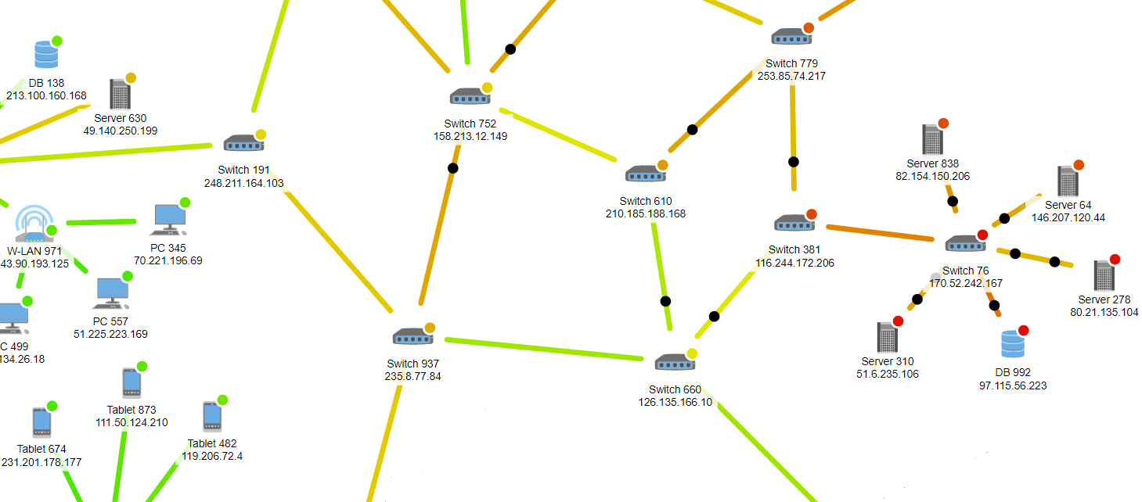
Example: Computer Networks

Slide 5
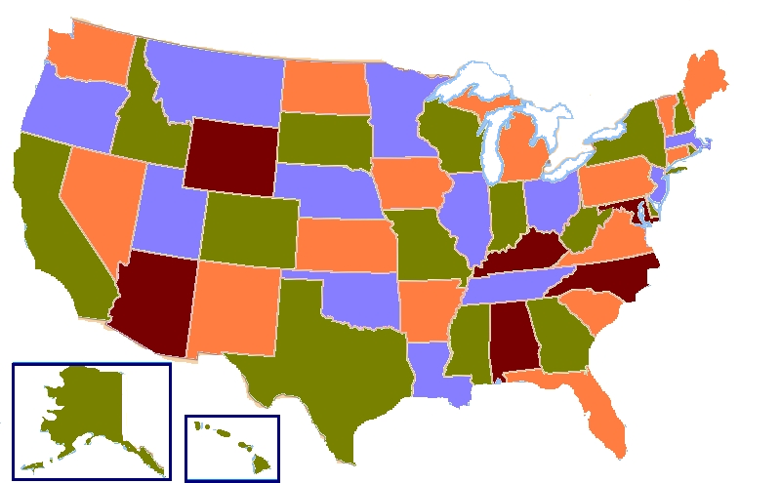
Example: Map Coloring
For any map you can draw on paper, it’s always possible to use at most 4 colors such that no two adjacent regions have the same color.
This is known as the Four Color Theorem, and wasn’t proven until 1976. The proof was controversial: it has ~1,500 sub-cases that were proven individually with computer. While improvements on the proof have been made, no simple short proof has been discovered.

Slide 6
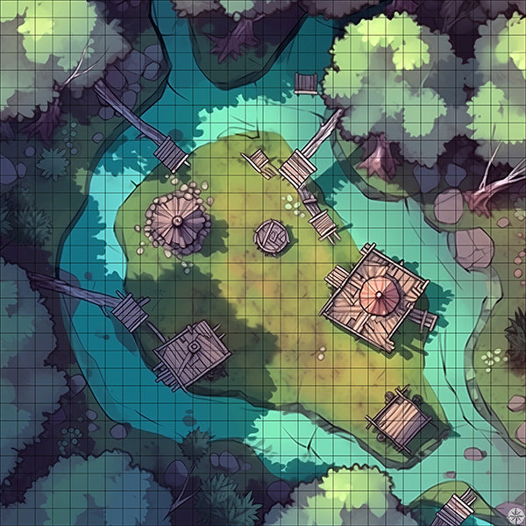
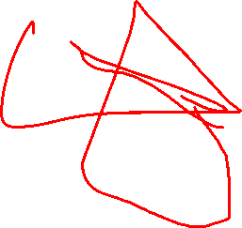
Example: Video Game Navigation
You can overlay a grid on any map, and then treat that grid as a graph, and use it to do path-finding, etc.
By making the grid small enough, you can can get as much detail as you like.

Slide 7
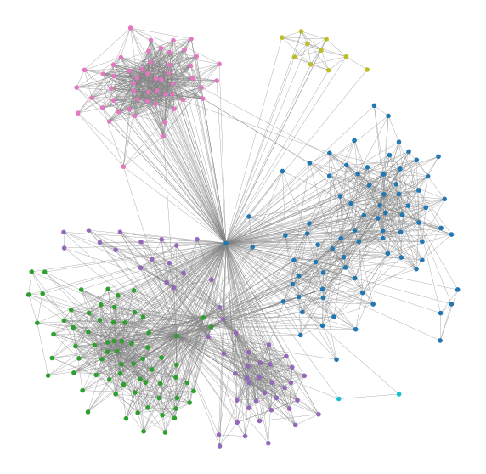
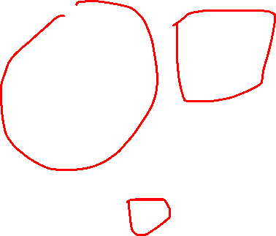
Example: Friendship Graphs
A graph of people who are friends on Facebook.

Slide 8
Undirected Graphs
# vertices:
# edges:
Cycles:
# components:
Longest path with no repeat vertices:
Sum of vertex degrees:
A
B
C
F
G
D
E
H
I
Undirected graph

Slide 9
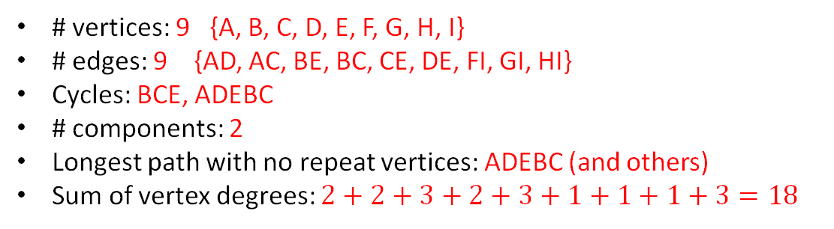
Undirected Graphs
# vertices: 9 {A, B, C, D, E, F, G, H, I}
# edges: 9 {AD, AC, BE, BC, CE, DE, FI, GI, HI}
Cycles: BCE, ADEBC
# components: 2
Longest path with no repeat vertices: ADEBC (and others)
Sum of vertex degrees: $2+2+3+2+3+1+1+1+3=18$
2
A
2
B
3
1
1
C
F
G
2
3
D
E
1
3
H
I
Undirected graph

Slide 10
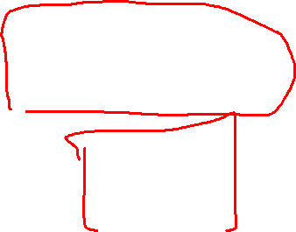
Graph Theory
# vertices: 9 {A, B, C, D, E, F, G, H, I}
# edges: 9 {AD, AC, BE, BC, CE, DE, FI, GI, HI}
Cycles: BCE, ADEBC
# components: 2
Longest path with no repeat vertices: ADEBC (and others)
Sum of vertex degrees: $2+2+3+2+3+1+1+1+3=18$
2
A
2
B
A simple graph has at most one edge between any pair of vertices, and no loop edges (e.g. edges where both ends are the same vertex).
3
1
1
C
F
G
2
3
D
E
1
3
H
I
Undirected graph

Slide 11
Graph Theory
# vertices: 9 {A, B, C, D, E, F, G, H, I}
# edges: 9 {AD, AC, BE, BC, CE, DE, FI, GI, HI}
Cycles: BCE, ADEBC
# components: 2
Longest path with no repeat vertices: ADEBC (and others)
Sum of vertex degrees: $2+2+3+2+3+1+1+1+3=18$
2
A
2
B
3
1
1
C
F
G
Proposition 13.6
The sum of the degrees of a graph is twice the number of edges.
2
3
D
E
1
3
H
I
Undirected graph

Slide 12
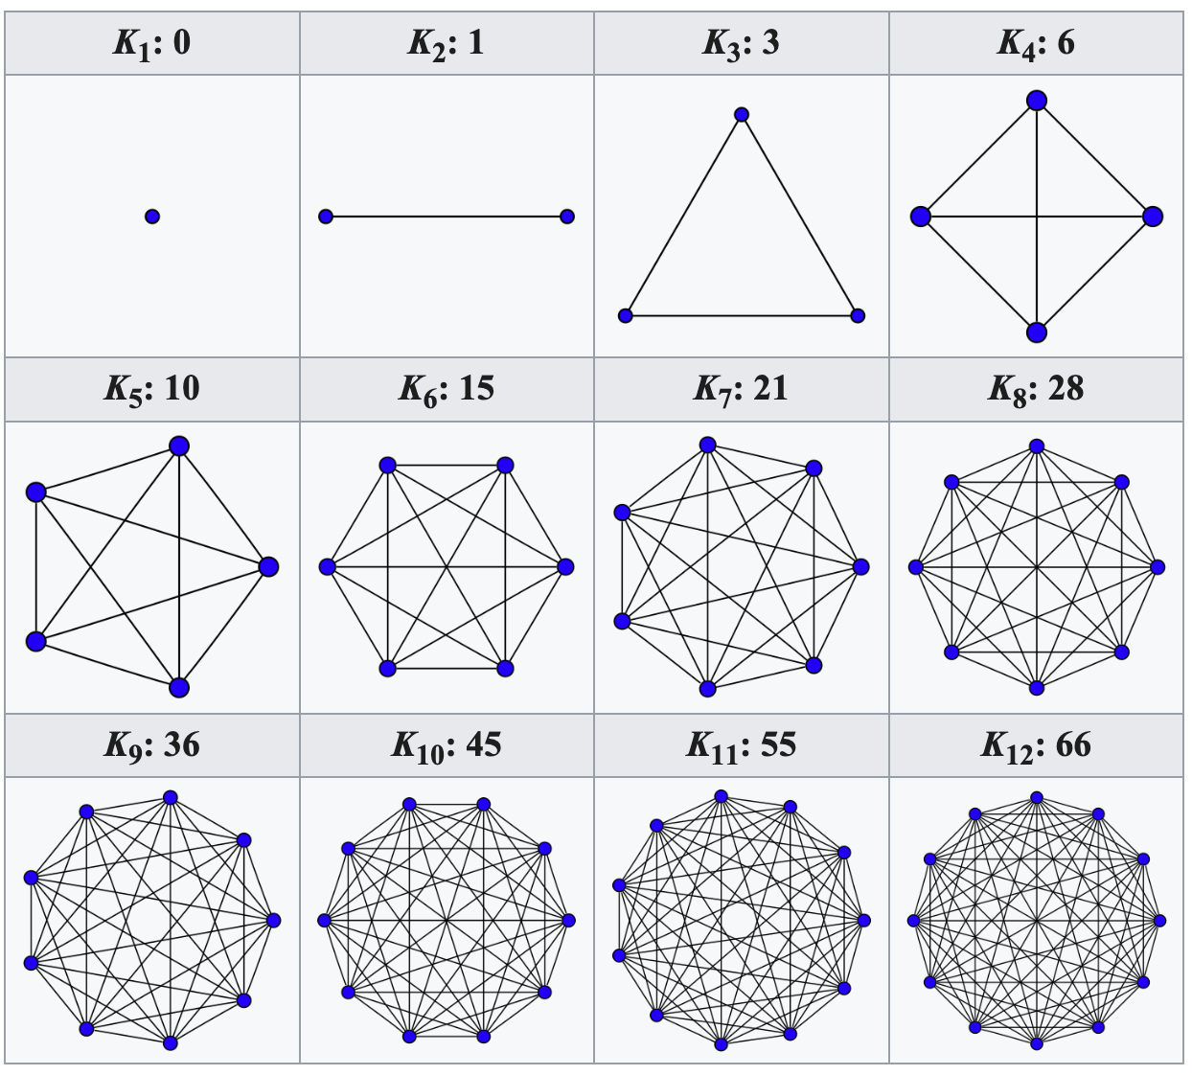
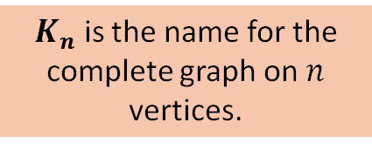
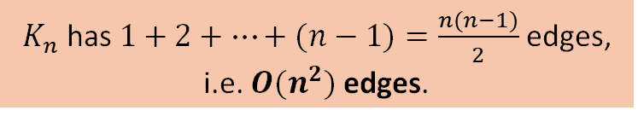
Complete Graphs
A complete graph is a simple graph where each pair of vertices is connected by an edge.
$K_{n}$ is the name for the complete graph on $n$ vertices.
$K_{n}$ has $1+2+…+(n−1)=\frac{n(n−1)}{2}$edges, i.e. $O(n^{2})$edges.
Any simple graph is a sub-graph of a complete graph, i.e. by removing edges or vertices you can get any other graph.

Slide 13

Directed Graphs
# vertices:
# edges:
Cycles:
# components:
Longest path with no repeat vertices:
Sum of in-degrees:
Sum of out-degrees:
A
B
C
D
E
Directed graph

Slide 14
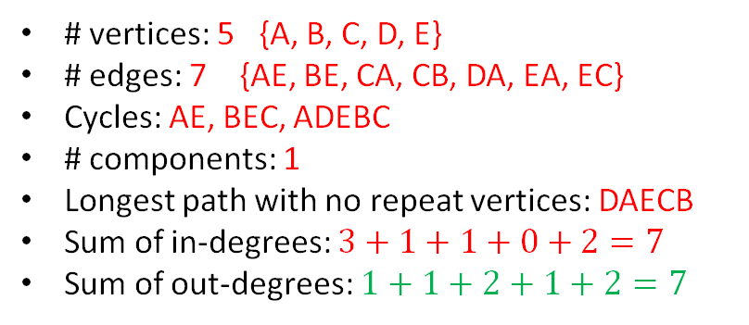
Directed Graphs
# vertices: 5 {A, B, C, D, E}
# edges: 7 {AE, BE, CA, CB, DA, EA, EC}
Cycles: AE, BEC, ADEBC
# components: 1
Longest path with no repeat vertices: DAECB
Sum of in-degrees: $3+1+1+0+2=7$
Sum of out-degrees: $1+1+2+1+2=7$
In: 3
Out: 1
Proposition 13.7
For a directed graph, the sum of the in-degrees equals the sum of the out-degrees.
A
In: 1
Out: 1
B
C
In: 1
Out: 2
In: 0
Out: 1
D
E
In: 2
Out: 2
Directed graph

Slide 15
Trees: connected graphs with no cycles
# vertices:
# edges:
Cycles:
# components:
Longest path with no repeat vertices:
Sum of degrees:
A
B
C
D
E
No vertex is designated as the root, so this is called a free tree.

Slide 16
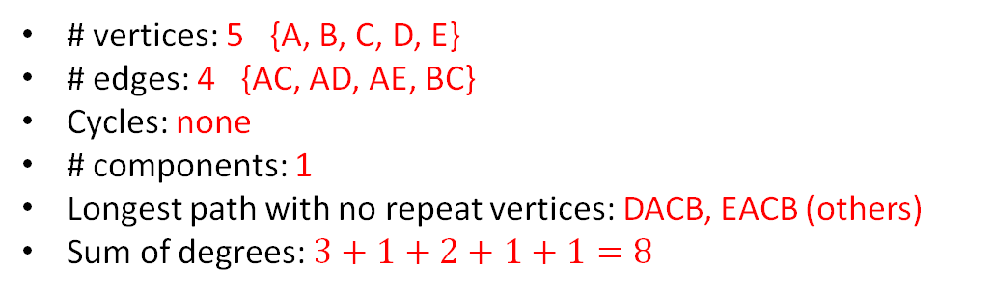
Trees: connected graphs with no cycles
# vertices: 5 {A, B, C, D, E}
# edges: 4 {AC, AD, AE, BC}
Cycles: none
# components: 1
Longest path with no repeat vertices: DACB, EACB (others)
Sum of degrees: $3+1+2+1+1=8$
3
1
A
B
2
C
1
1
D
E
No vertex is designated as the root, so this is called a free tree.

Slide 17
Trees: connected graphs with no cycles
# vertices: 5 {A, B, C, D, E}
# edges: 4 {AC, AD, AE, BC}
Cycles: none
# components: 1
Longest path with no repeat vertices: DACB, EACB (others)
Sum of degrees: $3+1+2+1+1=8$
3
1
A
B
2
C
Proposition 13.11
The number of edges in a tree is one less than the number of vertices.
1
1
D
E
No vertex is designated as the root, so this is called a free tree.

Slide 18
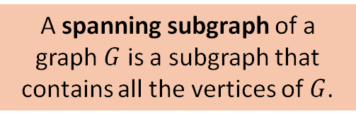
Spanning Trees
A spanning subgraph of a graph $G$ is a subgraph that contains all the vertices of $G$.
A
B
A spanning tree of a graph G is spanning subgraph that is a tree.
C
All graphs have a spanning tree (often more than one).
D
E

Slide 19
Graph Traversal
Imagine standing on a graph node and walking around it by following edges
There is no one best way to traverse a graph, it depends on the problem
In general there are two main strategies
Depth-first search: explore one neighbor of a node as far as possible before backing up and trying the next neighbor
Breadth-first search: explore all neighbors of a node, then all neighbors of neighbors, and so on

Slide 20
Depth First Search
Solving a maze with depth-first search.
From https://brilliant.org/wiki/depth-first-search-dfs/

Slide 21
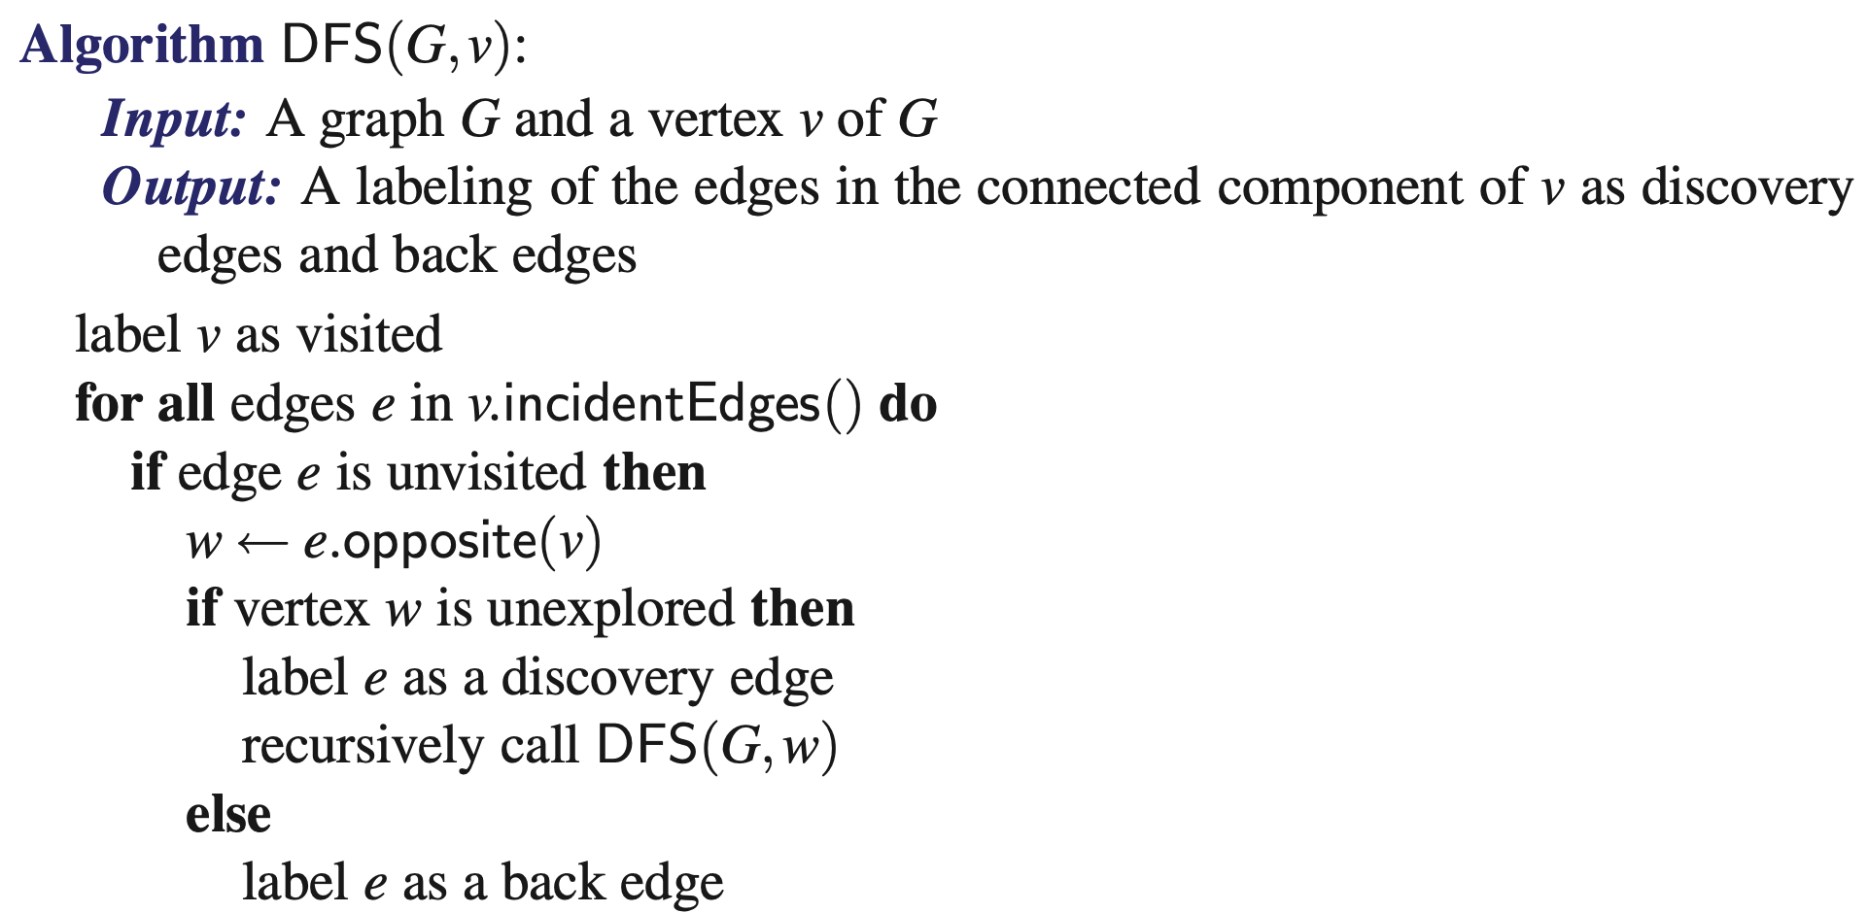
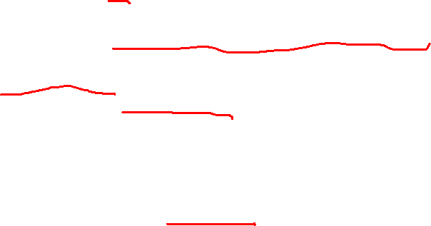
Depth First Search (DFS , graph traversal)
An edge is visited if it has been marked as a discovery edge or a back edge.

Slide 22
Depth First Search (DFS , graph traversal)
Proposition 3.12: the discovery edges of DFS form a spanning tree of a connected graph
Proof relies on two observations:
the visited vertices form a tree because cycles can never be formed with visited vertices
when DFS is done, all the nodes are visited (i.e. there are no unvisited nodes)

Slide 23
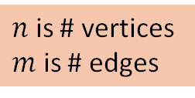
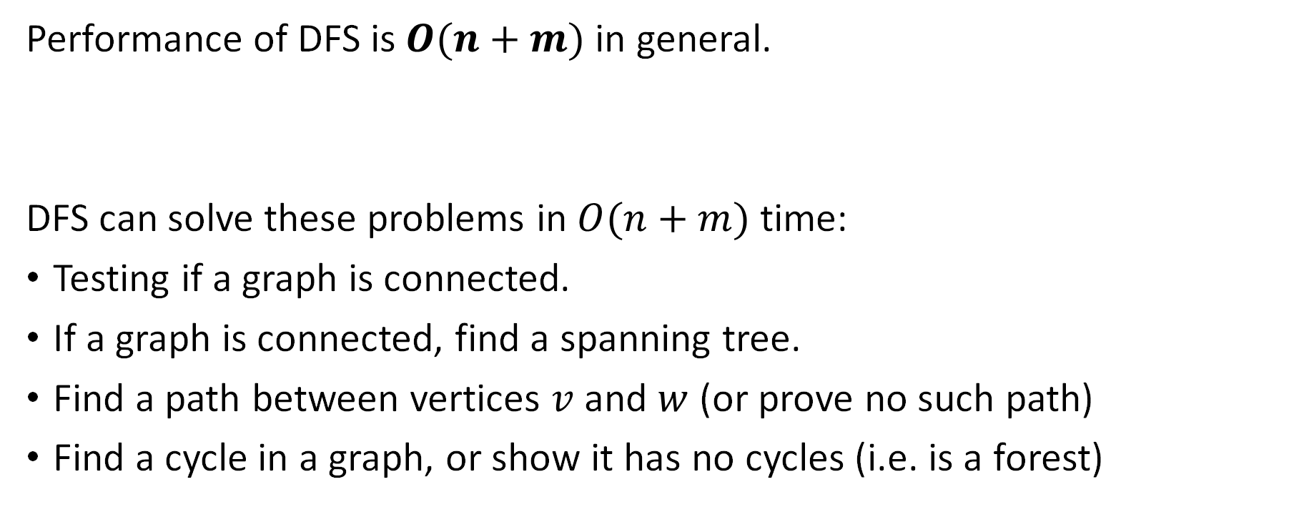
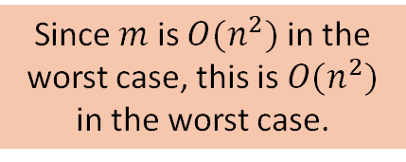
Depth First Search (DFS , graph traversal)
Performance of DFS is $O(n+m)$ in general.
DFS can solve these problems in $O(n+m)$ time:
Testing if a graph is connected.
If a graph is connected, find a spanning tree.
Find a path between vertices $v$ and $w$ (or prove no such path)
Find a cycle in a graph, or show it has no cycles (i.e. is a forest)
Since $m$ is $O(n^{2})$ in the worst case, this is $O(n^{2})$ in the worst case.
$n$ is # vertices
$m$ is # edges

Slide 24
Breadth First Search
From https://en.wikipedia.org/wiki/Breadth-first_search

Slide 25
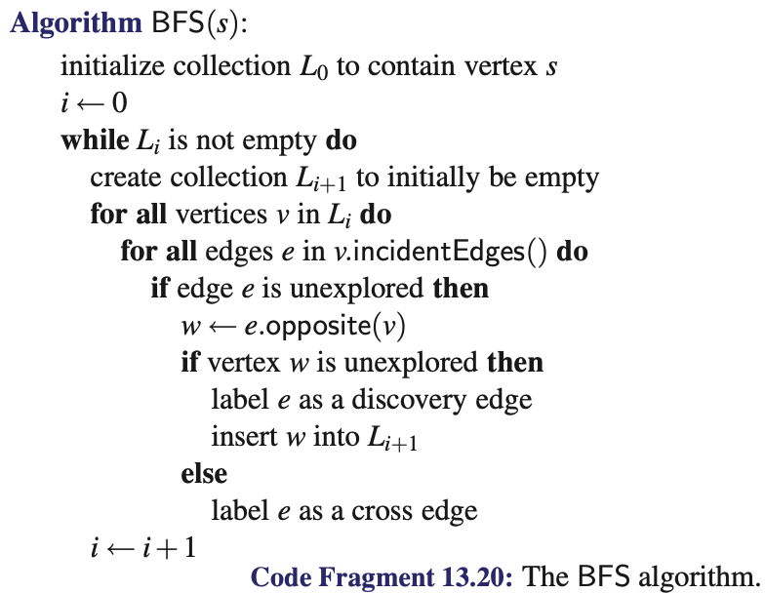
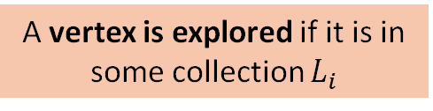
Breadth First Search (BFS, graph traversal)
A vertex is explored if it is in some collection $L_{i}$

Slide 26
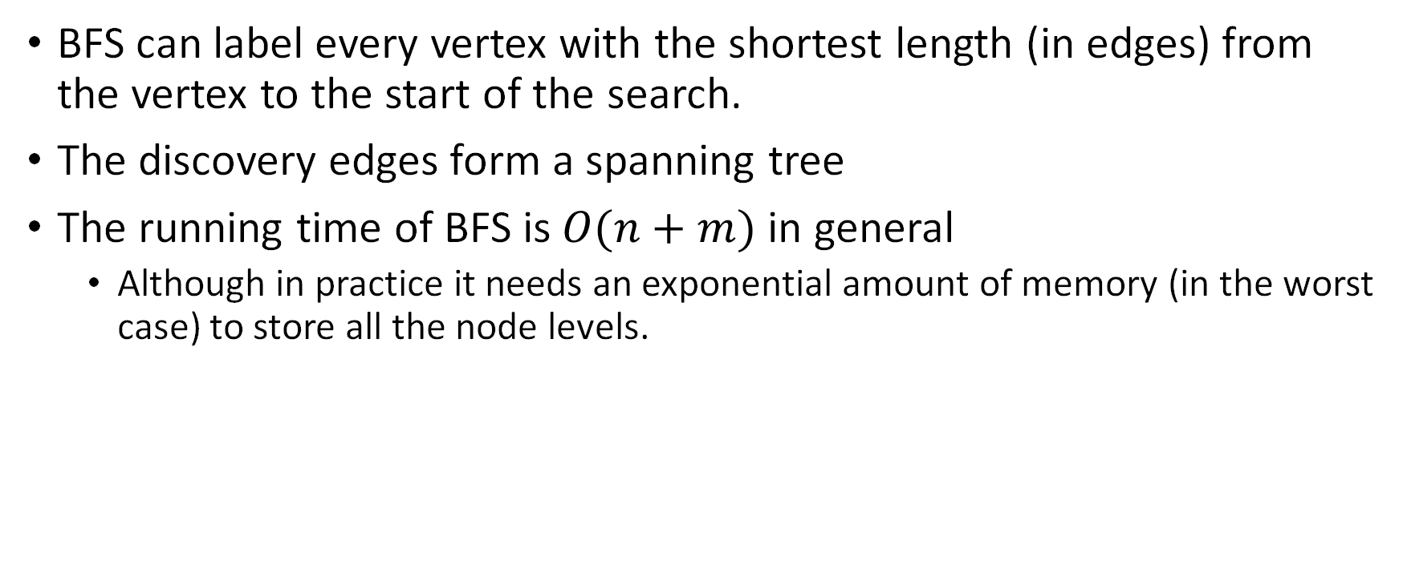
Breadth First Search (BFS, graph traversal)
BFS can label every vertex with the shortest length (in edges) from the vertex to the start of the search.
The discovery edges form a spanning tree
The running time of BFS is $O(n+m)$ in general
Although in practice it needs an exponential amount of memory (in the worst case) to store all the node levels.

Slide 27
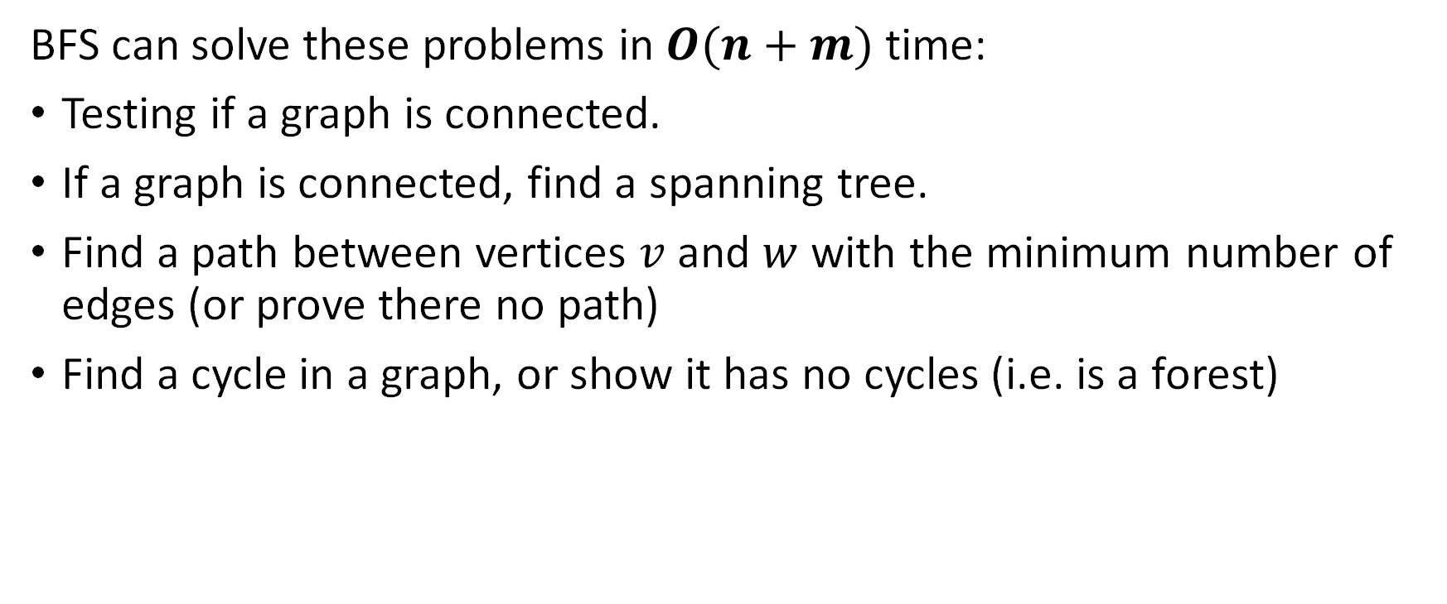
Breadth First Search (BFS, graph traversal)
BFS can solve these problems in $O(n+m)$ time:
Testing if a graph is connected.
If a graph is connected, find a spanning tree.
Find a path between vertices $v$ and $w$ with the minimum number of edges (or prove there no path)
Find a cycle in a graph, or show it has no cycles (i.e. is a forest)

Slide 28
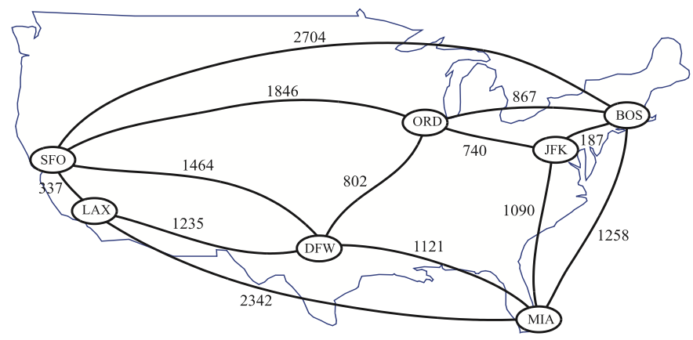
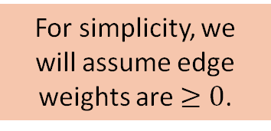
Weighted Graphs
For simplicity, we will assume edge weights are $≥0$.
In practice it is often useful to put weights on edges
Weights could represent time, distance, cost, strength, etc.
A
3
B
4
2
1
C
2
E
D
5

Slide 29
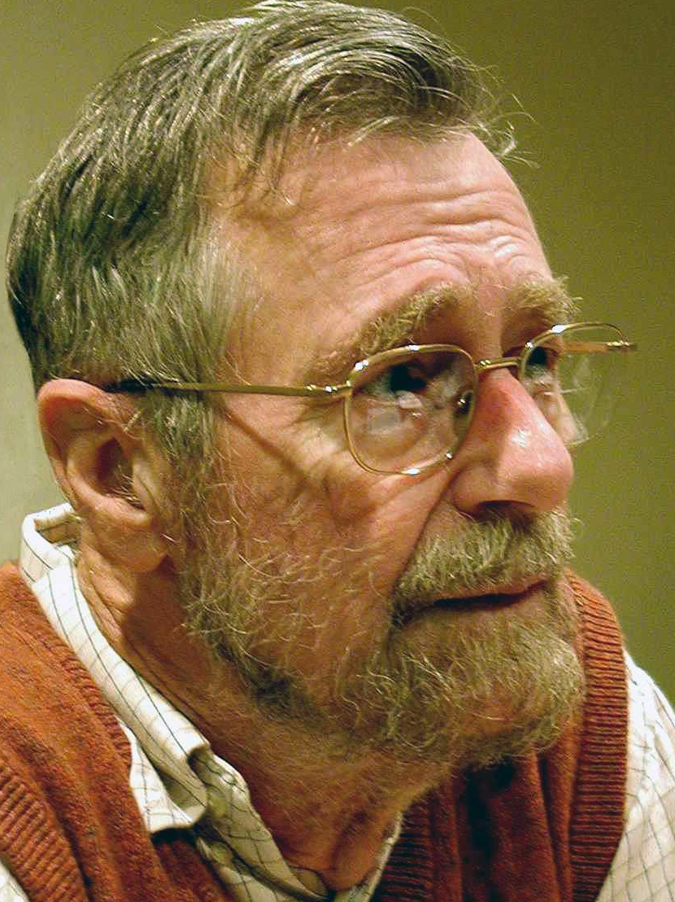
Dijkstra’s Algorithm (Shortest Path)
Dijkstra’s algorithm is a variation of breadth-first search.
It finds the shortest distance (in terms of edge weight sum) between a given starting node and all other nodes.
It can solve mazes and similar problems

Slide 30
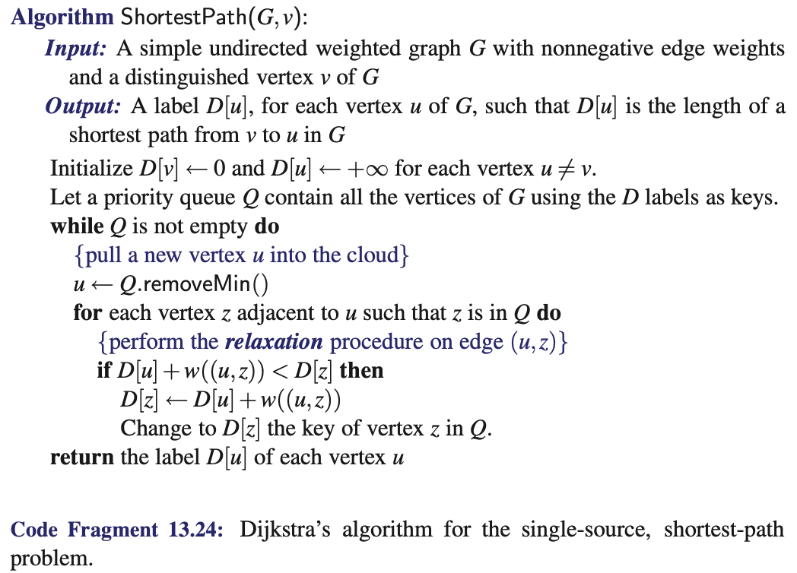

Dijkstra’s Algorithm (Shortest Path)

Slide 31
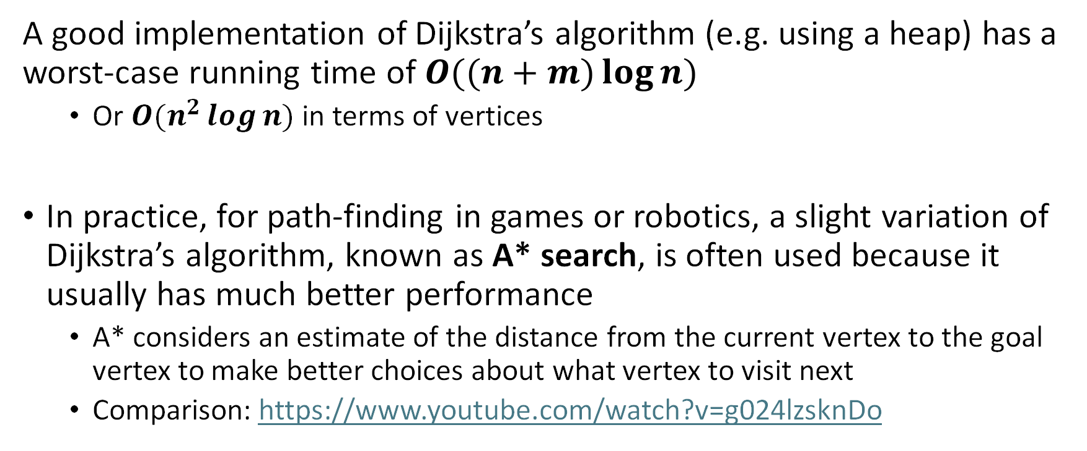
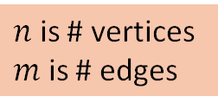
Dijkstra’s Algorithm (Shortest Path)
A good implementation of Dijkstra’s algorithm (e.g. using a heap) has a worst-case running time of $O((n+m)\log{n})$
Or $O(n^{2}\log{n})$ in terms of vertices
In practice, for path-finding in games or robotics, a slight variation of Dijkstra’s algorithm, known as A* search, is often used because it usually has much better performance
A* considers an estimate of the distance from the current vertex to the goal vertex to make better choices about what vertex to visit next
Comparison: https://www.youtube.com/watch?v=g024lzsknDo
$n$ is # vertices
$m$ is # edges

Slide 32
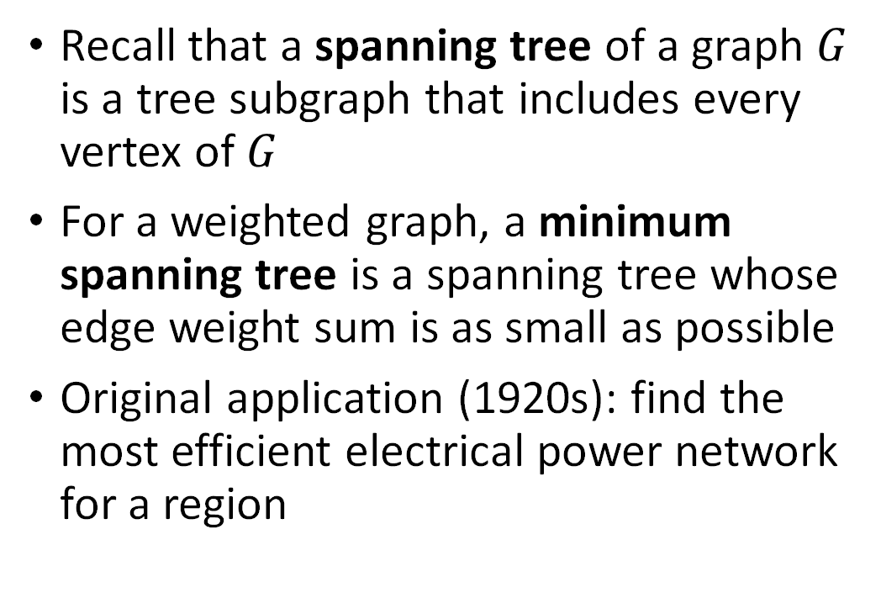
Minimum Spanning Trees
Recall that a spanning tree of a graph $G$ is a tree subgraph that includes every vertex of $G$
For a weighted graph, a minimum spanning tree is a spanning tree whose edge weight sum is as small as possible
Original application (1920s): find the most efficient electrical power network for a region

Slide 33
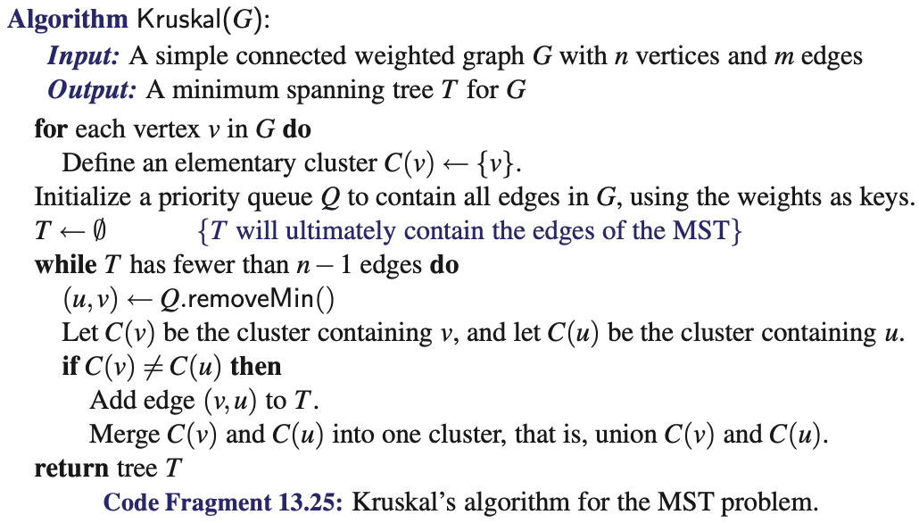
Kruskal’s Algorithm (Minimum Spanning Tree)
The text also discusses Prim’s algorithm, but we won’t cover that in this course.
Tracking clusters efficiently is typically done with the union-find algorithm.
this check prevents cycles

Slide 34
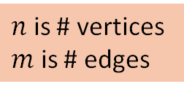

Kruskal’s Algorithm (Minimum Spanning Tree)
For a simply connected graph, a well-implemented version of Kruskal’s algorithm (using a heap and an efficient union-find algorithm for merging clusters) has running time $O(m\log{n})$
$n$ is # vertices
$m$ is # edges

