Slide 1
Sorting
Chp 11.1, 11.2, 11.3 of textbook

Slide 2
Topics
Simple but slow: insertion sort
Clever and fast: heap sort
Divide-and-conquer for sorting
Mergesort
Quicksort
Lower bounds for sorting
Bucket sort and radix sort

Slide 3
Sorting
Sorting is the problem of permutation a list of number (or strings, or values that can be ordered) from smallest to biggest.
Sorted: {}, {4}, {4, 9}, {3, 3, 3, 3}, {-2, 0, 5, 10, 14}, …
Unsorted: {9, 4}, {1, 2, 3, 4, 0, 5}, …
In practice, sorted data is very useful:
Binary search runs on it
Helps detect duplicates, make groups
Building blocks for other algorithms
Humans like things in sorted order
Databases, computer graphics, networking, …
When we say sorted order, we always mean arranged from smallest to biggest.
If the values are ordered from biggest to smallest, they are in reverse sorted order. We will always explicitly say if we mean reverse sorted order.

Slide 4
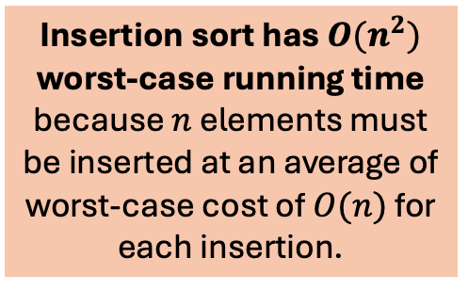
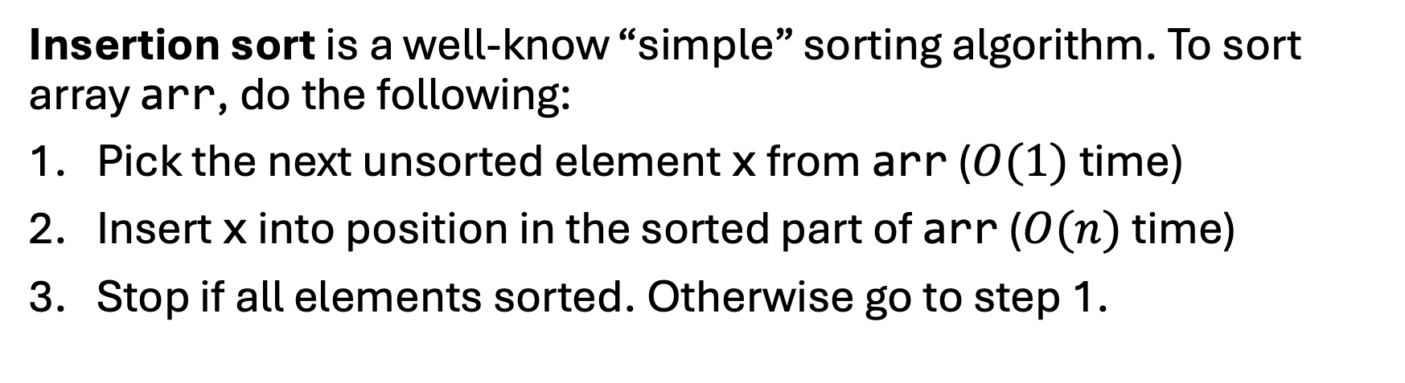
Simple Sorting
Insertion sort is a well-know “simple” sorting algorithm. To sort array arr, do the following:
Pick the next unsorted element x from arr ($O(1)$ time)
Insert x into position in the sorted part of arr ($O(n)$ time)
Stop if all elements sorted. Otherwise go to step 1.
Insertion sort has $O(n^{2})$ worst-case running time because $n$ elements must be inserted at an average of worst-case cost of $O(n)$ for each insertion.
Sorted part
Unsorted part

Slide 5
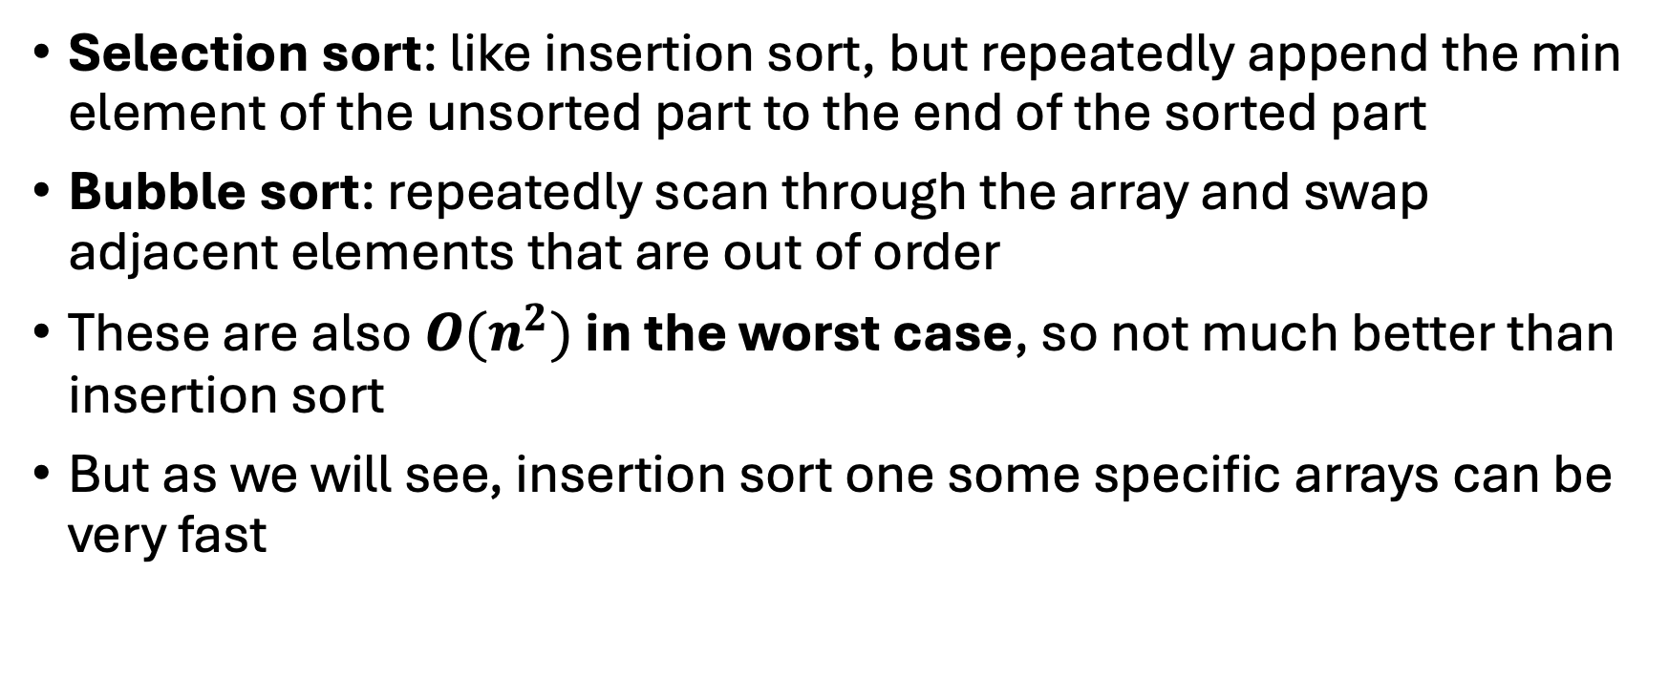
Other Simple Sorts
Selection sort: like insertion sort, but repeatedly append the min element of the unsorted part to the end of the sorted part
Bubble sort: repeatedly scan through the array and swap adjacent elements that are out of order
These are also $O(n^{2})$ in the worst case, so not much better than insertion sort
But as we will see, insertion sort one some specific arrays can be very fast

Slide 6
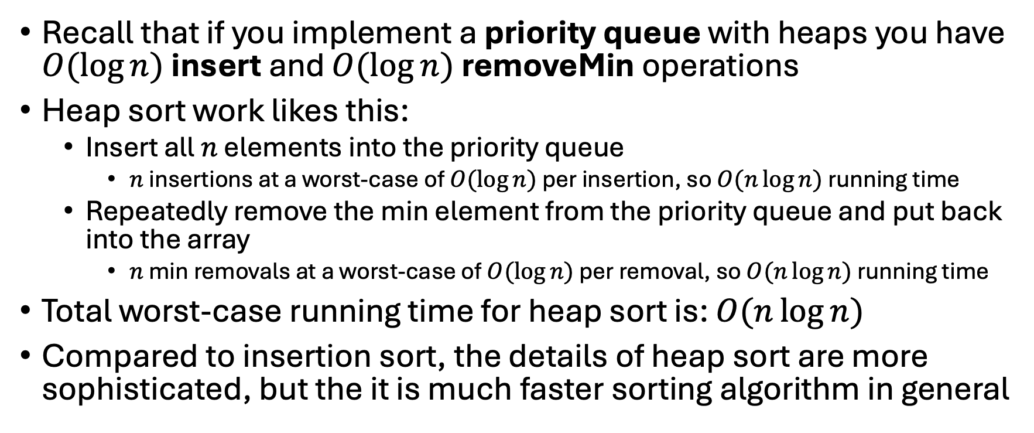
Heap Sort
Recall that if you implement a priority queue with heaps you have $O(\log{n})$ insert and $O(\log{n})$ removeMin operations
Heap sort work likes this:
Insert all $n$ elements into the priority queue
$n$ insertions at a worst-case of $O(\log{n})$ per insertion, so $O(n\log{n})$ running time
Repeatedly remove the min element from the priority queue and put back into the array
$n$ min removals at a worst-case of $O(\log{n})$ per removal, so $O(n\log{n})$ running time
Total worst-case running time for heap sort is: $O(n\log{n})$
Compared to insertion sort, the details of heap sort are more sophisticated, but the it is much faster sorting algorithm in general

Slide 7
Divide-and-Conquer for Sorting
Idea: to solve a big problem, divide it into small problems, solve the small problems, then combine those solutions to solve the big problem.
Applying divide and conquer to sorting:
Split the array into smaller arrays
Sort those smaller arrays
Re-combine the sorted arrays

Slide 8
Mergesort
function mergeSort(A):
n = A.size()
if n <= 1:
return A
mid = n / 2
left = A[0 .. mid-1]
right = A[mid .. n-1]
return merge(mergeSort(left), mergeSort(right))
Mergesort chops the array into two equal halves, sorts each half, and then recombines the sorting halves by merging them.

Slide 9
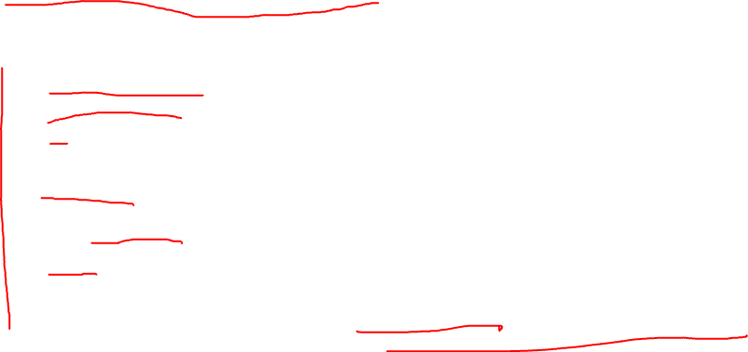
Merge
A and B must sorted arrays
A
function merge(A, B): C = new array of size A.size() + B.size() i = 0 // index into A j = 0 // index into B
for k = 0 to C.size() - 1:
if i >= A.size(): // A is exhausted C[k] = B[j] j = j + 1
else if j >= B.size(): // B is exhausted C[k] = A[i] i = i + 1 else if A[i] <= B[j]: // pick from A C[k] = A[i] i = i + 1 else: // pick from B C[k] = B[j] j = j + 1
return C
i
B
j
The smaller of A[i] or A[j] is copied into C[k]. i or j is incremented (depending which was chosen), and then k is incremented.
C
k

Slide 10
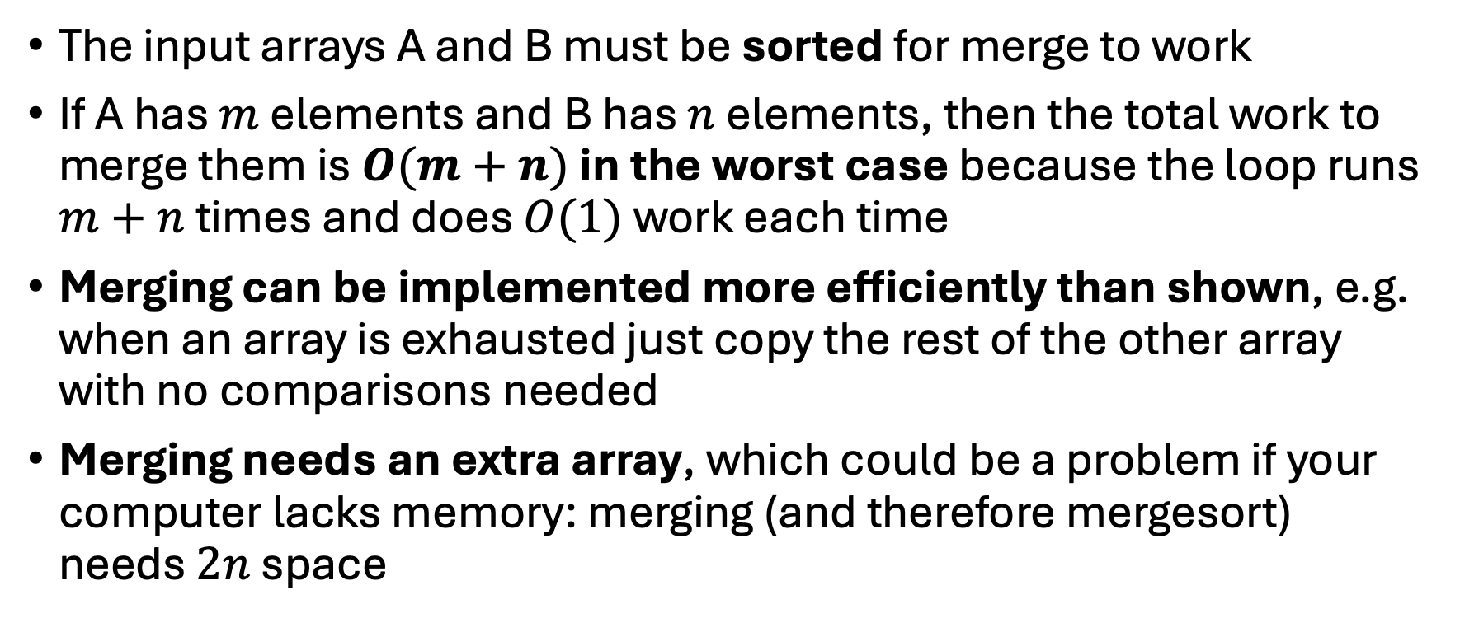
Merging
The input arrays A and B must be sorted for merge to work
If A has $m$ elements and B has $n$ elements, then the total work to merge them is $O(m+n)$ in the worst case because the loop runs $m+n$ times and does $O(1)$ work each time
Merging can be implemented more efficiently than shown, e.g. when an array is exhausted just copy the rest of the other array with no comparisons needed
Merging needs an extra array, which could be a problem if your computer lacks memory: merging (and therefore mergesort) needs $2n$ space

Slide 11
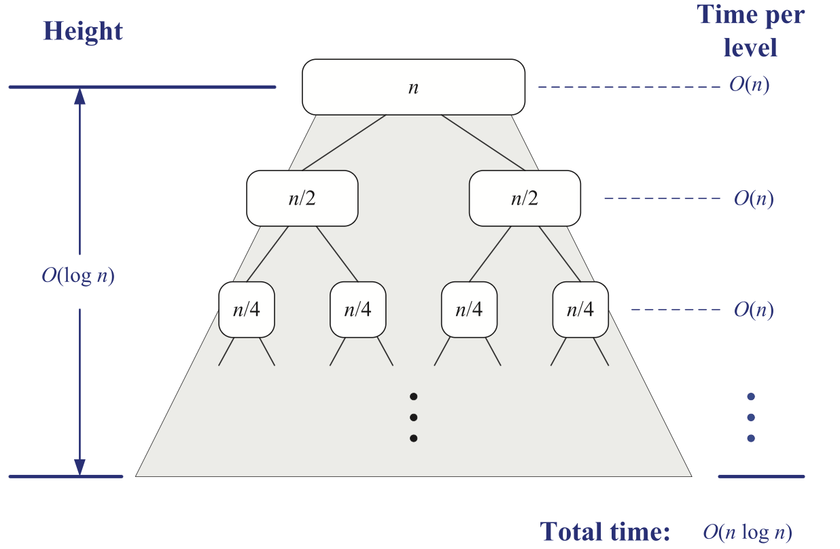
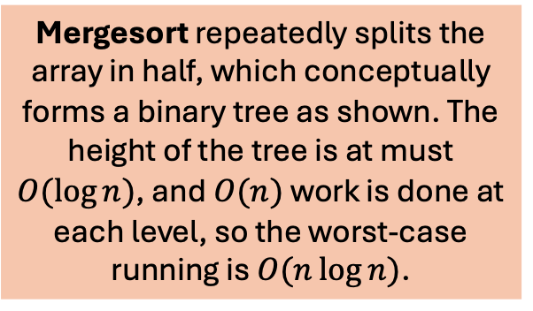
Mergesort Performance
Mergesort repeatedly splits the array in half, which conceptually forms a binary tree as shown. The height of the tree is at must $O(\log{n})$, and $O(n)$ work is done at each level, so the worst-case running is $O(n\log{n})$.

Slide 12
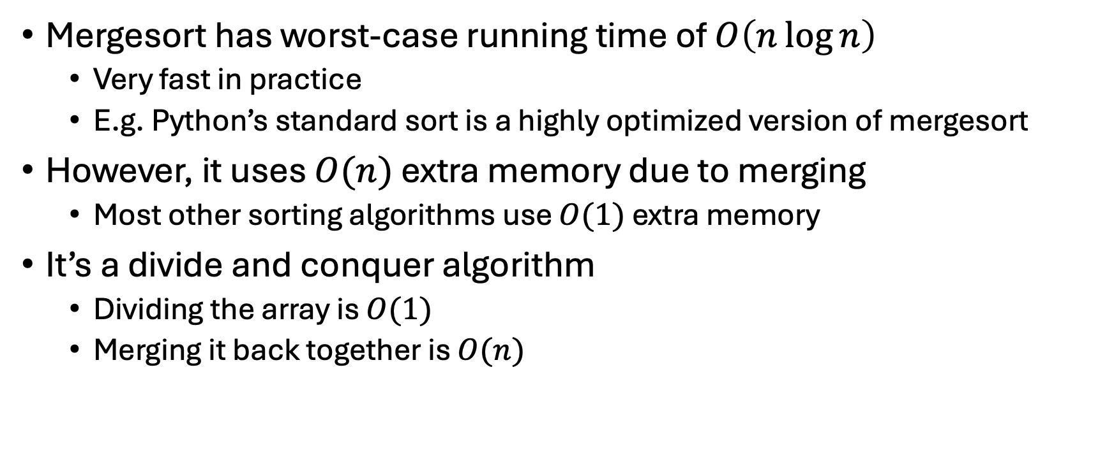
Mergesort
Mergesort has worst-case running time of $O\left(n\log{n}\right)$
Very fast in practice
E.g. Python’s standard sort is a highly optimized version of mergesort
However, it uses $O(n)$ extra memory due to merging
Most other sorting algorithms use $O(1)$ extra memory
It’s a divide and conquer algorithm
Dividing the array is $O(1)$
Merging it back together is $O(n)$

Slide 13
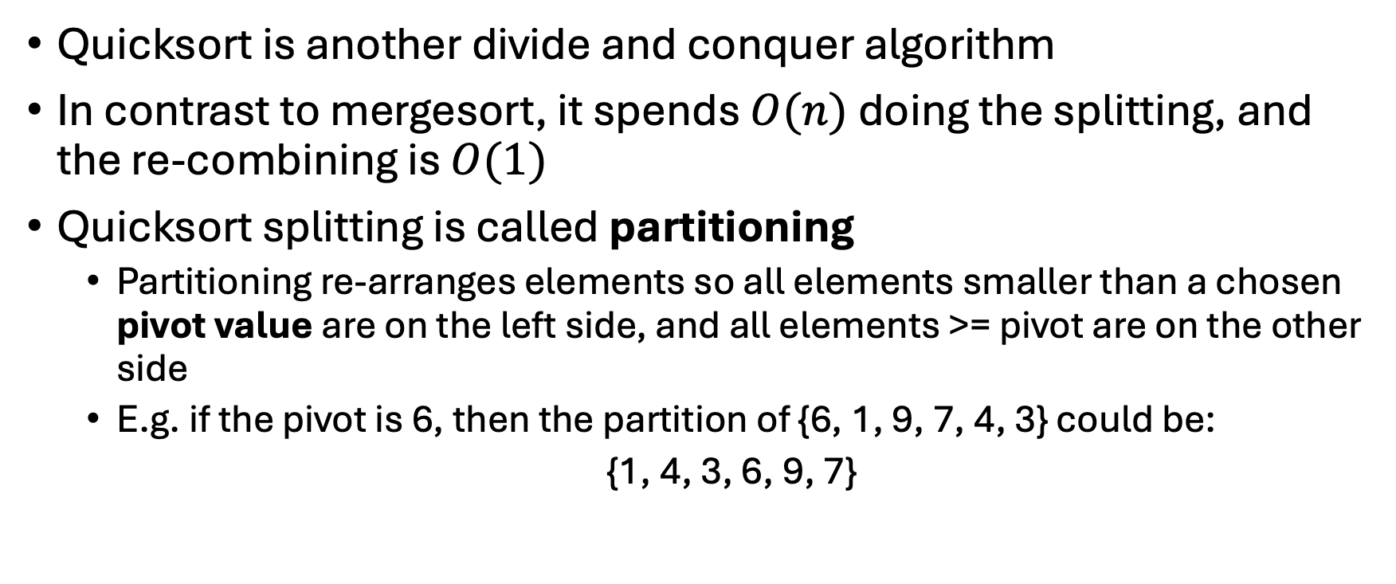
Quicksort
Quicksort is another divide and conquer algorithm
In contrast to mergesort, it spends $O(n)$ doing the splitting, and the re-combining is $O(1)$
Quicksort splitting is called partitioning
Partitioning re-arranges elements so all elements smaller than a chosen pivot value are on the left side, and all elements >= pivot are on the other side
E.g. if the pivot is 6, then the partition of {6, 1, 9, 7, 4, 3} could be:
{1, 4, 3, 6, 9, 7}
If you now sort both sides of the partition, the entire array is sorted.

Slide 14
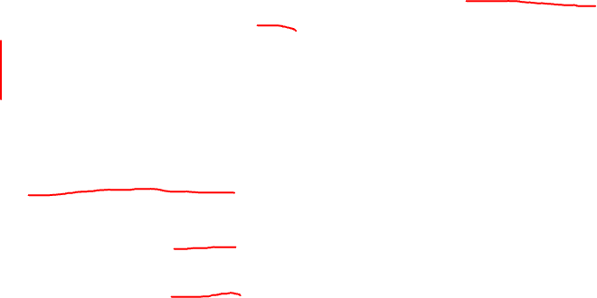
Quicksort
lo
hi
function quicksort(A, lo, hi):
if lo >= hi: // base case: 0 or 1 element, already sorted
return
p = partition(A, lo, hi) // partition and get pivot's final index
quicksort(A, lo, p - 1) // sort left of pivot
quicksort(A, p + 1, hi) // sort right of pivot

Slide 15
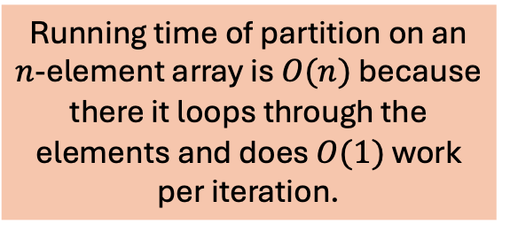
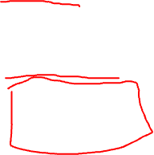
Partition
Choosing the pivot this way is the default strategy, but there are other ways to do it!
function partition(A, lo, hi):
pivot = A[hi] // choose last element as pivot
i = low - 1 // boundary of "elements <= pivot"
for j = lo to hi - 1:
if A[j] <= pivot:
i = i + 1
swap(A[i], A[j])
swap(A[i + 1], A[hi]) // move pivot into its final position
return i + 1 // pivot's final index
Running time of partition on an $n$-element array is $O(n)$ because there it loops through the elements and does $O(1)$ work per iteration.

Slide 16
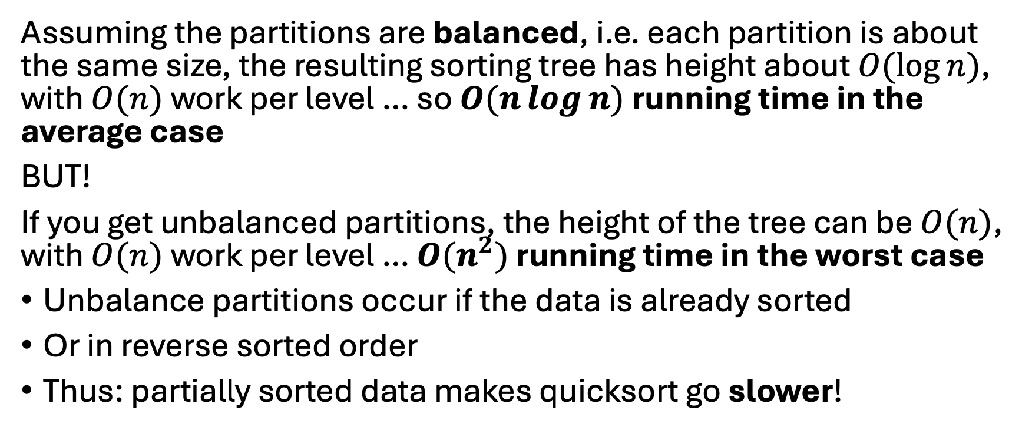
Quicksort Performance
Assuming the partitions are balanced, i.e. each partition is about the same size, the resulting sorting tree has height about $O(\log{n})$, with $O(n)$ work per level … so $O(n\log{n})$ running time in the average case
BUT!
If you get unbalanced partitions, the height of the tree can be $O(n)$, with $O(n)$ work per level … $O(n^{2})$ running time in the worst case
Unbalance partitions occur if the data is already sorted
Or in reverse sorted order
Thus: partially sorted data makes quicksort go slower!

Slide 17
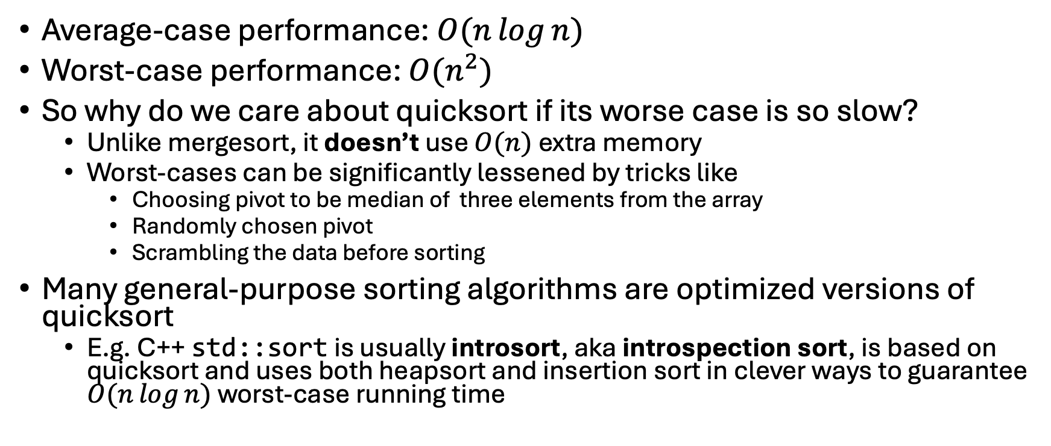
Quicksort Performance
Average-case performance: $O(n\log{n})$
Worst-case performance: $O(n^{2})$
So why do we care about quicksort if its worse case is so slow?
Unlike mergesort, it doesn’t use $O(n)$ extra memory
Worst-cases can be significantly lessened by tricks like
Choosing pivot to be median of three elements from the array
Randomly chosen pivot
Scrambling the data before sorting
Many general-purpose sorting algorithms are optimized versions of quicksort
E.g. C++ std::sort is usually introsort, aka introspection sort, is based on quicksort and uses both heapsort and insertion sort in clever ways to guarantee $O(n\log{n})$ worst-case running time

Slide 18
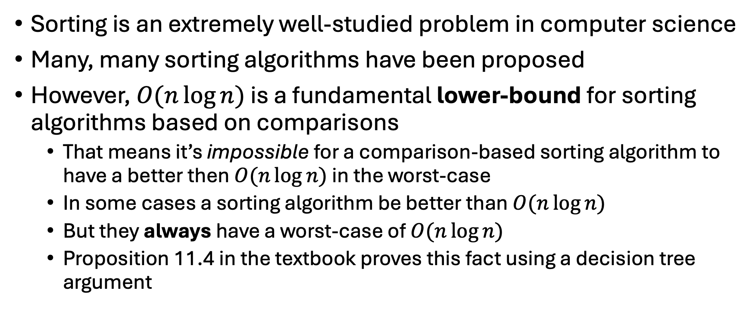
Sorting: Lower Bound
Sorting is an extremely well-studied problem in computer science
Many, many sorting algorithms have been proposed
However, $O(n\log{n})$ is a fundamental lower-bound for sorting algorithms based on comparisons
That means it’s impossible for a comparison-based sorting algorithm to have a better then $O(n\log{n})$ in the worst-case
In some cases a sorting algorithm be better than $O(n\log{n})$
But they always have a worst-case of $O(n\log{n})$
Proposition 11.4 in the textbook proves this fact using a decision tree argument

Slide 19
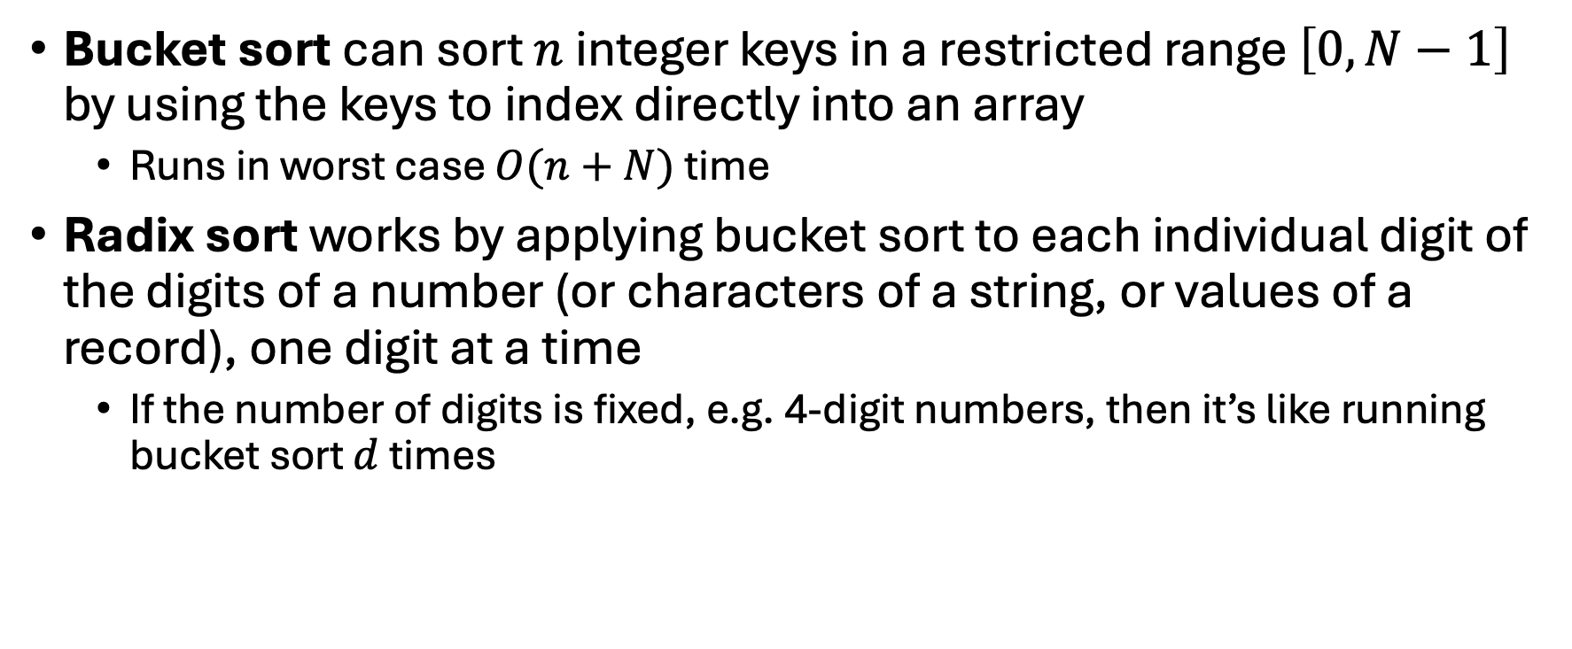
Faster Sorts
Bucket sort can sort $n$ integer keys in a restricted range $\left[0,N−1\right]$ by using the keys to index directly into an array
Runs in worst case $O(n+N)$ time
Radix sort works by applying bucket sort to each individual digit of the digits of a number (or characters of a string, or values of a record), one digit at a time
If the number of digits is fixed, e.g. 4-digit numbers, then it’s like running bucket sort $d$ times

Slide 20
Comparing Sorting
We usually talk about number of comparisons because that approximates the actual running time of many sorts very well
But “data moves” can also matter, i.e. how many swaps or insertions are done
Plus code outside of the comparisons matters too, and running time can often be improved doing less (or faster) work between comparisons
In general, built-in sorting routines like std::sort are generally well-tested and efficient for many different types of data

