Slide 1
Maps and Hashing
Chp 9.1, 9.2 of textbook
(we are skipping skiplists)

Slide 2

Topics
Why are heaps height $\log{n}$?
The Map ADT
Hash tables
Bucket arrays
Hash functions
Hash codes
Polynomial hash codes
Collision resolution schemes
Linear probing
Quadratic probing
Double hashing
Load factors and rehashing
Deletion with tombstones
Hash tables in practice

Slide 3
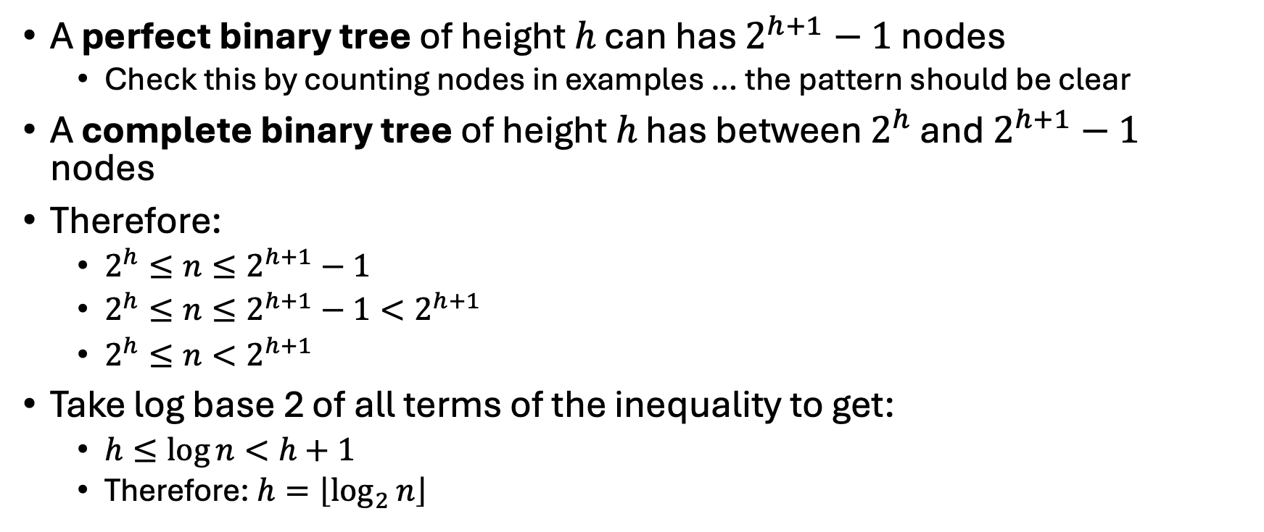


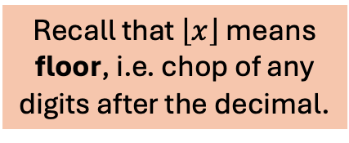
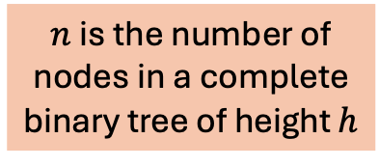
Why Are Heaps height $\log{n}$?
A perfect binary tree of height $h$ can has $2^{h+1}−1$ nodes
Check this by counting nodes in examples … the pattern should be clear
A complete binary tree of height $h$ has between $2^{h}$ and $2^{h+1}−1$ nodes
Therefore:
$2^{h}≤n≤2^{h+1}−1$
$2^{h}≤n≤2^{h+1}−1<2^{h+1}$
$2^{h}≤n<2^{h+1}$
Take log base 2 of all terms of the inequality to get:
$h≤\log{n<h+1}$
Therefore: $h=\left\lfloor \log_{2}{n}\right\rfloor$
$n$ is the number of nodes in a complete binary tree of height $h$
Recall that $\left\lfloor x\right\rfloor$ means floor, i.e. chop of any digits after the decimal.

Slide 4

The Map ADT
size(), is_empty() // O(1) as usual
// returns the value associated with key;
// error if there is no such key
T find(key) // returns value
// puts (key, value) in the map; // if key is already in the map,
// overwrite the value
void put(key, T value)
// removes the pair associated with key // from the map
void remove(key)
The Map ADT specifies a mini “database”
It stores (key, value) pairs
You can assume key is an int, but as we will see it can be any “hashable” type
We assume value of any type T
You add/remove/retrieve by using the key
If done right, it can be extremely fast
Designing a good practical map ADT is surprisingly challenging. A significant (and popular) feature of Python is that maps are part of the base language instead of an add-on from a library. So Python’s maps tend to be easier to use than C++ maps.

Slide 5
Simple Map Implementation
{("hamburger", 4.99),
("hot dog", 3.99), ("soup", 3.99),
("fries", 1.99)
}
An array of (key, value) pairs
Unordered pairs:
find(key):
put(key, value):
remove:

Slide 6

Simple Map Implementation
{("hamburger", 4.99),
("hot dog", 3.99), ("soup", 3.99),
("fries", 1.99)
}
An array of (key, value) pairs
Unordered pairs:
find(key): $O(n)$ using linear search
put(key, value): $O(n)$
remove: $O(n)$

Slide 7
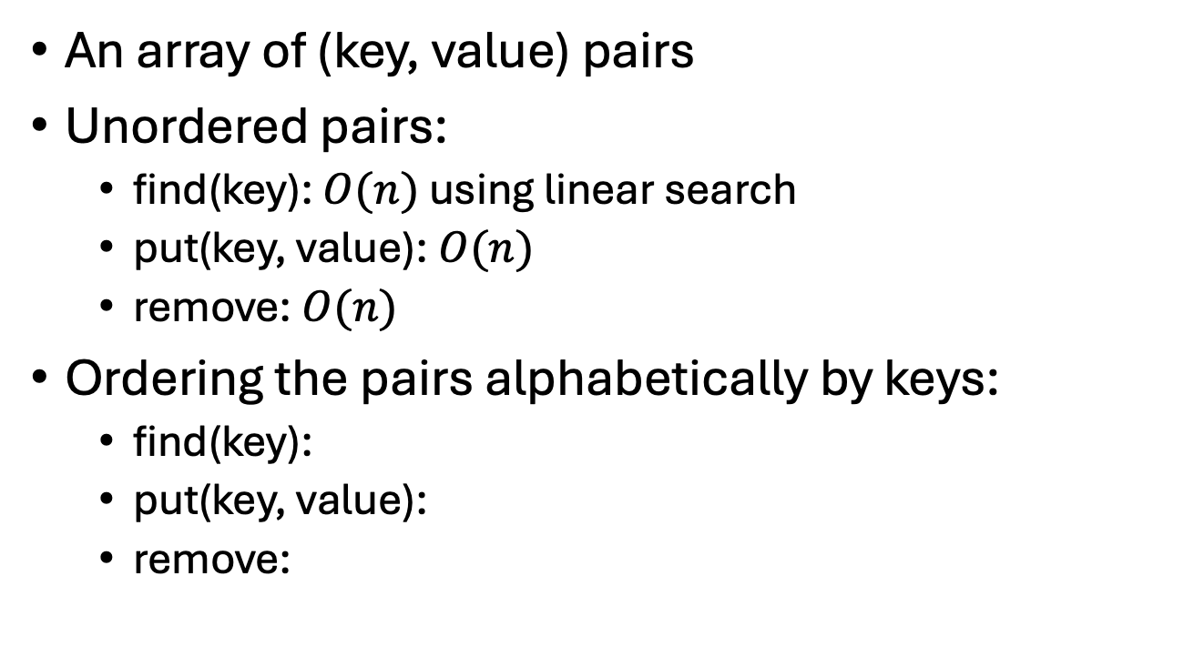
Simple Map Implementation
{("hamburger", 4.99),
("hot dog", 3.99), ("soup", 3.99),
("fries", 1.99)
}
An array of (key, value) pairs
Unordered pairs:
find(key): $O(n)$ using linear search
put(key, value): $O(n)$
remove: $O(n)$
Ordering the pairs alphabetically by keys:
find(key):
put(key, value):
remove:

Slide 8
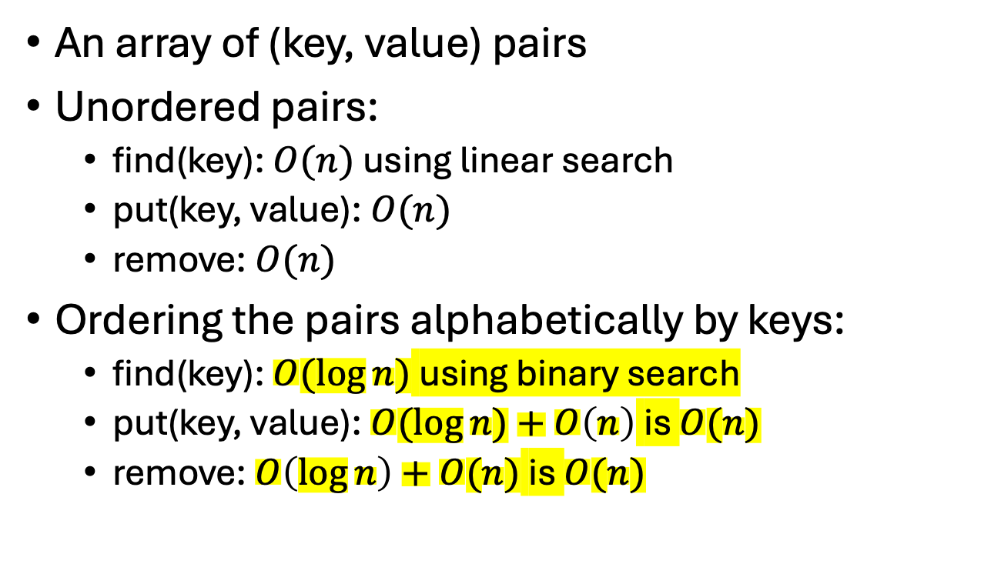
Simple Map Implementation
{("hamburger", 4.99),
("hot dog", 3.99), ("soup", 3.99),
("fries", 1.99)
}
An array of (key, value) pairs
Unordered pairs:
find(key): $O(n)$ using linear search
put(key, value): $O(n)$
remove: $O(n)$
Ordering the pairs alphabetically by keys:
find(key): $O(log⁡n)$ using binary search
put(key, value): $O(log⁡n)+O\left(n\right)$ is $O(n)$
remove: $O\left(\log{n}\right)+O(n)$ is $O(n)$

Slide 9
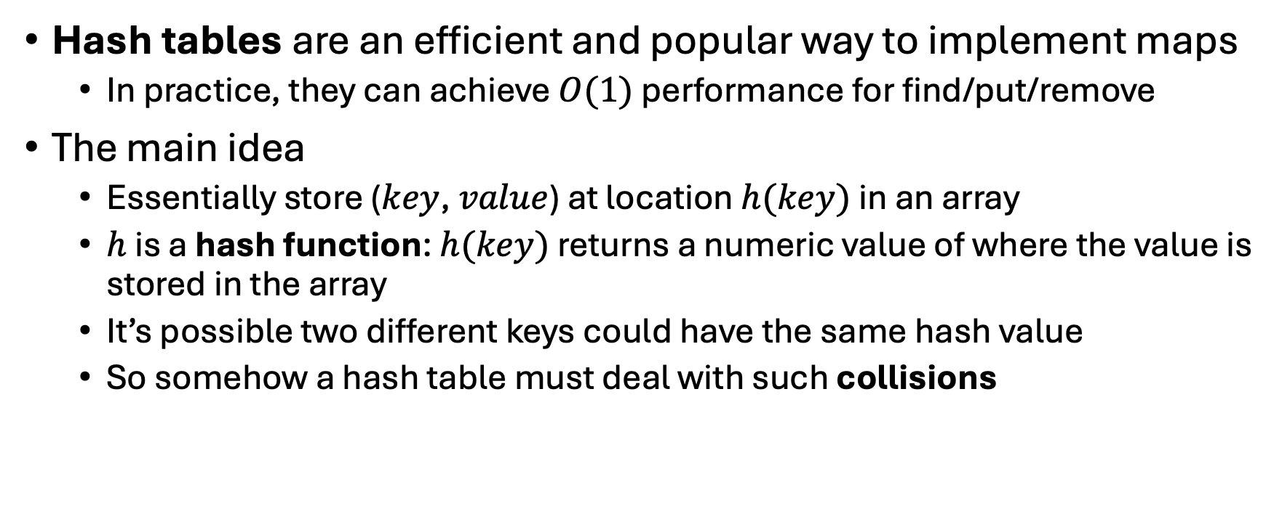
Hash Tables
Hash tables are an efficient and popular way to implement maps
In practice, they can achieve $O(1)$ performance for find/put/remove
The main idea
Essentially store ($key$, $value$) at location $h(key)$ in an array
$h$ is a hash function: $h(key)$ returns a numeric value of where the value is stored in the array
It’s possible two different keys could have the same hash value
So somehow a hash table must deal with such collisions

Slide 10
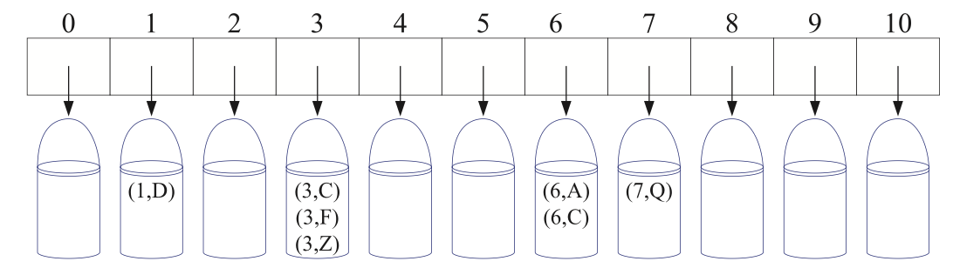
Bucket Array
Make an array of “buckets”
E.g. the buckets could be implemented as linked lists
Each location of the array can store 0 or more items
If the bucket is big, maybe spend a lot time searching it
If the array is big, could be a lot of wasted space
Requires keys are index values

Slide 11
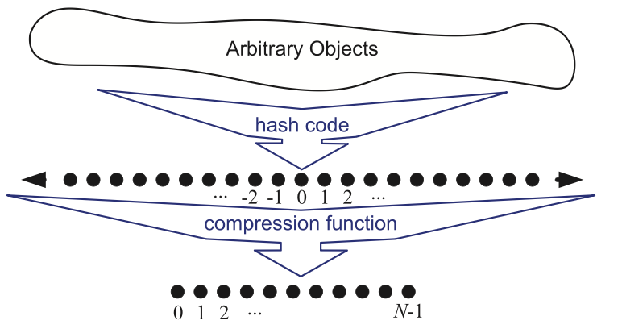
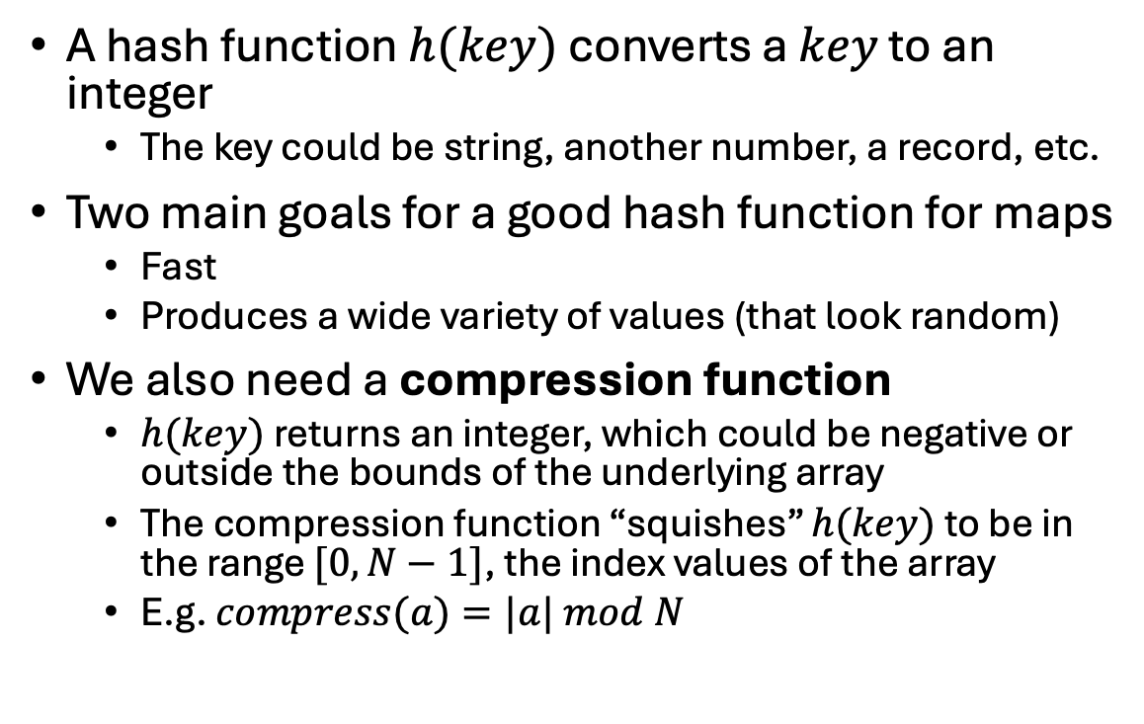

Hash Functions: $h(key)$
A hash function $h(key)$ converts a $key$ to an integer
The key could be string, another number, a record, etc.
Two main goals for a good hash function for maps
Fast
Produces a wide variety of values (that look random)
We also need a compression function
$h(key)$ returns an integer, which could be negative or outside the bounds of the underlying array
The compression function “squishes” $h(key)$ to be in the range $[0, N−1]$, the index values of the array
E.g. $compress(a)=|a| mod N$

Slide 12

String Hash Functions
A common hash function strategy for strings is
Convert the characters to their Unicode/ASCII code values
Somehow combine those values with a mathematical formula to get the hash value
E.g. "SPOT" has these character values: {83, 80, 79, 84}
You could just add them up
h("SPOT") = 83 + 80 + 79 + 84 = 326
But permutations of strings have the same hash value
h("POTS") = 84 + 80 + 79 + 83 = 326
h("POST") = 80 + 79 + 83 + 84 = 326

Slide 13
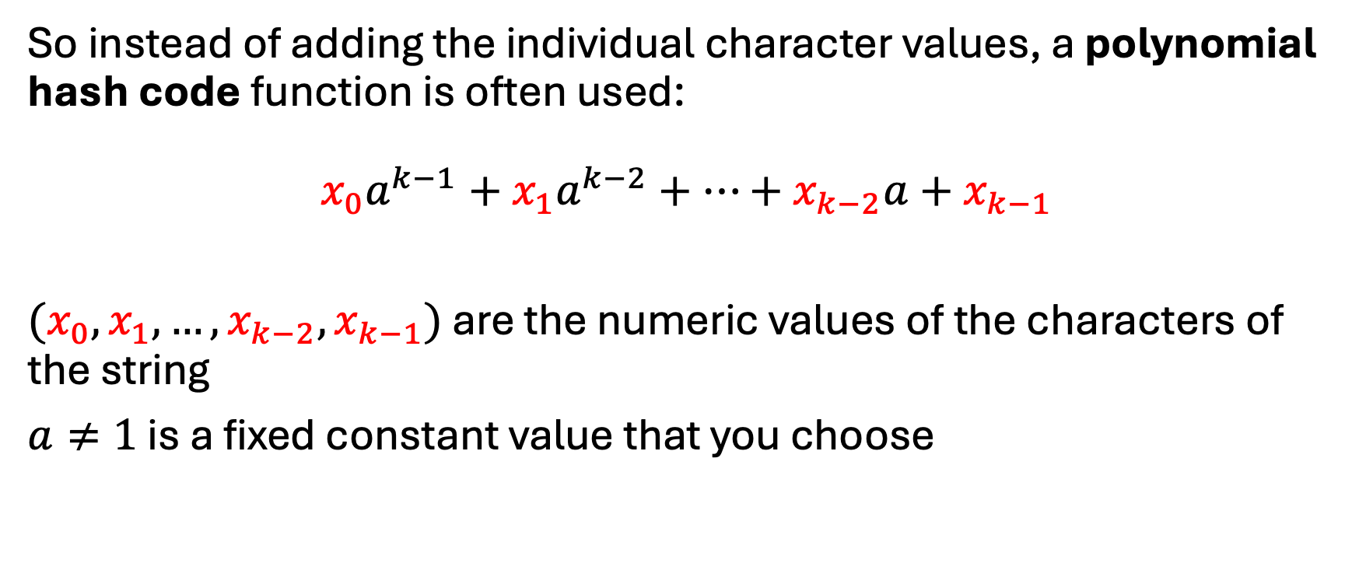

String Hash Functions
So instead of adding the individual character values, a polynomial hash code function is often used:
$$x_{0}a^{k−1}+x_{1}a^{k−2}+…+x_{k−2}a+x_{k−1}$$
$(x_{0}, x_{1}, …, x_{k−2}, x_{k−1})$ are the numeric values of the characters of the string
$a≠1$ is a fixed constant value that you choose

Slide 14
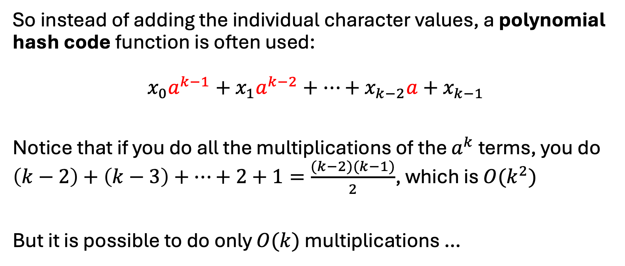
String Hash Functions
So instead of adding the individual character values, a polynomial hash code function is often used:
$$x_{0}a^{k−1}+x_{1}a^{k−2}+…+x_{k−2}a+x_{k−1}$$
Notice that if you do all the multiplications of the $a^{k}$ terms, you do $\left(k−2\right)+\left(k−3\right)+…+2+1=\frac{(k−2)(k−1)}{2}$, which is $O(k^{2})$
But it is possible to do only $O(k)$ multiplications …

Slide 15
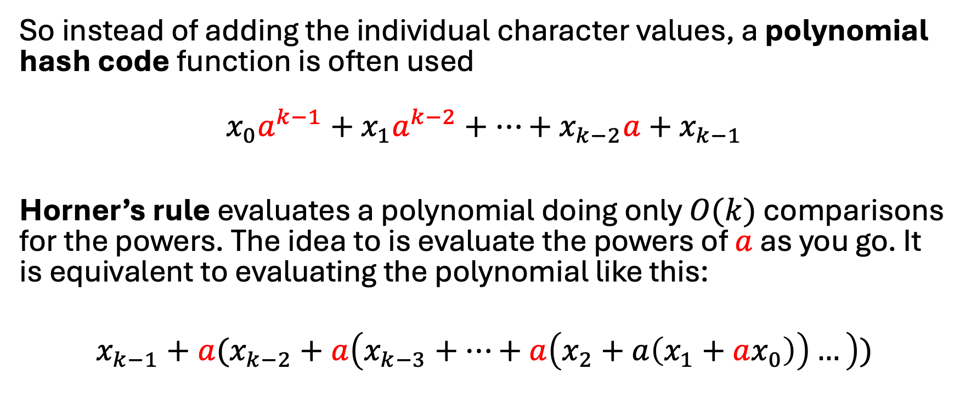
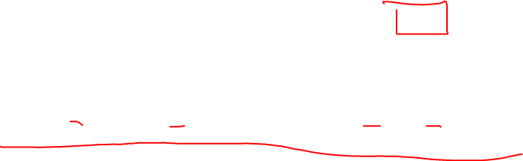
String Hash Functions
So instead of adding the individual character values, a polynomial hash code function is often used
$$x_{0}a^{k−1}+x_{1}a^{k−2}+…+x_{k−2}a+x_{k−1}$$
Horner’s rule evaluates a polynomial doing only $O(k)$ comparisons for the powers. The idea to is evaluate the powers of $a$ as you go. It is equivalent to evaluating the polynomial like this:
$$x_{k−1}+a(x_{k−2}+a\left(x_{k−3}+…+a\left(x_{2}+a\left(x_{1}+ax_{0}\right)\right)…\right))$$

Slide 16
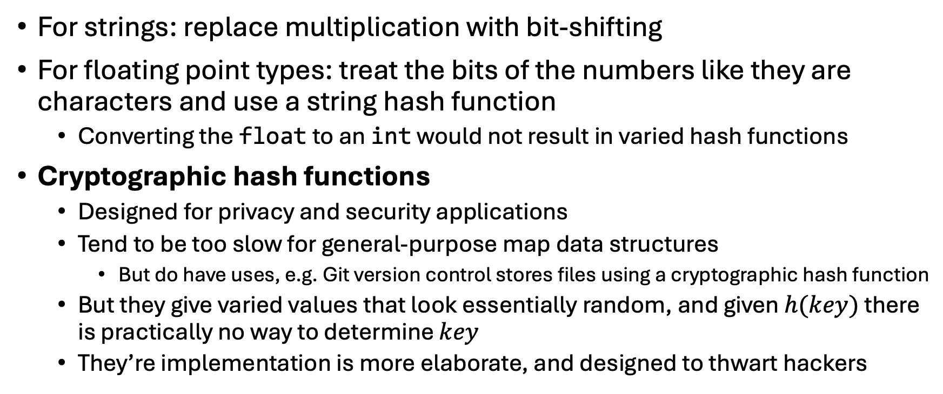
Other Hash Code Strategies
For strings: replace multiplication with bit-shifting
For floating point types: treat the bits of the numbers like they are characters and use a string hash function
Converting the float to an int would not result in varied hash functions
Cryptographic hash functions
Designed for privacy and security applications
Tend to be too slow for general-purpose map data structures
But do have uses, e.g. Git version control stores files using a cryptographic hash function
But they give varied values that look essentially random, and given $h(key)$ there is practically no way to determine $key$
They’re implementation is more elaborate, and designed to thwart hackers

Slide 17
Collision Resolutions Schemes
What do you do when two keys hash to the same location?
Could use a bucket array
If we store the values directly in an array, there are some common ways to resolve collisions
Linear probing
Quadratic probing
Double hashing
We now assume a single array of size N that stores the values

Slide 18
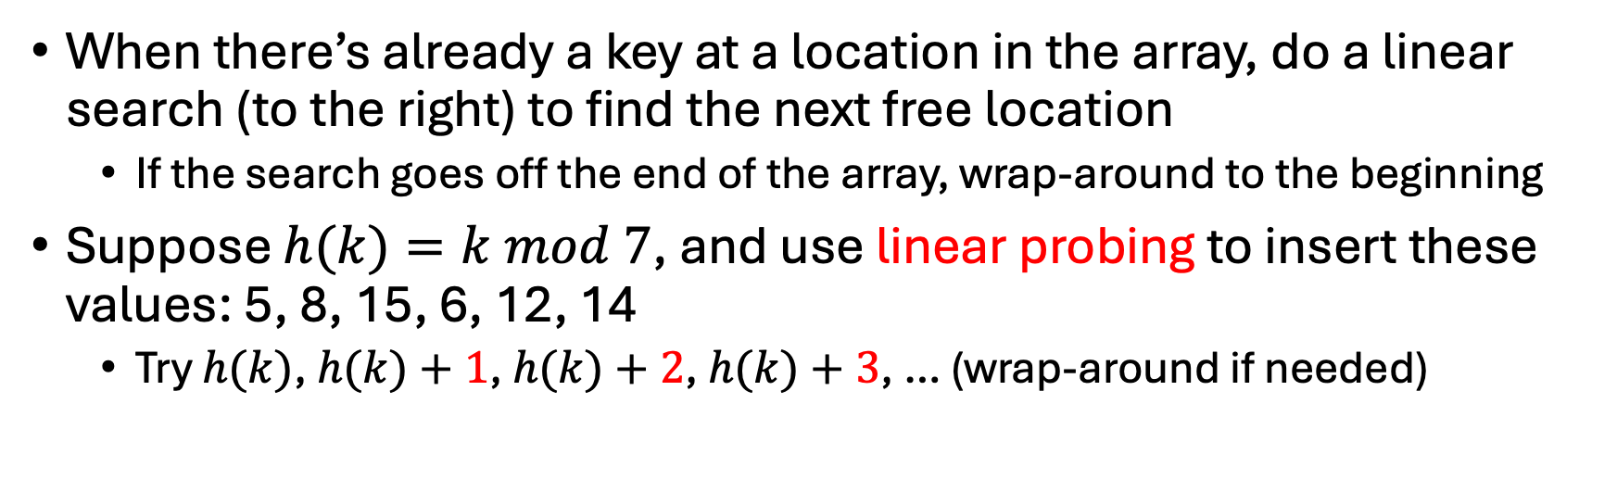
Collision Resolution: Linear Probing
When there’s already a key at a location in the array, do a linear search (to the right) to find the next free location
If the search goes off the end of the array, wrap-around to the beginning
Suppose $h(k)=k mod 7$, and use linear probing to insert these values: 5, 8, 15, 6, 12, 14
Try $h(k)$, $h(k)+1$, $h(k)+2$, $h(k)+3$, … (wrap-around if needed)
0 | 1 | 2 | 3 | 4 | 5 | 6

Slide 19
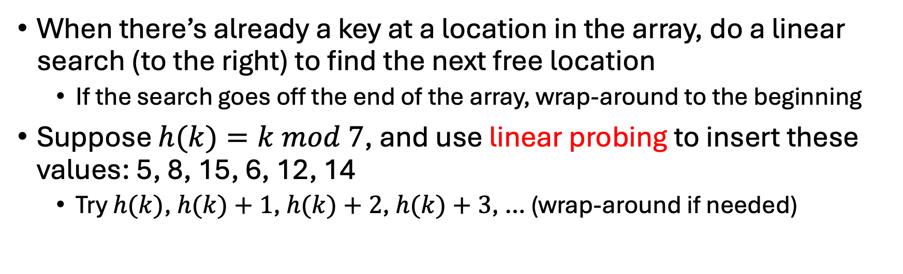
Collision Resolution: Linear Probing
When there’s already a key at a location in the array, do a linear search (to the right) to find the next free location
If the search goes off the end of the array, wrap-around to the beginning
Suppose $h(k)=k mod 7$, and use linear probing to insert these values: 5, 8, 15, 6, 12, 14
Try $h(k)$, $h(k)+1$, $h(k)+2$, $h(k)+3$, … (wrap-around if needed)
0 | 1 | 2 | 3 | 4 | 5 | 6
12 | 8 | 15 | 14 |  | 5 | 6

Slide 20
Collision Resolution: Linear Probing
When there’s already a key at a location in the array, do a linear search (to the right) to find the next free location
If the search goes off the end of the array, wrap-around to the beginning
Suppose $h(k)=k mod 7$, and use linear probing to insert these values: 5, 8, 15, 6, 12, 14
Try $h(k)$, $h(k)+1$, $h(k)+2$, $h(k)+3$, … (wrap-around if needed)
Problem: linear probing tends to cause values to cluster, known as primary clustering. Clusters significantly degrade performance.
0 | 1 | 2 | 3 | 4 | 5 | 6
12 | 8 | 15 | 14 |  | 5 | 6

Slide 21
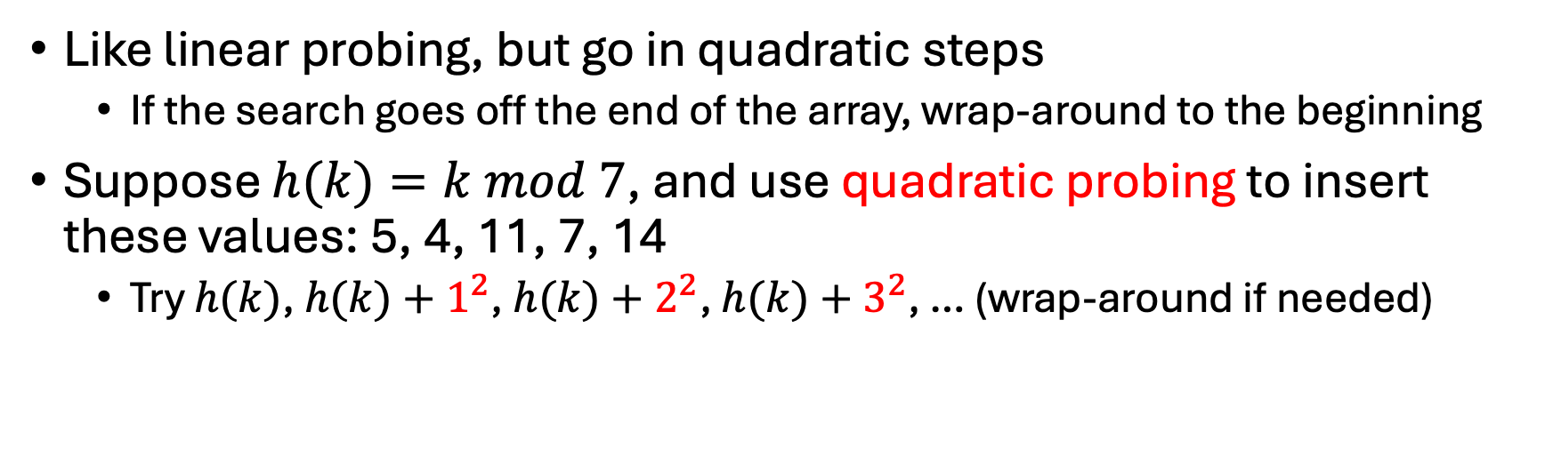
Collision Resolution: Quadratic Probing
Like linear probing, but go in quadratic steps
If the search goes off the end of the array, wrap-around to the beginning
Suppose $h(k)=k mod 7$, and use quadratic probing to insert these values: 5, 4, 11, 7, 14
Try $h(k)$, $h(k)+1^{2}$, $h(k)+2^{2}$, $h(k)+3^{2}$, … (wrap-around if needed)
0 | 1 | 2 | 3 | 4 | 5 | 6

Slide 22
Collision Resolution: Quadratic Probing
Like linear probing, but go in quadratic steps
If the search goes off the end of the array, wrap-around to the beginning
Suppose $h(k)=k mod 7$, and use quadratic probing to insert these values: 5, 4, 11, 7, 14
Try $h(k)$, $h(k)+1^{2}$, $h(k)+2^{2}$, $h(k)+3^{2}$, … (wrap-around if needed)
0 | 1 | 2 | 3 | 4 | 5 | 6
7 | 11 | 14 |  | 4 | 5

Slide 23
Collision Resolution: Quadratic Probing
Like linear probing, but go in quadratic steps
If the search goes off the end of the array, wrap-around to the beginning
Suppose $h(k)=k mod 7$, and use quadratic probing to insert these values: 5, 4, 11, 7, 14
Try $h(k)$, $h(k)+1^{2}$, $h(k)+2^{2}$, $h(k)+3^{2}$, … (wrap-around if needed)
Problem: quadratic probing avoids primary clustering, but can still have patterns called secondary clustering.
0 | 1 | 2 | 3 | 4 | 5 | 6
7 | 11 | 14 |  | 4 | 5

Slide 24
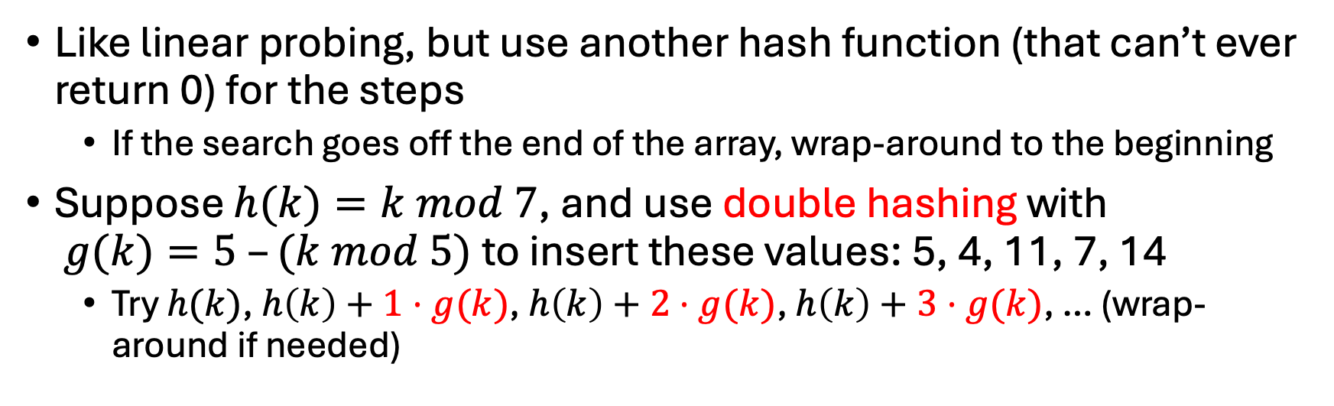
Collision Resolution: Double Hashing
Like linear probing, but use another hash function (that can’t ever return 0) for the steps
If the search goes off the end of the array, wrap-around to the beginning
Suppose $h(k)=k mod 7$, and use double hashing with $g(k)=5 –(k mod 5)$ to insert these values: 5, 4, 11, 7, 14
Try $h(k)$, $h\left(k\right)+1⋅g(k)$, $h\left(k\right)+2⋅g(k)$, $h\left(k\right)+3⋅g(k)$, … (wrap-around if needed)
0 | 1 | 2 | 3 | 4 | 5 | 6

Slide 25
Collision Resolution: Double Hashing
Like linear probing, but use another hash function (that can’t ever return 0) for the steps
If the search goes off the end of the array, wrap-around to the beginning
Suppose $h(k)=k mod 7$, and use double hashing with $g(k)=5 –(k mod 5)$ to insert these values: 5, 4, 11, 7, 14
Try $h(k)$, $h\left(k\right)+1⋅g(k)$, $h\left(k\right)+2⋅g(k)$, $h\left(k\right)+3⋅g(k)$, … (wrap-around if needed)
0 | 1 | 2 | 3 | 4 | 5 | 6
7 | 11 | 14 |  | 4 | 5

Slide 26
Deletion with Tombstones
In a hash table that uses linear probing or variations, you can’t just delete items
Deleting an item breaks the chain of items needed to find/put other items
Standard solution: tombstones
When you delete an item, but a tombstone in its place, i.e. mark it as deleted but not empty so that find/put keeps working
Over time tombstones can degrade performance, and so you may need to re-hash the table occasionally

Slide 27
Deletion with Tombstones
h(k) = k mod 7
0 | 1 | 2 | 3 | 4 | 5 | 6
12 | 8 | 15 | 14 |  | 5 | 6
If you delete 8 and replace it with an empty slot, then you can’t find 15!
0 | 1 | 2 | 3 | 4 | 5 | 6
12 |  | 15 | 14 |  | 5 | 6
0 | 1 | 2 | 3 | 4 | 5 | 6
12 |  | 15 | 14 |  | 5 | 6
Instead, flag it has “deleted” but not empty, so that the chain of elements is not broken.

Slide 28
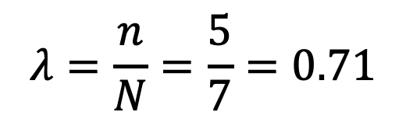


Load Factors and Rehashing
Load factor of a hash table of size $N$ containing $n$ keys:
$$λ=\frac{n}{N}$$
0 | 1 | 2 | 3 | 4 | 5 | 6
7 | 11 | 14 |  | 4 | 5
$$λ=\frac{n}{N}=\frac{5}{7}=0.71$$
Rule of Thumb When load factors is over 0.5, performance may degrade. Therefore, re-make the table by doubling the size of the underlying array and re-hashing all the values.

Slide 29
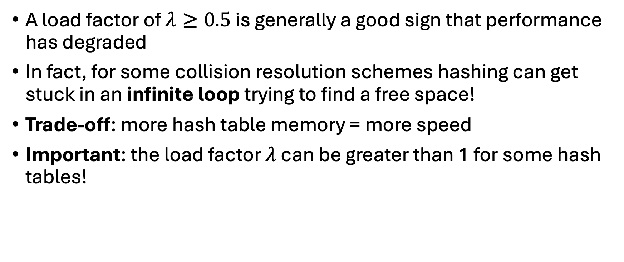
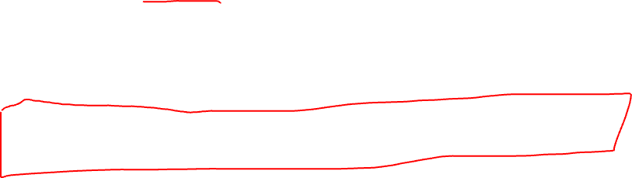
Load Factors and Rehashing
A load factor of $λ≥0.5$ is generally a good sign that performance has degraded
In fact, for some collision resolution schemes hashing can get stuck in an infinite loop trying to find a free space!
Trade-off: more hash table memory = more speed
Important: the load factor $λ$ can be greater than 1 for some hash tables!

Slide 30
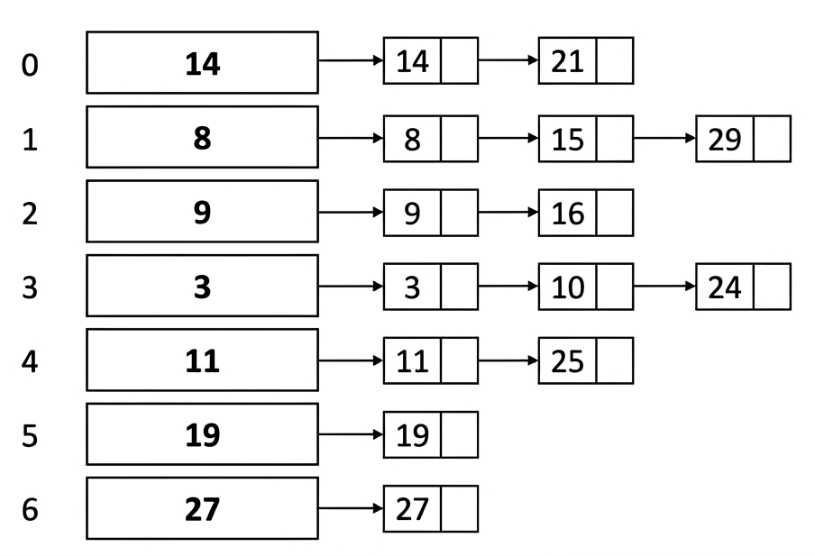
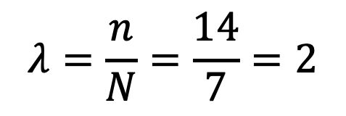
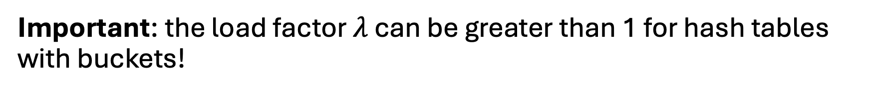
Load Factors and Rehashing
Important: the load factor $λ$ can be greater than 1 for hash tables with buckets!
$$λ=\frac{n}{N}=\frac{14}{7}=2$$

Slide 31
Performance Puzzle
How many people need to be in room so there is a better than 50% chance that two more people have the same birthday?

Slide 32
Hash Tables in Practice
Hash tables and maps are very common in practice
When implemented well, they can have excellent performance
They beat binary search
But the details matter, and they can be subtle, e.g.
The constants in hash functions can make a big difference
Prime table sizes are usually used to avoid loops and clusters
Experiments are generally needed to know if one hashing approach is better than another
We’ve only scratched the surface of hashing!
Many other ideas and schemes and approaches --- a vast and rich topic of study!

