Slide 1
Binary Search Trees (BSTs)
Chapter 10.1, 10.2

Slide 2
Binary Search Trees (BSTs)
Binary search trees (BSTs) area a variation of binary trees designed for storing data.
If implemented well, they can be efficient ways to store ordered data as a map.
E.g. the Linux kernel uses red-black BSTs for its scheduling system

Slide 3
Definition of a Tree
This is the definition of a tree (not yet binary, not yet a BST).
A tree T is a set of nodes storing elements in a parent-child relationship with the following properties:
If T is nonempty, it has a special node, called the root of T , that has no parent.
Each node v of T different from the root has a unique parent node w; every node with parent w is a child of w.
(textbook p. 269)

Slide 4
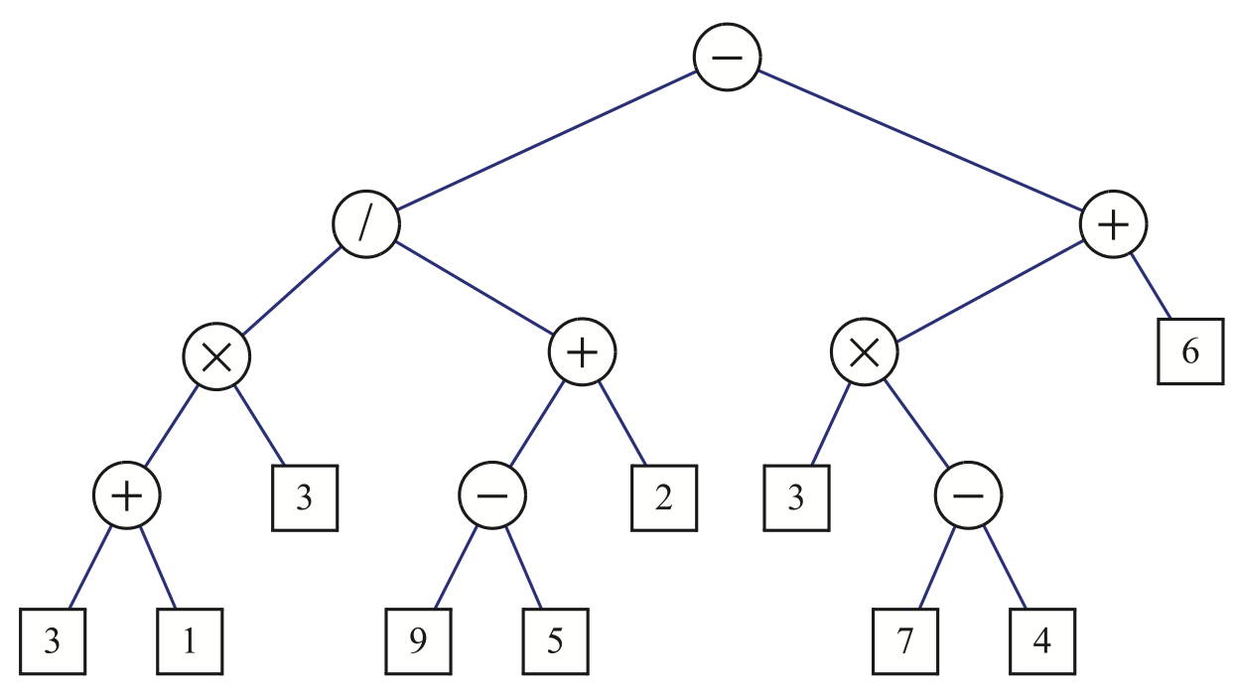
Binary Trees
Ordered means that the order of the node’s children matters.
A binary tree is an ordered tree where each node has:
Every node has at most 2 children
Each child is labelled as left or right
The left child comes before the right child in the ordering of nodes
This is not binary search tree yet. It’s just a binary tree.

Slide 5
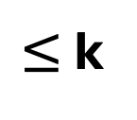
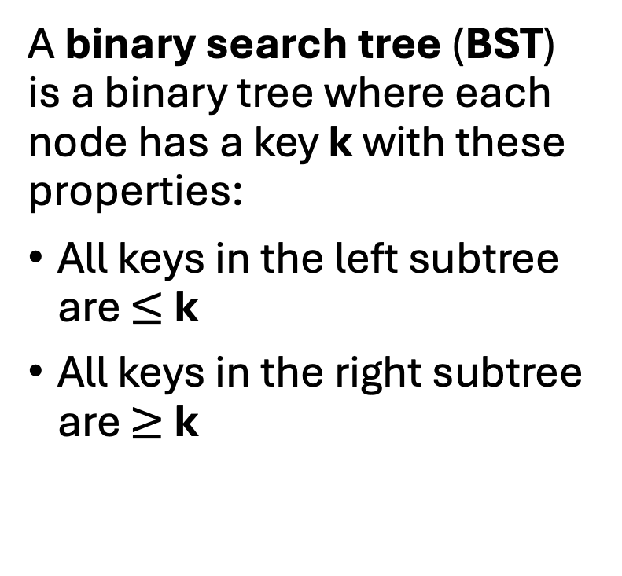
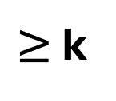
Binary Search Trees
k
A binary search tree (BST) is a binary tree where each node has a key k with these properties:
All keys in the left subtree are $≤$ k
All keys in the right subtree are $≥$ k
$≤$ k
$≥$ k
left subtree
right subtree

Slide 6
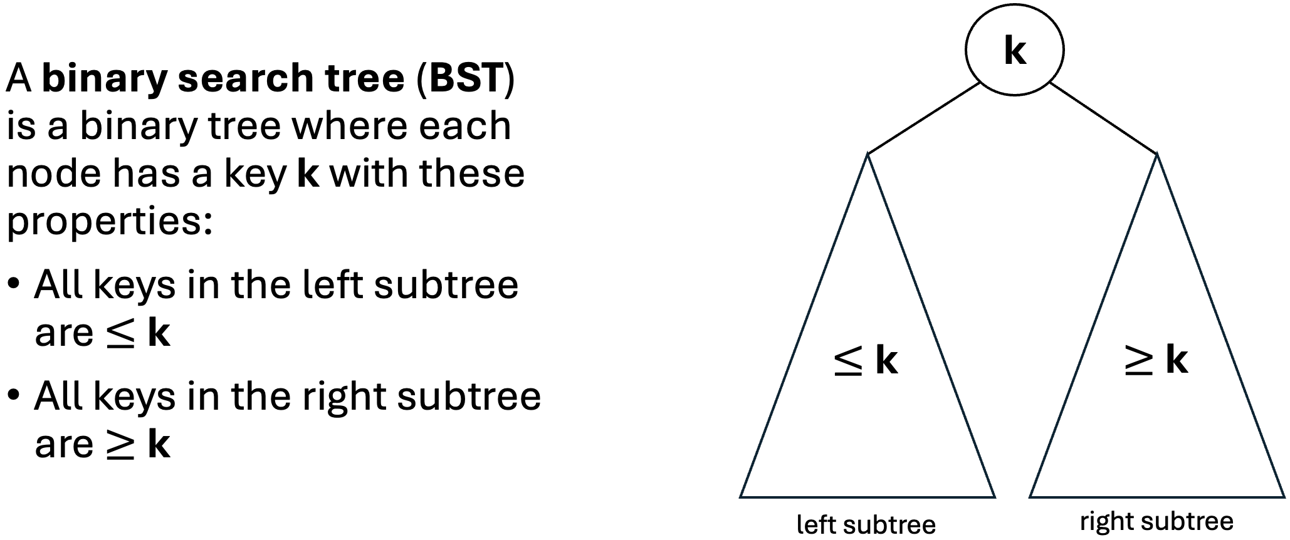
Binary Search Tree Examples
a BST?
5

Slide 7
Binary Search Tree Examples
a BST
5

Slide 8
Binary Search Tree Examples
a BST
a BST
5
5
2

Slide 9
Binary Search Tree Examples
a BST
a BST?
5
5
2

Slide 10
Binary Search Tree Examples
a BST
a BST
a BST?
5
5
5
2
2
4

Slide 11
Binary Search Tree Examples
a BST
a BST
a BST
5
5
5
2
2
4

Slide 12
Binary Search Tree Examples
a BST
a BST
a BST
5
5
5
2
2
4
a BST?
5
8

Slide 13
Binary Search Tree Examples
a BST
a BST
a BST
5
5
5
2
2
4
NOT a BST
5
8

Slide 14
Binary Search Tree Examples
a BST
a BST
a BST
5
5
5
2
2
4
NOT a BST
a BST?
5
5
8
2

Slide 15
Binary Search Tree Examples
a BST
a BST
a BST
5
5
5
2
2
4
NOT a BST
NOT a BST
5
5
8
2

Slide 16
Binary Search Tree Examples
a BST
a BST
a BST
a BST?
5
5
5
5
2
2
2
4
7
NOT a BST
NOT a BST
5
5
8
2

Slide 17
Binary Search Tree Examples
a BST
a BST
a BST
NOT a BST
5
5
5
5
2
2
2
4
7
NOT a BST
NOT a BST
5
5
8
2

Slide 18
Binary Search Tree Examples
a BST
a BST
a BST
NOT a BST
5
5
5
5
2
2
2
4
7
NOT a BST
NOT a BST
5
5
8
2

Slide 19
Binary Search Tree Examples
a BST?
9
6
5
2
1

Slide 20
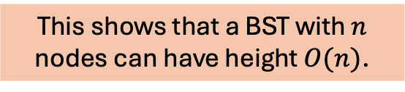
Binary Search Tree Examples
a BST
9
This shows that a BST with $n$ nodes can have height $O(n)$.
6
5
2
1

Slide 21
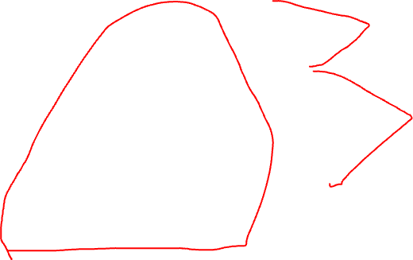
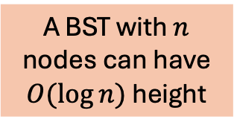
Binary Search Tree Examples
a BST
a BST
9
1
This shows that a BST with $n$ nodes can have height $O(n)$.
6
9
a BST
5
2
5
A BST with $n$ nodes can have $O(\log{n)}$ height
2
9
2
6
1
6
1
5

Slide 22
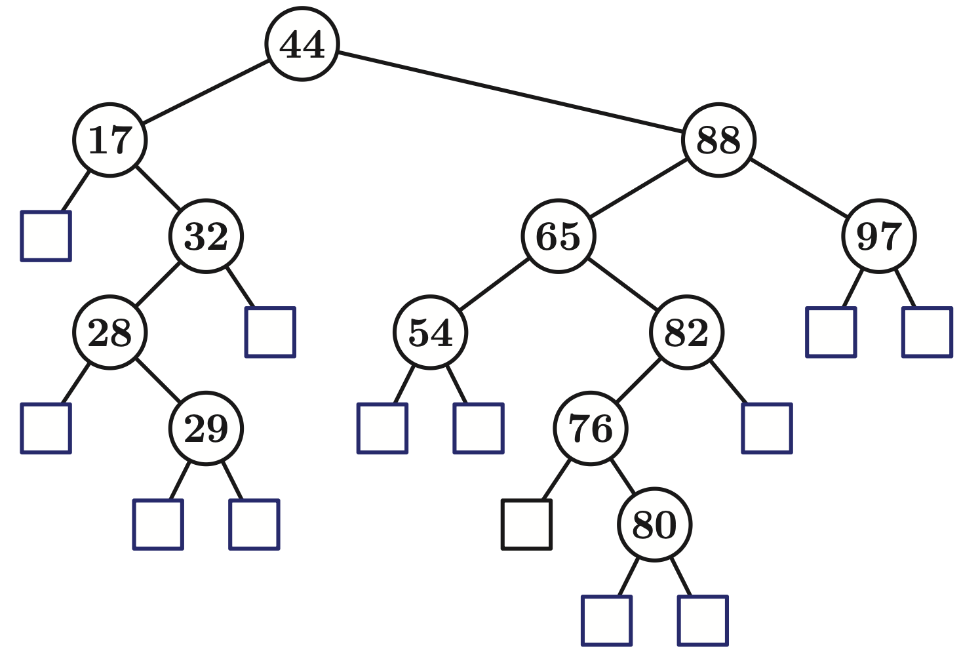

BST Example
This tree shows the leaf nodes explicitly. We often implement those as null pointers and don’t show them in drawings.

Slide 23

BST Example
Where is the min value of a BST?

Slide 24
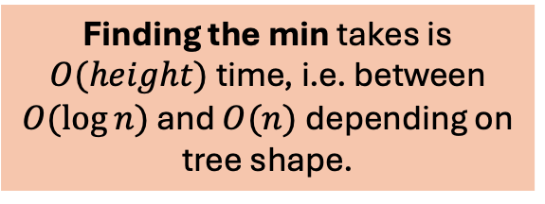
BST Example
Where is the min value of a BST?
To find the min value of a BST, start at the root and “keep going left” to the left-most leaf.
Finding the min takes is $O(height)$ time, i.e. between $O(\log{n})$ and $O(n)$ depending on tree shape.

Slide 25
BST Example
Where is the max value of a BST?

Slide 26

BST Example
Where is the max value of a BST?
To find the max value of a BST, start at the root and “keep going right” to the right-most leaf.
Finding the max takes is $O(height)$ time, i.e. between $O(\log{n})$ and $O(n)$ depending on tree shape.

Slide 27

Binary Search Tree Examples
a BST?
5
2
10
1
4
15
3
8
18
7
9

Slide 28
Binary Search Tree Examples
NOT a BST
5
2
10
1
4
15
3
8
18
3 and 4 are less than the root key 5
7
9

Slide 29

Binary Search Tree Examples
NOT a BST
a BST
5
3
2
10
2
10
1
4
15
1
5
15
3
18
4
8
18
8
7
9
7
9

Slide 30


Searching a BST
RecursiveSearch(p, k) if isLeaf(p): return true if p.key == k, otherwise false else if k < p.key: return RecursiveSearch(k, left_subtree(p)) else if k > p.key: return RecursiveSearch(k, right_subtree(p)) else: return true // found it

Slide 31
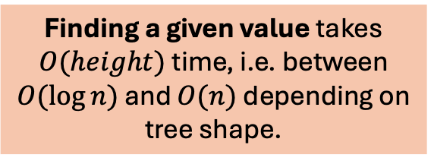
Searching a BST
RecursiveSearch(p, k) if isLeaf(p): return true if p.key == k, otherwise false else if k < p.key: return RecursiveSearch(k, left_subtree(p)) else if k > p.key: return RecursiveSearch(k, right_subtree(p)) else: return true // found it
Finding a given value takes $O(height)$ time, i.e. between $O(\log{n})$ and $O(n)$ depending on tree shape.

Slide 32
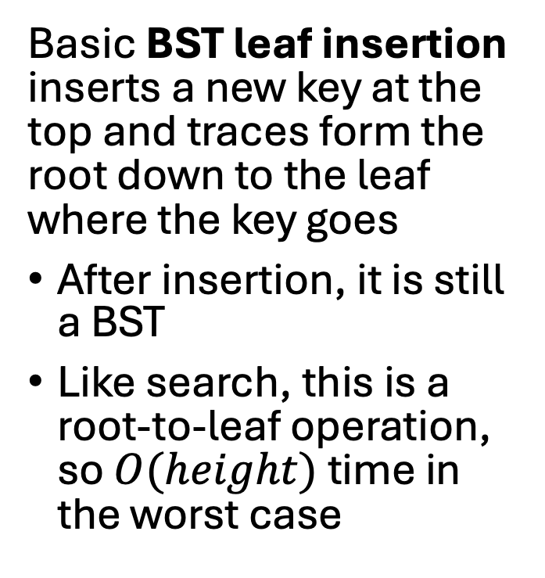
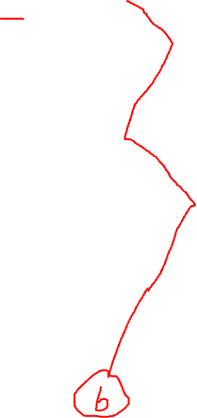
Inserting Into a BST
3
insert 6
2
10
Basic BST leaf insertion inserts a new key at the top and traces form the root down to the leaf where the key goes
After insertion, it is still a BST
Like search, this is a root-to-leaf operation, so $O(height)$ time in the worst case
1
5
15
4
8
18
7
9

Slide 33
Inserting Into a BST
3
insert 6
2
10
Basic BST leaf insertion inserts a new key at the top and traces form the root down to the leaf where the key goes
After insertion, it is still a BST
Like search, this is a root-to-leaf operation, so $O(height)$ time in the worst case
1
5
15
4
8
18
7
9
6

Slide 34
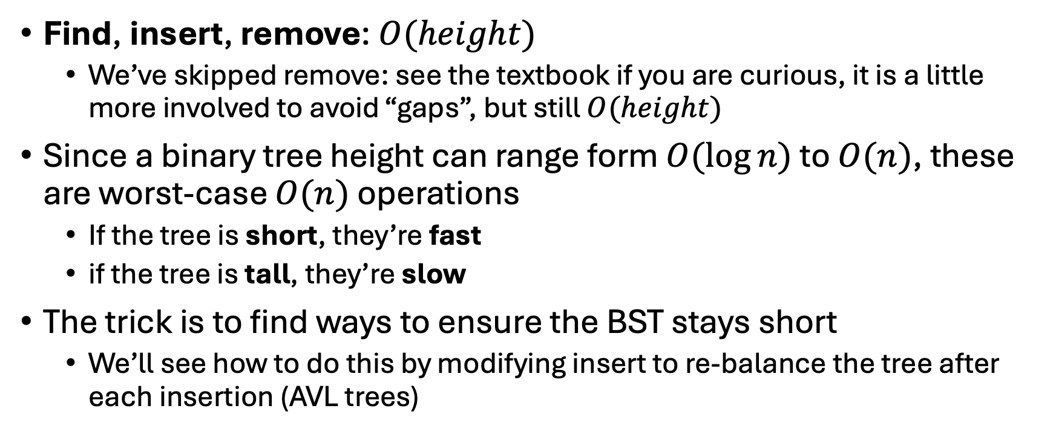
BST Performance summary
Find, insert, remove: $O(height)$
We’ve skipped remove: see the textbook if you are curious, it is a little more involved to avoid “gaps”, but still $O(height)$
Since a binary tree height can range form $O(\log{n})$ to $O(n)$, these are worst-case $O(n)$ operations
If the tree is short, they’re fast
if the tree is tall, they’re slow
The trick is to find ways to ensure the BST stays short
We’ll see how to do this by modifying insert to re-balance the tree after each insertion (AVL trees)

Slide 35
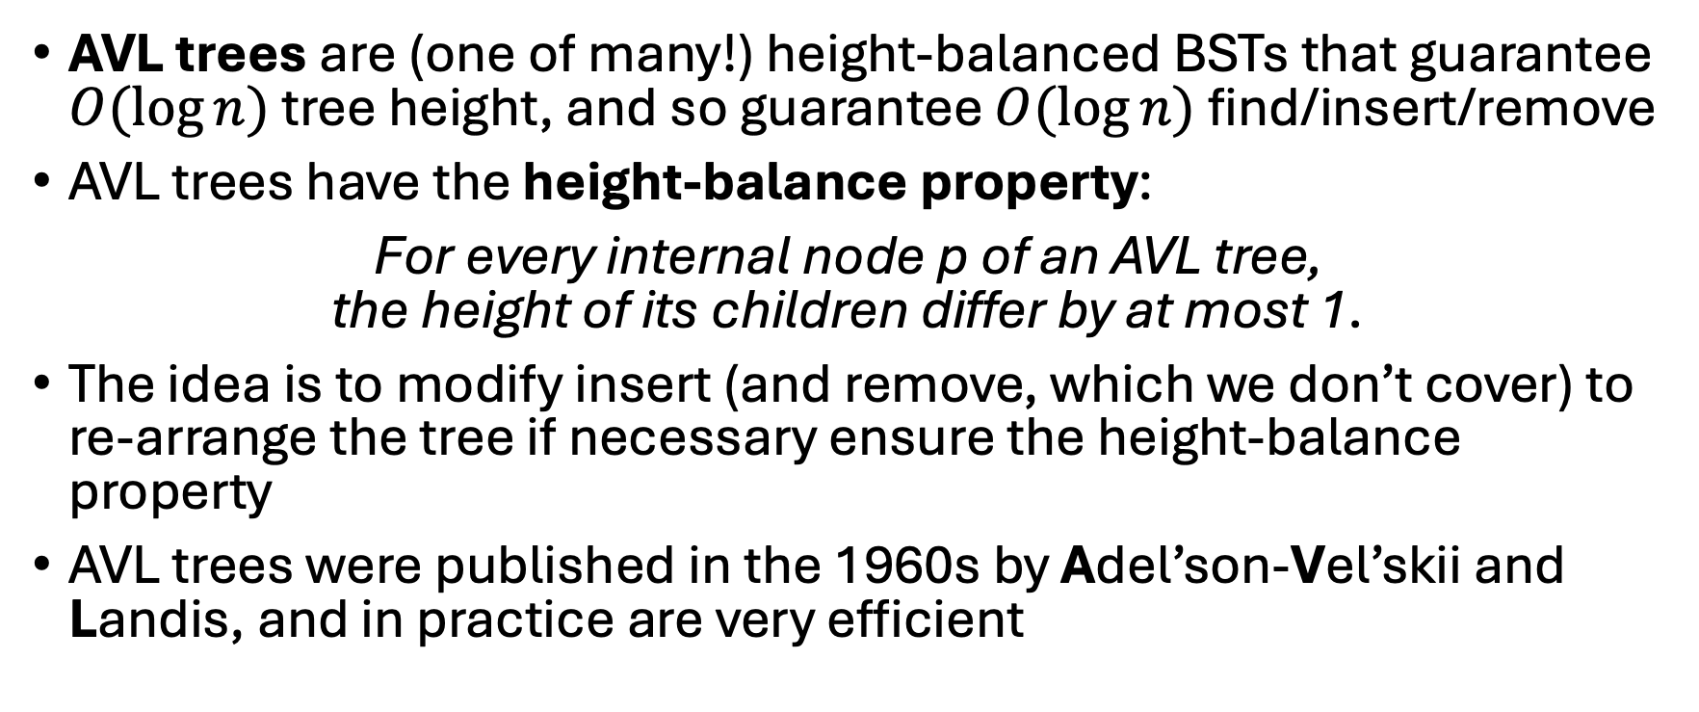
AVL Trees
AVL trees are (one of many!) height-balanced BSTs that guarantee $O(\log{n})$ tree height, and so guarantee $O(\log{n})$ find/insert/remove
AVL trees have the height-balance property:
For every internal node p of an AVL tree, the height of its children differ by at most 1.
The idea is to modify insert (and remove, which we don’t cover) to re-arrange the tree if necessary ensure the height-balance property
AVL trees were published in the 1960s by Adel’son-Vel’skii and Landis, and in practice are very efficient
Memorize this definition!

Slide 36
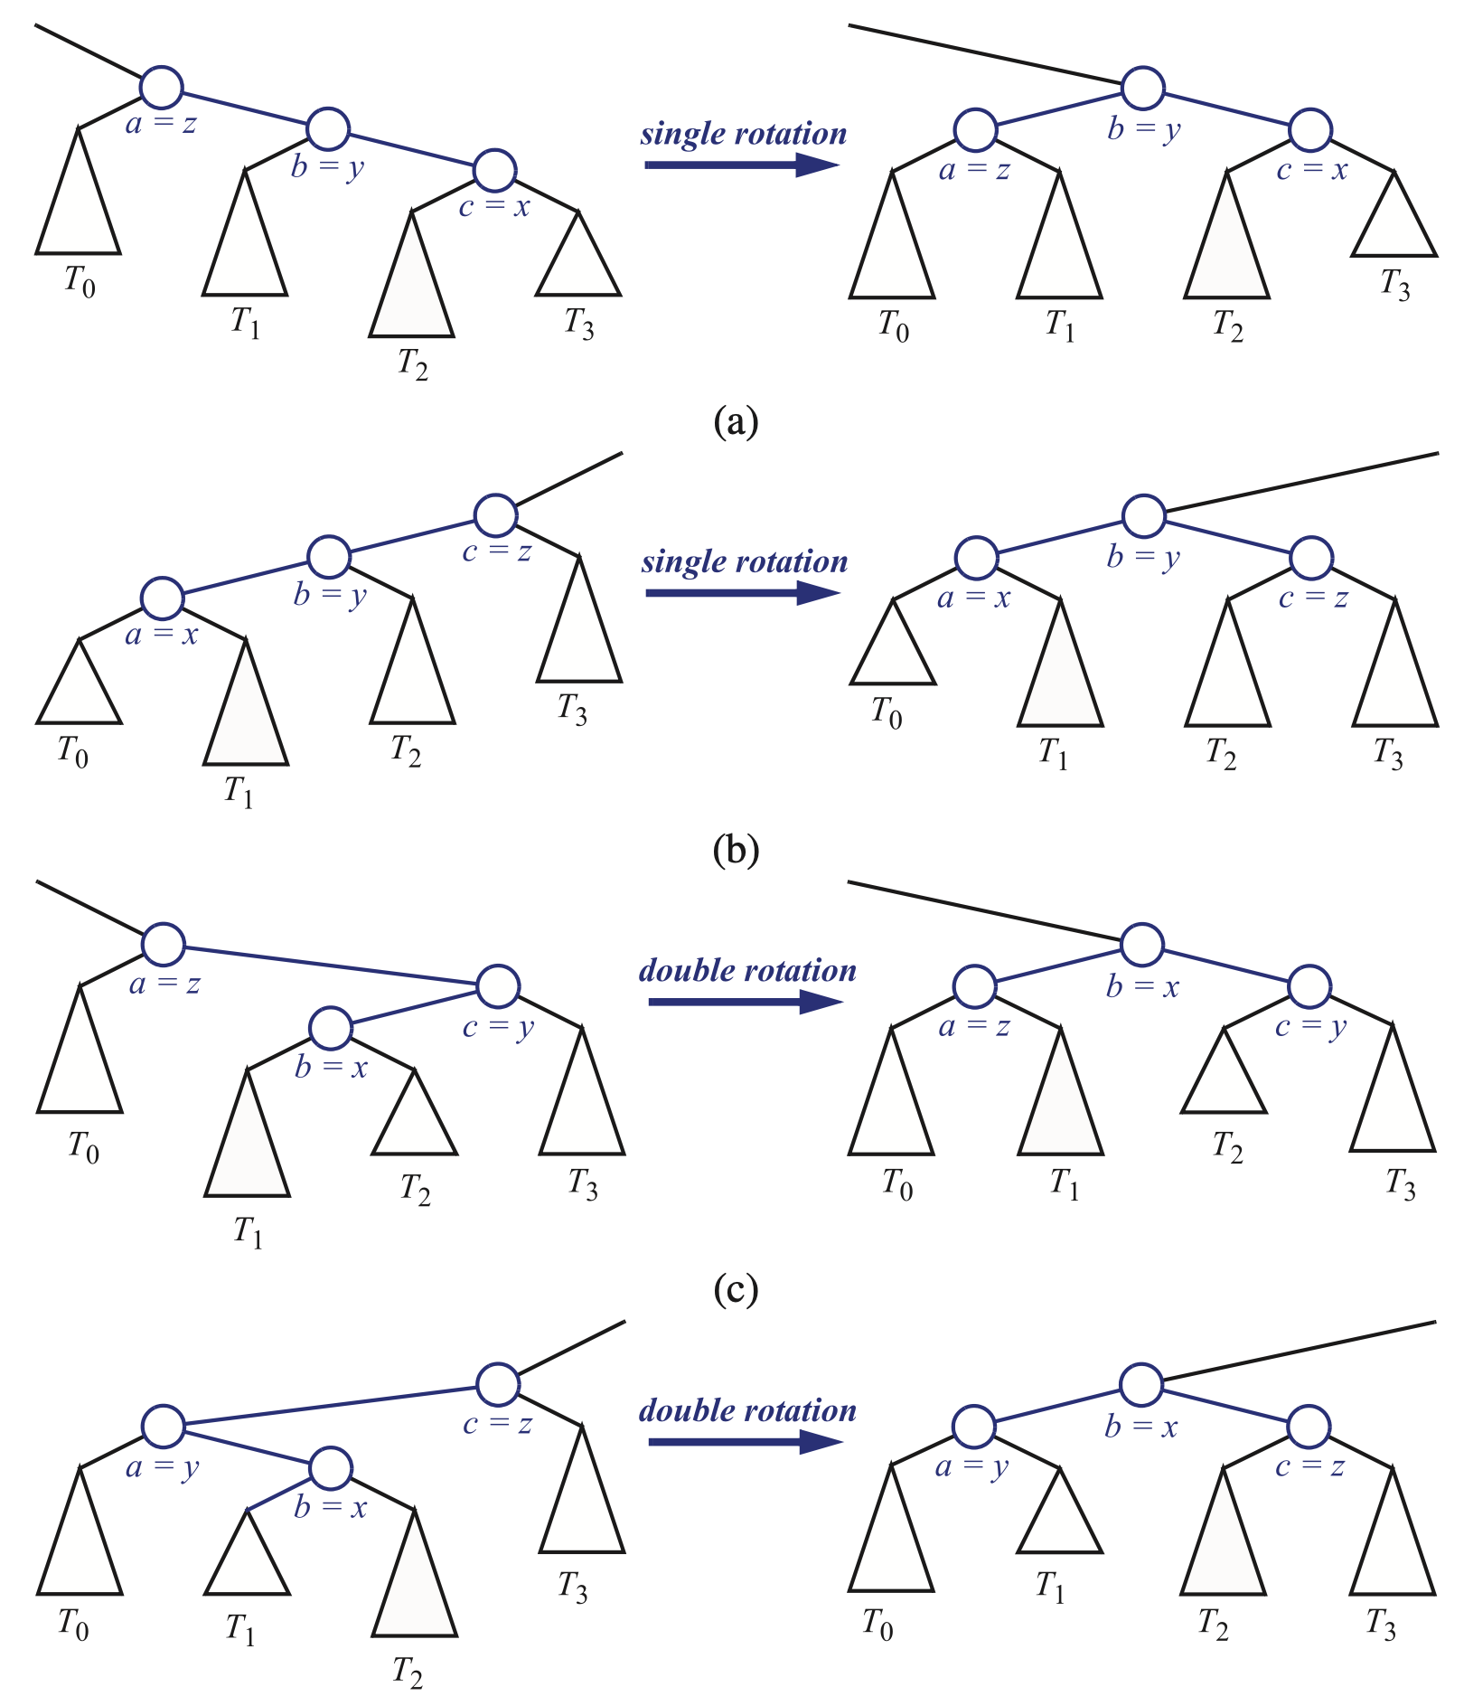
AVL Tree Rotations
z: the first unbalanced node
y: the tallest child of z
x: the tallest child of y
Practice doing insertions by hand!

Slide 37
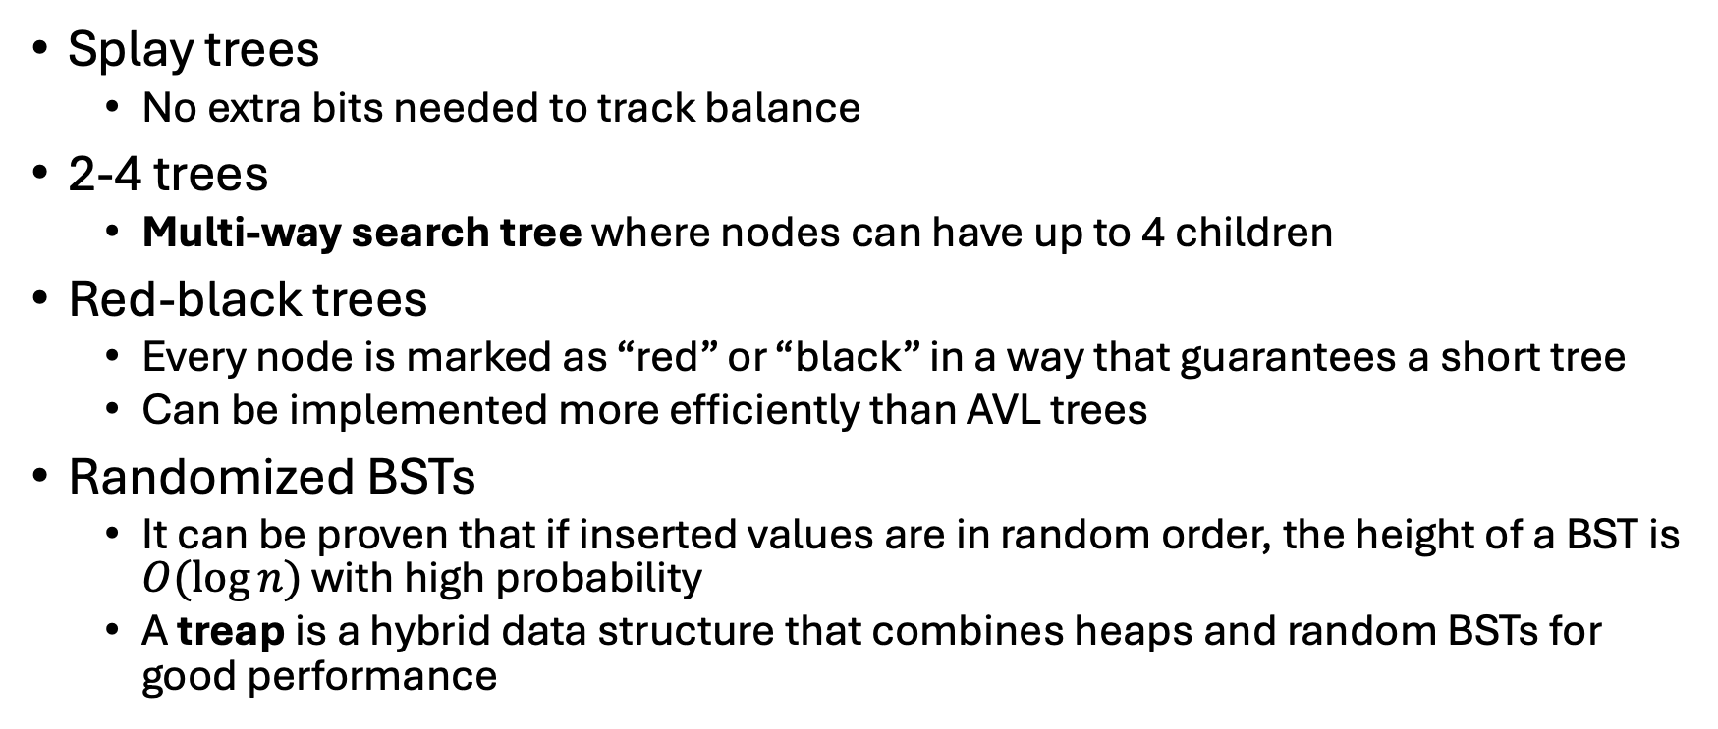
Other Balanced Trees
Splay trees
No extra bits needed to track balance
2-4 trees
Multi-way search tree where nodes can have up to 4 children
Red-black trees
Every node is marked as “red” or “black” in a way that guarantees a short tree
Can be implemented more efficiently than AVL trees
Randomized BSTs
It can be proven that if inserted values are in random order, the height of a BST is $O(\log{n})$ with high probability
A treap is a hybrid data structure that combines heaps and random BSTs for good performance

