Slide 1
Graph Algorithms
Chapter 13.1 – 13.6

Slide 2
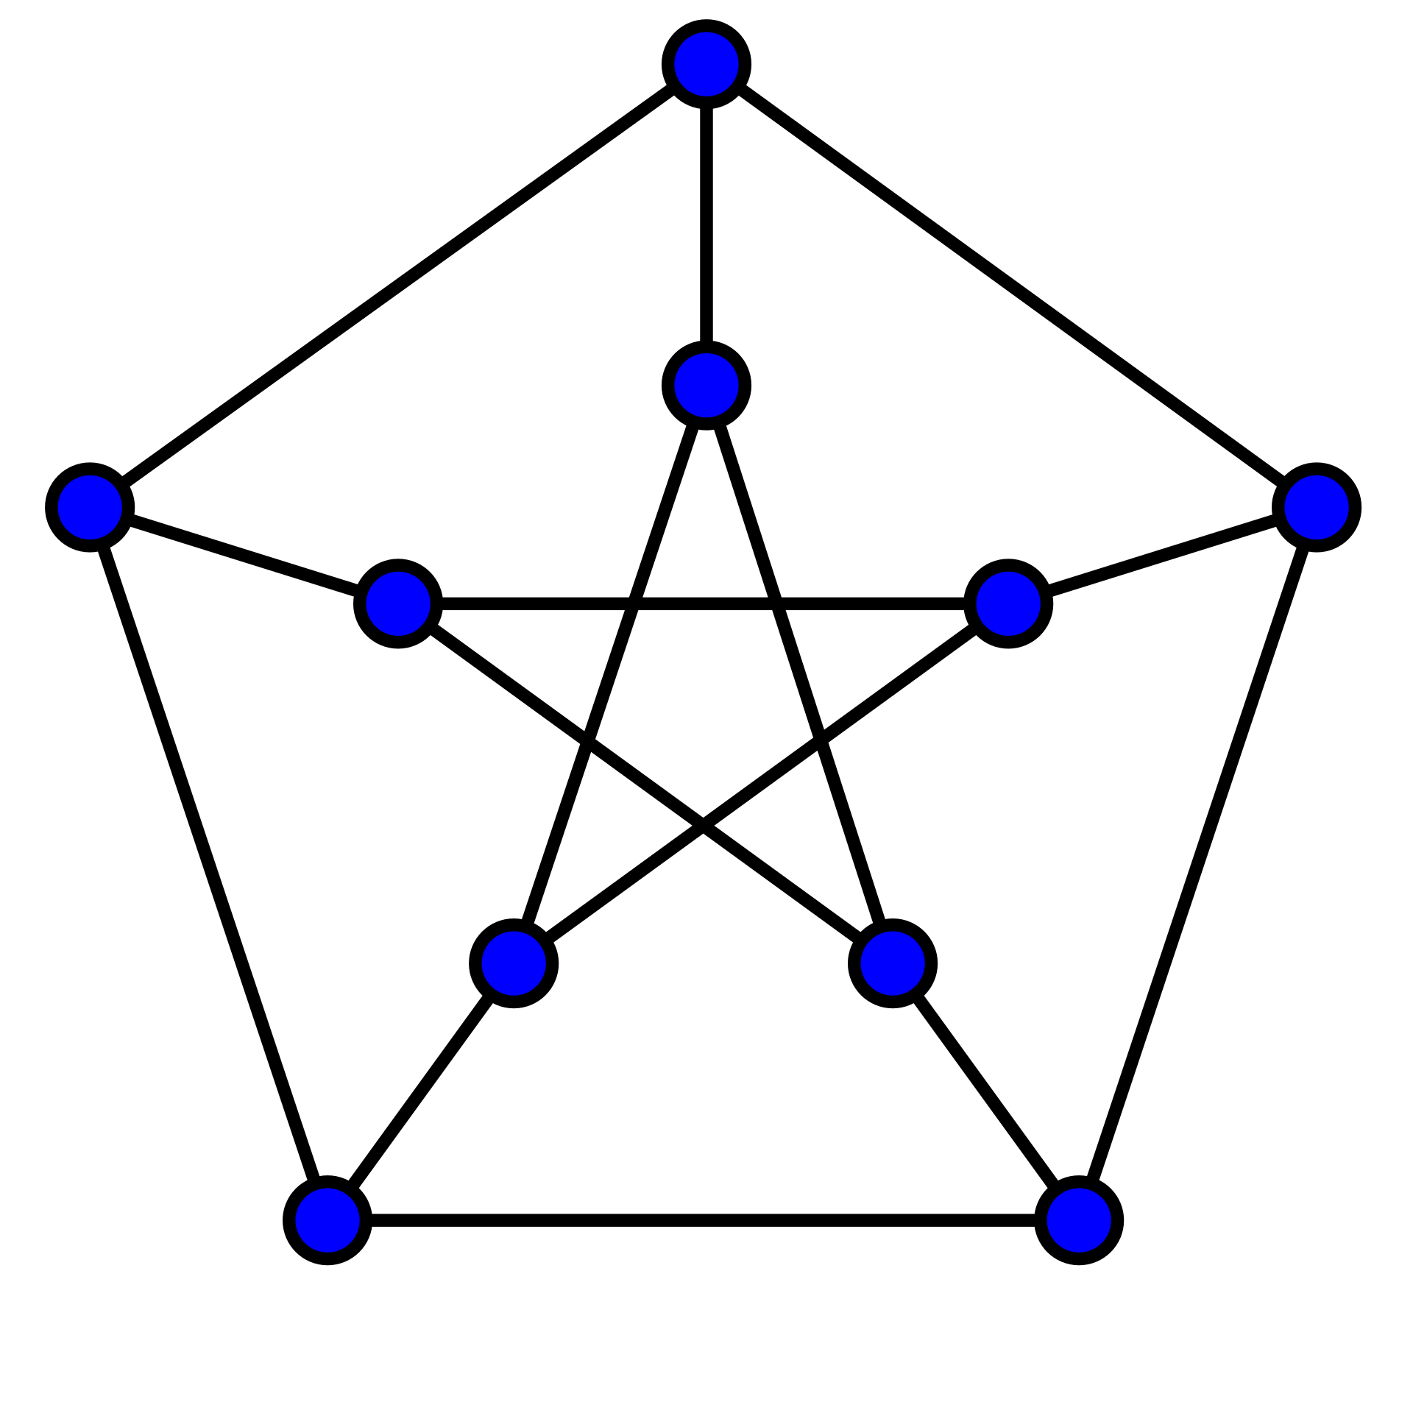
Graph Theory
Graph theory is major branch of mathematics with many applications in computer science and programming.
The key idea is that graphs consists of vertices (nodes), and pairs of vertices can be connected by an edge.
For instance, linked lists and trees are graphs.

Slide 3
Undirected Graphs
# vertices:
# edges:
Cycles:
# components:
Longest path with no repeat vertices:
Sum of vertex degrees:
A
B
C
F
G
D
E
H
I
Undirected graph

Slide 4
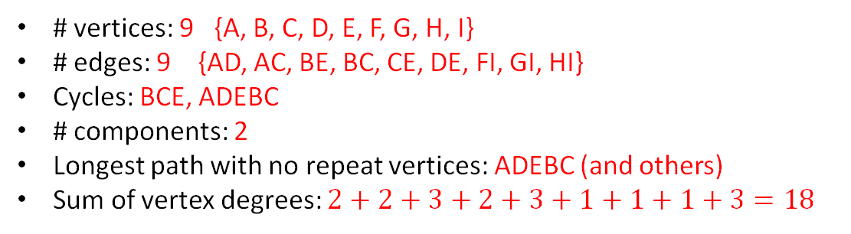
Undirected Graphs
# vertices: 9 {A, B, C, D, E, F, G, H, I}
# edges: 9 {AD, AC, BE, BC, CE, DE, FI, GI, HI}
Cycles: BCE, ADEBC
# components: 2
Longest path with no repeat vertices: ADEBC (and others)
Sum of vertex degrees: $2+2+3+2+3+1+1+1+3=18$
2
A
2
B
3
1
1
C
F
G
2
3
D
E
1
3
H
I
Undirected graph

Slide 5
Graph Theory
# vertices: 9 {A, B, C, D, E, F, G, H, I}
# edges: 9 {AD, AC, BE, BC, CE, DE, FI, GI, HI}
Cycles: BCE, ADEBC
# components: 2
Longest path with no repeat vertices: ADEBC (and others)
Sum of vertex degrees: $2+2+3+2+3+1+1+1+3=18$
2
A
2
B
A simple graph has at most one edge between any pair of vertices, and no loop edges (e.g. edges where both ends are the same vertex).
3
1
1
C
F
G
2
3
D
E
1
3
H
I
Undirected graph

Slide 6
Graph Theory
# vertices: 9 {A, B, C, D, E, F, G, H, I}
# edges: 9 {AD, AC, BE, BC, CE, DE, FI, GI, HI}
Cycles: BCE, ADEBC
# components: 2
Longest path with no repeat vertices: ADEBC (and others)
Sum of vertex degrees: $2+2+3+2+3+1+1+1+3=18$
2
A
2
B
3
1
1
C
F
G
Proposition 13.6
The sum of the degrees of a graph is twice the number of edges.
2
3
D
E
1
3
H
I
Undirected graph

Slide 7
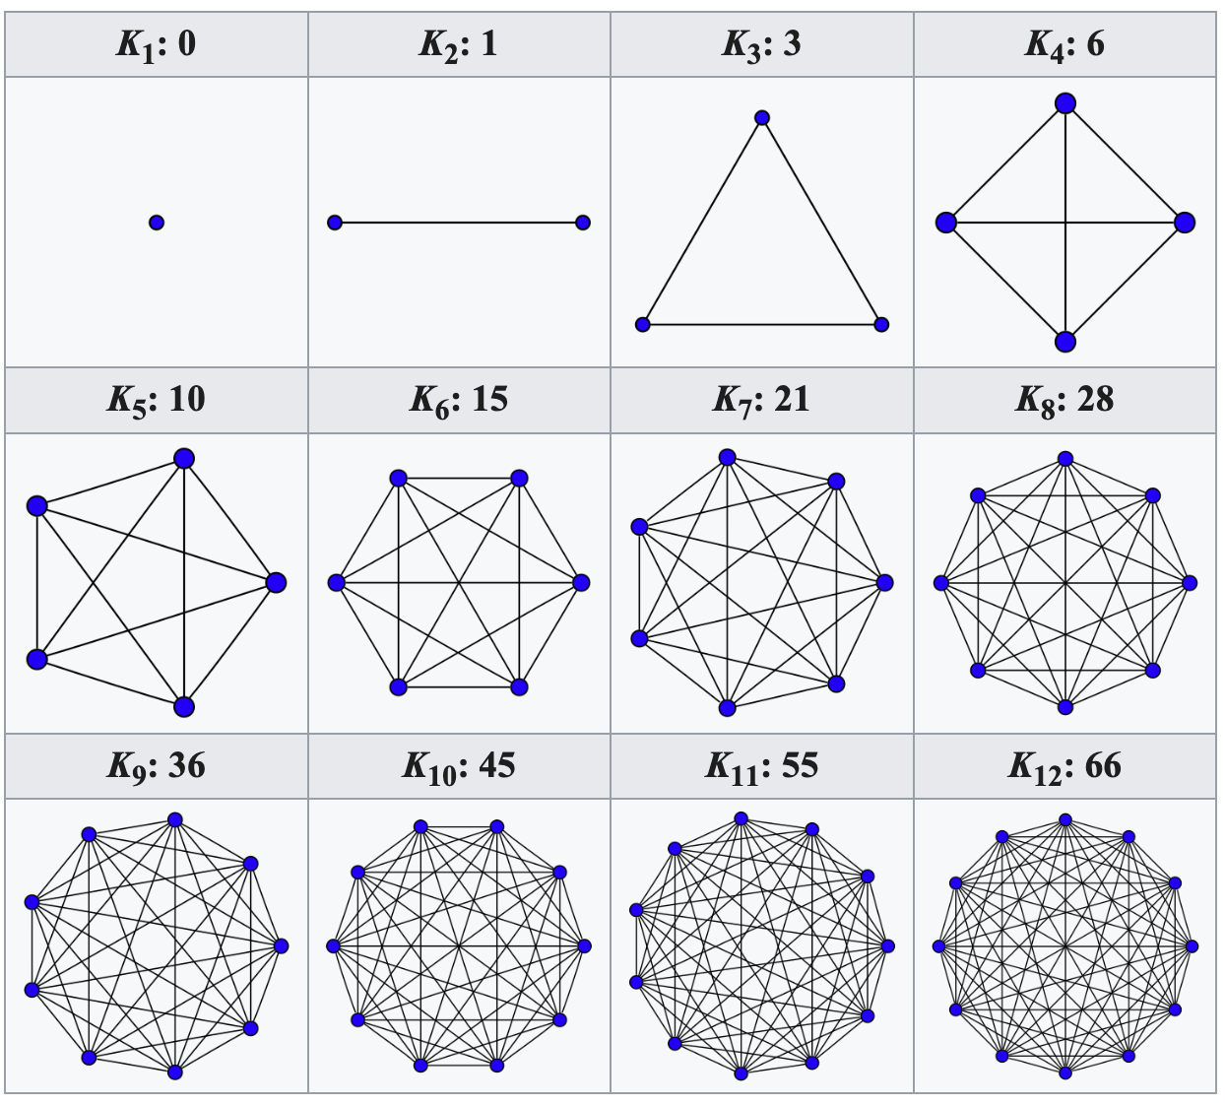
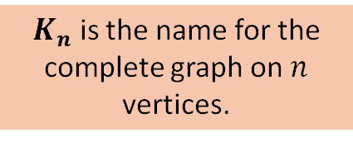
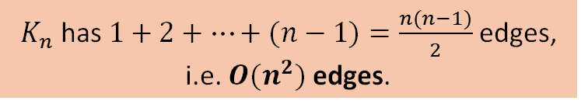
Complete Graphs
A complete graph is a simple graph where each pair of vertices is connected by an edge.
$K_{n}$ is the name for the complete graph on $n$ vertices.
$K_{n}$ has $1+2+…+(n−1)=\frac{n(n−1)}{2}$edges, i.e. $O(n^{2})$edges.
Any simple graph is a sub-graph of a complete graph, i.e. by removing edges or vertices you can get any other graph.

Slide 8
Directed Graphs
# vertices:
# edges:
Cycles:
# components:
Longest path with no repeat vertices:
Sum of in-degrees:
Sum of out-degrees:
A
B
C
D
E
Directed graph

Slide 9
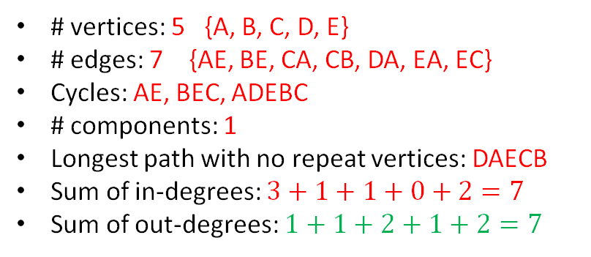
Directed Graphs
# vertices: 5 {A, B, C, D, E}
# edges: 7 {AE, BE, CA, CB, DA, EA, EC}
Cycles: AE, BEC, ADEBC
# components: 1
Longest path with no repeat vertices: DAECB
Sum of in-degrees: $3+1+1+0+2=7$
Sum of out-degrees: $1+1+2+1+2=7$
In: 3
Out: 1
Proposition 13.7
For a directed graph, the sum of the in-degrees equals the sum of the out-degrees.
A
In: 1
Out: 1
B
C
In: 1
Out: 2
In: 0
Out: 1
D
E
In: 2
Out: 2
Directed graph

Slide 10
Trees: connected graphs with no cycles
# vertices:
# edges:
Cycles:
# components:
Longest path with no repeat vertices:
Sum of degrees:
A
B
C
D
E
No vertex is designated as the root, so this is called a free tree.

Slide 11
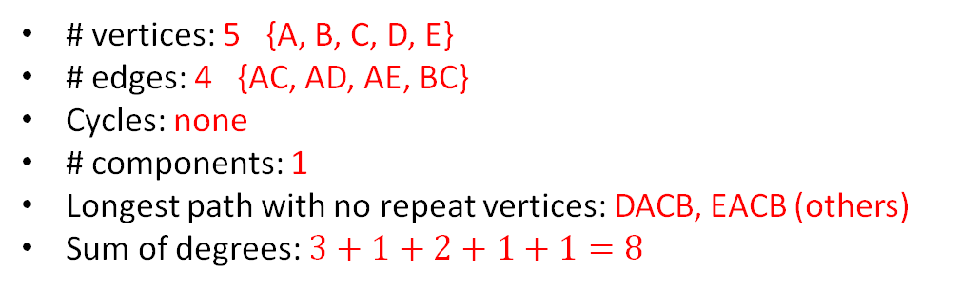
Trees: connected graphs with no cycles
# vertices: 5 {A, B, C, D, E}
# edges: 4 {AC, AD, AE, BC}
Cycles: none
# components: 1
Longest path with no repeat vertices: DACB, EACB (others)
Sum of degrees: $3+1+2+1+1=8$
3
1
A
B
2
C
1
1
D
E
No vertex is designated as the root, so this is called a free tree.

Slide 12
Trees: connected graphs with no cycles
# vertices: 5 {A, B, C, D, E}
# edges: 4 {AC, AD, AE, BC}
Cycles: none
# components: 1
Longest path with no repeat vertices: DACB, EACB (others)
Sum of degrees: $3+1+2+1+1=8$
3
1
A
B
2
C
Proposition 13.11
The number of edges in a tree is one less than the number of vertices.
1
1
D
E
No vertex is designated as the root, so this is called a free tree.

Slide 13
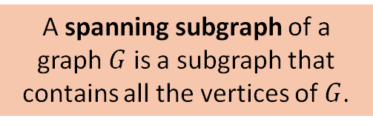
Spanning Trees
A spanning subgraph of a graph $G$ is a subgraph that contains all the vertices of $G$.
A
B
A spanning tree of a graph G is spanning subgraph that is a tree.
C
All graphs have a spanning tree (often more than one).
D
E

Slide 14
Graph Traversal
Imagine standing on a graph node and walking around it by following edges
There is no one best way to traverse a graph, it depends on the problem
In general there are two main strategies
Depth-first search: explore one neighbor of a node as far as possible before backing up and trying the next neighbor
Breadth-first search: explore all neighbors of a node, then all neighbors of neighbors, and so on

Slide 15
Depth First Search
Solving a maze with depth-first search.
From https://brilliant.org/wiki/depth-first-search-dfs/

Slide 16
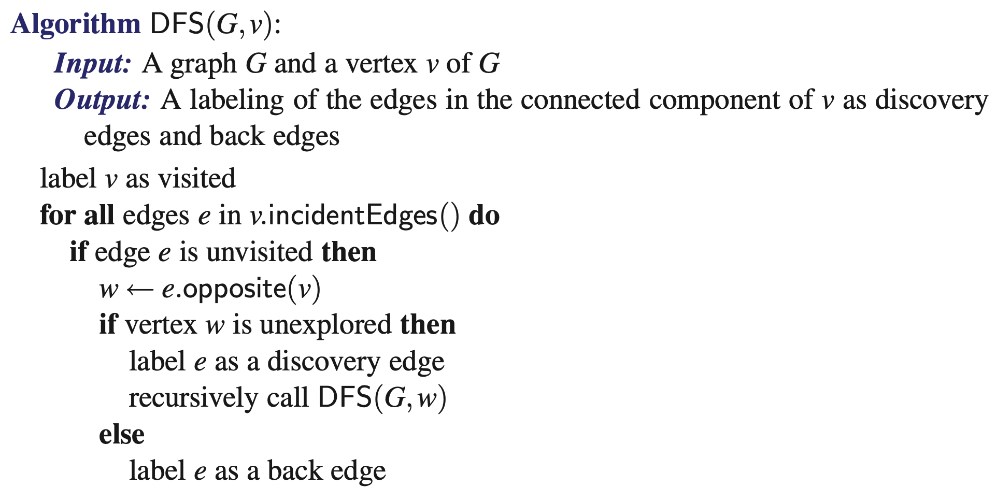
Depth First Search (DFS , graph traversal)
An edge is visited if it has been marked as a discovery edge or a back edge.

Slide 17
Depth First Search (DFS , graph traversal)
Proposition 3.12: the discovery edges of DFS form a spanning tree of a connected graph
Proof relies on two observations:
the visited vertices form a tree because cycles can never be formed with visited vertices
when DFS is done, all the nodes are visited (i.e. there are no unvisited nodes)

Slide 18
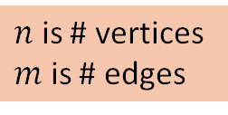
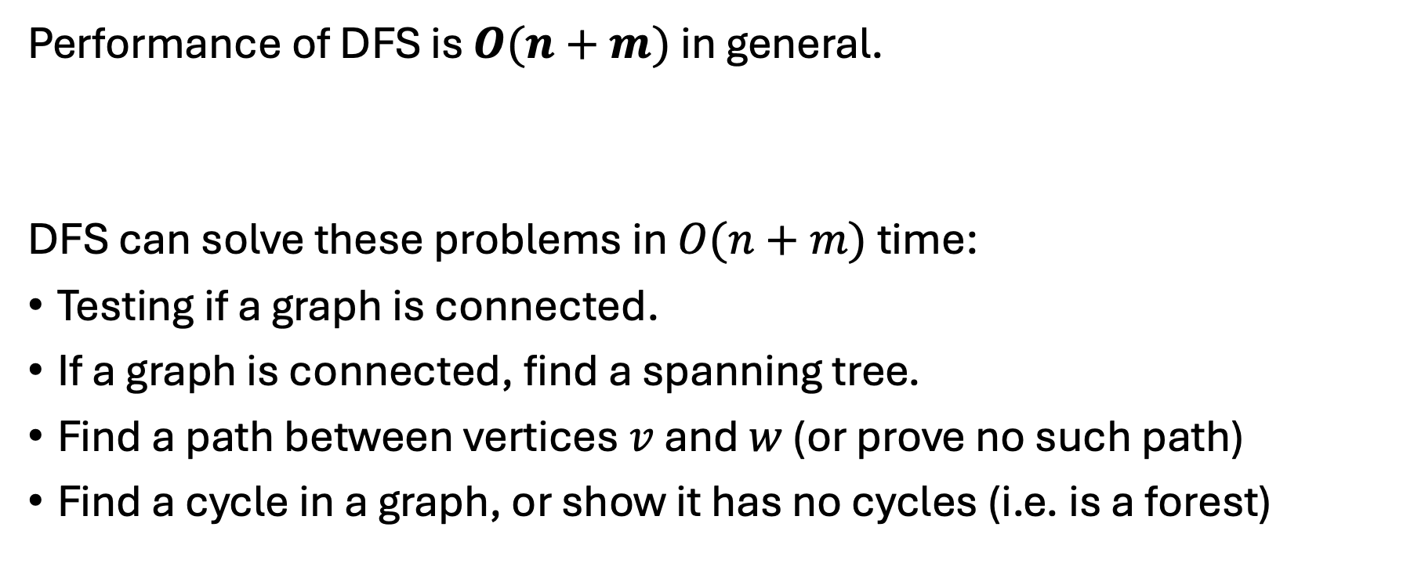
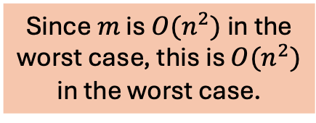
Depth First Search (DFS , graph traversal)
Performance of DFS is $O(n+m)$ in general.
DFS can solve these problems in $O(n+m)$ time:
Testing if a graph is connected.
If a graph is connected, find a spanning tree.
Find a path between vertices $v$ and $w$ (or prove no such path)
Find a cycle in a graph, or show it has no cycles (i.e. is a forest)
Since $m$ is $O(n^{2})$ in the worst case, this is $O(n^{2})$ in the worst case.
$n$ is # vertices
$m$ is # edges

Slide 19
Breadth First Search
From https://en.wikipedia.org/wiki/Breadth-first_search

Slide 20
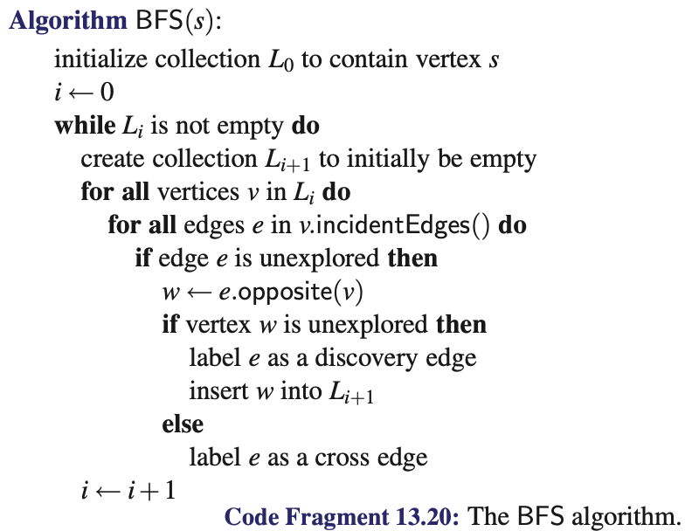
Breadth First Search (BFS, graph traversal)

Slide 21
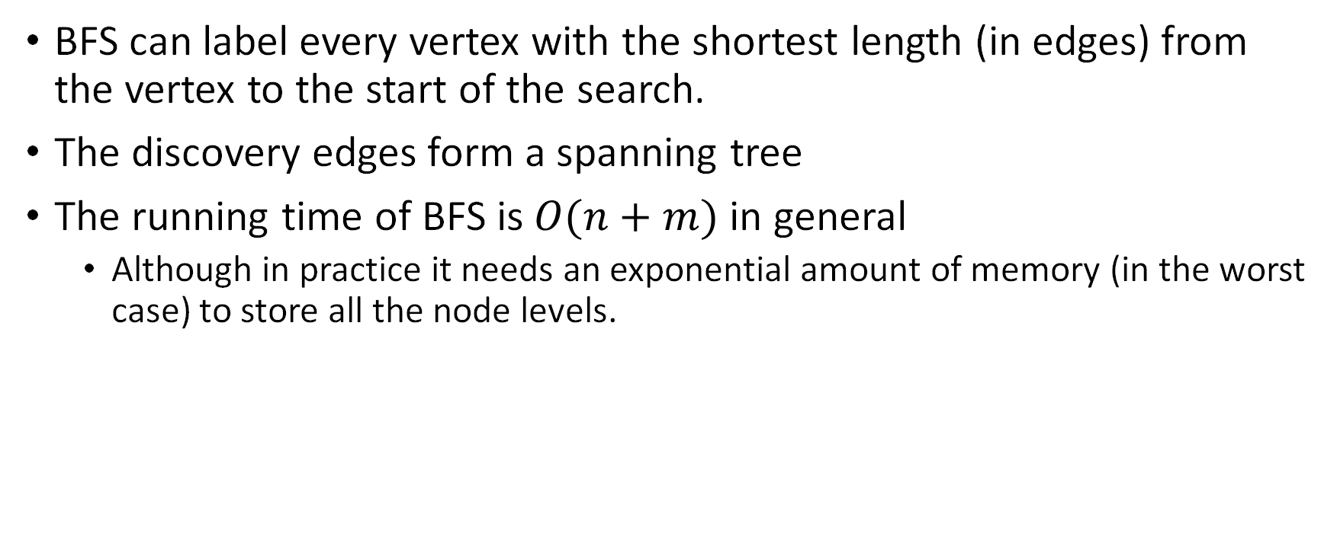
Breadth First Search (BFS, graph traversal)
BFS can label every vertex with the shortest length (in edges) from the vertex to the start of the search.
The discovery edges form a spanning tree
The running time of BFS is $O(n+m)$ in general
Although in practice it needs an exponential amount of memory (in the worst case) to store all the node levels.

Slide 22
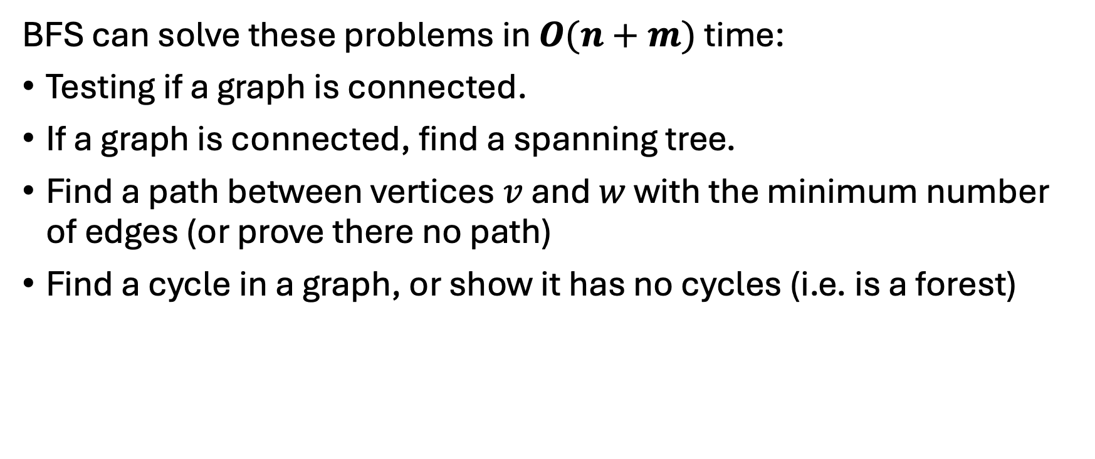
Breadth First Search (BFS, graph traversal)
BFS can solve these problems in $O(n+m)$ time:
Testing if a graph is connected.
If a graph is connected, find a spanning tree.
Find a path between vertices $v$ and $w$ with the minimum number of edges (or prove there no path)
Find a cycle in a graph, or show it has no cycles (i.e. is a forest)

Slide 23
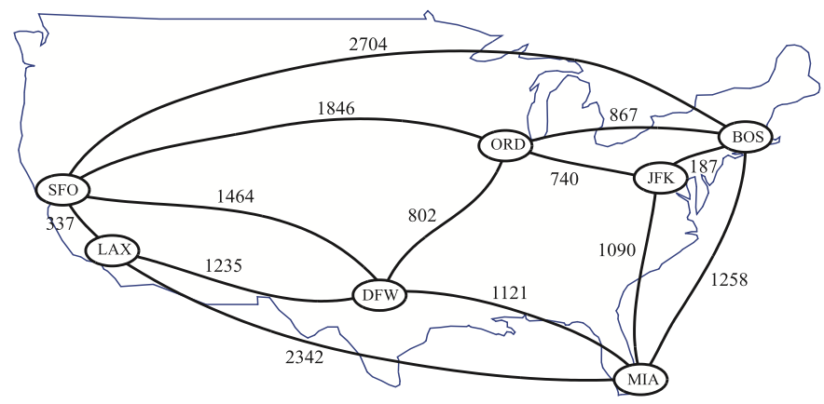
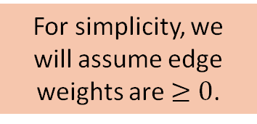
Weighted Graphs
For simplicity, we will assume edge weights are $≥0$.
In practice it is often useful to put weights on edges
Weights could represent time, distance, cost, strength, etc.
A
3
B
4
2
1
C
3
E
D
5

Slide 24
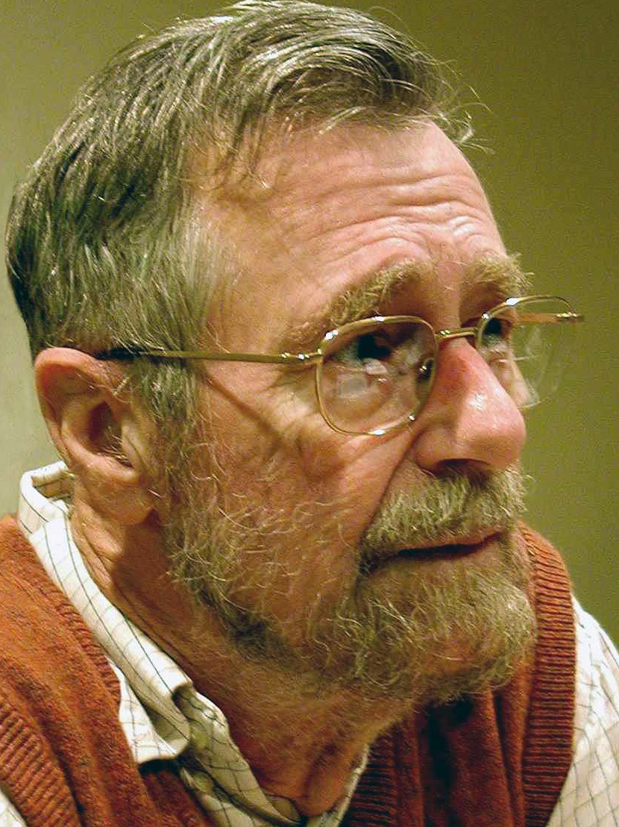
Dijkstra’s Algorithm (Shortest Path)
Dijkstra’s algorithm is a variation of breadth-first search.
It finds the distance (in terms of edge weight sum) between a given starting node and all other nodes.
It can solve mazes and similar problems
A slight variation of Dijkstra’s algorithm, known as A* search, is often used
A* adds a heuristic function that estimates the distance from a vertex to a goal vertex

Slide 25
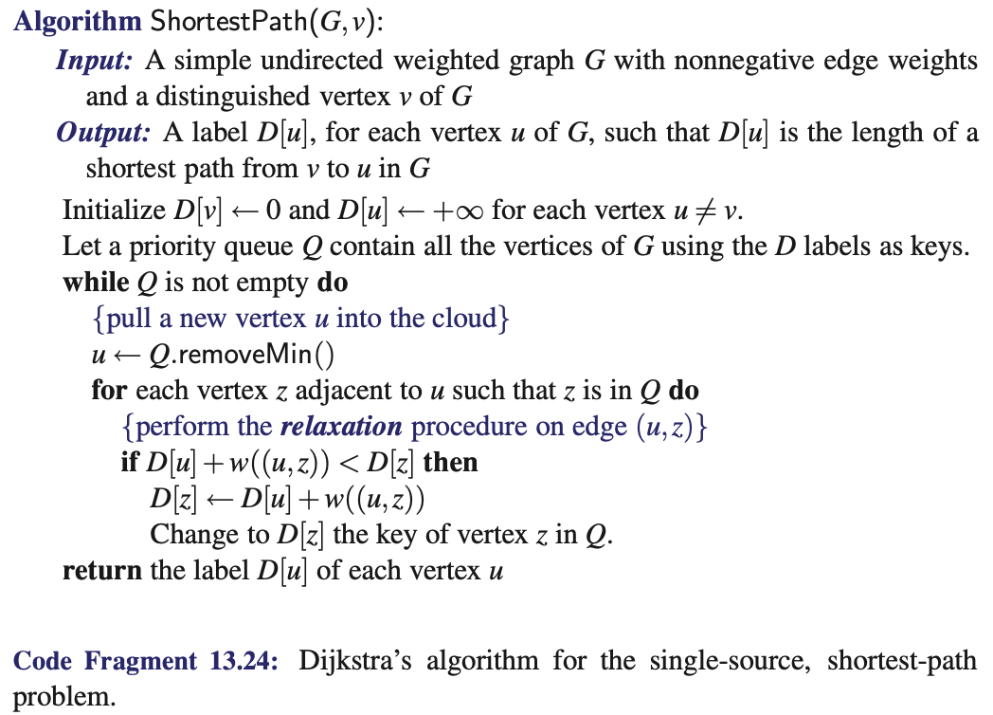
Dijkstra’s Algorithm (Shortest Path)

Slide 26
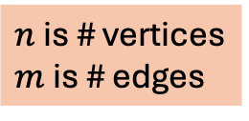

Dijkstra’s Algorithm (Shortest Path)
A good implementation of Dijkstra’s algorithm (e.g. using a heap) has a worst-case running time of $O((n+m)\log{n})$
Or $O(n^{2}\log{n})$ in terms of vertices
$n$ is # vertices
$m$ is # edges

Slide 27
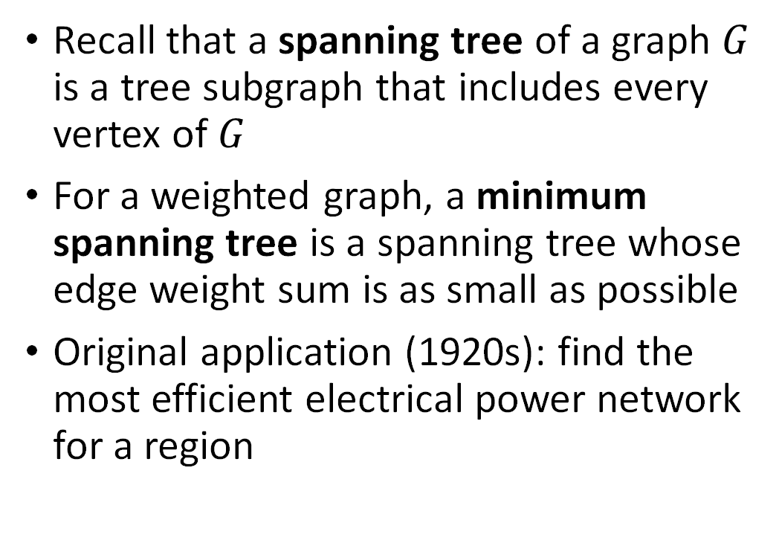
Minimum Spanning Trees
Recall that a spanning tree of a graph $G$ is a tree subgraph that includes every vertex of $G$
For a weighted graph, a minimum spanning tree is a spanning tree whose edge weight sum is as small as possible
Original application (1920s): find the most efficient electrical power network for a region

Slide 28
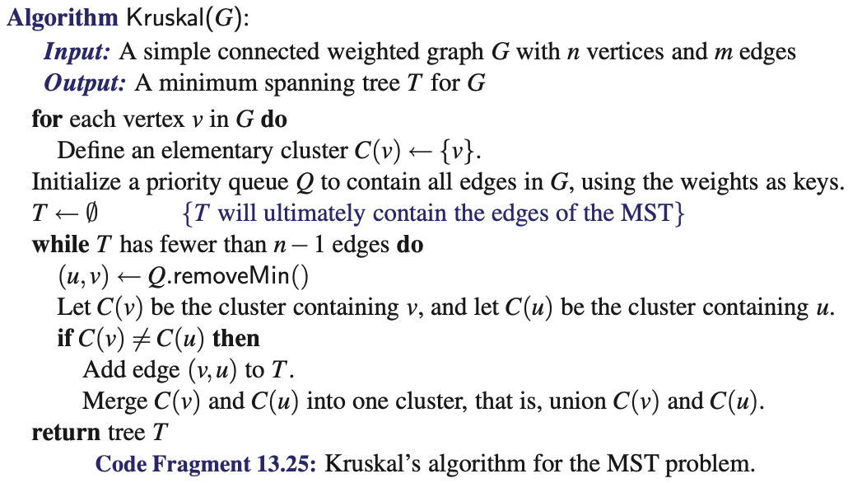
Kruskal’s Algorithm (Minimum Spanning Tree)

Slide 29
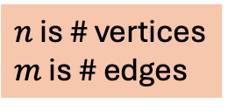

Kruskal’s Algorithm (Minimum Spanning Tree)
For a simply connected graph, a well-implemented version of Kruskal’s algorithm (using a heap and an efficient union-find algorithm for the merging clusters) has running time $O(m\log{n})$
$n$ is # vertices
$m$ is # edges

