Slide 1
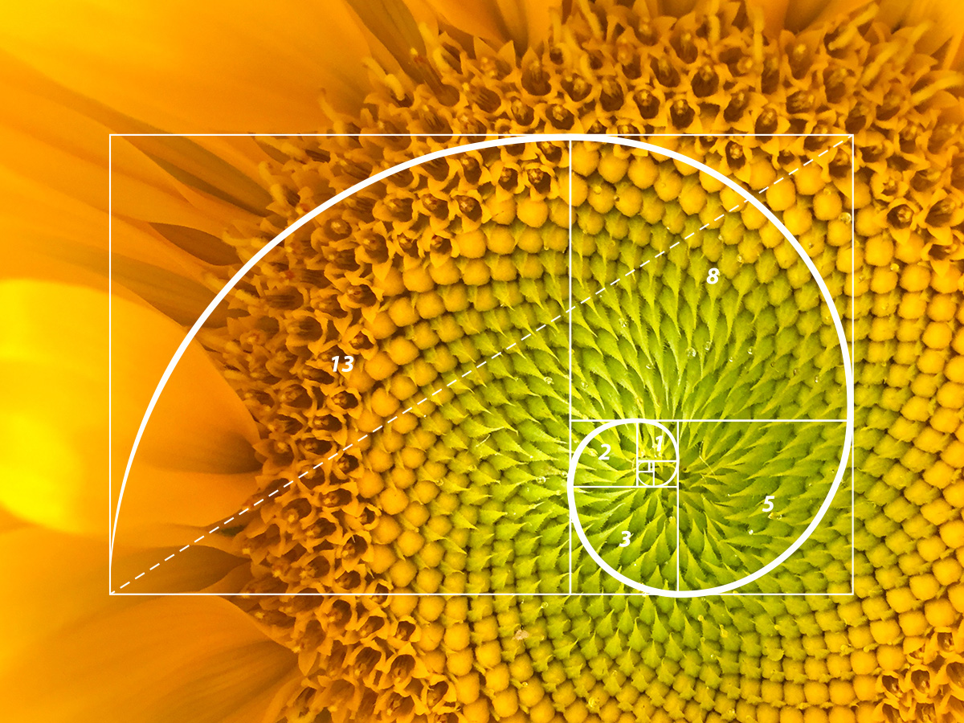
Fibonacci Numbers
CMPT 225, Summer 2026

Slide 2
The Fibonacci Sequence
1, 1, 2, 3, 5, 8, 13, 21, 34, 55, 89, 144, …

Slide 3
The Fibonacci Sequence
1, 1, 2, 3, 5, 8, 13, 21, 34, 55, 89, 144, …
The first two numbers are 1 and 1.
Each other number is the sum of the two numbers before it.

Slide 4
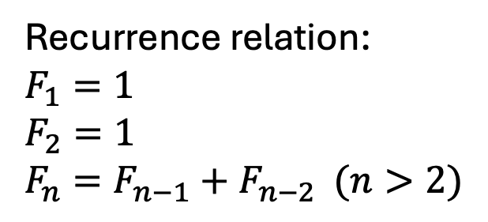
The Fibonacci Sequence
1, 1, 2, 3, 5, 8, 13, 21, 34, 55, 89, 144, …
The first two numbers are 1 and 1.
Each other number is the sum of the two numbers before it.
Recurrence relation:
$$F_{1}=1$$
$$F_{2}=1$$
$$F_{n}=F_{n−1}+F_{n−2} (n>2)$$

Slide 5

The Fibonacci Sequence
1, 1, 2, 3, 5, 8, 13, 21, 34, 55, 89, 144, …
Some computer science applications of the Fibonacci sequence:
The min # of nodes in an AVL tree of height $h$ is related to the Fibonacci numbers
Fibonacci heaps are used in high-performance implementations of priority queues (e.g. for Dijkstra’s algorithm)
Fibonacci numbers often appear in graphs, e.g. Fibonacci spirals
The pair of numbers $(F_{n},F_{n+1})$ require the maximum number of steps to find their greatest common divisor (GCD) using Euclid’s algorithm
The first two numbers are 1 and 1.
Each other number is the sum of the two numbers before it.
Recurrence relation:
$$F_{1}=1$$
$$F_{2}=1$$
$$F_{n}=F_{n−1}+F_{n−2} (n>2)$$

Slide 6

The Fibonacci Sequence
1, 1, 2, 3, 5, 8, 13, 21, 34, 55, 89, 144, …
Note the following for:
$$F_{n}=F_{n−1}+F_{n−2}$$
$≤F_{n−1}+F_{n−1}$
$={2F}_{n−1}$
Therefore $F_{n}≤{2F}_{n−1}$, and so roughly $F_{n}≤2^{n}$(calculate some values to check this!).
This shows that $F_{n}$ grows, at most, exponentially (with base 2).
The first two numbers are 1 and 1.
Each other number is the sum of the two numbers before it.
Recurrence relation:
$$F_{1}=1$$
$$F_{2}=1$$
$$F_{n}=F_{n−1}+F_{n−2} (n>2)$$

Slide 7


The Fibonacci Sequence
1, 1, 2, 3, 5, 8, 13, 21, 34, 55, 89, 144, …
Going the other way, since $F_{n−1}>F_{n−2}$:
$$F_{n}=F_{n−1}+F_{n−2}$$
$>F_{n−2}+F_{n−2}$
$={2F}_{n−2}$
By repeated substitution we get $$F_{n}>2^{k}⋅F_{n−2k}$$
This takes $k≈\frac{n}{2}$ applications, and plugging that in gives $F_{n}>2^{\frac{n}{2}}⋅1={\sqrt{2}}^{n}$.
So $F_{n}$ grows at least as fast as ${\sqrt{2}}^{n}$.
The first two numbers are 1 and 1.
Each other number is the sum of the two numbers before it.
Recurrence relation:
$$F_{1}=1$$
$$F_{2}=1$$
$$F_{n}=F_{n−1}+F_{n−2} (n>2)$$

Slide 8

The Fibonacci Sequence
1, 1, 2, 3, 5, 8, 13, 21, 34, 55, 89, 144, …
So we have two things:
$F_{n}≤2^{n}$
$F_{n}>{\sqrt{2}}^{n}$
So combining them:
$${{\sqrt{2}}^{n}<F}_{n}≤2^{n}$$
Since $\sqrt{2}≈1.41$, we get:
$${{(1.141)}^{n}<F}_{n}≤2^{n}$$
The exact value is …
The first two numbers are 1 and 1.
Each other number is the sum of the two numbers before it.
Recurrence relation:
$$F_{1}=1$$
$$F_{2}=1$$
$$F_{n}=F_{n−1}+F_{n−2} (n>2)$$

Slide 9
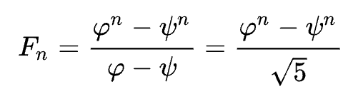
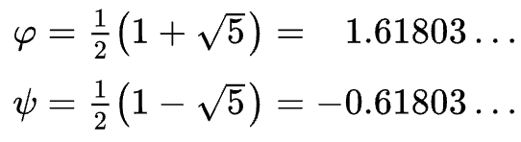
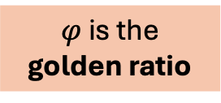
The Fibonacci Sequence
1, 1, 2, 3, 5, 8, 13, 21, 34, 55, 89, 144, …
The first two numbers are 1 and 1.
Each other number is the sum of the two numbers before it.
Exponential!
Recurrence relation:
$$F_{1}=1$$
$$F_{2}=1$$
$$F_{n}=F_{n−1}+F_{n−2} (n>2)$$
$φ$ is the golden ratio

Slide 10
Coding the Fibonacci Sequence
See the online code for working examples.
The Fibonacci sequence can easily be programmed using it’s recursive definition
But it does an exponential number of recursive calls!
A non-recursive version using a loop is much faster
But the is trickier to get right
An interesting technique that can speed up the recursive version (at the cost of using more memory) is memoization
memoization is an example of a general technique called dynamic programming

