Slide 1
Semantic Data Retrieval
Team 1
By Sotheanith Sok, Lauro Cabral, Christopher Vargas, Abhinay Kacham, and Dinesh Reddy Kommera

Slide 2
Datasets

Slide 3
Arrest Data from 2020 to Present
Report ID
Report Type
Arrest Date
Time
Area ID
Area Name
Reporting District
Age
Sex Code
Descent Code
Charge Group Code
Charge Group Description
Arrest Type Code
Charge
Charge Description
Disposition Description
Address
Cross Street
LAT
LON
Location
Booking Date
Booking Time
Booking Location
Booking Location Code

Slide 4
Crime Data from 2020 to Present
DR_NO
Date Rptd
DATE OCC
TIME OCC
AREA
AREA NAME
Rpt Dist No
Part 1-2
Crm Cd
Crm Cd Desc
Mocodes
Vict Age
Vict Sex
Vict Descent
Premis Cd
Premis Desc
Weapon Used Cd
Weapon Desc
Status
Status Desc
Crm Cd 1
Crm Cd 2
Crm Cd 3
Crm Cd 4
LOCATION
Cross Street
LAT
LON

Slide 5
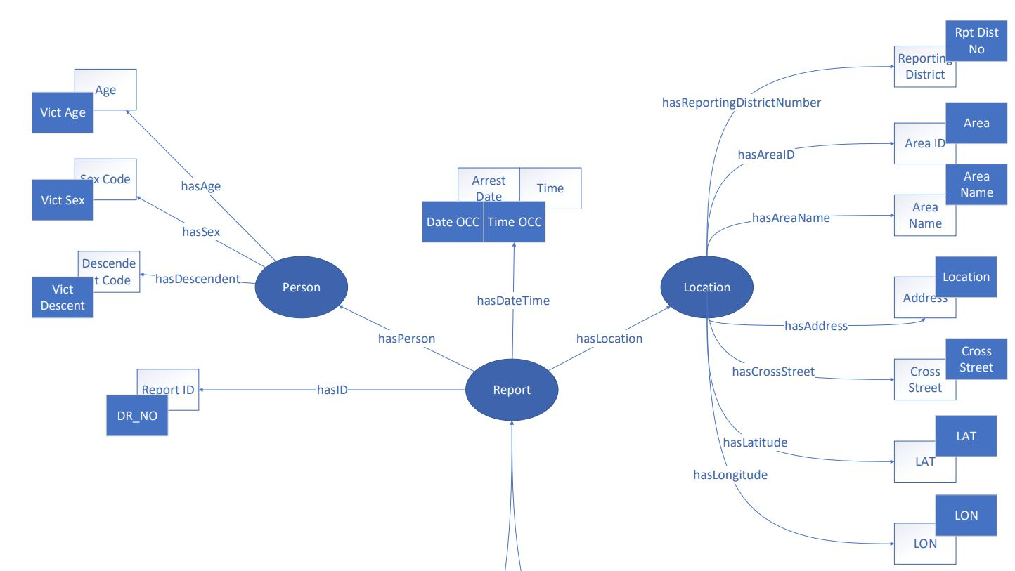
Report Class

Slide 6
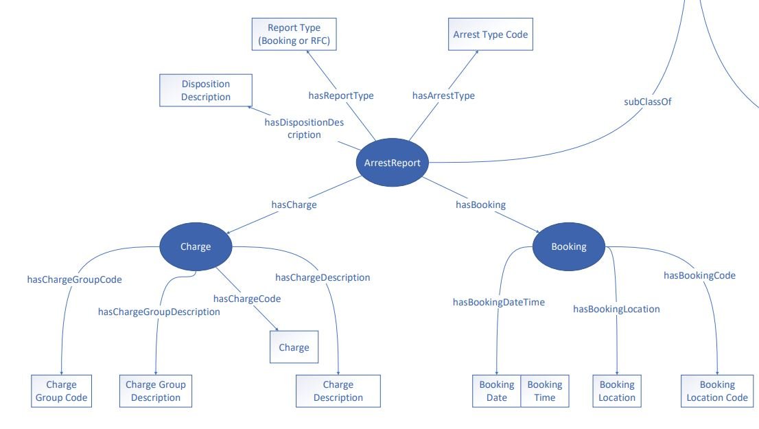
ArrestReport Class

Slide 7
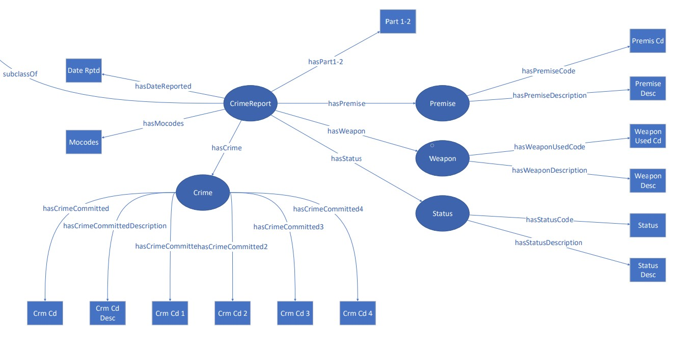
CrimeReport Class

Slide 8
Technical Debt
Issues with Projects 2

Slide 9
Too Many Loops
Problem:
Most processes of our program for generating rdf files, such as data processing and adding data to rdf graph, rely on “for loops.”
Everything has to be done linearly.
It is very slow for our data size.
Solution:
Store all our data in Pandas dataframes.
Convert as many “ for loops” as possible to Pandas “map” function.
“Map” function is faster than “for loop” because it vectorizes our data

Slide 10
Naive Instance Checking of RDF Graph
Problems:
In project 2, the name of an instance of a class is formatted as “ className - #s of instances of the class in the graph ”
Ex: Report-0, Report-1,...etc.
To check if an instance of a class already exists in the graph, we have to find all instances that have the property and then, we repeat the process for all properties.
Finally, we intersect multiple lists of instances to check if there exist an instance with properties that we are looking for.
It is really slow to do this.
Solution:
Change naming scheme to “className - hashValues”
hasValues = md5 ( property_1 + property_2 + … )
This approach means that two instances of a class with the same properties and properties’ values will have the same name.
This bypass the instance checking and any duplicate instances will simply override the existing one.

Slide 11
Search System using SPARQL
Integrating RDF Graph Manager with UI

Slide 12
Requirements
Old Libraries:
Python
Request
RdfLib
Pandas
Auto-Py-to-Exe
New Libraries:
Tqdm - cli progress bar
Dominate - generate dom using python syntax
PyQt5 - gui library
PyQtWebEngine - add web viewer to PyQt5

Slide 13
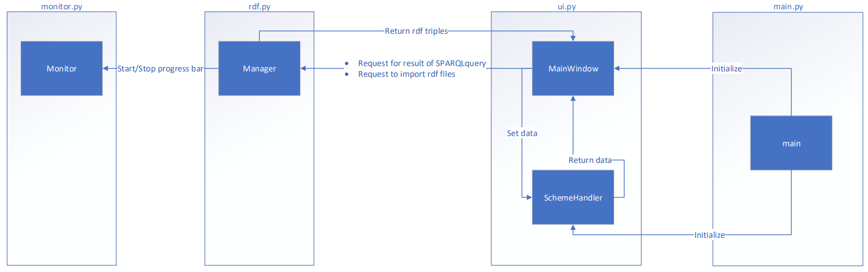
Program Structure

Slide 14
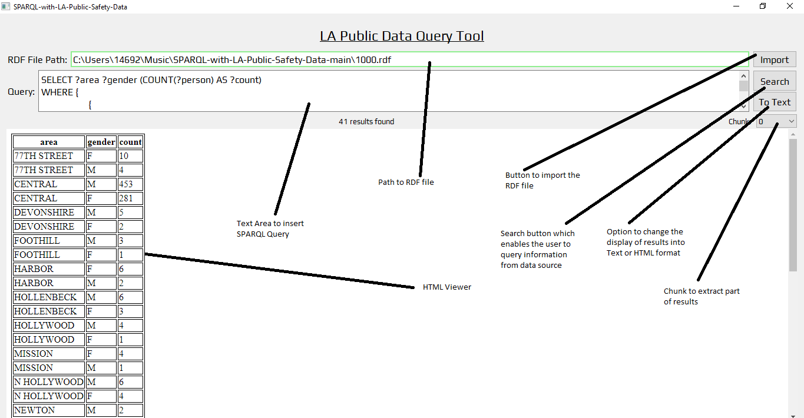
User Interfaces

Slide 15
Queries & Results

Slide 16
Query 1:
Q: What is the time with the least amount of crime occured?

Slide 17
Query 1:
Query: SELECT (COUNT(?report) AS ?number_of_crimes) ?hours WHERE {
{
SELECT (HOURS (?o) AS ?hours) ?report
WHERE {
?report rdf:type ns1:CrimeReport .
?report ns1:hasDateTime ?o
}
}
}
GROUP BY ?hours
ORDER BY ?number_of_crimes
LIMIT 5

Slide 18
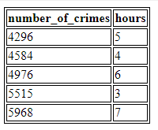
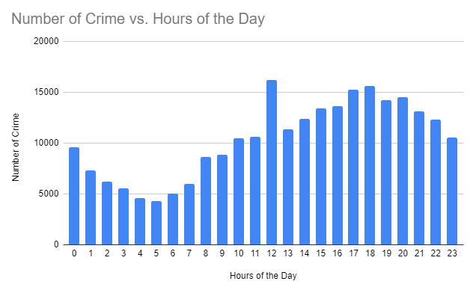
Query 1:
Result:

Slide 19
Query 2:
Q: What is the ratio of the number of arrests of a person who committed a crime at a particular location to that of the total number of crimes located at that location?

Slide 20
Query 2:
SELECT (?number_of_arrests/?number_of_crimes AS ?fraction)
WHERE {
{
SELECT (COUNT (?arrest_report) AS ?number_of_arrests)
WHERE {
?arrest_report rdf:type ns1:ArrestReport .
?arrest_report ns1:hasLocation ?location .
?location ns1:hasAddress ?a_crime_address .
FILTER (?a_crime_address = '6TH ST')
}
}
.
{
SELECT (COUNT (?crime_report) AS ?number_of_crimes)
WHERE {
?crime_report rdf:type ns1:CrimeReport .
?crime_report ns1:hasLocation ?location .
?location ns1:hasAddress ?c_crime_address .
FILTER (?c_crime_address = '6TH ST')
}
}
}

Slide 21

Query 2:
Result:

Slide 22
Query 3:
Q: For a given url reference, what are rdf triples that contain such a reference?

Slide 23
Query 3:
Query: Let X be the url reference
SELECT ?s ?p ?o WHERE {
{
SELECT (COALESCE(X) as ?s) ?p ?o
WHERE {
X ?p ?o
}
} UNION {
SELECT ?s (COALESCE(X) as ?p) ?o
WHERE {
?s X ?o
}
} UNION {
SELECT ?s ?p (COALESCE(X) as ?o)
WHERE {
?s ?p X
}
}
}

Slide 24
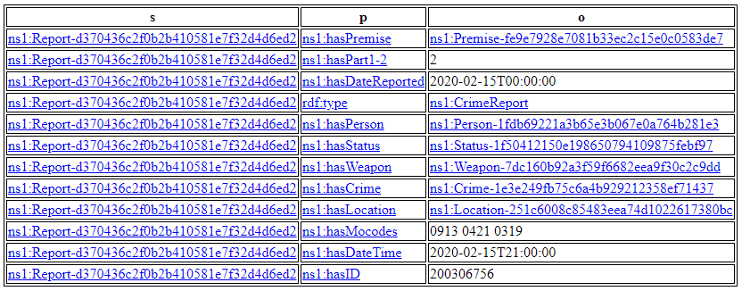
Query 3:
Result:

Slide 25
Technical Challenges
Problem, problem, and more problems...

Slide 26
Web Viewer
Problems:
Since the web viewer is based on chromium, it has an inherent 2mb limit when you set content of the viewer directly.
The web viewer has a performance and an instability when displaying table with 10,000 rows or more.
Solutions:
Implement “SchemeHandler” that is responsible for intercepting http request and send back data to the web viewer. It also allows controller to set data in which it supposes to reply with.
Split results into chunks of 1,000 data and only one chunk gets send to the web viewer at any given time.

Slide 27
SPARQL Quirk
Problems:
Unlike SQL, SPARQL has limited set of flexible capabilities.
There are special characters that mark the end of a term in a query such as “#”.
Some SPARQL functions only work with xsd:dateTime rather than xsd:date or xsd:time.
Solutions:
Updated ‘#’ with ‘-’ RDF, as it has own importance in SPARQL.
Merge xsd:date and xsd:time to xsd:dateTime.
For xsd:date only, assume time is 00:00:00.

Slide 28
Others
On some machine, there are python compatibility issues with current libraries and it requires a complete reinstall and downgrade python from 3.9 to 3.8.
We have to do a lot of learning since this is our first time working with these datasets or libraries/framework.

Slide 29
Thank you

