Slide 1

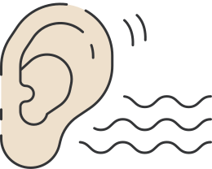
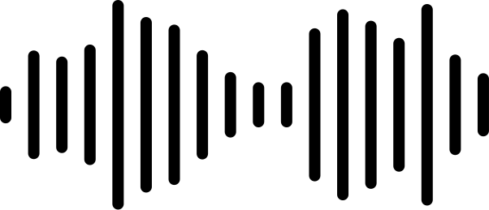


AUDIO NOISE REDUCTION
Digital Signal Processing - Term Project

Slide 2
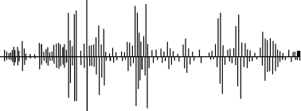


CONTENTS
  Overview
  Audio Preparation
  Exploratory Data Analysis
  Noise reduction pipeline
  Test and validate algorithm with noisy records
  Failure Cases
  Conclusion

Slide 3
OVERVIEW

Slide 4


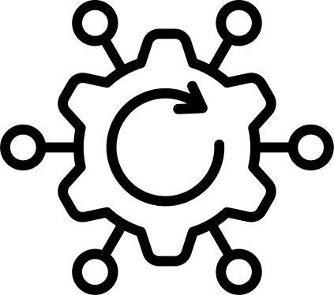


OVERVIEW
1
2
3
Restore real world noisy audio by DSP algorithm
Add custom noise profiles with clean reference audio
Build DSP pipeline based on the synthetic baseline
4
5
Test the algorithm against unknown noisy records
Use algorithm with real world noisy audio

Slide 5
AUDIO PREPARATION

Slide 6

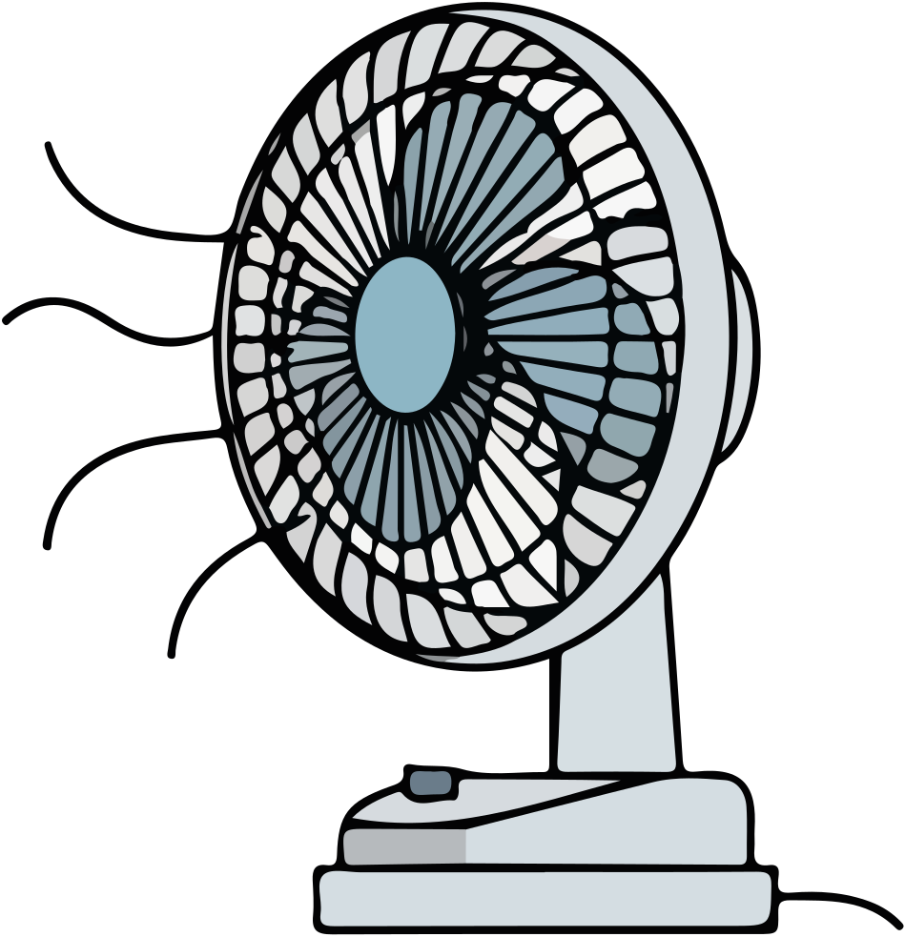
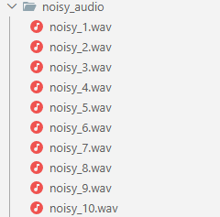
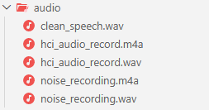

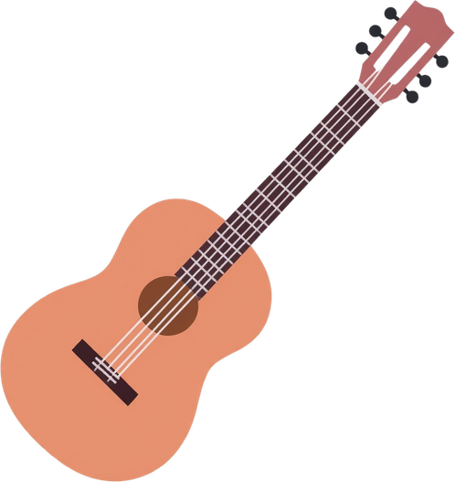
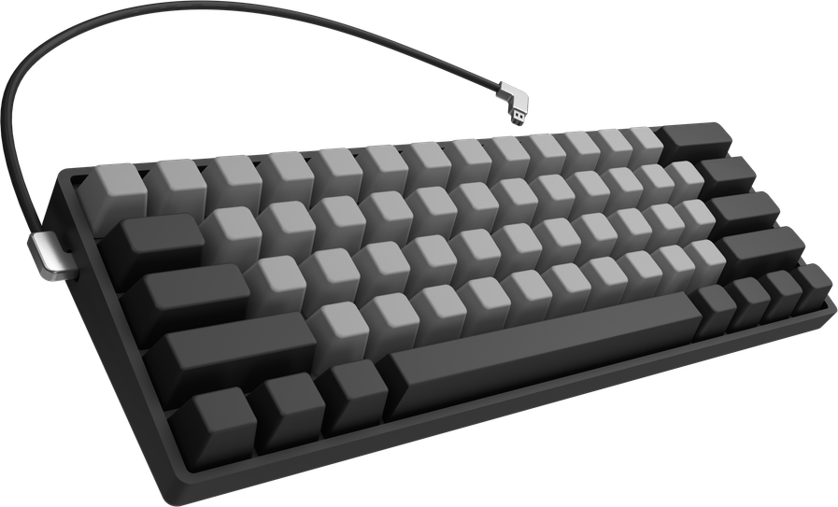


AUDIO PREPARATION

Slide 7
EXPLORATORY DATA ANALYSIS (EDA)

Slide 8
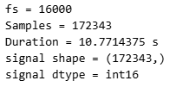
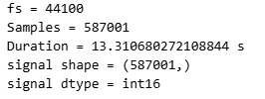


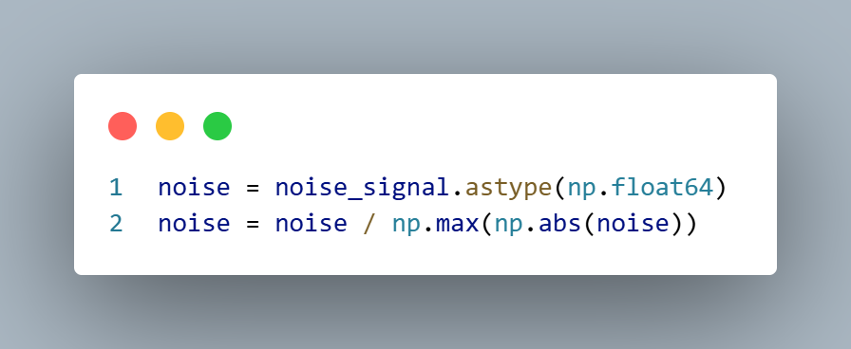
EXPLORATORY DATA ANALYSIS
Convert from .m4a file to .wav file
!ffmpeg -y -loglevel error -i audio/sound_1.m4a -ac 1 -ar 44100 -c:a pcm_s16le audio/sound_1.wav
clean_speech.wav
noise_recording.wav

Slide 9



EXPLORATORY DATA ANALYSIS
Resample_poly

Slide 10
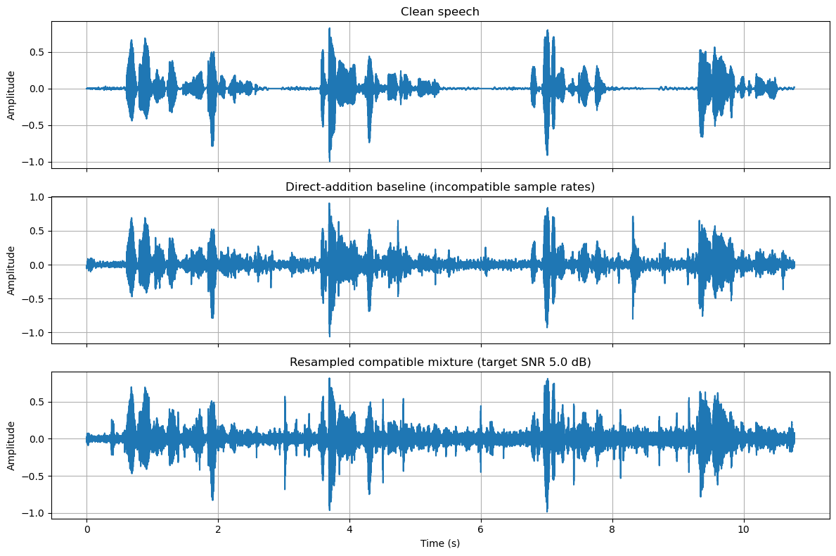
EXPLORATORY DATA ANALYSIS

Slide 11

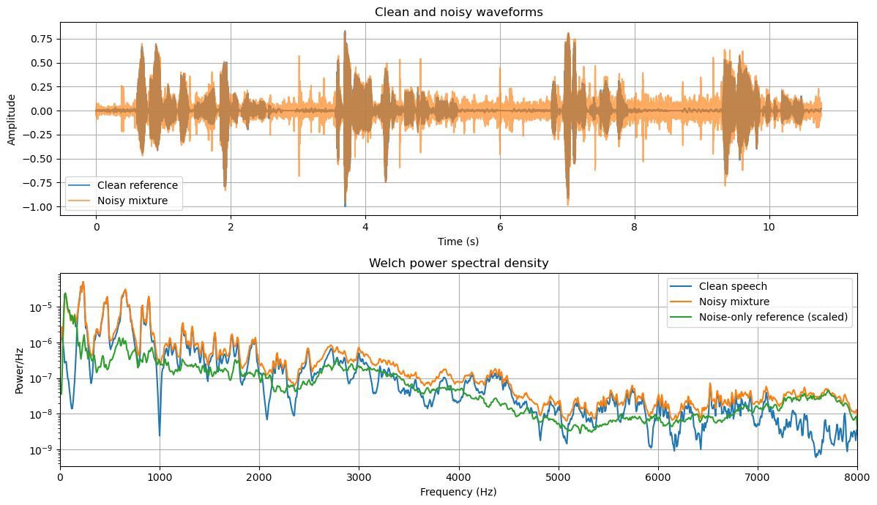
EXPLORATORY DATA ANALYSIS

Slide 12
NOISE REDUCTION PIPELINE

Slide 13
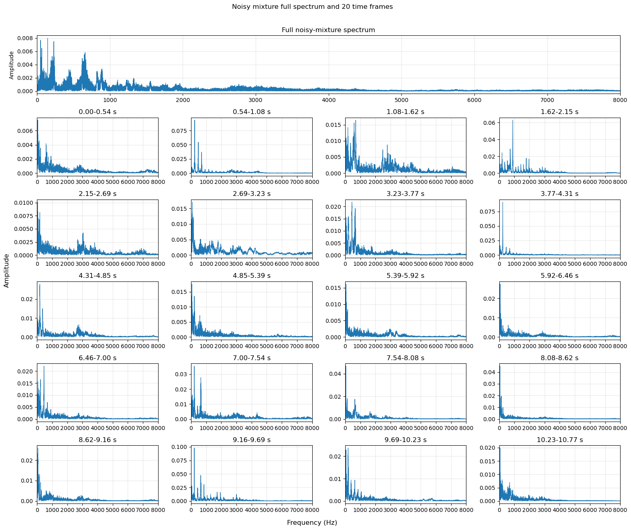
FFT SPECTRUM

Slide 14
FFT SPECTRUM

Slide 15
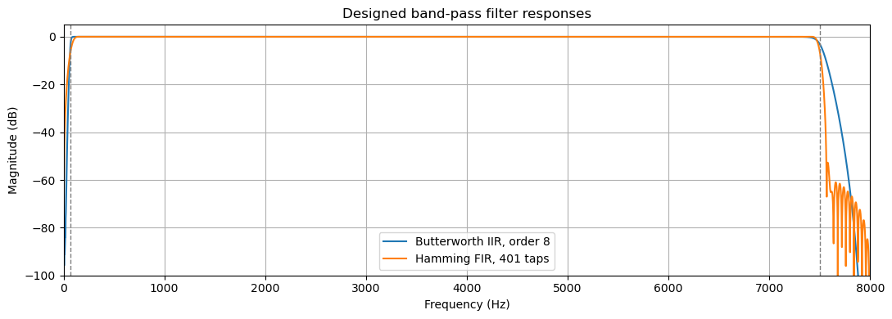
FIR AND IIR BASELINE FILTER

Slide 16
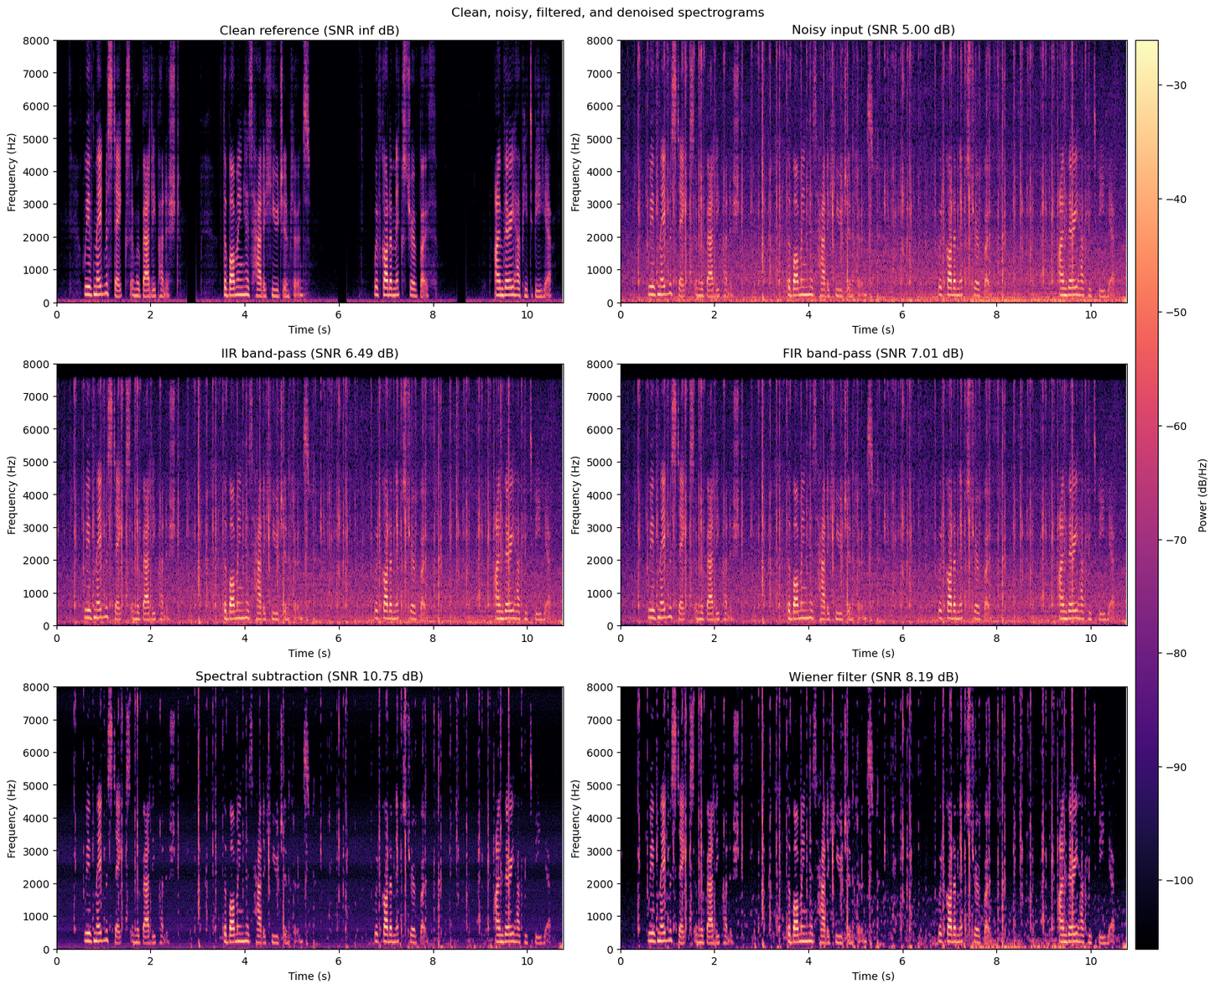
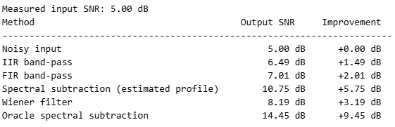

STFT

Slide 17
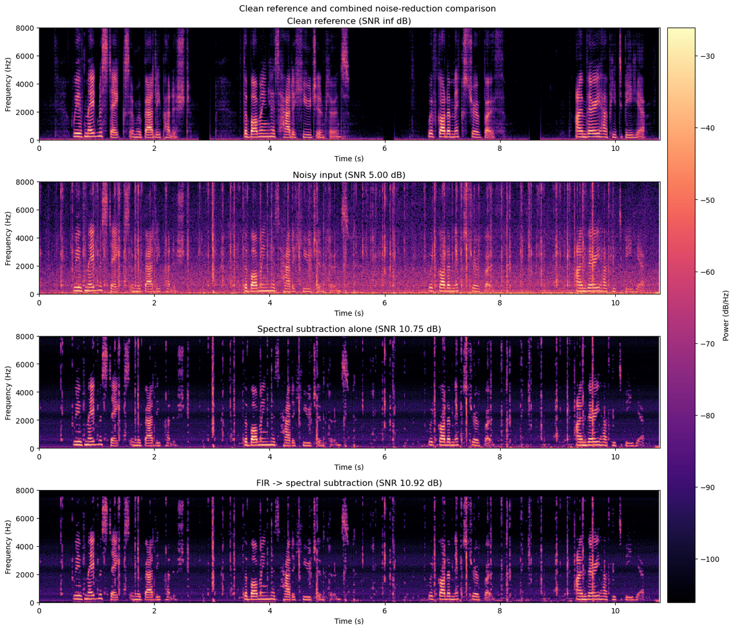
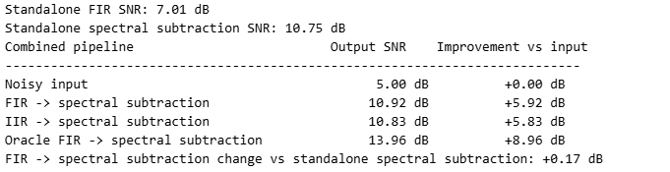
COMBINED DESOISING PIPELINE

Slide 18

TARGETED KEYBOARD CLICK EXPERIMENT
1. Find click:
  Use the known noise track
  Band-pass the audio
  Use median over frame
  Clean up the detections
2. Spectral subtraction
  STFT
  Noise profile
  Subtract
Goal:
  removes clicks that would damage the spectral subtraction stage
  needs no clean signal or noise recording
  tells what kind of noise each file has

Slide 19
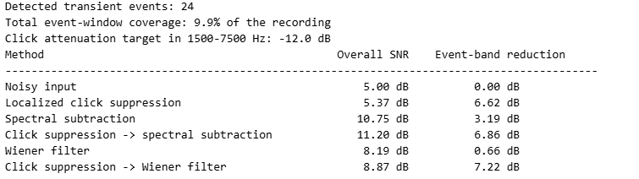
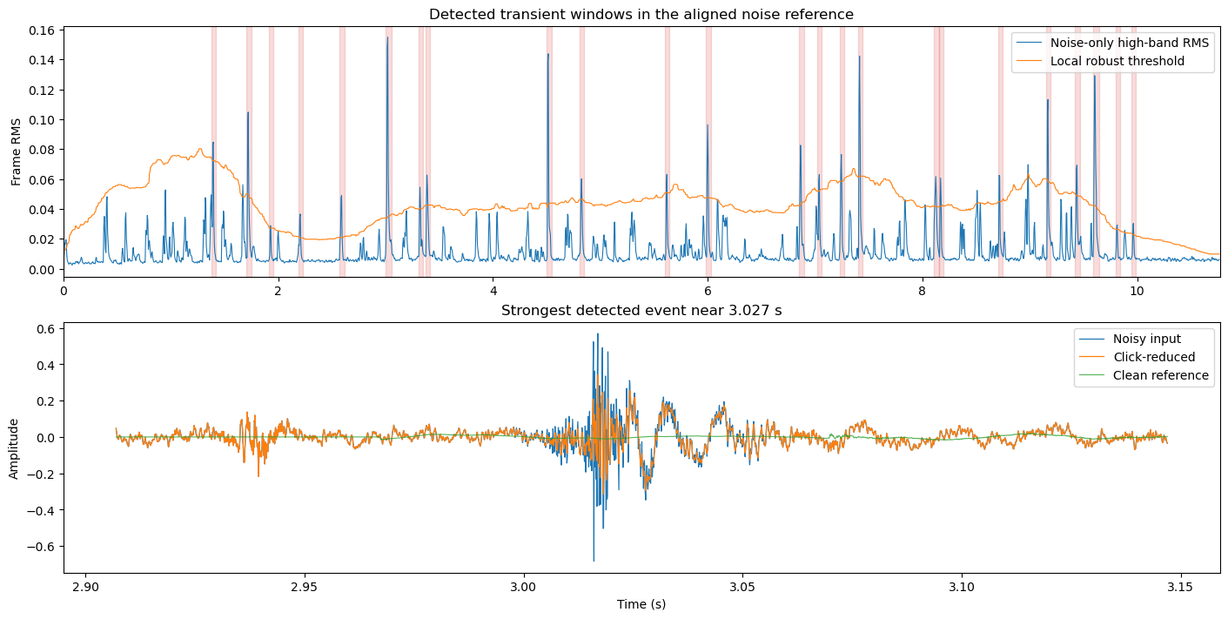
TARGETED KEYBOARD CLICK EXPERIMENT

Slide 20
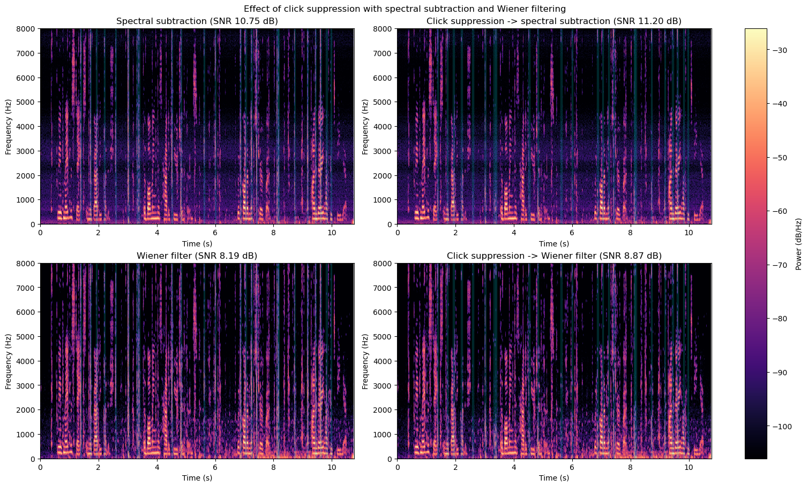
TARGETED KEYBOARD CLICK EXPERIMENT

Slide 21
TEST AND VALIDATE ALGORITHM WITH NOISY RECORDS

Slide 22
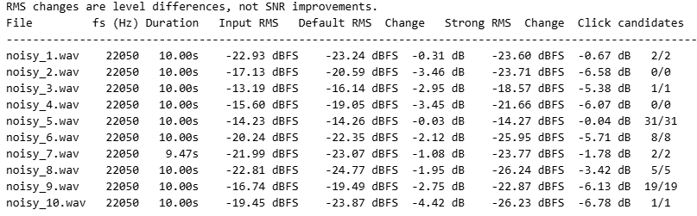
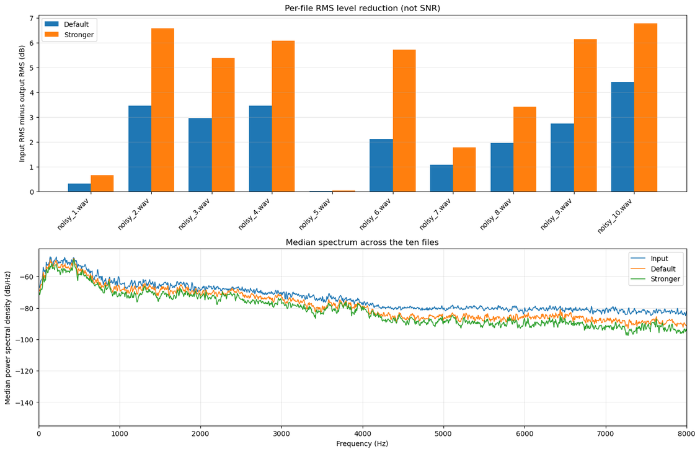
VALIDATE ALGORITHM WITH 10 NOISY RECORDS

Slide 23
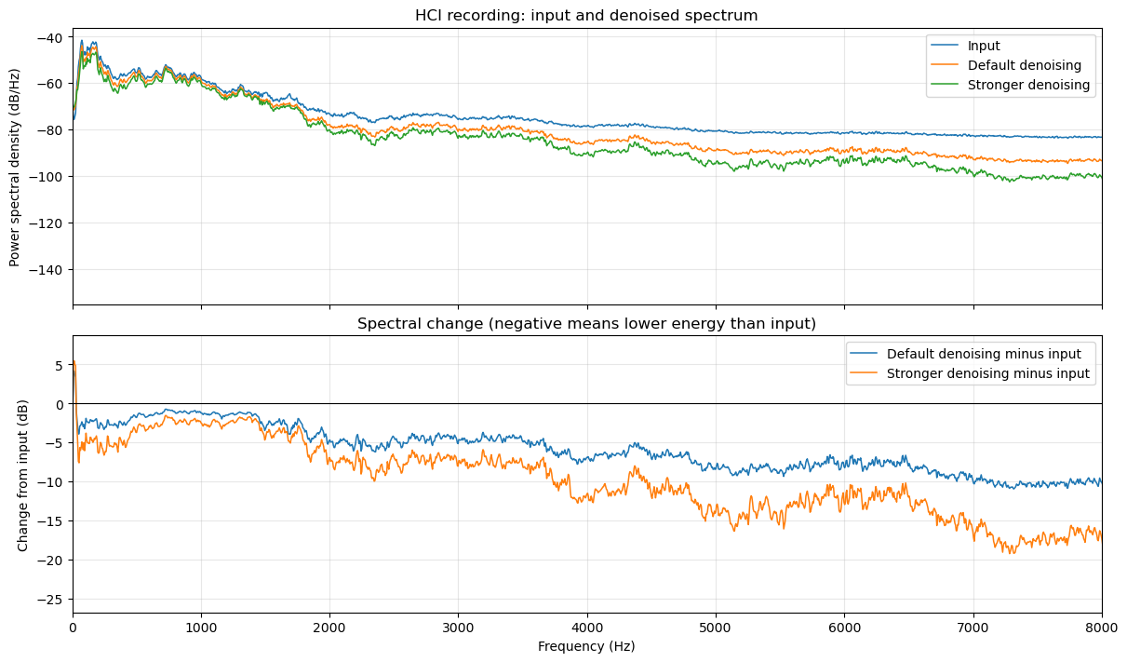
TEST ALGORITHM WITH 10 NOISY RECORDS

Slide 24
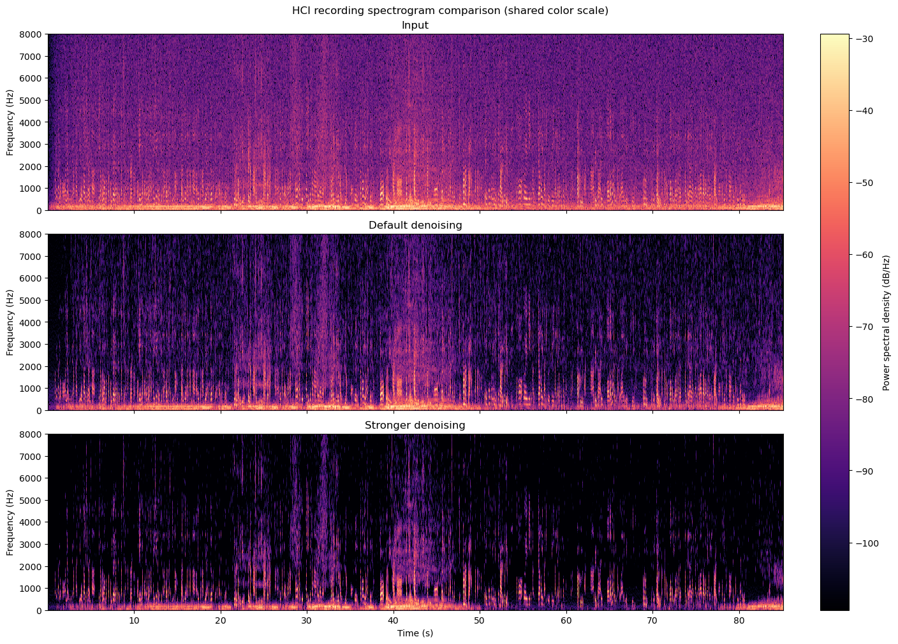
TEST ALGORITHM WITH 10 NOISY RECORDS

Slide 25
FAILURE CASE

Slide 26
FAILURE CASES
  FIR/IIR filtering: Limited when noise overlaps speech frequencies
  Click detection:May mistake speech transients for clicks and suppress wanted speech.
  Aggressive denoising: Can reduce speech quality along with noise.
  Evaluation limitation: No clean reference for the unknown and batch recordings, so noise-removal quality cannot be objectively confirmed.

Slide 27
CONCLUSION

Slide 28
CONCLUSION
  Spectral subtraction performed best in controlled testing (+5.75 dB SNR).
  Filter FIR/IIR can’t use in this noise reduction project
  Default click suppression plus spectral subtraction sounded best on the real recording, but is not yet effective enough for real world noise.
  Further improvement and testing are needed.

Slide 29
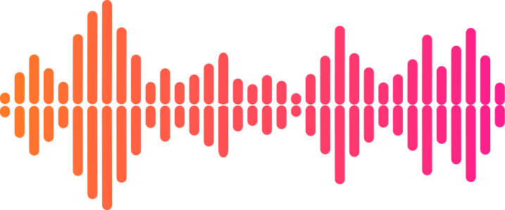
MEMBER
670710123 กัญญาณัฐ เขมนรากร
670710258 Sothea Sokea
REFERENCE
  clean speech: https://www.kaggle.com/datasets/anhquocdevelop/clean-speech
  noisy audio: https://www.kaggle.com/datasets/367a72ddd73170fa1dee00402d00fcb5e0cbe08d84c0db192a69176bdf8606ee
  scipy : https://docs.scipy.org/doc/scipy/index.html
  Digital Signal Processing course lessons
AI USAGE
  Github Copilot: helped edit and debug notebook code, explain DSP concepts, and document the project
  Claude: used to verify approaches and explain concepts or results.
  ChatGPT: used to check code and explanations.

Slide 30

MORE INFOMATION
github repository: audio_noise_reduction

Slide 31
THANK
YOU

