Slide 1
ICT LOTTERY
6010210706 SOTHORNIN MAM
6010210372 SARAWUT KHAMSET

Slide 2
APP SPECIFICATION
01
Can sell lottery number randomly and input number
02
Show cycle prize number
03
Show winner and prize
04
Set up a new cycle
05
Manager can check transaction

Slide 3
Class Diagram

Slide 4
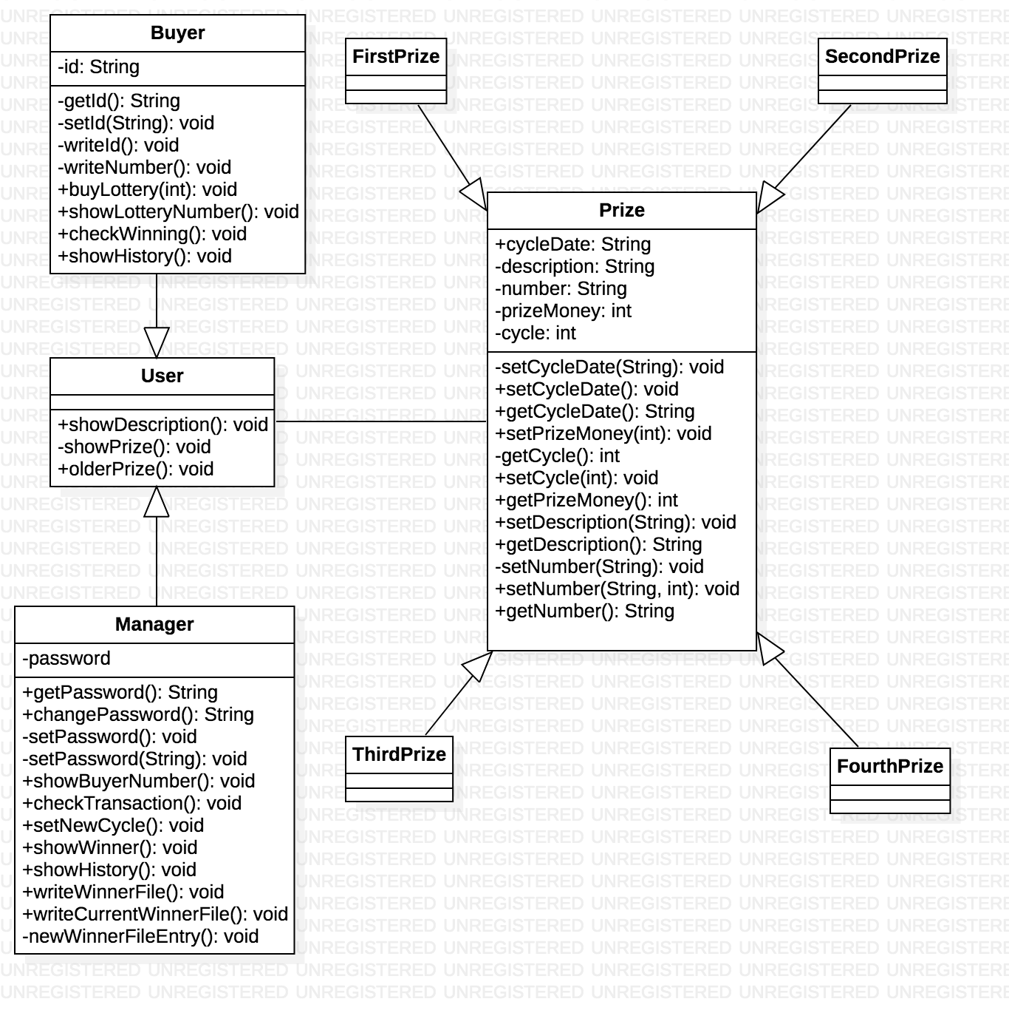

Slide 5
Prize Detail
01
02
03
04
1st Prize
2nd Prize
3rd Prize
4th Prize
1500 Baht
1000 Baht
500 Baht
100 Baht
Match all of the 4 digits
(Only 1 Number per cycle)
Match all of the 4 digits
(5 Numbers per cycle)
Match all of the 4 digits
(5 Numbrs per cycle)
Match last 2 digits
(Unlimited Winner)

Slide 6
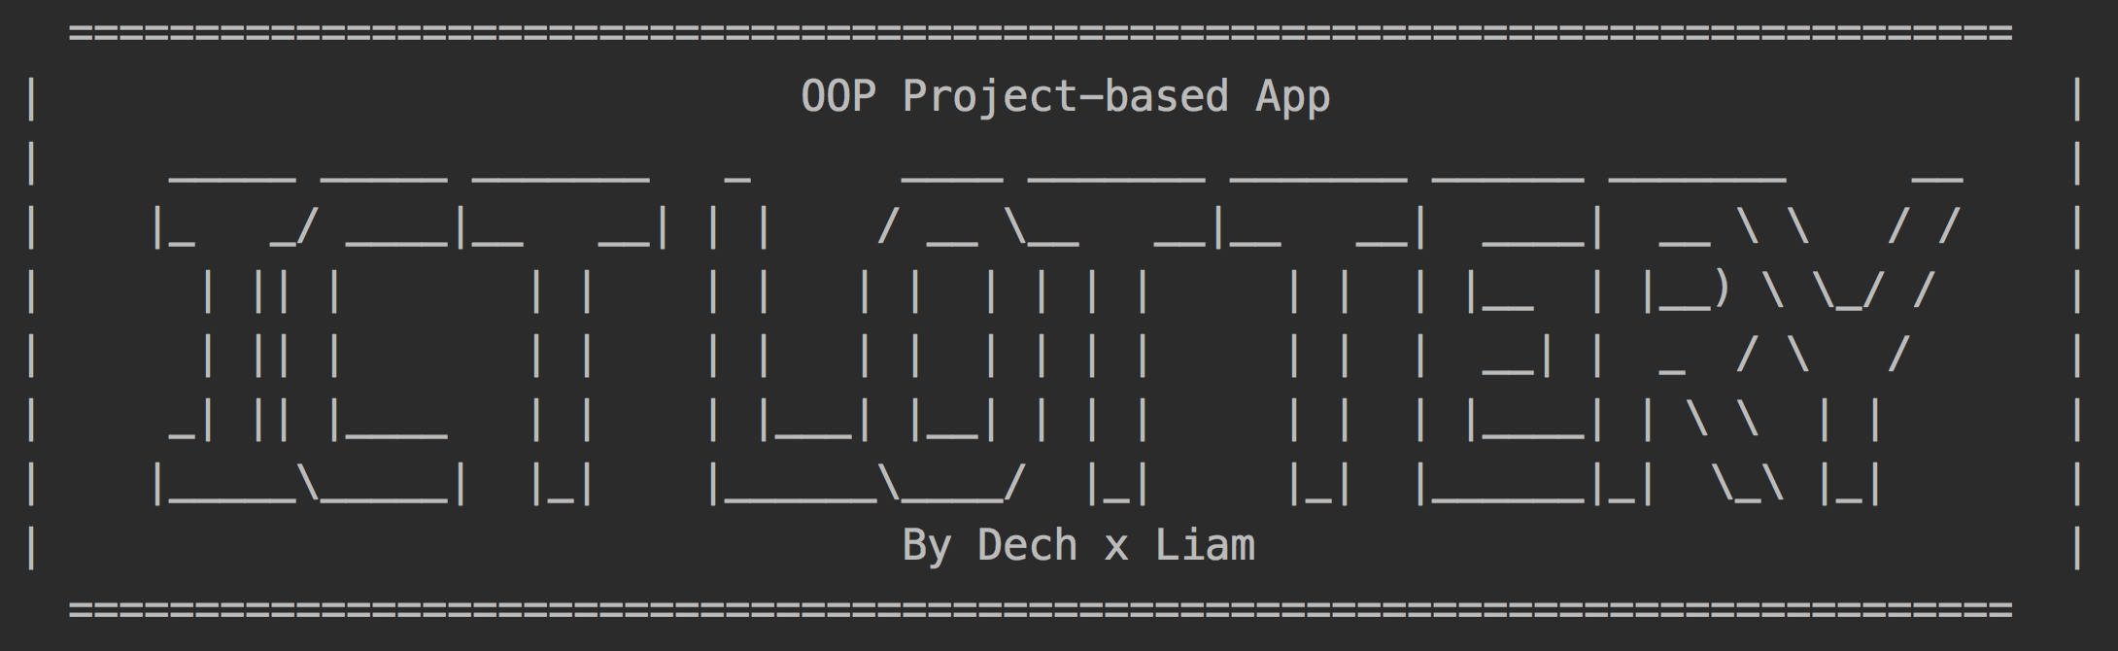
Welcome to ICT LOTTERY

Slide 7
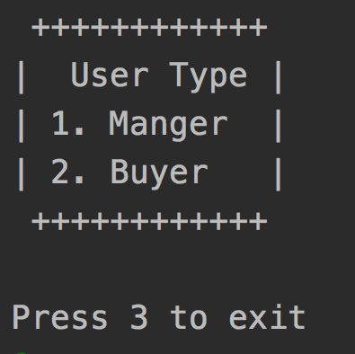
User Selection

Slide 8
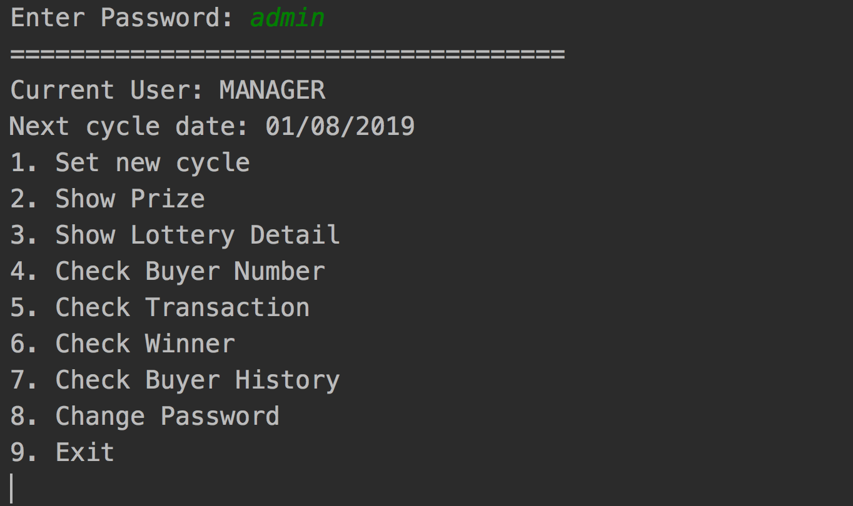
Manager Menu

Slide 9
1. Set up new cyle
Set Up New Date
Random new Cycle Prize
Find prize winner
Restart Application

Slide 10
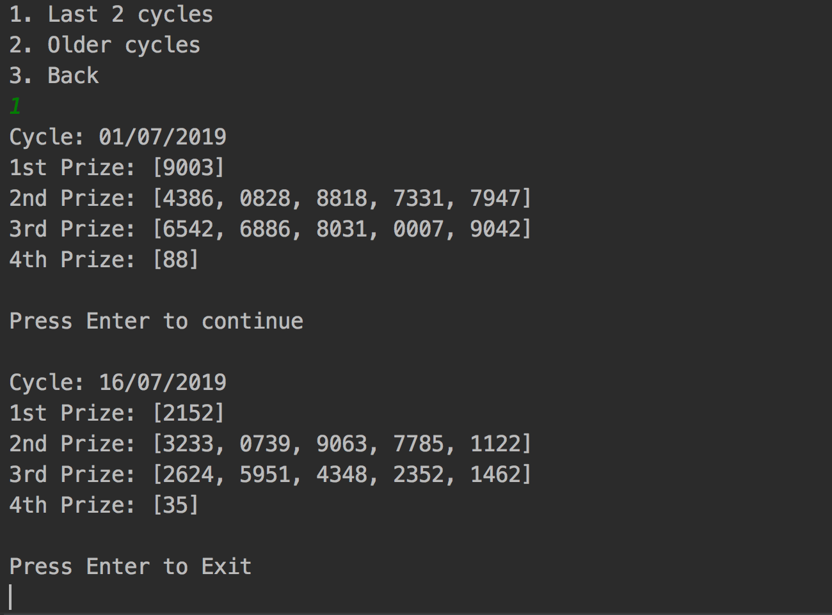
2. Show Prize

Slide 11
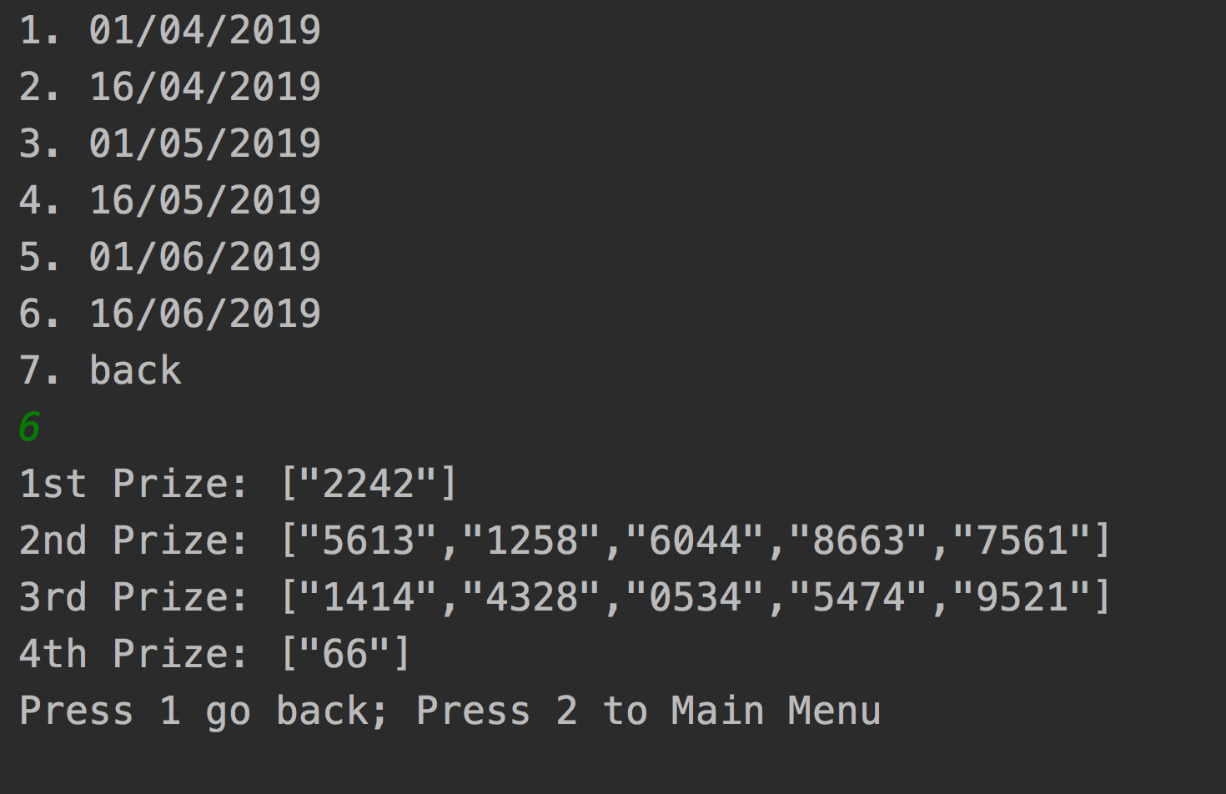
2. Show Prize

Slide 12
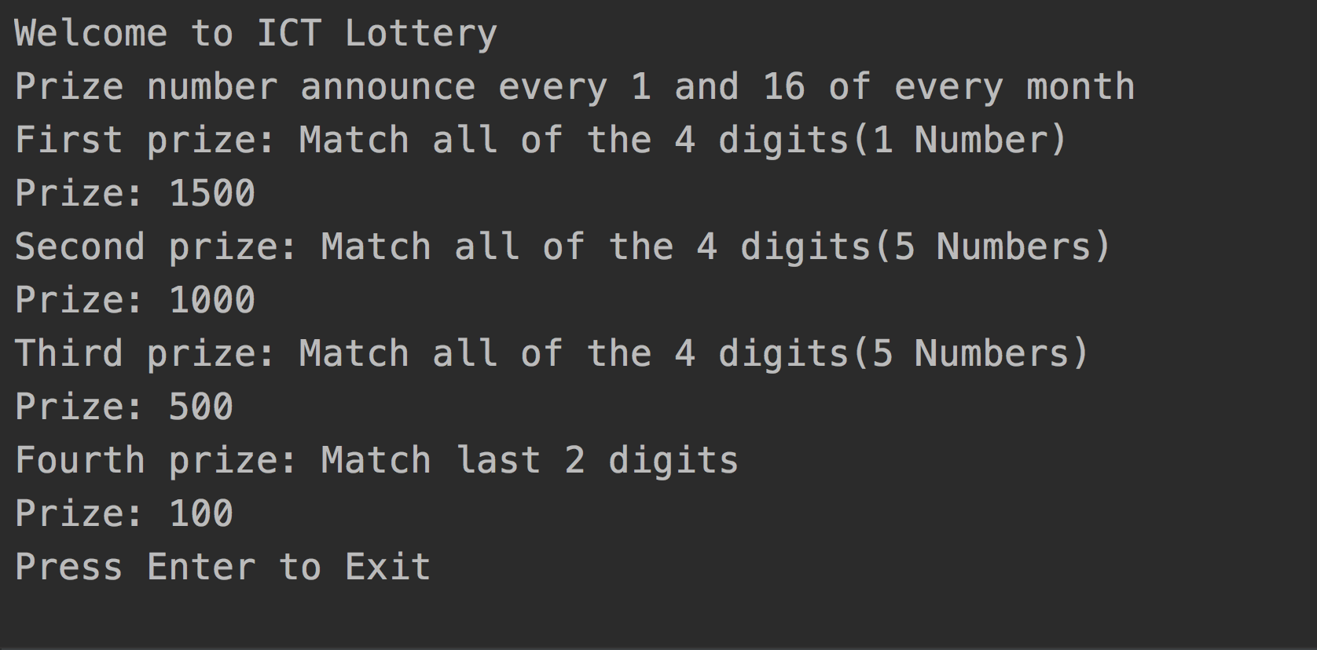
3. Show Lottery Detail

Slide 13
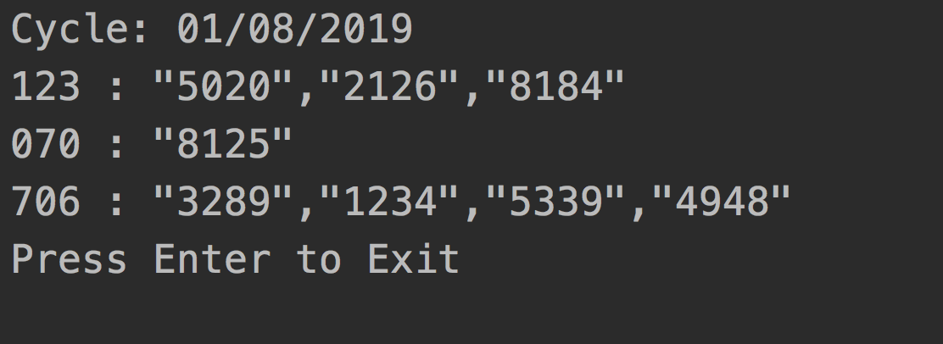
4. Check Buyer Number

Slide 14
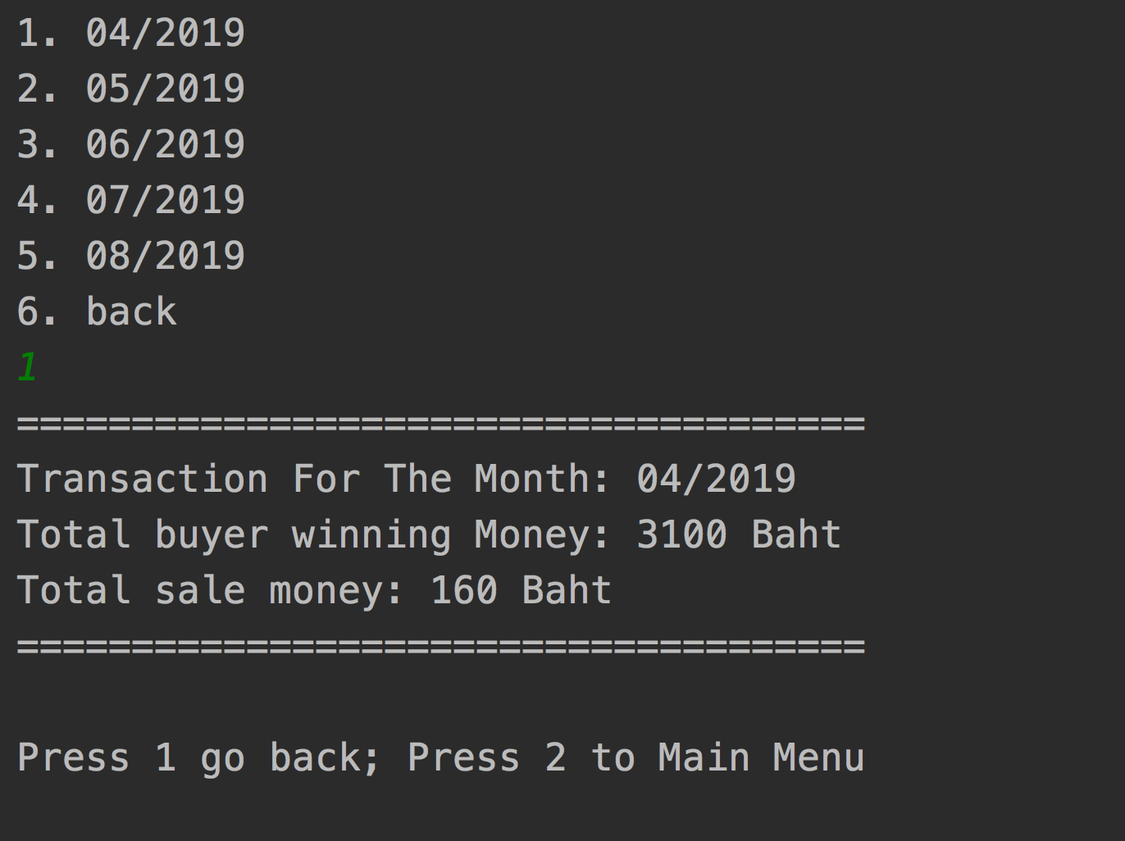
5. Check Transaction

Slide 15
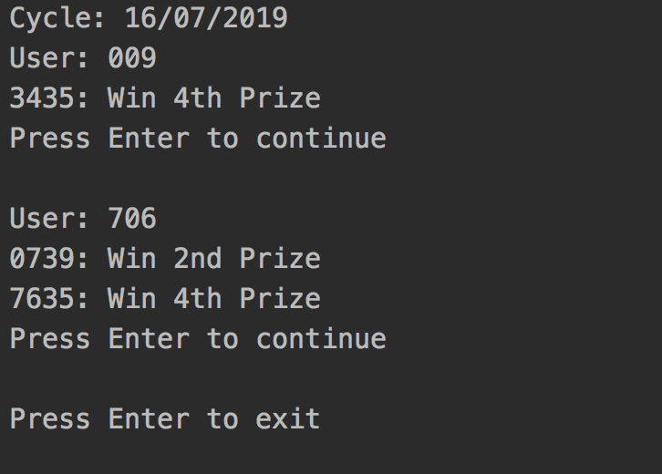
6. Check Winner

Slide 16
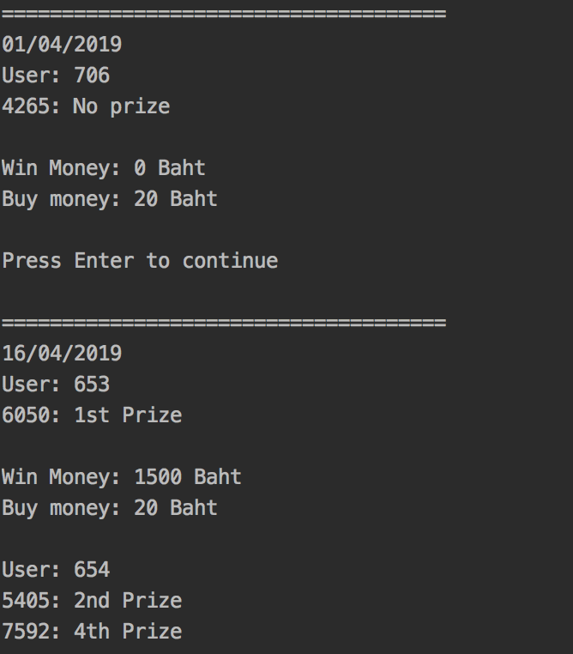
7. Check Buyer History

Slide 17
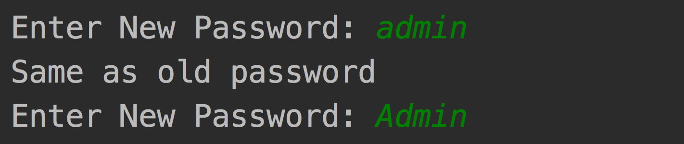
8. Change Password

Slide 18
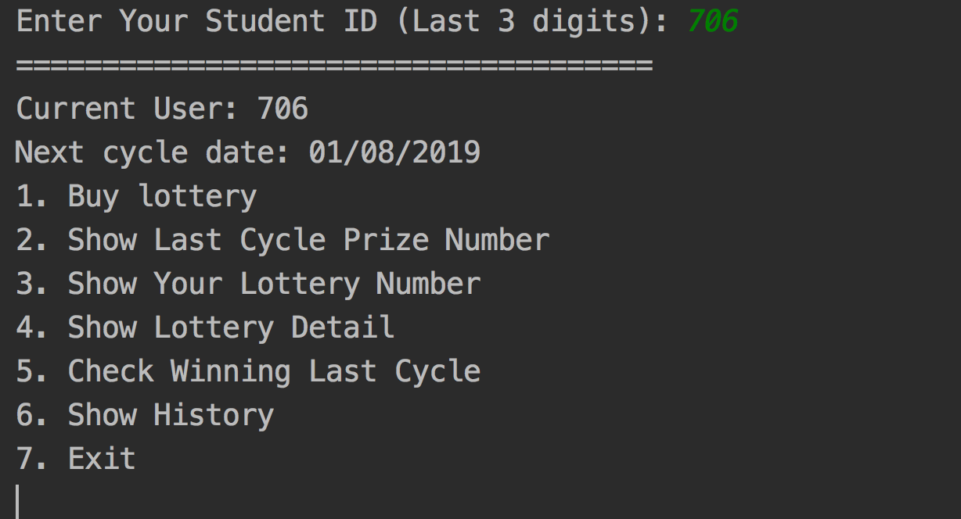
Buyer Menu

Slide 19
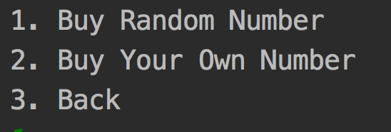
1. Buy lottery

Slide 20
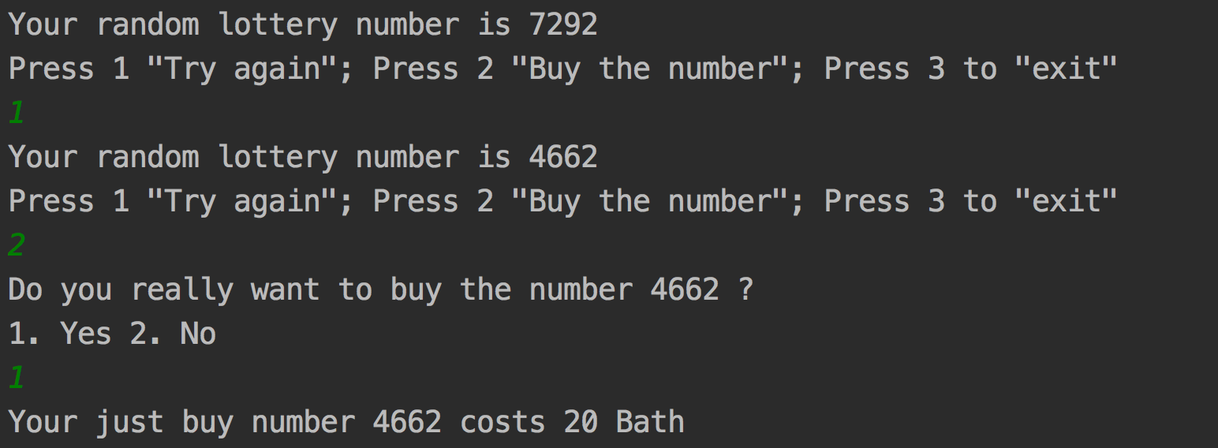
Buy Random Number

Slide 21
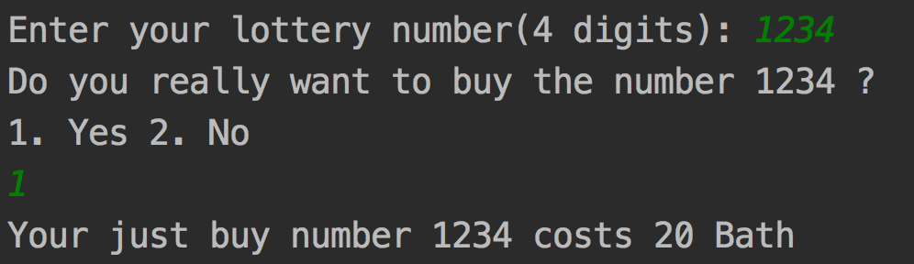
Buy Your Own Number

Slide 22
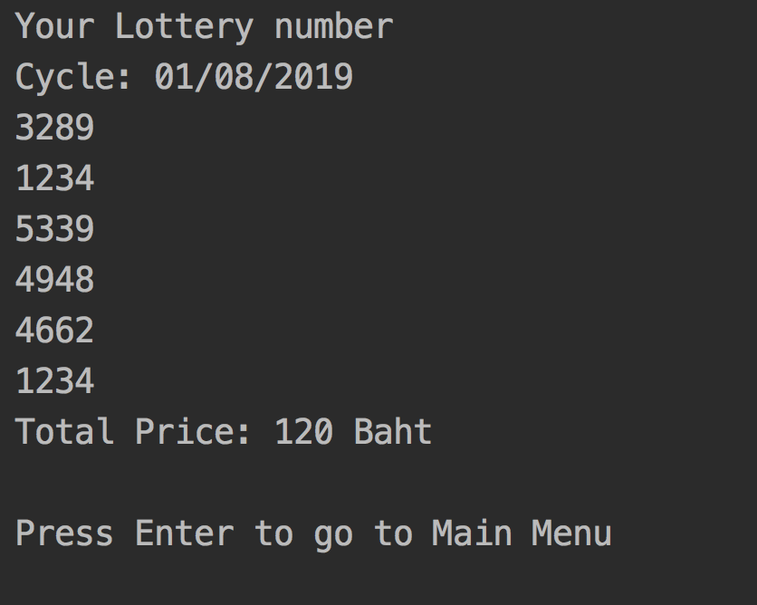
3. Show Your Lottery Number

Slide 23
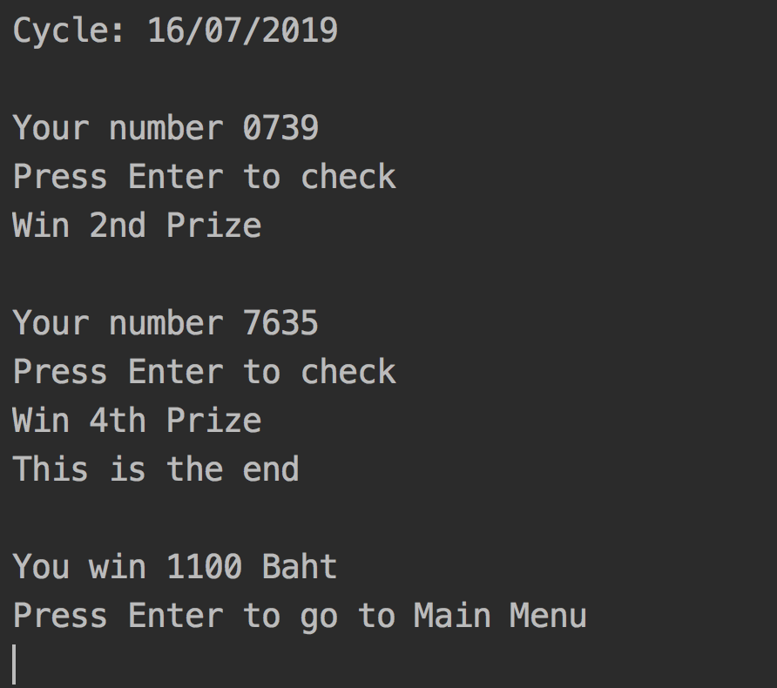
5. Check Winning Last Cycle

Slide 24
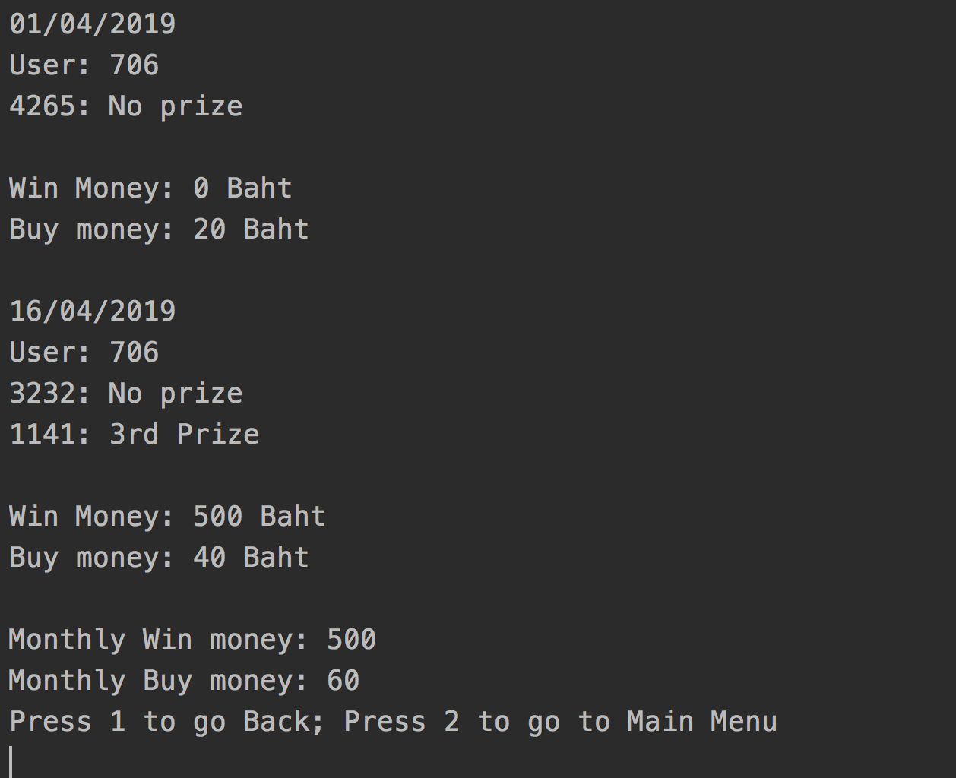
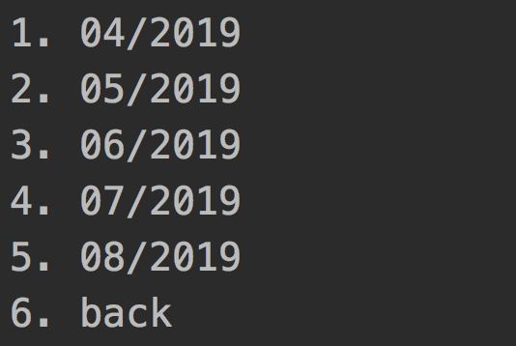
6. Show History

Slide 25
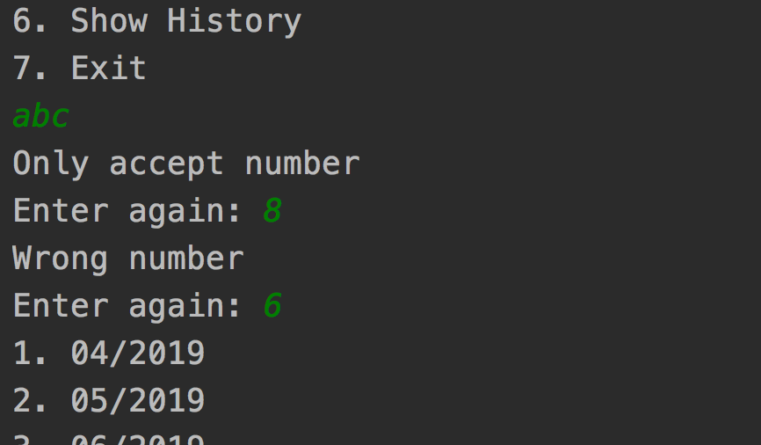
Input Validation

Slide 26
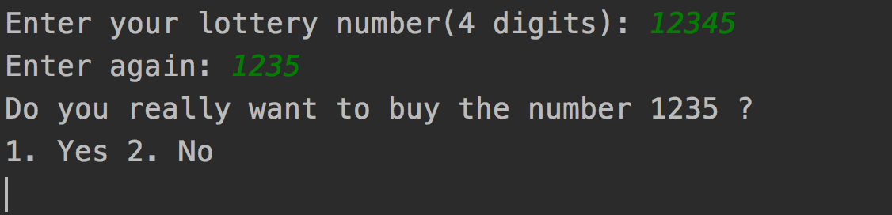
Input Validation

Slide 27
Thank you

