Slide 1
Distributed learning of deep neural network over multiple agents
Paper Analysis

Slide 2
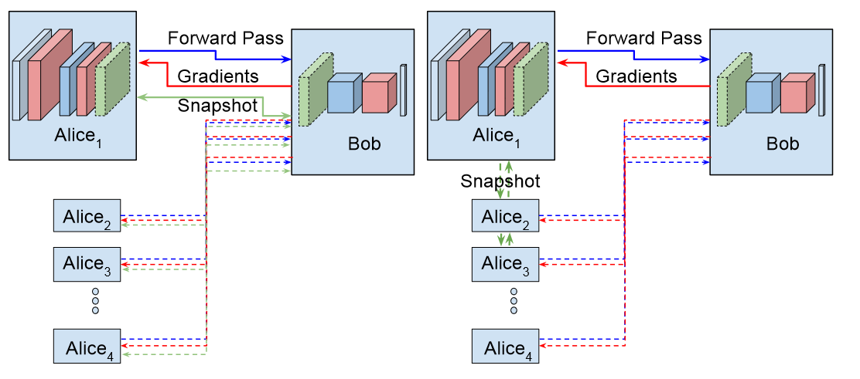
Split Learning
Basic Architecture
Basic Split Learning Procedure
DNN split into 2 partitions.
Clients transmits activations and labels to server.
Server backpropagates error back to client.
Serial Procedure, training happens one client at a time.
Labels need to be sent to the server
Notes:
This is the basic architecture of split learning.
Split Learning splits a deep neural network in two partitions.
The first partition is residing in the client and the second in the server.
The forward propagation starts from the client and ends at the cutoff layer.
Then the activations of the cutoff layer, and the labels of the data are sent to the server.
The server finishes the forward propagation and computes the loss.
Then using gradient descent and backpropagation the weights are updated.
At the cutoff layer, the gradients are sent to the client where the backpropagation process is terminated.
Multiple clients can contribute to the training of the deep neural network.
However, the updated weights are either transmitted from the server in a client-server fashion,
or from the client that just finished training in a peer-to-peer fashion.

Slide 3
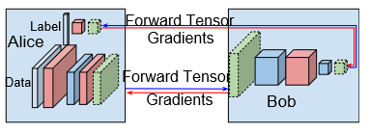
Split Learning
No Label Sharing Training
Slight change in the overall architecture
No need to send labels to server
Wrap around final layers back to the client and let client compute losses
Notes:
No label sharing is another edition of split learning architecture.
Slight change of the overall architecture so that the final layers are wrap back to the client.

Slide 4
NoPeek: Information leakage reduction to share activations in distributed deep learning
Paper Analysis

Slide 5
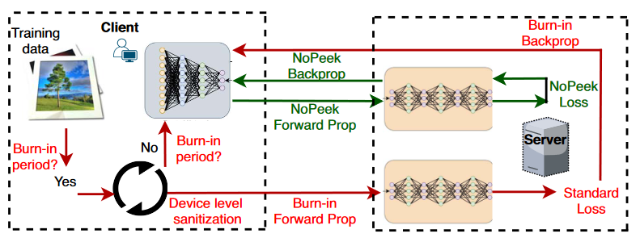

NoPeek
Idea
Decorrelate activation data at cutoff layer and raw data to prevent information leakage.
Loss function is a combination of distance correlation and cross-entropy
Notes:
This article is about to show that minimizing distance correlation between raw data and intermediary representations reduces leakage of sensitive raw data patterns.

Slide 6
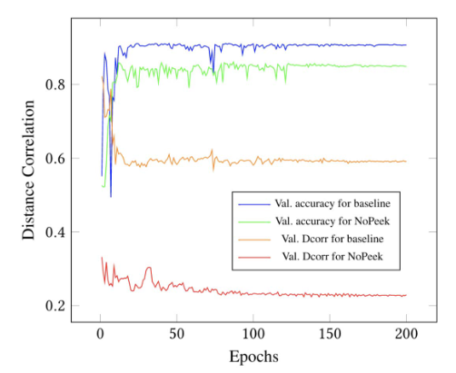
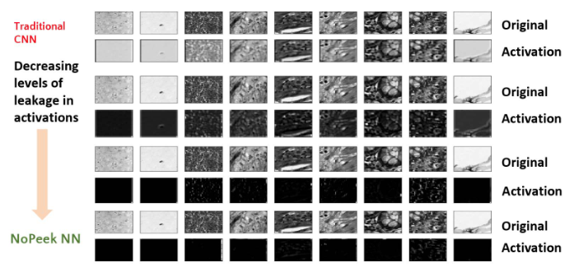
NoPeek
Performance
Notes:
The figure on the left shows that a good accuracy can be achieved when using the NoPeek method.
Even though the data are decorrelated now they can still train the DNN.
The figure on the right shows how the activations are when the NoPeek method is gradually applied

Slide 7
Federated or Split? A Performance and Privacy Analysis of Hybrid Split and Federated Learning Architectures
Paper Analysis

Slide 8
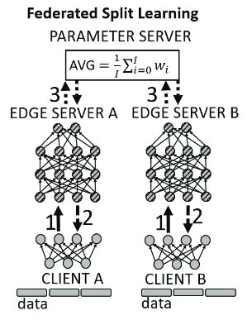
Federated Split Learning
Architecture
Incorporation of both FL and SL architectures
One-to-one connection of client and edge-server (allows scalability)
Parameter server for aggregation at the end of each epoch
Notes:
Before Introducing the proposed hybrid method of the paper.
Parallel Split Learning is mentioned.
In PSL the first part of the split neural network is sent to multiple clients and the second to a server.
This way the training phase is parallelized since clients sent their intermediate data in parallel.
However, since the server waits until all clients to finish their forward propagation in order to start the backward propagation, this can be a bottleneck.
FSL introduces a new architecture to tackle this bottleneck as well as incorporating federated learning.
The deep neural network is again logically split into two partitions.
The first partition containing the input layer of the learning model is sent to a client,
and the second partition runs within an (edge) server.
However, when all pairs finish processing their batches of data, the weights in the edge servers are averaged in a parameter server
and then are sent back to each edge server.

Slide 9
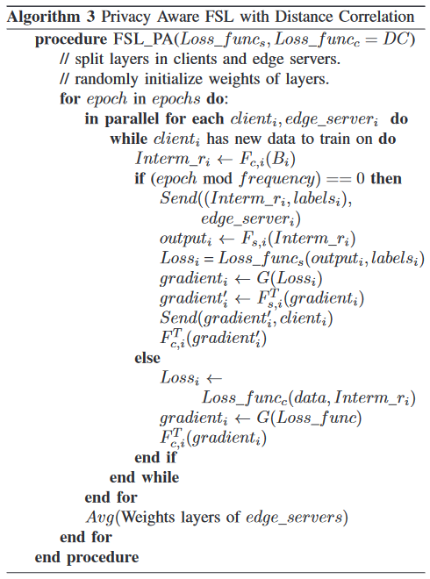
Federated Split Learning
Privacy Aware Federated Split Learning
This algorithm enhances the privacy.
Incorporates the distance correlation in the client partition of the DNN.
Distance Correlation tries to maximize the diversity of the intermediate data sent to the server and the original data.
Notes:
After proposing the baseline algorithm, the authors proposed a privacy aware algorithms as well.
This algorithm makes use of two loss functions instead of just only one.
The first loss function is the Cross Correlation that is used at the end of the DNN at the server’s partition.
The second loss function is Distance Correlation and is used only in the client partition in order to maximize the diversity of the intermediate and original data.

Slide 10
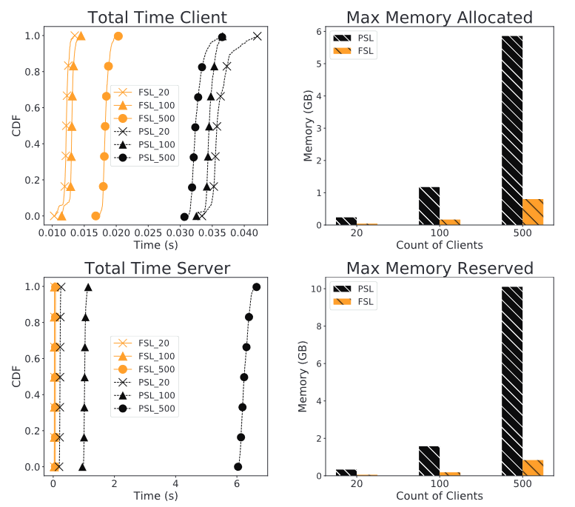
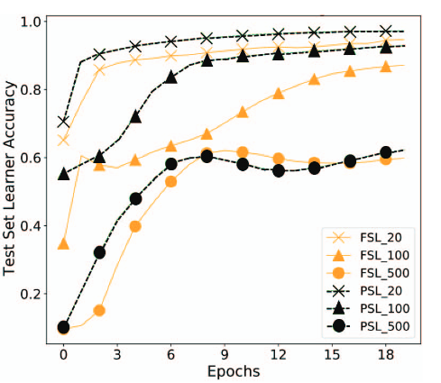
Federated Split Learning
Evaluation FSL
Notes:
FSL can parallelize the training better than PSL does.
Less memory allocated by clients and servers.
However, PSL has slightly better performance than FSL.
With lower number of clients 20 or 100 the performances of both PSL and FSL are good.
However, for 500 clients the performances degrade a bit. A reason can be the amount of data held by each client is not sufficient to train.
And a reason why FSL has lower performance than PSL can be the aggregation of only the edge server weights.

Slide 11
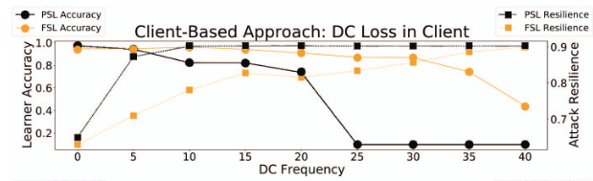
Federated Split Learning
Evaluation of Privacy Aware FSL
Notes:
This slide is about the privacy preserving abilities of FSL and PSL. If the attacker can reconstruct the data.
When Distance Correlation is used the FSL performs better than PSL, and both methods have good attack resilience
Applying differential privacy either on the client or both in the client and the server benefits more the PSL method than the FSL.

Slide 12
Paper Analysis
Comments and Possible Future Work
How feasible is to have an “edge server” for each client.
Why not at the end of each epoch to aggregate the client weights as well?
Since a lot of data were used to modify the network weights maybe an intruder will not be able to reconstruct the client weights.
Is better to have the labels in the client side to reduce the risk of data leakage even more
How ever we need a mechanism to be able to cross-validate that the decorrelated values sent to the server because if there is a client adversary that has as scope to degrade the overall model

