Slide 1
Practical Secure Aggregation for Privacy-Preserving Machine Learning
Paper Analysis
Notes:
Paper Analysis

Slide 2
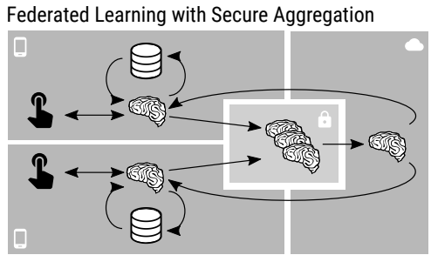
Practical Secure Aggregation for Privacy-Preserving Machine Learning
Motivation & Scope
Create a protocol that:
Operates with high dimensional vectors
Is Communication efficient
Is robust to users dropping out
Provides strong security under constrains
Training data information exposure during model training process
Motivation:
Securely computes a multiparty sum without revealing users’ update
Notes:
Traditional federated learning maintains data confidentiality of the users as there is no raw data transmission between server and client
However, there are exploitation methods that can infer a users' data from the model updates sent from the user to the server.
A privacy preserving machine learning protocol is created in this article.
As shown in the figure on the right, the article proposes a protocol that will securely compute a multiparty sum without revealing the raw users’ model updates to the server.
Furthermore, the protocol will be able to operate with high dimensional vectors, is communication efficient, is robust to users dropping out and provide a strong security under some constrains.

Slide 3
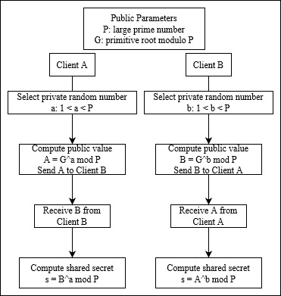
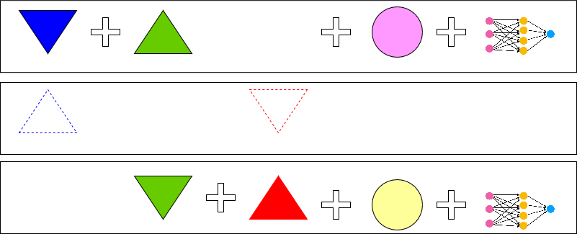
Practical Secure Aggregation for Privacy-Preserving Machine Learning
Secure Aggregation Protocol-Abstract Idea
Secret Sharing
Shamir’s t-out-of-n secret reconstruction.
Diffie-Hellman Key agreement scheme
Enables two parties to agree on a shared secret key over an insecure communication channel without having to exchange the key directly.
Secret can be reconstructed only when enough shares are combined.
Use of DH-keys to create pairwise masks for every client pair.
Pairwise Masking
Masks cancel out at the summation of updates
In the aggregation phase, Shamir’s method is used if a user drops out.
Server requests either a share of the individual key (reconstruct individual mask) or a share of the DH-key (reconstruct pairwise mask) per user from each user.
Notes:
There are two main cryptography concepts that we need to get a hold of before observing the actual secure aggregation method.
Firstly, we have Shamir’s Secret Sharing method. Suppose a user divides a secret and distributes it to a group of users. The secret can be reconstructed if more than a specific number of users combine their shares together, else no information can be extracted for the secret.
Secondly, we have the DH key agreement.
DH enables two parties to agree on a shared secret key over an insecure communication channel without having to exchange the key directly.
The idea is that both parties generate a public-private key pair and exchange their public keys over the insecure channel.
Each party then combines its own private key with the other party’s public key to compute a shared secret key, which can be used for symmetric encryption.
Another main concept that we need to know is the pairwise masking used in the method.
Using the DH-keys pairwise masks are created for every client pair, which are then cancel out at the summation of updates.
In the case that a user drops out Shamir's method is used by the server in order obtain enough shares of the dropped user’s secret key to reconstruct the pairwise masks.

Slide 4
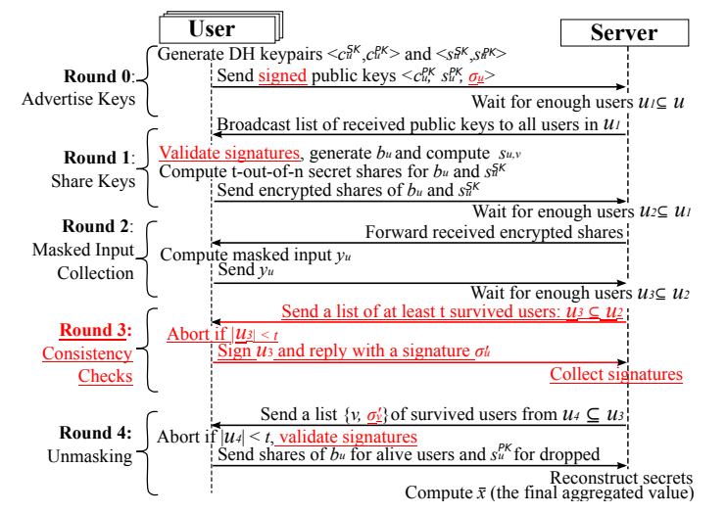
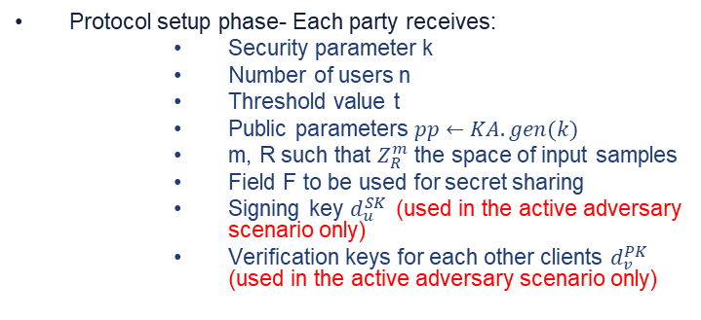
Practical Secure Aggregation for Privacy-Preserving Machine Learning
Secure Aggregation Protocol-Analysis
Protocol setup phase- Each party receives:
Security parameter k
Number of users n
Threshold value t
Public parameters $pp←KA.gen(k)$
m, R such that $Z_{R}^{m}$ the space of input samples
Field F to be used for secret sharing
Signing key $d_{u}^{SK}$(used in the active adversary scenario only)
Verification keys for each other clients $d_{v}^{PK}$ (used in the active adversary scenario only)
Notes:
This slide explains how the secure aggregation protocol works.
Before the start of the protocol each party receives some parameters that are needed during the different rounds.
At Round 0, each client generates two Diffie-Hellman keypairs.
The <c> key pair is to be used for message encryption while the <s> key pair is to be used to create the pairwise masks.
In the case of the active adversary scenario the users’ sign their Diffie Hellman public keys with their signing key.
Finally, each party send to the server its 2 DH public keys and in the AA scenario the signed public keys σu.
The server waits until it acquires enough users' DH-public keys and finally broadcast the list back to all the parties.
At Round 1, each client receives the list broadcasted by the server that is composed of {v, cPK, sPK, σv (AA)}
of the id of each user, it’s two public DH keys, and if in the AA scenario the signed PKs of user.
In the case of the AA scenario the parties have to verify that the signed document received matched the public keys.
Then they sample a random element bu from the F field, to be used for the PRG for the individual mask.
Generate the shares for the bu element and for the private key <sSK> of the DH to be sent to every user
Encrypt the shares using the key generated using the <c> DH-key pairs
Send encrypted message to the server.
The server waits until it receives at least t users ciphertexts. If it collects more than t users, it sends to each user the ciphertexts that it needs.
At Round 2,
Clients receive the ciphertexts. If less that t ciphertexts then abort the protocol.
For each other client v compute the shared key using the second pair of DH-keys <s> and using a PRG expand it to random vector.
If client id u>v then add mask to input else (u<v) subtract mask from input (pu,v)
Compute individual mask as well PRG(bu) = pu.
Compute mask input yu= xu + Σpu,v +pu.
Send yu to server.
Server waits until it receives at least t yu masked inputs else aborts.
At Round3 is only necessary when we are in the AA scenario:
Server sends to each client the list of all alive clients. Clients need to be at least t else aborts.
Clients sign the list and send it back to the server
Server collects the signatures.
At Round 4,
Server sends to each client the id of the survived user along with their signatures if in the AA scenario.
Suppose that users are at least t and that signatures are verified. Else abort.
For every client that dropped out decrypt their cyphertext and send the share of their DH secret key, for every survived client
decrypt cyphertext and send the share of bu element.
Sever reconstructs the secret keys and bu elements and computes the final aggregated values.
Su,v = KA.agree(Su^SK ,Sv^PK)
Pu,v = Sum(PRG(su,v))
Pu = PRG(bu)
Yu = xu + pu,v + pu

Slide 5
Practical Secure Aggregation for Privacy-Preserving Machine Learning
Protocol Security Analysis & Client Communication Cost
Threat Model | Minimum Threshold | Minimum inputs in Sum | Maximum Dropouts
Client-Only Adversary | 2 | threshold | n – threshold
Server-Only Adversary | [n/2] + 1 | threshold | n – threshold
Client-Server Collusion | [2n/3] +1 | threshold – #corrupt | n – threshold
Notes:
The top table shows how security can be guaranteed.
Security is guaranteed for the honest-but-curious scenario, as well as for active-adversary scenario under some assumptions. It is assumed that either a public key infrastructure is used, or the DH-exchange is honest. Setting the threshold accordingly can ensure security for all malicious categories(client-only, server-only, client-server). Table 1 shows how parameters have to be set for all the cases. In a scenario that a client is malicious it does not matter how the threshold parameter is set since clients can learn nothing about other clients. In the case where the server only is malicious the threshold must be higher than half of the total clients participating. Since the server can split the clients into two groups and transmitting to each group the message that the other group has dropped out, thus the sever will be able to reconstruct both the individual and pairwise masks of each client. Finally, in the scenario of both malicious server and clients the threshold must be set high enough so that even if the server can collaborate with up to but less than a third of the total clients, the server is still not be able to learn a client's both individual and pairwise keys.
Now concerning the communication costs of the client, the article wanted to create a protocol that will achieve at most twice the communication cost needed of sending the raw updates directly to the user. The equation shows how communication cost is computed. First part is bit transmitted and received for the public key exchanges. The second part is bits transmitted and received for the secret sharing and final part is bits transmitted for the masked input. If data vector is over 200K the expansion factor is less than 2.

Slide 6
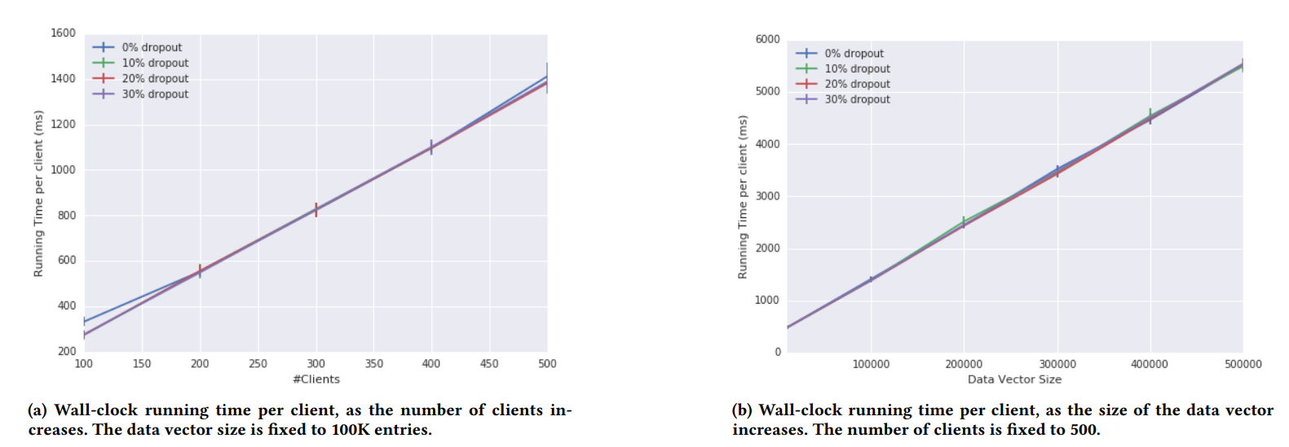
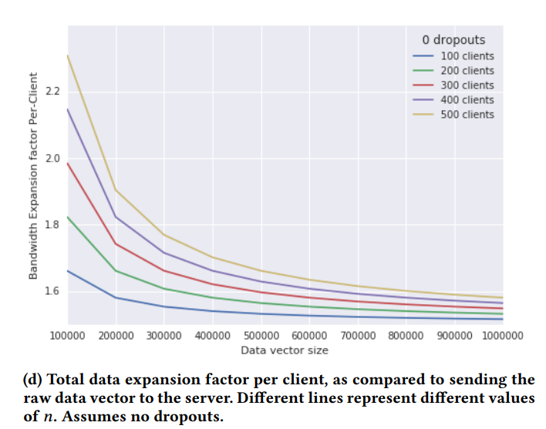
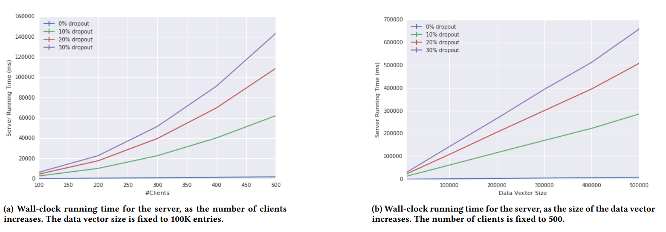
Practical Secure Aggregation for Privacy-Preserving Machine Learning
Performance Evaluation
Notes:
Concluding with the evaluation of the SA method,
There is a linear increase in the running time of clients as the data vectors get larger or as the number of clients increase. Dropouts do not really affect drastically the time.
Also, the communication per client stays under the 2x expansion if the data vector size is more than 200K.
Finally, server’s running time is linear for the size of the data vector and quadradic for the number of clients as the number of dropouts increases.

Slide 7
Reconstructing Individual Data Points in Federated Learning Hardened with Differential Privacy and Secure Aggregation
Notes:
The second paper analysis is for the article named reconstructing individual data points in FL hardened with DP and SA

Slide 8
Reconstructing Individual Data Points in Federated Learning Hardened with Differential Privacy and Secure Aggregation
Motivation
Federated Learning was designed to provide confidentiality (data does not leave user device).
Lack of privacy, data can be reconstructed from model updates.
Privacy preserving methods are introduced to enhance the FL framework (e.g., SA & DP)
Under circumstances the privacy methods can by bypassed.
Notes:
FL by default provides data confidentiality because it lets users not share their private data. However, there is lack of privacy in FL since model updates can be used by the server in order to reconstruct an individual user’s private data.
Privacy preserving methods were introduced in order to enhance the privacy of the FL framework such as SA protocol or the DP method.
Even though the privacy preserving methods most of the times work there are certain scenarios that those methods can be bypassed.

Slide 9
Reconstructing Individual Data Points in Federated Learning Hardened with Differential Privacy and Secure Aggregation
Threat Model and Assumptions
Goal: Create an attack that can reconstruct an individual user’s training data in the FL + SA + DDP scheme.
An occasionally malicious server that can:
Introduce sybil devices
Control the user sampling
Manipulate the model weights
Aim to bypass Secure Aggregation with the introduction of N-1 sybil devices and 1 target user.
Aim to exploit Distributed Differential Privacy. DDP assumes that participants are honest and add the required noise to their data.
Notes:
This paper tries to reconstruct an individual user's private data in the FL framework that is enhanced with secure aggregation and differential privacy.
For the reconstruction attack to be feasible some assumptions are made. It is assumed that there is an occasionally malicious server that can introduce sybil devices, control the user sampling and manipulate the model weights of the global model. The server is OM so that the attack remains stealthy, and a good global model is still created.
The attack aims to bypass SA by introducing N-1 sybil devices and 1 target devices. Since the sibyl devices introduced are greater that some thresholds set by
the SA protocol then privacy cannot be guaranteed. For example, if the all sybil devices contribute zero gradients and only the target device contributes it’s real gradients then the final aggregate value will contain the gradients of the target user.
Furthermore, the attack aims to exploit DDP. Since for DDP method to work each user participating in a training rounds must add enough noise so that privacy can be guaranteed. Since there are N-1 sybil devices that add no noise and only one device that adds noise , the noise is not enough to obtain privacy in isolation.

Slide 10
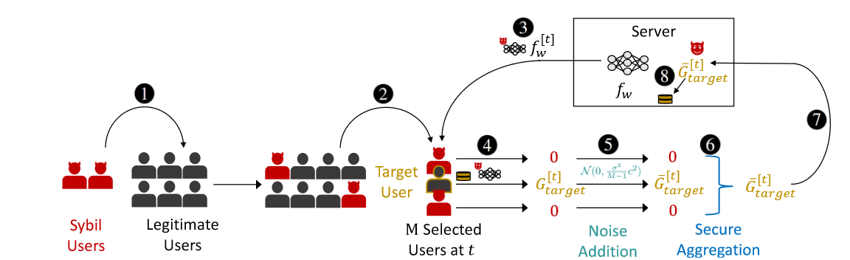
Reconstructing Individual Data Points in Federated Learning Hardened with Differential Privacy and Secure Aggregation
Attack Outline
Notes:
This slide shows the attack outline
Firstly, the server introduces several sybil devices into the FL application.
Then the server samples M users for participation in training round t of which there is one target user and M − 1 sybils.
At step 3 the server manipulates the shared model with trap weights and sends it out to the selected users.
At step 4 the target user locally calculates its gradients on the manipulated model while the sybil users return zero or constant value gradients that are known by the server.
Furthermore, at stage 5 we observe that the target user locally applies a small amount of noise to its gradients to implement DDP.
Step 6 is the secure aggregation where the target user’s local noised gradients are aggregated with the sybil users’ values. After step 6 we solely have the target user’s gradients sent to the server.
Finally, the server extracts the target user’s training data from the received gradients
Attack evaluation

Slide 11
Reconstructing Individual Data Points in Federated Learning Hardened with Differential Privacy and Secure Aggregation
Attack Evaluation
Sample 1 target user and N-1 sybil that return zero gradients.
The more benign users participate in the protocol round the lower the SNR is of the reconstructed data of a target user.
Trap weights allow more data points to be extractable, also cause the same data points to be extractable from different gradient values. (redundancy).
Trap weights allow better data reconstruction since less neurons are activated by each data point, thus less overlay.
Post-processing techniques are used to boost the data reconstruction quality.

Slide 12
Possible Future Work
Secure Aggregation Protocol:
A malicious client can send malicious messages to other clients or server causing them to abort. (Trust Score)
Protocol works if inputs from users are well formed and pairwise masks added are correct. If a client send arbitrary values to the server, then the training will not be good. (LDP)
Data Reconstruction Attack:
Instead of send the gradients to the server how about sending the local new weights to the server. Can this prevent a malicious server from identifying the data. (FedAVG instead of FedSGD)
Instead of DDP switch to LDP but find a minimum threshold that can provide privacy guarantee and not degrade so much the global model performance
** Check the vector send from each client on a batch of data in the server to see the performance of that client, maybe the client tries to degrade the global model. (Time Consuming).
Notes:
WRITE

