Slide 1
Intrusion Detection Systems for Software Defined Networks
Overview

Slide 2
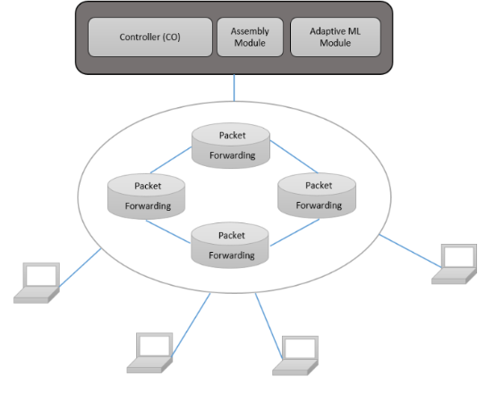
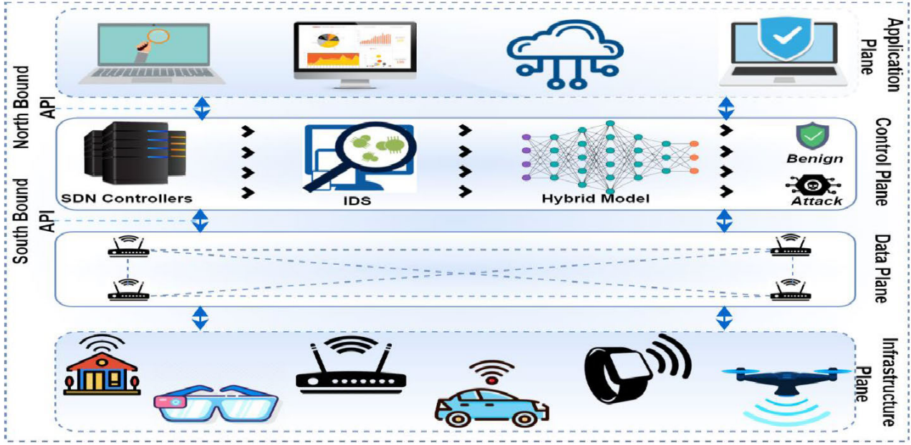
SDN-IDS & SDNIoT-IDS
Comparison of SDN Architecture
1st Approach: Create an IDS to capture traffic and detect anomalies that may affect the normal function of the SDN. Deployed in the control plane.
2nd Approach: Implement an IDS to be deployed in the controller of the SDN to capture traffic to IoT devices. Detect anomalies through the traffic to maintain a normal function of the IoT devices.

Slide 3
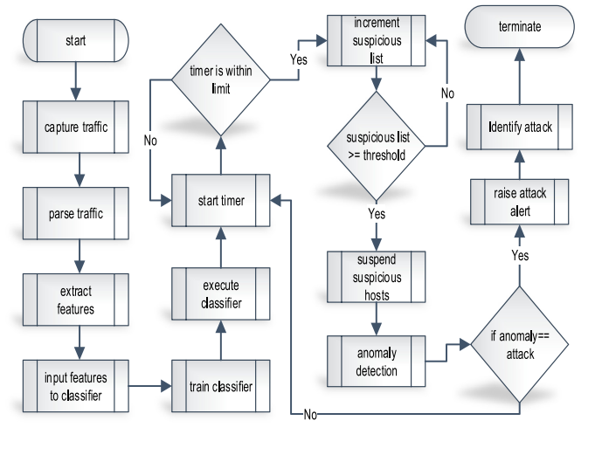
IDS General Info
Main Idea
Capture Data Traffic
Process/Parse Data Traffic
Feature Selection/Extraction
Classifier Learning
Anomaly Detection
Notes:
Main Idea is the same but depending on the IDS what the final task is.
Furthermore, a Signature-Based IDS can be appended in the beginning to boost performance.

Slide 4
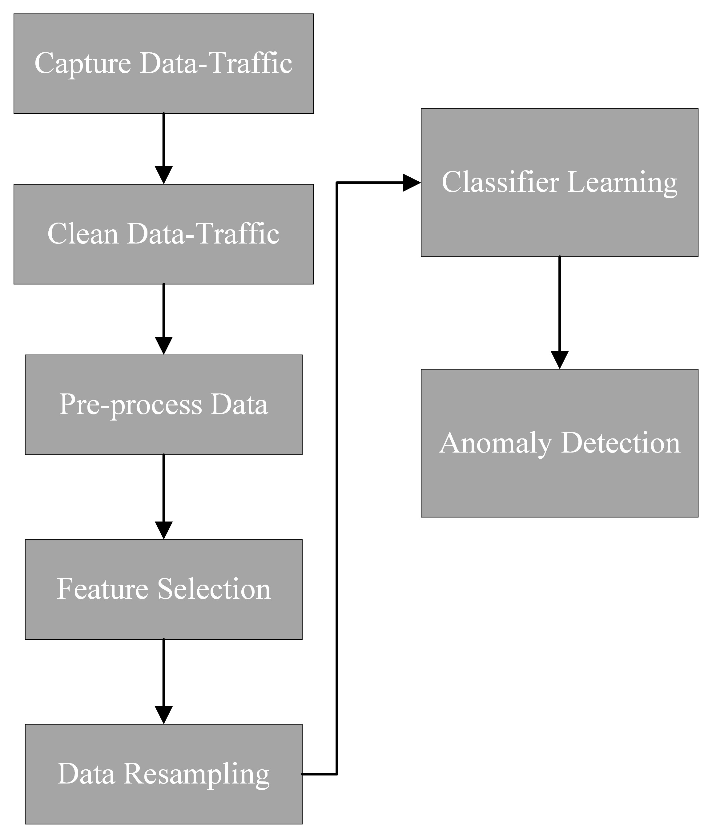
Our Proposed IDS
Capture Data Traffic
Clean Data Traffic
Process Data Traffic
Feature Selection
Resample
Classifier Learning
Anomaly Detection
Notes:
Finally depending on whether we go for an SDN-IDS or an SDNIoT-IDS we are going to adapt and create the appropriate architecture.

Slide 5
Literature Review
SDN-IDS
Notes:
Before starting the literature review it needs to be mentioned that multiple works have created a virtual SDN using Mininet and Ryu controller. However, there are other papers that didn’t.

Slide 6
Literature Review
SDNIoT-IDS
Wani et al. (2020,5) Proposed an SDN-based IDS which uses deep learning classifiers to detect anomalies in IoT. IDS with 3 main components, an activity monitor, an activity analyzer and a classifier (LSTM, inside analyzer). Using the activity monitor the data traffic is captured and traffic statistics are computed. Activity analyzer uses the statistics to detect abnormal behavior. Furthermore, LSTMs are used for anomaly and attack detection. Dataset used was CICIDS2018.
Muthanna et all (2022,6) Proposed a hybrid SDN framework using cuLSTMGRUs for threat detection in IoT environment. The same structure for the IDS was used. Dataset used was CICIDS2017.
Notes:
cuLSTMGRUs: Cuda LSTM Gate Recurrent Unit.

