Slide 1
Intrusion Detection Systems for Software Defined Networks
Overview

Slide 2
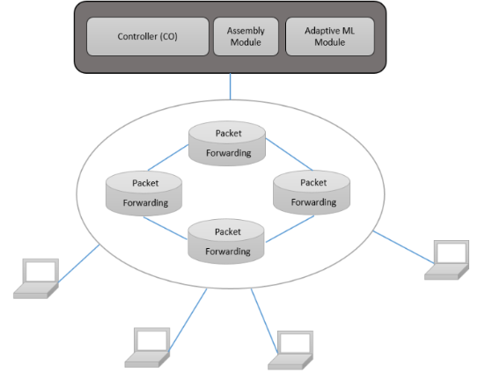
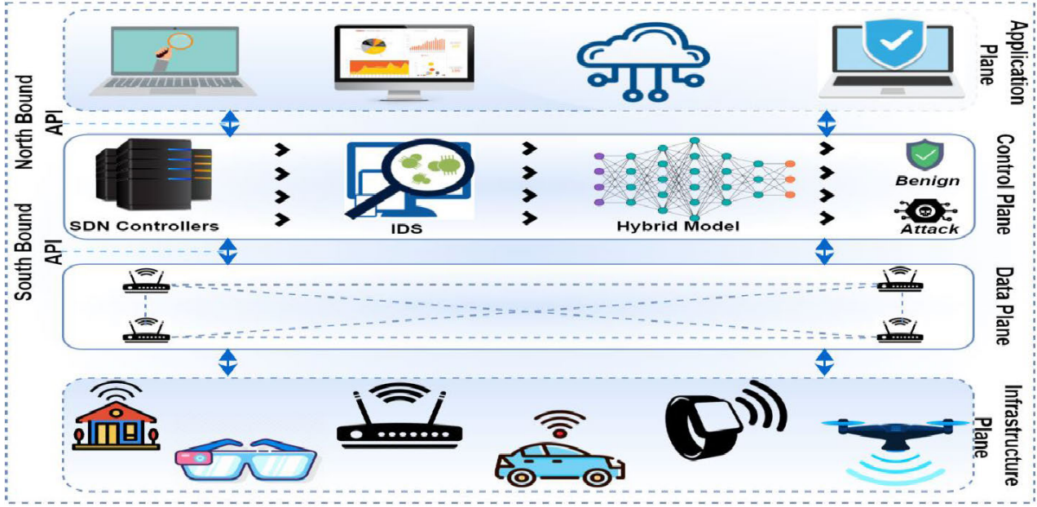
SDN-IDS & SDNIoT-IDS
Comparison of SDN Architecture
1st Approach: Create an IDS to capture traffic and detect anomalies that may affect the normal function of the SDN. Deployed in the control plane.
2nd Approach: Implement an IDS to be deployed in the controller of the SDN to capture traffic to IoT devices. Detect anomalies through the traffic to maintain a normal function of the IoT devices.
Notes:
Depending on what we choose to use we are going to use an appropriate architecture.

Slide 3
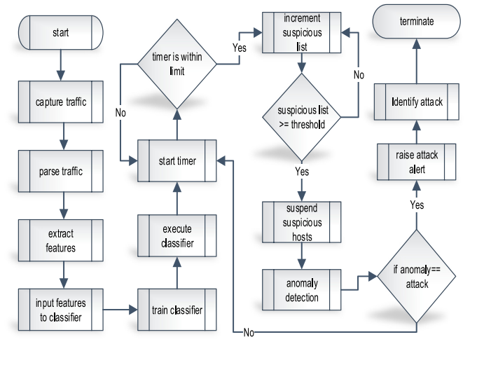
IDS General Info
Main Idea
Capture Data Traffic
Process/Parse Data Traffic
Feature Selection/Extraction
Classifier Learning
Anomaly Detection
Notes:
Main idea to develop an IDS is the same but depending on the final task the IDS get modified.
**Furthermore, a Signature-Based IDS can be appended in the beginning to boost performance.**

Slide 4
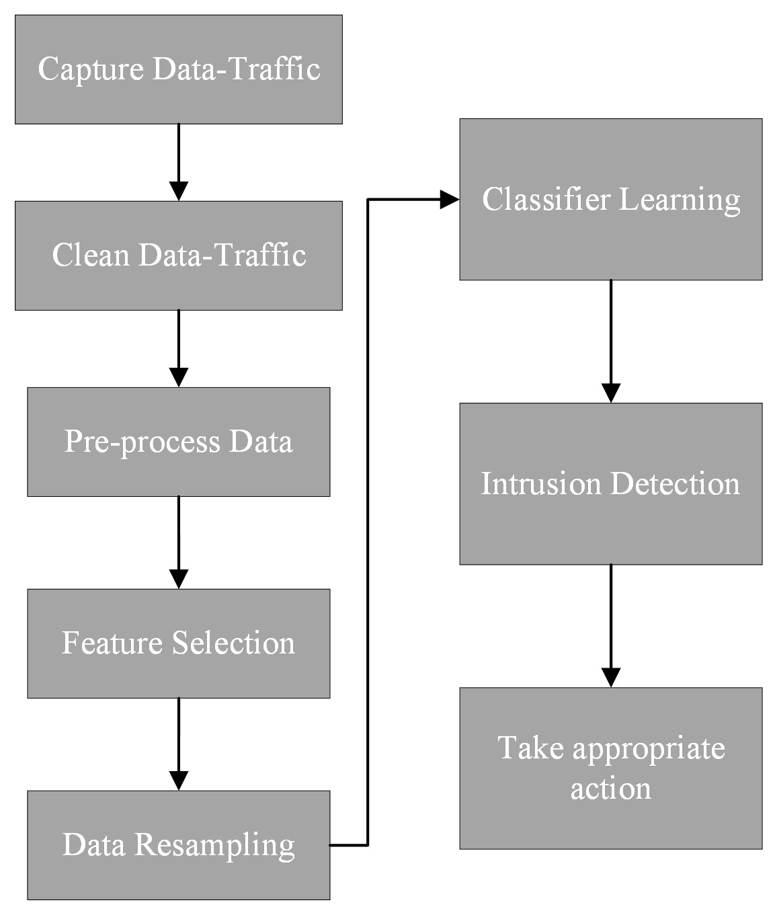
Our Proposed IDS
SDN_IDS Architecture
Capture Data Traffic
Clean Data Traffic
Process Data Traffic
Feature Selection
Resample
Classifier Learning
Intrusion Detection
Take actions (e.g., update flow-based tables)
Notes:
Finally depending on whether we go for an SDN-IDS or an SDNIoT-IDS we are going to adapt and create the appropriate architecture.

Slide 5
Literature Review
Different SDN-IDS
Rawat et al. (2019), proposed an IDS for the detection and prevention of network attacks and threat in organizations. Used deep neural networks and unsupervised feature extraction (PCA) with the NSLKDD dataset.
Tang et al. (2016), created an IDS using deep learning in an SDN environment using the NSLKDD dataset.
Satheesh et al. (2020), presented an IDS that uses different ML algorithms, a feature selection algorithm that reduce the features of the NSLKDD dataset. Finally they created a test-bed using the MININET framework and Floodlight controller.
Peng et al. (2018), proposed an anomaly detection system. The controllers collect the flow table information and extract the flow features. Flow features are pre-processed and classification detection of the network flows is performed using K-NN algorithm. They also create a virtual SDN using MININET and Ryu controller and used data generated for training.
Notes:
There are multiple papers that developed an SDN-IDS.
Papers usually did a feature selection or feature extraction to select features that can be easily obtained in an SDN network.
Finally, there are multiple works that created a virtual SDN using Mininet and Ryu controller.
References:
1)
2)
3)
4) https://ieeexplore.ieee.org/abstract/document/8362796

Slide 6
Literature Review
Different SDNIoT-IDS
Wani et al. (2020,5), proposed an SDN-based IDS which uses deep learning classifiers to detect anomalies in IoT. IDS with 3 main components, an activity monitor, an activity analyzer and a classifier (LSTM, inside analyzer). Using the activity monitor the data traffic is captured and traffic statistics are computed. Activity analyzer uses the statistics to detect abnormal behavior. Furthermore, LSTMs are used for anomaly and attack detection. Dataset used was CICIDS2018.
Muthanna et al. (2022,6), proposed a hybrid SDN framework using cuLSTMGRUs for threat detection in IoT environment. The same structure for the IDS was used. Dataset used was CICIDS2017.
Ashraf et al. (2021,1), created an ML-SDN based IoT anomaly detection scheme. They used UNSW-NB15 and ISCX datasets. They select some features from the datasets, applied some pre-processing and then trained SVM, K-NN and MLP classifiers. They implemented the model using the MININET emulator and the Ryu SDN controller.
Tsogbaatar et al. (2020)
Notes:
cuLSTMGRUs: Cuda LSTM Gate Recurrent Unit.

Slide 7
ITU Paper
What needs to be appended.
SDN architecture
IDS architecture
Literature review
Future work:
Test our solution in a testbed.

