Slide 1

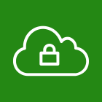




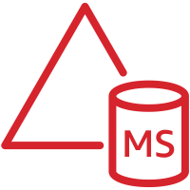


AWS Cloud
VPC
Public subnet
Private subnet
ENI
Internet gateway
AWS Managed Microsoft AD
踏み台兼作業用Windows
DFS Namespace Server
ENI
Public subnet
Private subnet
ENI
Amazon FSx for Windows File Server
DFS Namespace Server
ENI

Slide 2

AWS Cloud
SSM Session Manager
VPC
Endpoints
Public subnet
Private subnet
Self Managed AD ドメイン
resource.example.com
ENI
Internet gateway
BastionWindows
2019
Member
2012 R2
DomainController
2012 R2
Amazon FSx
ENI
Public subnet
Private subnet
AWS Managed AD ドメイン
corp.example.com
ENI
Member
2016
AWS Managed AD
ENI

Slide 3
AWS Cloud
SSM Session Manager
VPC
Endpoints
Public subnet
Private subnet
RESOURCE ドメイン（Self-managed AD）
Internet gateway
Bastion
2016
Member
2016
DomainController
2016
ENI
Amazon FSx
Public subnet
Private subnet
JAPAN ドメイン（Self-managed AD）
DomainContoller
2016
ENI

Slide 4
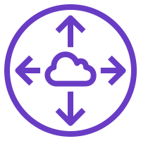
AWS Cloud
SSM Session Manager
VPC
VPC
Endpoints
Public subnet
Private subnet
Private subnet
RESOURCE ドメイン
Internet gateway
Internet gateway
Bastion
2016
DC
2016
FileServer1
2016
FileServer3
2016
Bastion
2016
Public subnet
Private subnet
Peering connection
Private subnet
JAPAN ドメイン
DC/DFSN
2016
Member
2016
FileServer2
2016
DFS Replication Group

Slide 5

接続パターン①
接続パターン②
DomainController
一方向の信頼
Amazon FSx
AWS Managed AD
corp.example.com
Self Managed AD
resource.example.com
Amazon FSx
Member
User
Member
Bastion

Slide 6
https://docs.aws.amazon.com/fsx/latest/WindowsGuide/self-managed-AD.html
Member
接続パターン①
接続パターン②
Amazon FSx
（要2008R2）
AWS Managed AD
corp.example.com
RESOURCE
2008
Amazon FSx
（要2008R2）
inet(JAPAN)
2012R2
BPR
2003

Slide 7
DomainController
双方向の信頼
FSx
Member
DomainController
RESOURCE
2016
User
JAPAN
2016

Slide 8
DomainController
双方向の信頼
Member
FileServer
FileServer
FileServer
DomainController
RESOURCE
2016
User
JAPAN
2016

