Slide 1







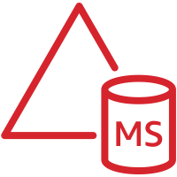


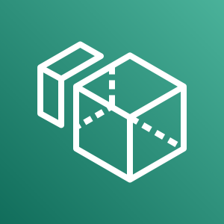
AWS Cloud
SSM Session Manager
VPC
Endpoints
Public subnet
Private subnet
ENI
Internet gateway
AWS Managed Microsoft AD
NAT gateway
踏み台用
Windows
Radius
Server
ENI
Public subnet
Private subnet
ENI
踏み台用
Linux
NAT gateway
Amazon WorkSpaces
ENI

