Slide 1



Towards Deepfake Detection using anomaly detection techniques
Sotiris Stamnas
June 20, 2024

Slide 2







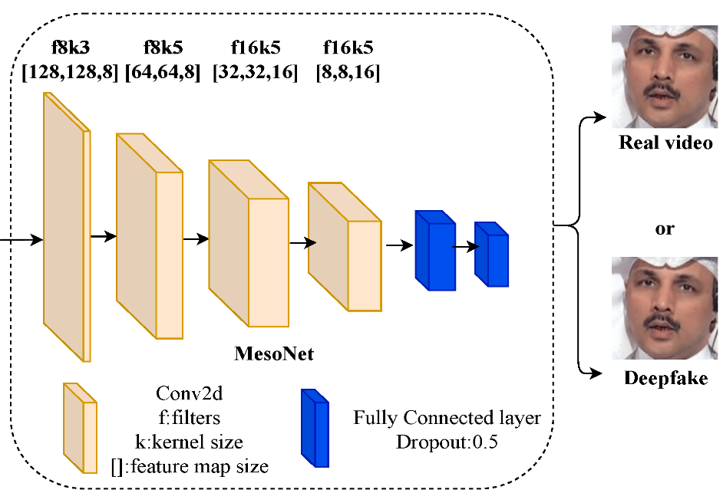
Deepfake Detection as a Binary Classification task
Given an image , binary classification based deepfake detection aims to estimate the label
State-of-the-art deepfake detection methods learn a classifier
During training, given a training dataset the classifier minimizes the binary cross entropy loss
where is the predicted probability that given
Architecture of MesoNet Deepfake Detector

Slide 3
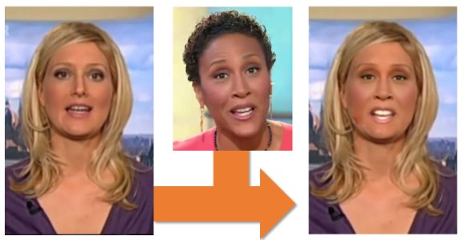
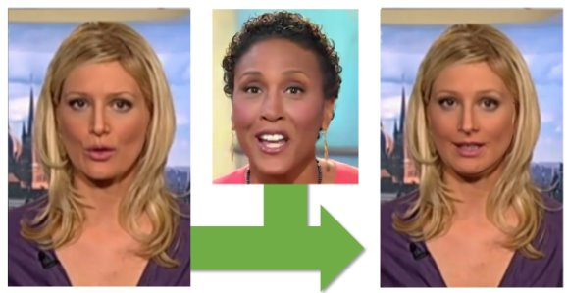
Face Forgery in Videos
Face Replacement
Face Reenactment
Other common types of facial manipulations include
Entire face synthesis (generation of fully artificial face)
Attribute manipulation (removal of glasses, change of hair, etc)

Slide 4
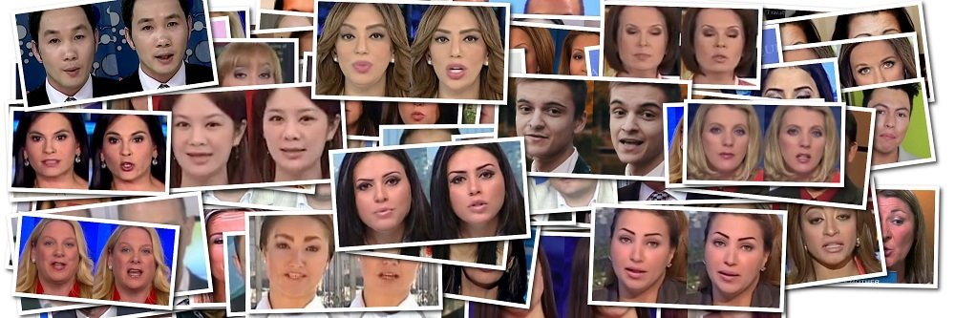
DeepFake Detection Datasets
FaceForensics++ Datasets:
Real: 1000 pristine videos downloaded from the Internet (509,914 images)
Fake: 4000 videos containing 1000 identities (more than 2M images)
Videos available in different qualities: original, HQ, LQ
Five Manipulation methods: DeepFakes (DF), Face2Face (F2F), FaceShifter (FS), FaceSwap (FS), NeuralTextures (NT)

Slide 5
SOTA and human performance
Human observer performance
State-of-the-art two class classifier performance: XceptionNet
Score are stated as accuracies
 | Deepfakes | Face2Face | FaceSwap | NeuralTextures | Real
Human | 78.17 | 50.19 | 74.8 | 30.75 | 75.41
XceptionNet | 97.49 | 97.69 | 96.79 | 92.19 | 95.41
Comparison of human and SOTA performance

Slide 6
Generalization to unseen deepfakes
Performance of XceptionNet when trained only on a specific DeepFake dataset and tested on all others
We observe bad generalization performance across unseen DeepFake datasets
 | Test set AUC
Training set | DF | F2F | FS | NT
DF | 99.38 | 75.05 | 49.13 | 80.39
FS | 70.12 | 61.7 | 99.36 | 68.71
Generalization performance of SOTA
How to fix this?
Use augmentation techniques to synthesize pseudo-fakes and train a binary classifier
Use lipreading models to learn representations of natural mouth movement
Formulate the detection problem as an anomaly detection (AD) task (current methods still use pseudo-fakes)

Slide 7
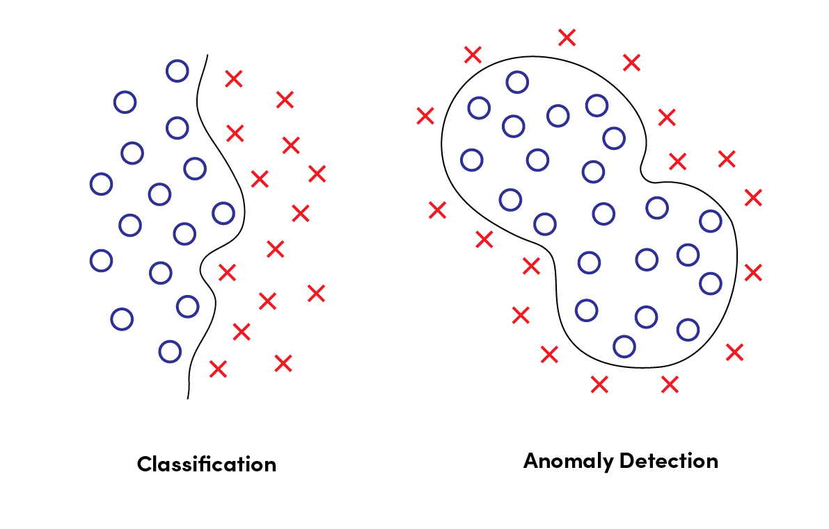
Anomaly Detection
Our dataset includes a mixture of "normal" and "anomaly" points
The assumption is that the anomaly points are generated by a different process than the normal points
An anomaly score is usually computed for a given datapoint and used to classify it as normal or an anomaly
Applications in areas such as: abnormal event detection, spoofing attack detection and biometrics
Methods include: image reconstruction, one-class classification, density estimation
Classification vs Anomaly Detection

Slide 8



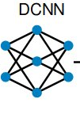

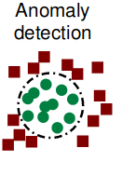



Differential anomaly detection
Idea: extract deep face embeddings from image pairs and combine them to train an anomaly detection module
We want to learn natural changes (i.e.change of head pose, illumination) that occur between two real images of the same subject
Unnatural and extreme changes not observed in real images will be considered as fakes
Trusted
Image 2
Suspected
Image
ADM
Trusted
Image 1
Trusted
image

Slide 9
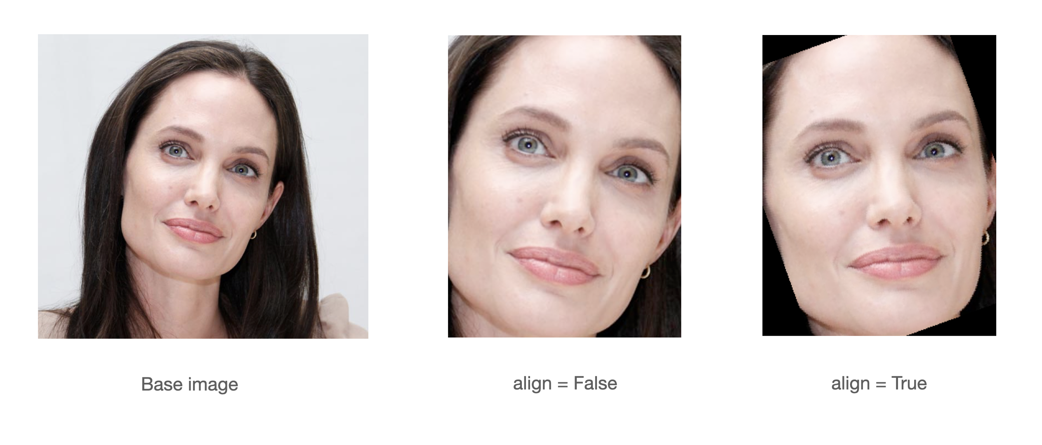


Data and experiments
Used FaceForensics++ to extract real and manipulated faces from: Real, DF, F2F, FSW, FS and NT
For every video in each dataset 40 equally spaced frames were extracted (40,000 images per dataset)
Face detection and aligment was done using Multi-task cascaded convolutional neural network (MTCNN)
Deep face embeddings (512) were extracted ArcFace, a model pre-trained on the task of face recognition
Given two face embeddings A (from a reference image) and B (from a probe image), we consider the feature combination:
A GMM model is trained on pairs of only pristine images
At testing, pairs of trusted (pristine) and suspected (pristine or fake) images are constructed
The log-likelihood of a testing sample is used as an anomaly score

Slide 10
Results
Methods | DF | F2F | FS | FSW | NT | Average
Our method | 0.975 | 0.65 | 0.988 | 0.975 | 0.562 | 0.830
UNTAG | - | - | - | - | - | 0.818
SeeABLE* | 0.992 | 0.988 | 0.991 | - | 0.969 | 0.985
XceptionNet | 0.975 | 0.977 | 0.968 | - | 0.922 | 0.960
Mesonet | 0.895 | 0.886 | 0.812 | - | 0.76 | 0.838
Comparison of our and SOTA methods. The performance score is AUC-ROC
*SeeABLE was trained on raw uncompressed images from FF+

Slide 11
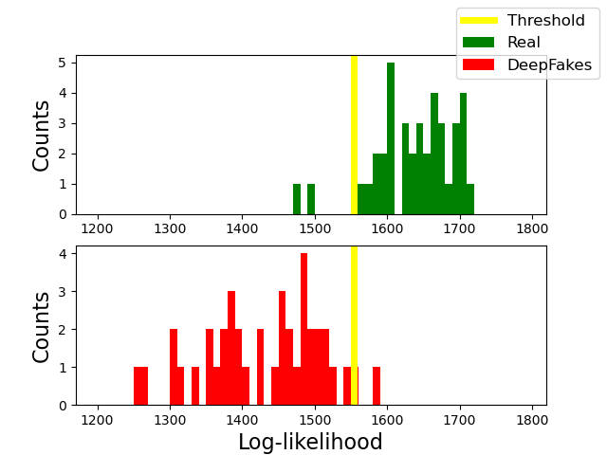
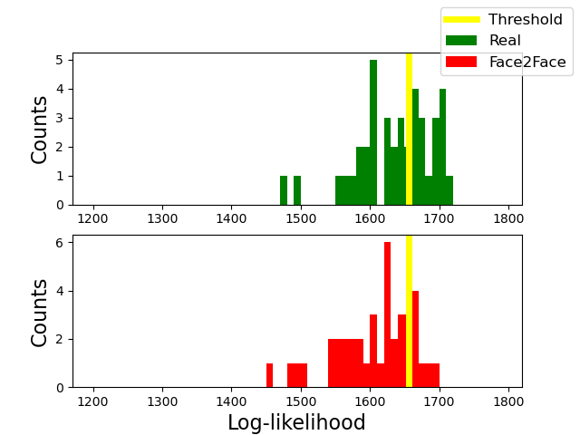
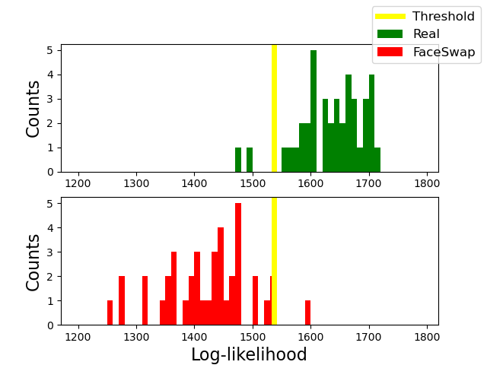
Results:

Slide 12
Conclusions and future work
Two class classifiers models do not generalise well to unseen DeepFake datasets
Pseudo-DeepFake based method generalise better, but they still make assumptions about the artifacts
Differential anomaly detection provides promising results on FF+. However it has low performance on F2F and NT
Extract more frames from FF+ videos (each video contains ~450 frames)
Try out different feature combinations between the two image embeddings
Use encodings from frequency domain
Use information from optical flow (inter-frame dissimilarities)
Test the method on Celeb-DF dataset

Slide 13
Thank you for listening,
any questions?

