Slide 1
Internet
CAN
IVI
Normal content
Webview based
Native App
Web Content
Web Content
App
Browser
Webview
OS

Slide 3
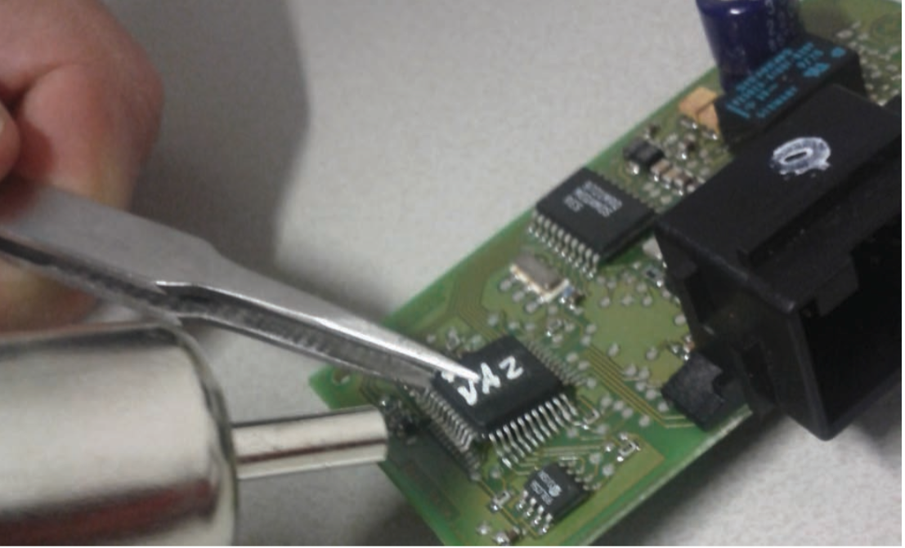
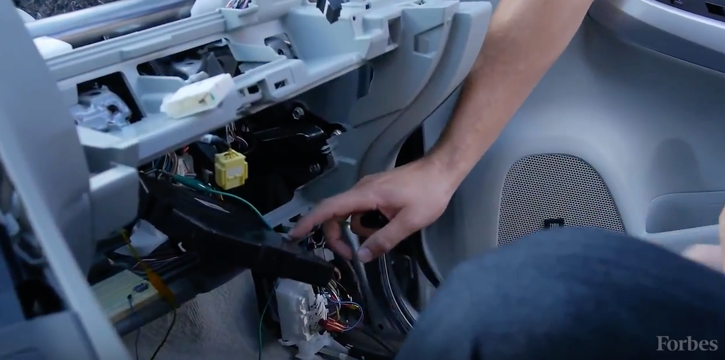
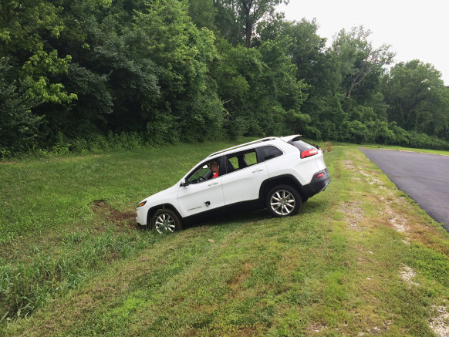
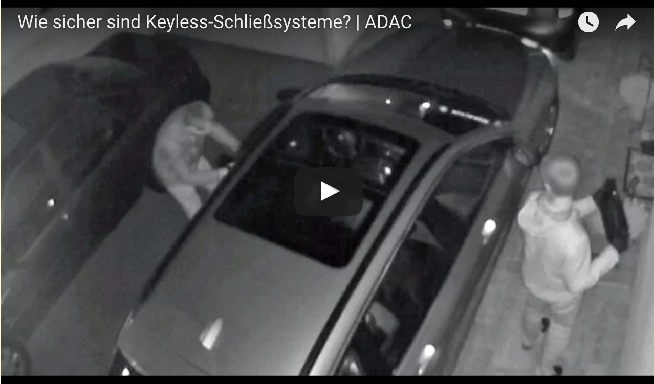
Car Hacking
2010~
Immobilizer Hacking (22nd USENIX Security Sympo.)
CAN Hacking (DefCON 21)
2015
Connected Drive (ADAC)
Cherokee (BLACK HAT 2015)
2016
Smart Key Hacking(ADAC)
https://www.usenix.org/sites/default/files/conference/protected-files/sec15_slides_verdult.pdf
http://www.forbes.com/video/2616901840001/
https://www.wired.com/2015/07/hackers-remotely-kill-jeep-highway/
https://www.adac.de/infotestrat/adac-im-einsatz/motorwelt/test_keyless.aspx
Notes:
People recognize that information security is quite important
And Recently it should be considered from the earliest stage of developping.
I believe that cars are secure.
It always work correctly and in an accedent, it saves us as much as possible.
However some weekness has been revealed recently.
As you know PCs that connected internet gets many attack from world.
In the same way, connected car faces many hacking.
In 2013, Researchers report car vuluntabilities on TOP Conferences and
It is recongnise widely.
First one is Immobilizer hacking. The name is Megamous Crypto transponder.
Researchers hack its cipher design and authentication protocol and
In 30 minutes, they recover key and start the engine.
Second one is CAN Hacking.
Researcher connect their PC with cars and controll break, handle, etc.
2015, attacks target network vulnalability.
ADAC, German Automoibile Organization, such as JAF in JAPAN
Discovered connection vulnalability between IVI and communication module
And retrive VIN(Vehicle Identification Number) and Key Control API.
Most of you know that new of チェロキー hackiing.
Researcher access IVI on a Cherocky via SPRINT network, update farmware of V850
Controller and controll all component
Handle, engine, transmission, break, wiper, aricon, door remotly.
The last one is simple but serious.
By using smart keys enables us to open door and start enging with just having it.
Because key signal is detected by car.
This attack amplificate the signal.
You can imagine, cars can be stealed even if you are not beside of your car.
This can work*** about 90meeter distance from the owner.
-------------
---------------
2013
22nd USENIX Security Symposium
https://www.usenix.org/conference/usenixsecurity15/technical-sessions/presentation/verdult
2013 Def Con
http://drive-love.jp/drivpedia/2013/08/post-19.html
http://huhcanitbetrue.blogspot.jp/2013/08/defcon21-car-jack.html
・ノートPCを直接接続、急ブレーキ、ハンドル操作、GPSご作動
・トヨタプリウス、フォードエスケープ
BMW Connected Car
http://www.pcworld.com/article/2878437/bmw-cars-found-vulnerable-in-connected-drive-hack.html
Nissan Leaf
http://www.itmedia.co.jp/enterprise/articles/1602/25/news067.html
Smart entry key
http://gigazine.net/news/20160324-car-smartkey-amplifier-attack/

Slide 4
Security & Privacy Task Force
Call For Participation (2015 Jun)
This task force will be exploring security primarily from the perspective of standards being worked on in the WG or under early exploration in the BG, focusing on potential attack vectors being created…
Privacy similarly will remain focused on data being exposed by standards emerging from the WG and BG…
Scope…?
Application format (Web content, Web-view based app, Packaged app )
Target (Browser, IVI, Car)
Who wants to protect (User, Owner, Automaker)
Notes:
In thease shocking news, dedicate Task force is formed under BG and WG
It CfP says that focusing on potential, and privacy as well.
At that time, anyone thought security and privacy was import but the target was not clear enogh.
I have several experience desining and developping security.
In these cases, it is clear that what is the asset, who could be attacker, what is the target system.
On the other hand, in the case of veihicle API they were not fixed.
Because vehilce API is Client side Web API, I though Application is any web content, security target is browser,
And we should provide user a controll way.
However
Confidentiality
Integrity
Availability

Slide 5
What to be exposed
List up use cases & concerns
About 60 items
Categorize
Protection against intrusion and attack
‘Set’ API
HVAC, window, ADAS
API Permission
App certification, user’s permission, access control
Communication
With devices/home/service, To cloud, V2X
User’s rights for their data
Do not track, Sensitive location, Emergency
Multi driver/users
Identification, environment switch, payment
Expected use
Unfavorable Use
Where is the border?

Slide 6




Access control
What’s that
Automaker’s permission for API use
How to realize
Marketplace check
Packaged App
Runtime check
Local server + OAuth
Local proxy
White list
Auth
Server
Distribute with sign
Local
Server
Browser
Notes:
There are a lot of OEM in WG,
By listen to their need, it was found that they need a way of access control.
When you install an application on your smartphone, you will be asked to give API permission
To the app. This is a kind of access control.
Hear I mean, Automaker’s permission.
There are several reasons. In one word, they have responsibility for safety driving.
However automaker’s permission is not easy to realize in web platform.
A popular way is marketplace of smartphones.
A Marketplace is the only one where distribute application and it can check apps before distribute it.
Another idea is separating API function to a local server.
By using local sever, we may apply the way of OAuth
どちらの方式も、W3Cの範疇を超えているように見えます。
しかしこういったものが本当に必要ならば、私達はその要求に答えなくてはいけないと思っている。

Slide 7
Architecture consensus
Internet
CAN
IVI
Normal content
Webview based
Native App
Web Content
Web Content
App
Browser
Webview
OS
Notes:
そこで、もう一度、どういうアーキテクチャを想定するのか、ということを考える必要が出てきた。
最初の図はシンプルに、IVIがCANとInternetのなかだちをしているが、
IVIの中をもっと正確に書いていく必要が出てきた。
当初考えていたのは単純な
WebRuntimeとWebコンテンツの関係は2つある。
いわゆるWebViewを内包するパッケージアプリと、
ブラウザ上で実行される通常のWebContent
そのどちらも対象として排除しないことが確認された。
This simple diagram is what I proposed in Seatle f2f.
Web content is downloaded from internet and the contents get car information via Web Runtime
Web runtime could have various meaning. In this diagram, browser or user-agent could be better words.
W3C

Slide 8
Reference Architecture
Web Content
Vehicle APIs
Existing Part
Web Runtime
WebSocket/Rest
Local Server
Newly added
System
ref. Jaguar Land Rover Model
Current reference model
Notes:
Jaguar Land Rover

Slide 9
Security Note
Contents
Architecture
Basic Web Security Techniques
HTTPS, CSP, CORS, DNT, CVE
Updatability
Privacy Protection
Best Practice on Access Control
Market
Local server
Schedule
Jul., TF fix
Sep., TPAC, WG Fix
Vehicle Information Access API
Refer
Security and Privacy consideration on Vehicle APIs
Vehicle Data Specification
Refer
W3C Recommendations
W3C Group Note

