Slide 1
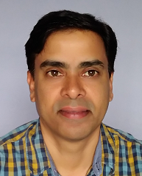

REACT JS CRASH COURSE
Skewcode.com
Sreekanth M. E.
Freelance Trainer & Consultant
http://www.SreekanthME.com
03-Feb-2018
Notes:
1. This is a 2-Part Crash Course. 2nd Part will be Redux (next week).

Slide 2
ReactJS (aka React.js or React) is an User Interface library for writing SPA.
It provides just the V of MVC.
React with Redux & React-Router together behave like a framework.

Slide 3
A React SPA is built out of building blocks called Components.

Slide 4


Slide 5
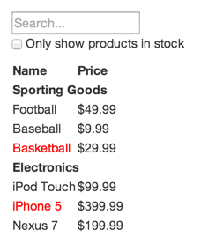
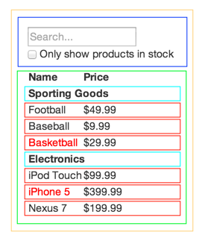

Slide 6
In React, all visual elements are defined ONLY in JavaScript (JSX).
No need for HTML.
Even CSS can be written as JavaScript.

Slide 7
JSX stands for JavaScript XML.
JSX is essentially JS but with a HTML-ish (XML-ish) syntax.
https://facebook.github.io/jsx/

Slide 8
Browsers cannot understand JSX or ES6/7.
So React takes the help of Babel to transpile JSX & ES6/7 to plain JavaScript.

Slide 9
Create React App is the best way to start building a new React SPA.
Babel converts ES6/ES7 and JSX to ES5.
Uses Webpack & Babel internally

Slide 10
INSTALL & RUN
npm install -g create-react-app
create-react-app my-app
cd my-app
npm start

Slide 11
State and Props are the core concepts of ReactJS.

Slide 12
VIRTUAL DOM DEMO

Slide 13
REACT DEV TOOLS DEMO

Slide 14
WHAT TO LEARN?

Slide 15
Prerequisites for Learner:
HTML Beginner Knowledge
CSS Beginner Knowledge
JavaScript Intermediate Knowledge

Slide 16
ES6/ES7 Concepts:
let & const
Template Literal
Arrow Function
Class
Modules
Default Parameters
Destructuring
Spread Operator

Slide 17
REACTJS Concepts:
Components
Properties
JSX
Create-react-app
Styling with CSS
State
Lifecycle Methods
Events
Controlled Components
Uncontrolled Components
Virtual DOM
React Dev Tools
Prop Type Validation
Keys

Slide 18
REDUX Concepts:
Immutability
Pure Functions
Flux Pattern
Actions
Store
Reducers
Dispatcher
React-Redux
Provider
Connect Method
Redux Dev Tools
Middleware
Redux Logger
Redux Thunk

Slide 19
REACT-ROUTER Concepts:
Dynamic Routing
React-router-dom
BrowserRouter
HashRouter
Link & NavLink
Route / Switch
Redirect

Slide 20
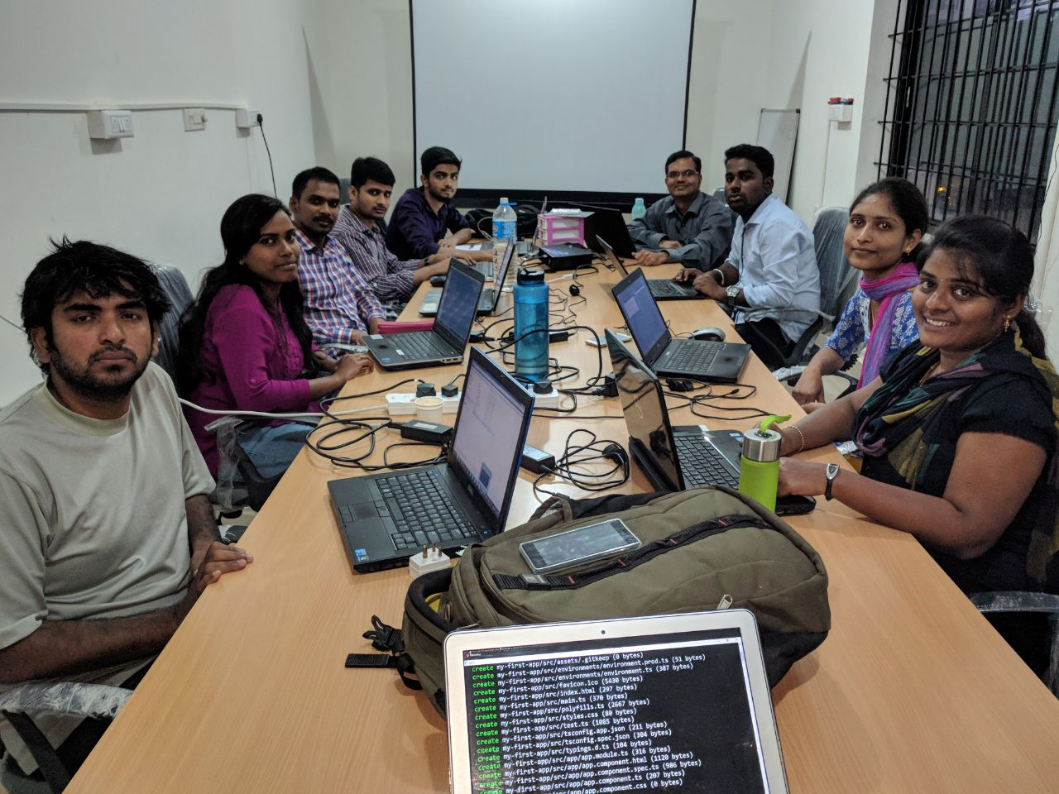

Slide 21
REACTJS COURSE DETAILS
https://www.skewcode.com/reactjs
8 classes in 4 weekends (Each class is 3.5 hours and on Saturday & Sunday).
28 hours of classroom training (also available online via webinar).
Includes 20 hours of offline project work.
Each class is recorded and the video made available.
Notes:
1. All things mentioned in the past 4 slides are part of our course.

Slide 22
Appendix

