Slide 1


REACT JS CRASH COURSE
Skewcode.com
Sreekanth M. E.
Freelance Trainer & Consultant
http://www.SreekanthME.com
10-Feb-2018
Notes:
1. This is Part-2 Crash Course. 1st Part was React.

Slide 2
Redux is a predictable state container for JavaScript apps.
Redux can be used with React, or with any other view library.
Notes:
https://www.foreach.be/why-react-redux-combo-magic

Slide 3
React is just a view library.
With redux, React gets the FLUX pattern for state management.
Notes:
https://www.foreach.be/why-react-redux-combo-magic

Slide 4
With Redux, all component level state is completely eliminated and all state is centralized in something called Redux store.
Notes:
https://www.foreach.be/why-react-redux-combo-magic

Slide 5
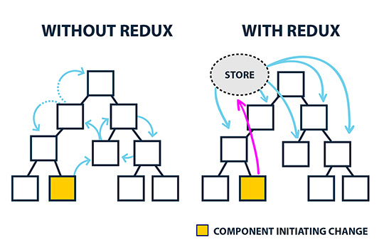

Slide 6
For simple SPA with a few components, coordinating components is possible with just React state.
But for large SPA with several components, a state management system like Redux becomes essential.

Slide 7
PURE FUNCTIONS

Slide 8
A pure function is a function which produces no side effects.

Slide 9
FUNCTION WITH NO SIDE EFFECTS MEANS:
Does not mutate its arguments (array/object).
Does not depend or change global variables.
No input/output.
No DB or Network (API) call.
No call to Date.now() or Math.random().

Slide 10
IMMUTABILITY

Slide 11
In programming, a value which is allowed to change over time is called mutable.
An immutable value is the exact opposite – after it has been created, it can never change.

Slide 12
In JS, primitive datatypes (like Strings and Numbers) are immutable by design.
But Objects (including arrays and functions) are mutable.

Slide 13
FLUX PATTERN

Slide 14
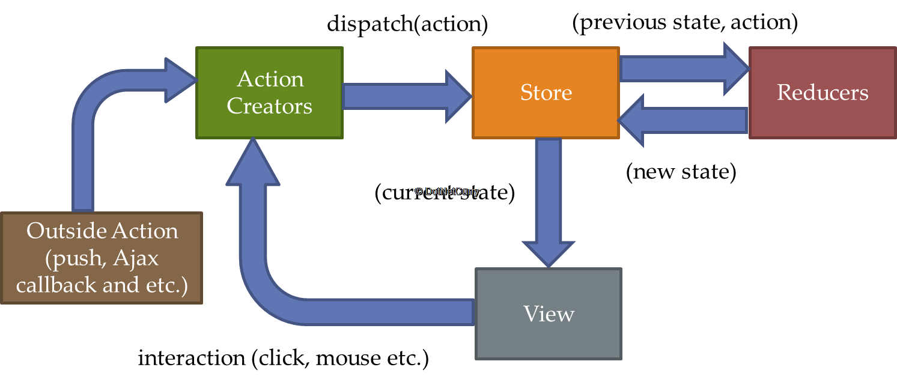

Slide 15
REACT-FLUX FLOW
React (View): Hey Action, someone clicked this “Save Course” button.
Action: Thanks React! I triggered an action creator with the dispatcher, so the dispatcher should take care of notifying all the stores that care.
Dispatcher: Let me see who cares about a course being saved. Ah! Looks like a Store has registered a callback with me, so I’ll let her know.
Store: Hi dispatcher! Thanks for the update! I’ll update my data with the payload you sent. Then I’ll emit an event for the React components that care.
React (View): Ooo! Shiny new data from the store! I’ll update the UI to reflect this!
Notes:
Source: https://softwareengineering.stackexchange.com/questions/295119/understanding-flux-pattern

Slide 16
ACTIONS
{ type: ‘LIKE_ARTICLE’,
articleId: 42 }
{ type: ‘FETCH_USER_SUCCESS’,
payload: { id: 3, name: ‘Mary’ } }
{ type: ‘ADD_TODO’,
text: ‘Read the Redux docs.’ }

Slide 17
Reducers are just pure functions that take the previous state and an action, and return the next state calculated by them in immutable fashion.
(previousState, action) => newState

Slide 18
REACT-REDUX

Slide 19
React-redux embraces the idea of separating presentational and container components.
Presentational: How things look.
Container: Subscribe to store and dispatch actions

Slide 20
Container Components are Redux-Aware while presentational components are not.

Slide 21
CODING DEMO

Slide 22
Prerequisites for Learner:
HTML Beginner Knowledge
CSS Beginner Knowledge
JavaScript Intermediate Knowledge

Slide 23
ES6/ES7 Concepts:
let & const
Template Literal
Arrow Function
Class
Modules
Default Parameters
Destructuring
Spread Operator

Slide 24
REACTJS Concepts:
Components
Properties
JSX
Create-react-app
Styling with CSS
State
Lifecycle Methods
Events
Controlled Components
Uncontrolled Components
Virtual DOM
React Dev Tools
Prop Type Validation
Keys

Slide 25
REDUX Concepts:
Immutability
Pure Functions
Flux Pattern
Actions
Store
Reducers
Dispatcher
React-Redux
Provider
Connect Method
Redux Dev Tools
Middleware
Redux Logger
Redux Thunk

Slide 26
REACT-ROUTER Concepts:
Dynamic Routing
React-router-dom
BrowserRouter
HashRouter
Link & NavLink
Route / Switch
Redirect

Slide 27
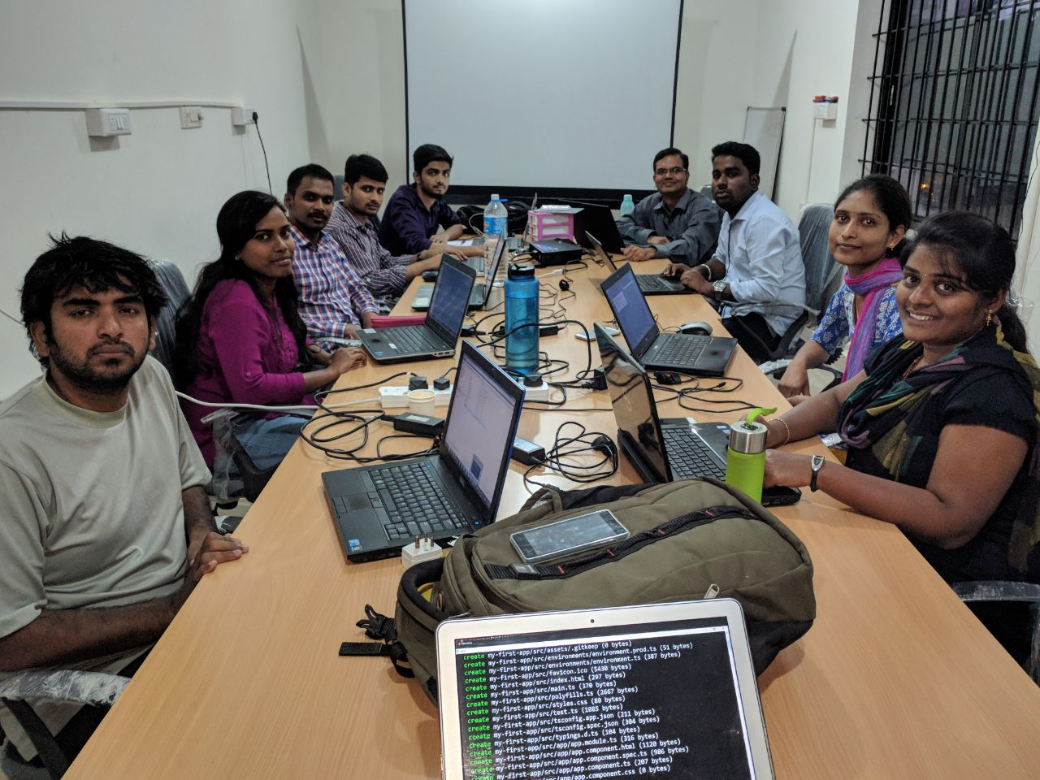

Slide 28
REACTJS COURSE DETAILS
https://www.skewcode.com/reactjs
8 classes in 4 weekends (Each class is 3.5 hours and on Saturday & Sunday).
28 hours of classroom training (also available online via webinar).
Includes 20 hours of offline project work.
Each class is recorded and the video made available.
Notes:
1. All things mentioned in the past 4 slides are part of our course.

Slide 29
Appendix

