Slide 1

Building REST API WITH NODE.JS
Skewcode.com
Sreekanth M. E.
Freelance Trainer & Consultant
http://www.SreekanthME.com
17-Mar-2018
Notes:
1. This is a 2-Part Crash Course. 2nd Part will be Redux (next week).

Slide 2
REST ARCHITECTURE:
GET: http://localhost:8080/users/
POST: http://localhost:8080/users/
PUT: http://localhost:8080/users/:id
DELETE: http://localhost:8080/users/:id

Slide 3
INSTALL NODE INSTALL POSTMAN

Slide 4
It is possible to create a simple web server using the http module of Node.js.
But other common web development tasks need a lot of custom code to be written.
Web Frameworks provide a easy way of implementing common web development requirements.

Slide 5
Express (4.x) is the most popular Node.js web framework, and is the underlying library for a number of other popular Node web frameworks like MEAN /MERN.

Slide 6
https://expressjs.com/

Slide 7
WHY NODEMON?

Slide 8
LIVE CODING DEMO

Slide 9
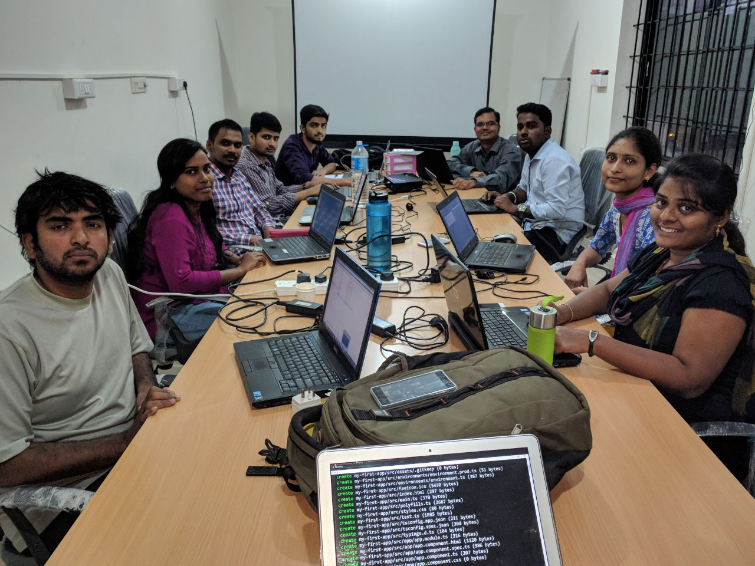

Slide 10
NODE.JS COURSE DETAILS
https://www.skewcode.com/nodejs
28 Hours of online training during weekdays (Evening IST hours).
Includes 20 hours of offline project work.
Each class is recorded and the video made available.
Notes:
1. All things mentioned in the past 4 slides are part of our course.

Slide 11
REACT / ANGULAR COURSE DETAILS
https://www.skewcode.com/reactjs
8 classes in 4 weekends (Each class is 3.5 hours and on Saturday & Sunday).
28 hours of classroom training (also available online via webinar).
Includes 20 hours of offline project work.
Each class is recorded and the video made available.
Notes:
1. All things mentioned in the past 4 slides are part of our course.

Slide 12
Appendix

