Slide 1
.NET CORE MVC
Lesson0 – 基礎傳值
Presented by: Silva
Dated: January 29, 2024

Slide 2
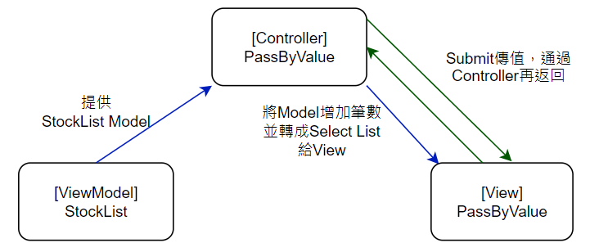
Lesson0 – POST/GET傳值 + SELECT

Slide 3
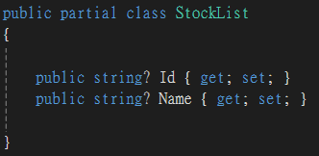
Lesson0 – ViewModels.StockList
Note.
避免null值
String?
Model!

Slide 4
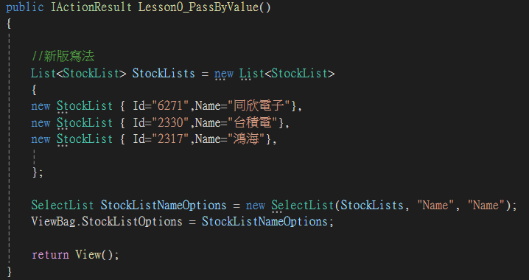
Lesson0 –LessonController.Less0_PassByBalue
Note.
1. New一個新List，結構來自於StockList且增加筆數
舊版寫法 :
List<StockList> StockLists = new List<StockList>();
StockLists.Add(new StockList { Id = "6271", Name = "同欣電子" });
新版寫法 :
List<StockList> StockLists = new List<StockList>
{
new StockList { Id="6271",Name="同欣電子"},
}
2. 轉成SelectList :
SelectList StockListNameOptions = new SelectList(StockLists, "Name", "Name");
^^^^^^ ^^^^^
Value Text
3. 若StockLists為Array or List，後面參數則不用:
SelectList StockListNameOptions = new SelectList(StockLists);

Slide 5
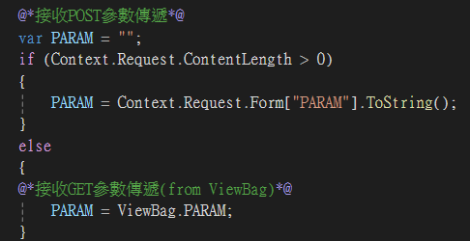
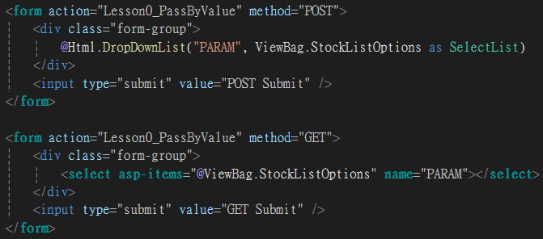
Lesson0 – View.Lesson0_PassByValue
Note.
接收POST參數 :
PARAM = Context.Request.Form["PARAM"].ToString();
2. Select :
HtmlHelper-
@Html.DropDownList("PARAM", ViewBag.StockListOptions as SelectList, new{@class="abc"})
^^^^^^^^^^^^^^^^^
定義其他屬性
TagHelper-
<select asp-items="@ViewBag.StockListOptions" name="PARAM"></select>

Slide 6
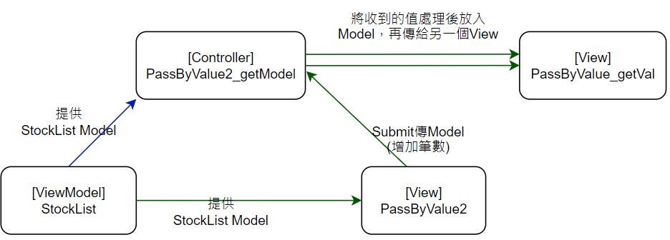
Lesson0 – Model/Form傳值 + Html.raw() + 驗證

Slide 7
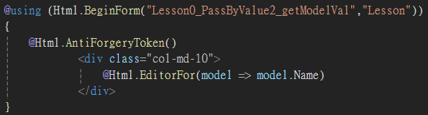


Lesson0 – Views.PassByValue2
Note.
Html Helper--
@using (Html.BeginForm("Lesson0_PassByValue2_getModelVal","Lesson"))
^^^^^^^^^^^^^^^^^^^^^^^^^^^^^^^^ ^^^^^^
Action Controller
{
@Html.AntiForgeryToken()
^^^^^^^^^^^^^^^^^^^^^^^^ 避免CSRF攻擊
……
}
Tag Helper—
<form asp-action="Lesson0_PassByValue2_getFormVal">
……
</form >

Slide 8
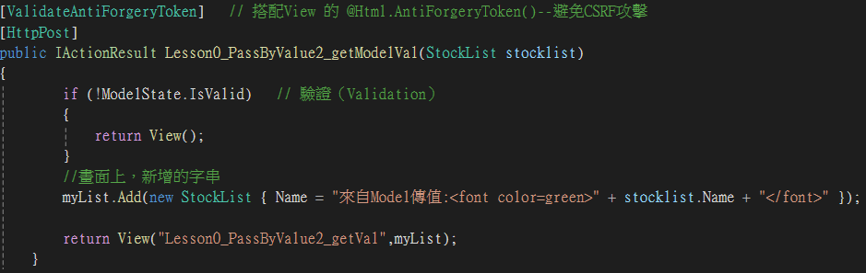
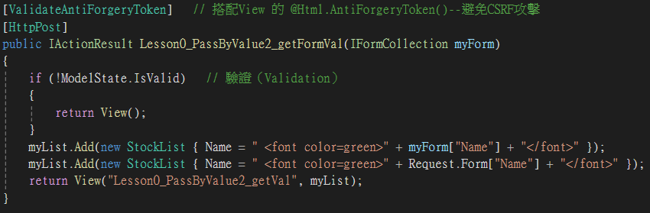
Lesson0 – LessonController.Lesson0_PassByValue2_getModelVal
Note.
Model傳值 –
public IActionResult xxx(StockList stocklist)
>stocklist.Name
Form傳值-
public IActionResult xxx(IFormCollection myForm)
>myForm["Name"]
>Request.Form["Name"]
驗證 –
[ValidateAntiForgeryToken]
if (!ModelState.IsValid）
{
return View();
}

Slide 9
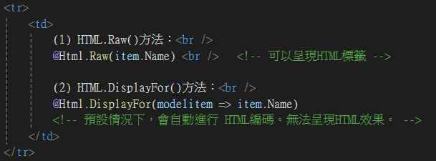
Lesson0 – Views.Lesson0_PassByValue_getVal
Note.
Controller回傳字串 :
<font color=green> abc </font>
In View
使用@HTML.Raw():
abc
使用@Html.DisplayFor():
<font color=green> abc </font>

Slide 11









Thank you for Listening!
Reality / Integrity / Customer First
Please Visit Us @ https://www.theil.com

