Slide 1
Establishment of Private Wireless Network Using open source Magma Software
Soubhik Baral
Chaitanya P. Umbare
Jeevitha L
Nidhi Jain
05.05.2023

Slide 2
Agenda
Need of Private Network using Magma Open-Source software
Magma Architecture
Magma Control , Data and Management plane
Magma software components
Magma software components Deployment
Test Bed
Hardware details
Test bed configuration
Lab Set up
Test cases and Results
Application
Future work

Slide 3
Objective:
Establishment of 4G/5G Transport Network using CBRS eNodeB & Magma Core Network for Helium Hotspot Miner Applications
Need of Private Network using Magma Open-Source software:
To provide reliable, scalable network and Cost effective Solution
Independent of underlying radio technology and spectrum (4G/5G/WiFi)
To address the challenges of rural internet access
Compatible with existing 3GPP network
Stores configuration state centrally and runtime state at the edges.

Slide 4
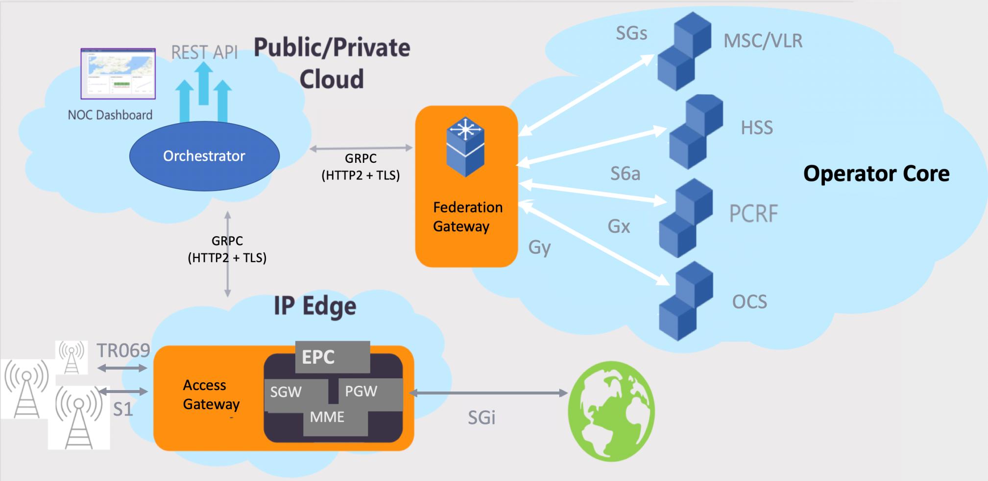
Magma Architecture for 4G/5G Cellular Data Coverage
SGW : Serving Gateway
PGW : PDN Gateway
MME : Mobility Management Entity
MSC : Mobile Switching Center
HSS : Home Subscriber Server
PCRF : Policy and Charging Rules Function Server
OCS : Online Charging System

Slide 5
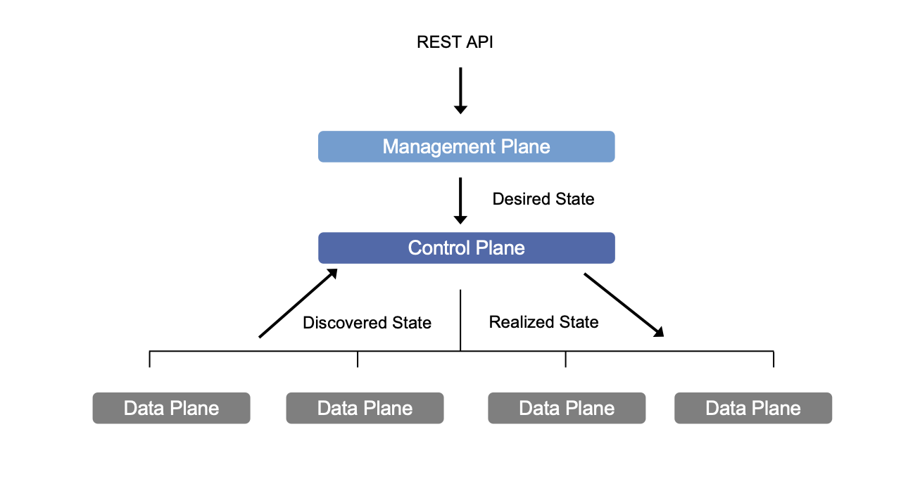
Management,Control and Data plane

Slide 6
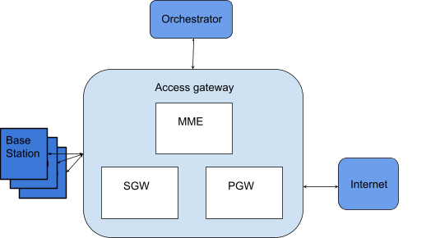
Magma software components
1.Access Gateway (AGW)

Slide 7
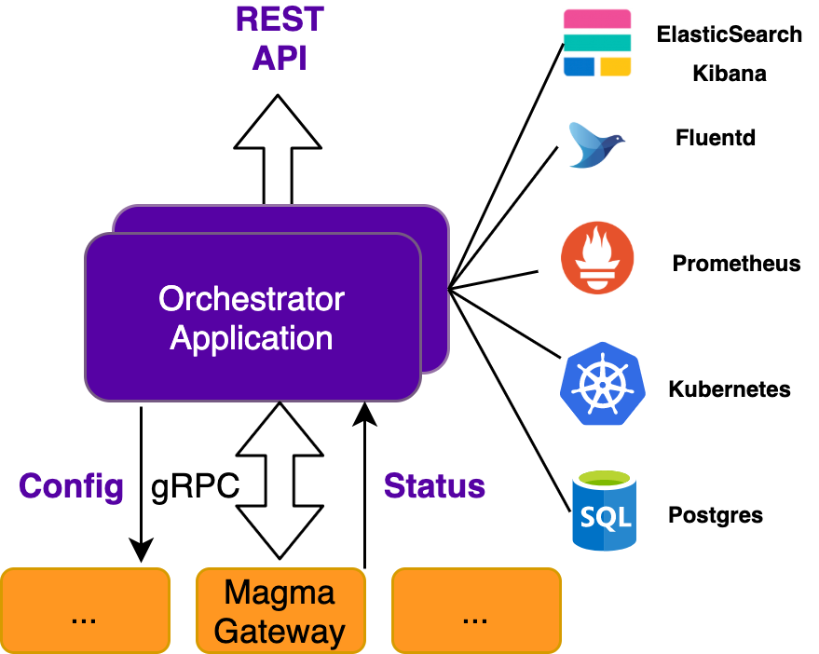
Magma software components
2. Orchestrator(OR8Cr)

Slide 8
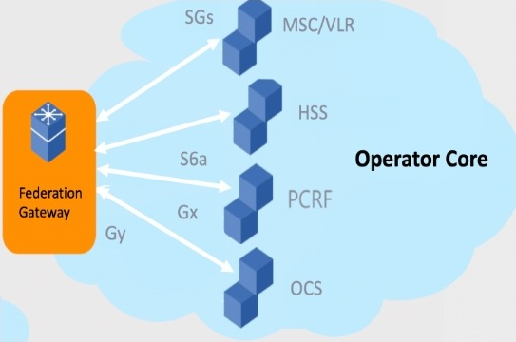
3. Federation Gateway (FGW)
The FGW integrates Mobile Network Operator (MNO) with magma.
Core functionalities such as authentication, data plans, Policy enforcement , charging should be uniform.
FGW is proxy : one side, it speaks with protocols (s6a,SGs..)
other it side GRPC

Slide 9

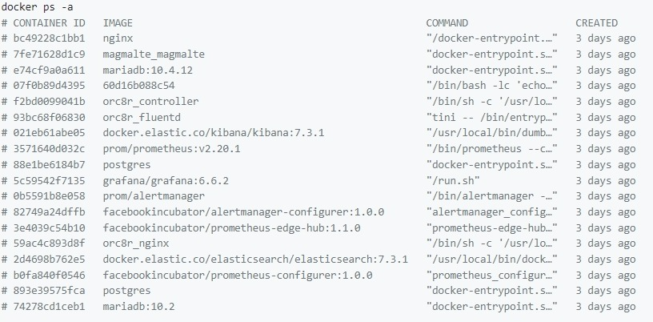
Magma software components Deployment
Access Gateway (AGW) was deployed using Vagrant
Orchestrator(ORC8r) was deployed using docker and its container was registered in docker hub account
Federation Gateway (FGW) can also be deployed using docker.

Slide 10
Test Bed Hardware Details
Customer Premise Equipment (CPE)
Baicells Atom ID06G
SIM card
4G Base station
Baicells Neutrino 430 eNB
Magma Access Gateway and Orchestrator deployment
KU551 development kit based on i-7 processor
Application Client / Server
Intel x86 based system

Slide 11
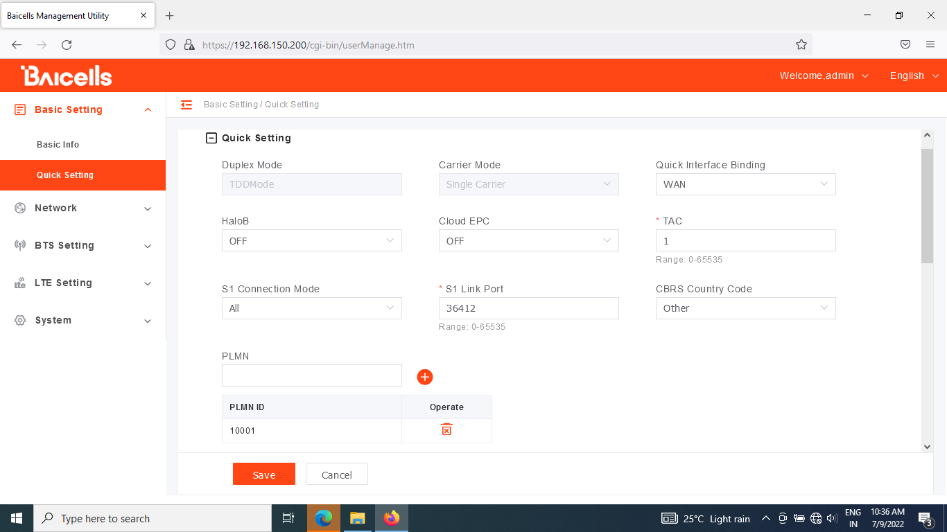
Test Bed Configuration
eNodeB
Band 48 - TDD
3GPP Rel. 15
Subframe Assignment
DSUDD
MIMO – 2x2
Bandwidth – 20 MHz
Magma
AGW
ORC8r

Slide 12
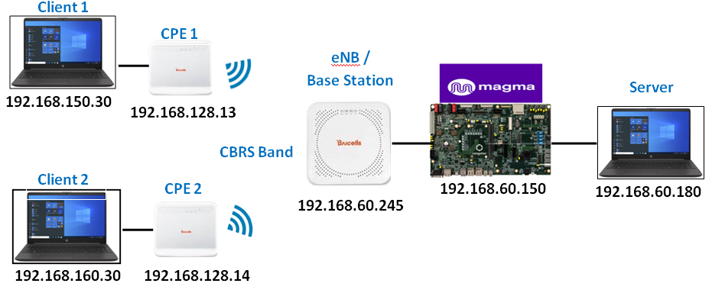
Lab setup of 4G/5G LTE Private Network over CBRS band using Magma Software components

Slide 13
Test Cases & Results
Throughput
DL ~ 110 Mbps
UL ~ 15 Mbps
VoIP Call
Using Open Source Asterisk SIP Server & Client

Slide 14









Application: Helium Hotspot Miner for 4G/5G Coverage
IoT Sensor Nodes
Helium Hotspot Miner/Gateway
Data Packet Forwarder
(Over LoRa)
Helium Miner Docker
Cellular Data Forwarder
(Over 4G/5G coverage)
Internet
Helium Network Server
Magma
Access Gateway
Mgmt+ Relay
CBRS Cell
Orchestrator
Magma
Federation Gateway
Mgmt+ Relay
CBRS Band
UE

Slide 15
Future Work
Integration & Testing of Magma 5GCN with 5G gNodeB/CPEs
Scale the Network with Multiple AGW, Base station
Deployment of orchestrator in cloud instead of ku551
Integration of Federation Gateway to the network.

Slide 16
THANK YOU

