Slide 1
Docker
Docker is an open-source platform that enables the creation, deployment, and management of applications using containerization. It provides a standardized way to package software and its dependencies into a container, which can then be run on any system that has Docker installed.
Containerization is light-weighted form of virtualization that allows multiple isolated containers to run on a single machine each of them has its own file system, memory and networking.

Slide 2
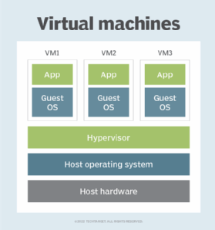
Virtual machines
Virtual machines are based on computer architectures and provide the functionality of a physical computer. Their implementations may involve specialized hardware, software, or a combination of the two.

Slide 3
Virtual Machines
Hypervisor: It manages and runs multiple VMs on host machines. It abstracts the hardware resources such as CPU, memory and storage to be shared.
Operating System: Each VM runs on its own OS including kernel, libraries and processes. This provides strong isolation between VMs.
Resource Allocation: The resources allocated to VM are dedicated and cant be shared with other VMs.
Resource overhead: Each VM runs full OS, resulting in larger memory footprints and slower startup times.

Slide 4
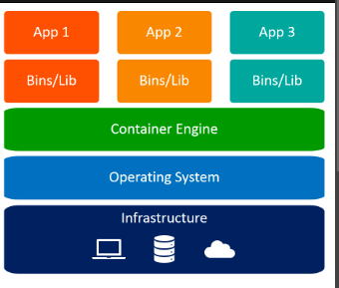
Containers
The technology that bundles the code for an application, and the configuration required to run the code itself, in one unit.
Why containers?
Portable: Can run on any OS.
Cost-effective: Uses less CPU
Scale: Self-contained. Can spun up/down in seconds
Quick replication: Create/erase replicas faster
Softwares: Docker, podman, containerd, rkt, cri-o

Slide 5
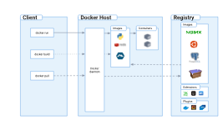
Docker Components

Slide 6
Docker Architecture
Docker Client: Talks to docker daemon, interacts using Rest API
Docker Daemon: Service that manages docker objects such as images, volumes.
O/S specific containers
WIndows server core (Windows server 2016)
Nano server (small size)
Hyper-v isloation (Win 10 professional+ )
Linux (alpine, ubuntu…)
Mac (Sierra 10.12 or newer)
Mac Hardware - 2010 model or newer

Slide 7
Why Docker?
Portability and Consistency: Ensures ML model runs consistently regardless of the underlying infrastructure. Useful for test/dev /production environments.
Isolation and Reproducibility: Can run in isolation.
Efficient Resource Utilization: Containers share host OS kernel, resulting in less overhead compared to full virtualization. They startup quickly.
Simplified deployment: Reduces overhead in deployment and manual configuration.
Scalability and Orchestration: Kubernetes and Docker Swarm enable seamless scaling of ML applications by managing multiple container instances.
Version control and collaboration: Docker Hub contains previous images. Versioning container images ensured that the images can be tracked and rolled-back.

Slide 8
Docker components
DockerFile: Text file that contains instructions to build docker image.
Docker Images: Template which contains application code, dependencies, libraries, created from docker file.
  Used to create multiple container instances.
Docker Containers: Running instance of the image. Light-weighted, isolated and encapsulates application environment. They can be connected to networks, have storage.
Docker Engine: Core component that provides runtime environment for containers. It manages lifetime of containers. Contains Docker Daemon and Docker client.
Docker Hub/Registry: Public repository with docker images. Push/pull requests.

Slide 9
Productionization
Development environment
Experimentation
  A/B testing
  Blue/Green deployment
  Canary deployment
Production environment
  Service deployment on clusters
  Service monitoring
  One-of changes and adhoc verification
  Experimentation for significant changes
  CI/CD environment

Slide 10
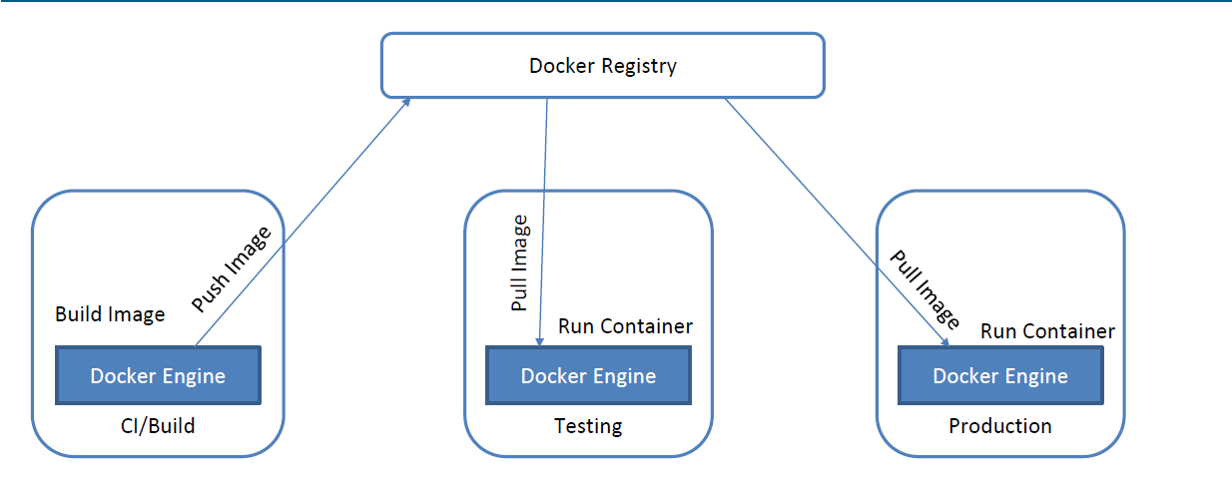
Docker Architecture

Slide 11
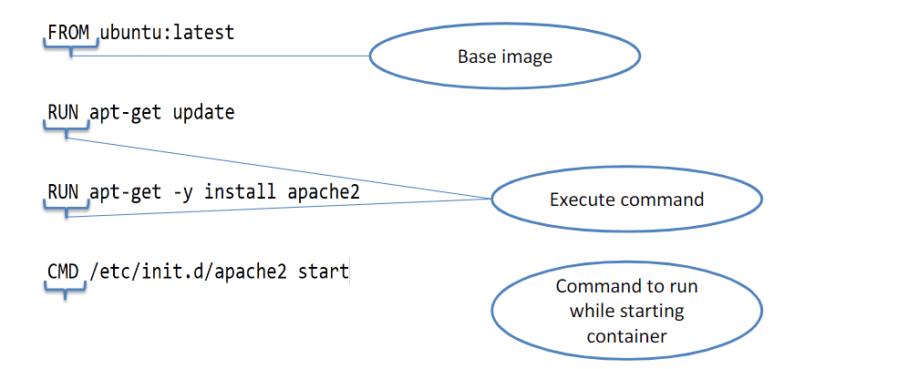
Docker File

Slide 12
Best Practices for Authoring Docker File
Split the dockerfile into multiple and staged instructions.
  Building the library
  Copying the relevant files
Use .dockerignore to ignore the files that are not needed.
Dont install un-necessary packages.
Container should be as independent and stateless as possible.
Each container should build one application/service/process.
Leverage build cache
  Order the layers depending on the changes. (keep the code building layer at the last)
  Keep the layers small.
  Name the build stages.

Slide 13
Docker image commands
Building docker image:
Docker build –f <dockerfilepath> <context>
Docker build –t <image_name> <context>
Docker image commands:
List docker images
docker ps
2. Remove/delete docker image from local system
Docker images rm <image>
3. Show details about an image
Docker image suspect <image>
4. Push local docker image to docker registry
Docker image push <NAME>
5. Pull an image from docker registry
Docker image pull <NAME>

Slide 14
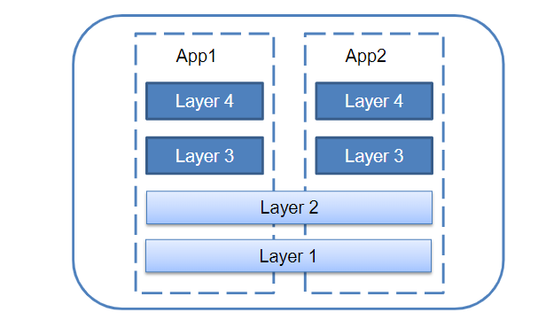
Each instruction creates a layer.
Docker Image Layers

Slide 15
Docker command
Docker run: Creates and starts new container from image
Docker stop: Stops a running container
Docker ps : Lists all running containers
Docker rm: Removes one or more containers.
Docker images: Lists available images
Docker exec: Runs a command inside container
Docker-compose: Manages multi-container applications using YAML file.
Docker logs <container>: View logs from container.
Docker stats: Display resource usage statistics
https://github.com/dockersamples/

Slide 16
Volumes
Concept:
Docker containers are ephemeral (temporary), meaning that any data inside it is lost when a container stops. Volumes provide persistent storage that stays even if the container stops.
You need a storage locker (Volume) outside the room.

Slide 17
Docker Networking
Docker provides different networking modes that allow containers to communicate with each other or with the outside world. The main types are:
Bridge (Default): Containers can talk to each other but not to the host.
Host: The container shares the same network as the host machine.
None: The container has no network access.
Custom Networks: Containers can communicate by name instead of IP addresses.

Slide 18
Functions
Service Discovery: It can run containers by name.
  Each container is assigned an IP address within the network,
  Containers can also register host names.
Global Configuration Stores:
  Config files can be shared across all images.
Communication:
  Docker Engine provides communication between containers.
  Tools like Weave, Flannel used when containers are running across multiple hosts.
Cluster Management:
  Docker containers can be deployed on multiple hosts/clusters.
  Kubernetes, Docker Swarm are used for cluster management.

Slide 19
Kubernetes
“Kubernetes is open-source system for automating deployment, scaling and management of containerized applications.”
96% of organizations are using/evaluating
Close to 6M developers using
Developed on basis of Google’s internal cluster management system called Borg
Donated K8 as first open-source project.
Written in Go programming language.
Applications for planet-scale - Spotify (10M/sec)

Slide 20
Why Kubernetes?
Open-sourced platform for managing containerized workloads and services
Makes it easy to orchestrate many containers on many hosts
Scales the container applications and deploy rollouts and rollbacks
Is a set of APIs to deploy containers on clusters.
Contains Control pane and set of nodes as containers
Can make set of applications can interact with each other

Slide 21
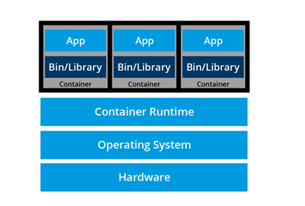
Kubernetes - Container
Containers are an application centric method to deliver high-performing scalable infrastructure of any choice.
Container orchestrators group systems together to form clusters where containers deployment and management is automated at scale while meeting the requirements:
  Fault tolerance
  On-demand scalability
  Optimal resource usage
  Auto-discovery of service
  Accessibility from outside
  Seamless updates/rollback

Slide 22
Kubernetes Features
  Self-healing: Replaces and reschedules containers from failed nodes.
  Horizontal scaling: Scaled manually/automatically based on CPU utilization.
  Service discovery and load balancing: It assigns single DNS to set of containers for load balancing.
  Automatic bin packing: Automatically schedules containers based on needs and resource constraints
  Automatic roll outs and rollbacks: Rolls out application updates and configuration changes.
  Secret and config management: Manages sensitive data separately from container image.
  Storage orchestration: Automatically mounts software defined storage from cloud, distributed storage.
  Batch Execution: Supports batch execution, long-running jobs.

Slide 23
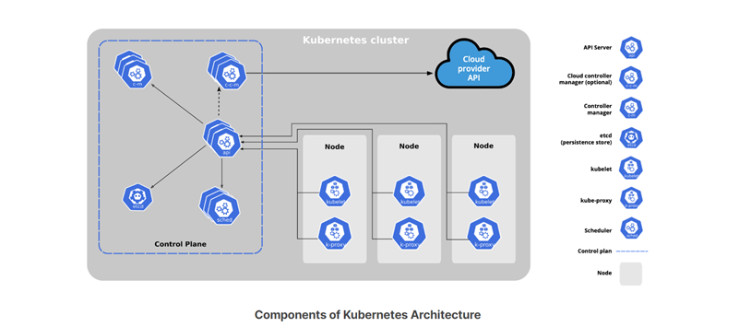
Kubernetes Architecture

Slide 24
Kubernetes components
kube-scheduler is to assign new workload objects, such as pods encapsulating containers, to nodes - typically worker nodes
Controller managers are components of the control plane node running controllers or operator processes to regulate the state of the Kubernetes cluster
kube-controller-manager runs controllers or operators responsible to act when nodes become unavailable
cloud-controller-manager runs controllers or operators responsible to interact with the underlying infrastructure of a cloud provider when nodes become unavailable
etcd is a strongly consistent, distributed key-value data store used to persist a Kubernetes cluster's state.

Slide 25
Workloads
Applications running on K8s are called workloads
Pods run workloads
Pods contain one or more nodes
K8s manages the lifecycle of pods
Pods start and stop all containers
Applications
  It can run stateless applications
  Can run stateful applications like databases
  It is used for batch jobs and cron jobs

Slide 26
Nodes
Nodes are hosts which run pod
Nodes can be physical machines/VMs
Nodes are managed by controllers
Components
  Kubelet
  Kube-proxy
  Container run time

Slide 27
Cloud Computing
Customers get computing resources on-demand
Access to resources from anywhere on Internet
Resource provider allocates the resources to user
Resources are flexible
Pay for only what they use

Slide 28
Kubernetes components
Worker node provides a running environment for client applications. These applications are microservices running as application containers
kubelet is an agent running on each node, control plane and workers, and communicates with the control plane.
kube-proxy is the network agent which runs on each node, control plane and workers, responsible for dynamic updates and maintenance of all networking rules on the node.
Node registration
Self discovery: kube-let with register the node with API server
Manual: Nodes can be updated using kubectl
Nodes provide the status information to API

Slide 29
Controllers
Maintain state of resources
Watch the state of resources and take action
Via API Server
  Calls the API to change the system state.e.g.,job state
- Via External resources
- Communicates with infra management
- Can run inside kube-control-manager component of control pane.
- Lot of built-in controllers available e.g., job controller, node controller

Slide 30
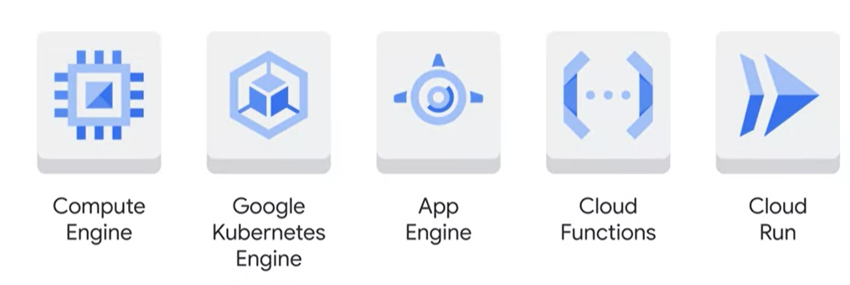
Google Cloud Offerings

Slide 31
Google cloud offerings
Compute engine - Compute, Storage, Network, VMs, Disks/SSDs
Google Kubernetes Engine - Runs containerized applications on cloud
App Engine - Fully managed Platform As Service. Infra app needs.
Cloud Functions - Event based code execution, deploys compute for the code, uses connected cloud solutions
Cloud run - Managed cloud platform, runs containers

Slide 32
Google Kubernetes Engine
Managed K8s service
Manages to scale, deploy and scale K8s
Manages cluster configuration likes nodes, config, security
Ensures clusters have latest version of K8s
Auto-repairs unhealthy nodes
Scales cluster

