Slide 1
MLOPS Workshop
Building an AutoML model using Azure
Building ML Pipeline from scratch
Building a Rest API service using Flask
Build a webpage using Streamlit
Creating a docker container for the ML pipeline

Slide 2
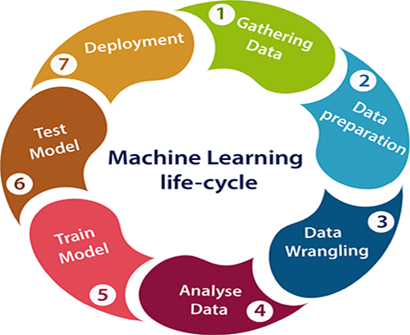
Machine learning Life cycle

Slide 3
Hyper-parameter tuning
Technique for automating the ANN design to achieve better performance
Trained parameters (weights)
Hyper-parameters before launching the learning process (Learning Rate)

Slide 4
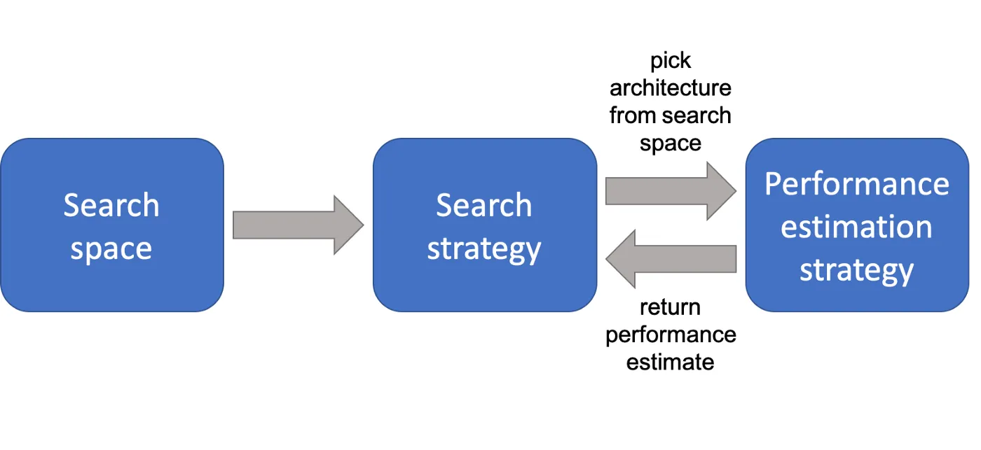
Neural Architecture Search

Slide 5
Search Strategy
Grid Search: Searches all combination
Random Search: Randomly picks the combination
Bayesian Optimization: Uses observations from tested architectures to predict the next combination
Reinforcement Learning: Agents take action and gets rewarded based on performance metric.

Slide 6
Resource Management Strategies
Handling scale in data, model (features, layers)
Dimensionality Reduction
Manual
Algorithmic
Quantization
Pruning

Slide 7
Why Dimension Reduction?
Removing unwanted features saves space.
Unwanted features introduces noise
Risk of overfitting
Hard to interpret and visualize
Curse of Dimensionality
As we add more dimensions we also increase the processing power we need to train the model and make predictions, as well as the amount of training data required. – Badreesh Shetty

Slide 8
Dimensionality Reduction
Manual
Tabular: Combine, Decompose, Aggregate
Text: Context indicators
Image: Use filters
Taxi dataset: {fare, pickup_datetime, pickup_longitude, dropoff_longitude, pickup_latitude, dropoff_latitude, passenger_count, key}
Compute distance, Scale latlong, Bucketize latlong
Algorithmic
Feature Selection techniques
Feature Extraction techniques

Slide 9
Algorithmic Feature Reduction Techniques
Feature Selection
Filter methods: Filter features based on the statistical measure like Information Gain, Chi-square test, Fisher’s score
Wrapper & Elimination methods: Trains with different subset of features, by adding/removing features to the subset
Embedded: Feature selection is embedded in the training algorithm like Regularization.
Feature Extraction
Principal Component Analysis (PCA): Projects the high dimensional vector into lower-dimensional spaces, while preserving the variance.
Linear Discriminant Analysis (LDA) : Finds set of features that maximize the class separation.
Independent Component Analysis (ICA): Does linear transformation of the data into independent components
Notes:
Information Gain defines the information provided by the feature in identifying the target value.
Chi-square test is used to test the relationship between categorical value.
Fisher score selects the feature using their scores. Higher score, better feature.
Regularization adds penalty to different parameters. The features with zero coefficients can be removed.

Slide 10
Resource Management Strategies
Quantization: Process to reduce the model size.
Converts weights into integer values
Helps reduce storage and computation
Effects the accuracy
Use MobileNet V2, TFLite
Pruning
Process to prune the synapses and neurons
Adding sparsity to the Neural Network

Slide 11
Project Description
Predict the fare price for the taxi ride.
Input columns: pickup_community_area, trip_start_month, trip_start_hour, trip_start_day, trip_start_timestamp, pickup_latitude, pickup_longitude, dropoff_latitude, dropoff_longitude, trip_miles, pickup_census_tract, dropoff_census_tract, payment_type, company, trip_seconds, dropoff_community_area, tips
Phase-1 Phase-2
EDA - Building a Rest API/
Choosing the right model - Building an E2E application
Hyper-parameter tuning - Creating a container
Building the pipeline
Notes:
https://colab.research.google.com/drive/11pL3tizdcsGKDsi8hC3dN3aDVaFyMobI

Slide 12
What is model deployment?
To build an end-to-end product of the model which can take inputs and produce outputs/predictions.
Deploy the model in an app/web service/Rest API so that user can interact with the model.
Deployment makes the model available 24 x7

Slide 13
Criteria
Portability: this refers to the ability of your software to be transferred from one machine or system to another. A portable model is one with a relatively low response time and one that can be rewritten with minimal effort.
Scalability: this refers to how large your model can scale. A scalable model is one that doesn’t need to be redesigned to maintain its performance.

Slide 14
Where to deploy?
Huge data centers/servers – Maintenance cost
Cloud – Fully managed, comes with cost
Mobile/ Edge devices – Sitting on device/Rest API from server
Factors effect the choice
Latency: Delay between user’s action and response. Minimal latency is the key
Throughput: No of successful requests served in unit time. Maximizing throughput is the key.
Cost: Cost of CPUs, GPUs, database. Minimize the cost.
Precision: Can we live with less precision ?

Slide 15
Deployment methodologies
One-off
Training vs running predictions
We don’t need to continuously predict a machine learning model in order for it to be deployed. Sometimes a model is only needed once or periodically. In this case, the model can simply be trained ad-hoc when it’s needed and pushed to production until it deteriorates enough to need some fixing.

Slide 16
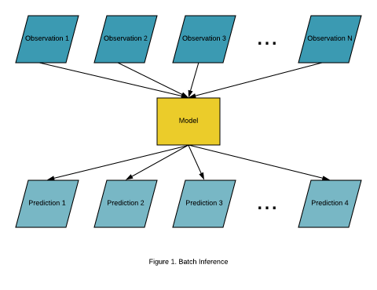
Deployment methodologies
Batch
Batch prediction allows you to constantly have an up-to-date version of your model. The predictions can be run at a bulk.

Slide 17
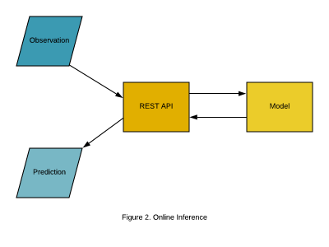
Deployment methodologies
Real-time
In some cases you’ll want a prediction in real-time, for example, to determine if a transaction is fraudulent or not. This is possible by using online machine learning models, like linear regression using stochastic gradient descent.

Slide 18
Continuous Deployment
Feedback from users
When we observe data drifts
Changing behavioral patterns/seasonality
Create new data and retrain the system
Automate this whole loop to CI/CD

Slide 19
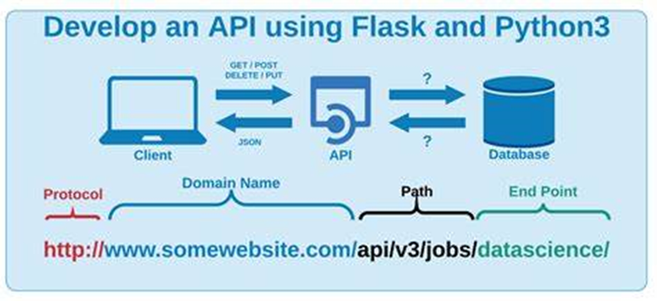
Rest API
REST - Representational State Transfer
REST is an API type. It’s popular for mobile/web applications.
REST API treats text/image/video as a resource.
Requester (client) sends the request and responder (server) sends the response.
REST API provides guiding principles on how to use URLs and HTTP protocol to structure the API
Features of REST API:
- Statelessness: For client-server communication, stateless constraint enforces server not to understand client state. Helps in scalability.
- Cacheable: Caching enhances the performance of the client.
- Flexible: It is flexible with multiple data formats.

Slide 20
Docker
Docker is an open-source platform that enables the creation, deployment, and management of applications using containerization. It provides a standardized way to package software and its dependencies into a container, which can then be run on any system that has Docker installed.
Containerization is light-weighted form of virtualization that allows multiple isolated containers to run on a single machine each of them has its own file system, memory and networking.

Slide 21
Docker components
DockerFile: Text file that contains instructions to build docker image.
Docker Images: Template which contains application code, dependencies, libraries, created from docker file.
Docker Containers: Running instance of the image. Light-weighted, isolated and encapsulates application environment. They can be connected to networks, have storage.
Docker Engine: Core component that provides runtime environment for containers. It manages lifetime of containers. Contains Docker Daemon and Docker client.
Docker Hub: Public repository with docker images. Push/pull requests.

Slide 22
Docker command
Docker build: Builds a Docker image from a Docker file.
Docker run: Creates and starts new container from image
Docker stop: Stops a running container
Docker rm: Removes one or more containers.
Docker ps: Lists running containers
Docker images: Lists available images
Docker pull: Pull a docker image from library
Docker push: Pushes an image to registry
Docker exec: Runs a command inside container
Docker-compose: Manages multi-container applications using YAML file.

Slide 23
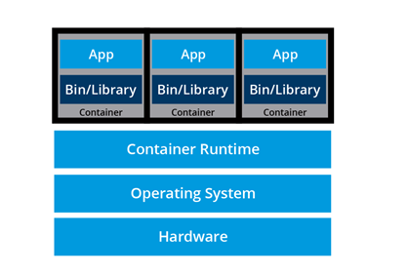
Kubernetes - Container
Containers are an application centric method to deliver high-performing scalable infrastructure of any choice.
Container orchestrators group systems together to form clusters where containers deployment and management is automated at scale while meeting the requirements:
Fault tolerance
On-demand scalability
Optimal resource usage
Auto-discovery of service
Accessibility from outside
Seamless updates/rollback

Slide 24
References
Neural Architecture Survey https://arxiv.org/pdf/1808.05377.pdf
Principal Component Analysis
https://arxiv.org/pdf/1404.1100.pdf
Quantization
https://arxiv.org/abs/1712.05877
Streamlit https://docs.streamlit.io/

