Slide 1

B. P. Poddar Institute of Management and Technology
Department of Computer Science & Engineering
Final Year Project
Topic: Credit Card Fraud Detection
Group No - 8
NAME | ROLL
Sagar Debnath | 11500120009
Ramesh Das | 11500120010
Shoham Sen | 11500120075
Soudeep Ghosh | 11500120093

Slide 2

Credit Card Fraud Detection

Slide 3
Agenda
01
05
Abstract
Dependencies
02
06
Introduction
Information about Data Set
03
07
Scope of the Project
Data Analysis
04
08
Technology to be Used
Data Preprocessing

Slide 4
Abstract
In the era of cashless Transaction every people use ATM card and credit card for transaction, so the scope of online fraud can increase.
Losses of Billion dollars are caused every year by fraudulent credit card transactions. The design of efficient fraud detection algorithms is key for reducing these losses, and more and more algorithms rely on advanced machine learning techniques to assist fraud investigators.

Slide 5

Introduction
In today’s digital age, where electronic transactions have become the norm, credit card fraud has become a significant concern for both financial institutions and consumers. Detecting fraudulent activities in real-time is crucial to prevent financial losses and protect sensitive information. This has led to the development of advanced techniques and technologies for credit card fraud detection. In this project, we aim to implement a robust and efficient credit card fraud detection system using machine learning algorithms.

Slide 6

Scope of our Project
Detect the fraudulent transactions
Minimization of credit card fraud
Analysis of different Machine Learning Algorithms
Better Performance and Accuracy

Slide 7




Technology to be used
Python
Data Set
Credit Card Fraud Detection System
Python Modules
Google Colab

Slide 8


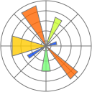

Dependencies
01
02
03
Numpy
Pandas
Matplotlib
Numpy is the fundamental package for scientific computing in Python. It is a Python library that provides a multidimensional array object, various derived objects
Pandas is a Python library used for working with data sets. It has functions for analyzing, cleaning, exploring, and manipulating data.
Matplotlib is a low level graph plotting library in python that serves as a visualization utility.

Slide 9
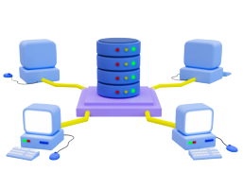
Information about Data Set
The dataset comprises credit card transactions made by European cardholders in September 2013. The data covers two days and includes a total of 284,807 transactions, out of which 492 are identified as frauds. Notably, the dataset is highly imbalanced, with frauds accounting for only 0.172% of all transactions.
The dataset consists solely of numerical input variables, resulting from a PCA transformation. Unfortunately, due to confidentiality constraints, the original features and additional background information about the data cannot be provided. The features V1 to V28 represent principal components obtained through PCA, while 'Time' indicates the seconds elapsed between each transaction and the first transaction in the dataset. The 'Amount' feature represents the transaction amount and has not been transformed. The 'Class' feature serves as the response variable, taking a value of 1 in cases of fraud and 0 otherwise.

Slide 10
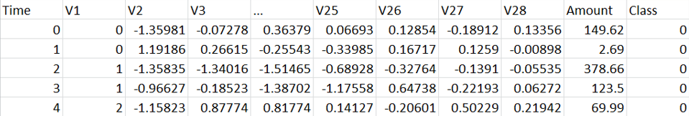
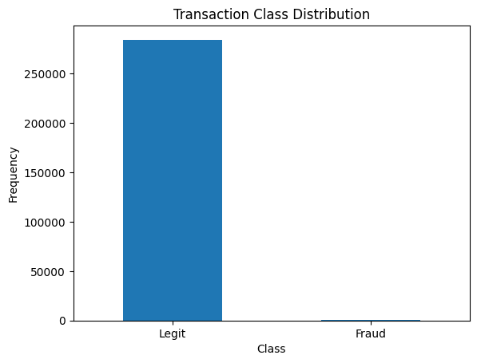
Data Analysis
Head of the Data Set
Dealing with highly unbalanced data is a common challenge in machine learning, especially in scenarios where one class (in this case, fraud transactions) is significantly underrepresented compared to the other class (non-fraud transactions). If left unaddressed, machine learning models trained on imbalanced data can be biased towards the majority class, leading to poor performance in detecting the minority class (frauds, in this case).

Slide 11
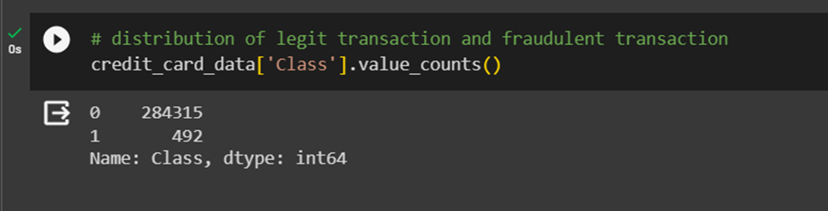
Data Analysis
In our dataset, transactions are classified into two categories: 0 for legitimate transactions and 1 for fraudulent transactions. There are 284,315 instances of legitimate transactions and only 492 instances of fraudulent transactions, highlighting a significant imbalance in the data distribution.

Slide 12
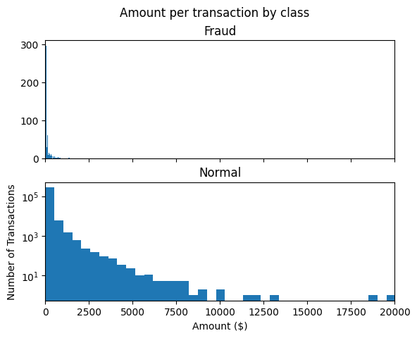
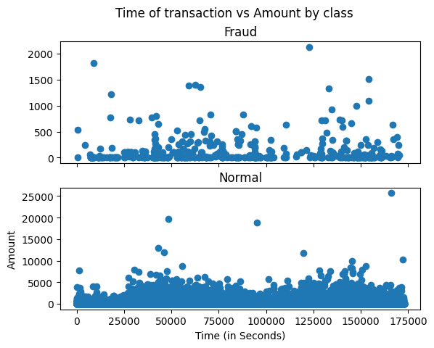
Data Analysis
The graph illustrates the distribution of transaction amounts categorized by class, specifically focusing on fraudulent transactions. By visualizing this data, we gain valuable insights into the patterns and disparities between the amounts involved in fraudulent and non-fraudulent activities.
This graph provides a clear distinction between two classes of transactions: fraudulent and non-fraudulent. By comparing the histograms representing these classes, we can discern how transaction amounts vary significantly between the two categories.
The unbalanced nature of the dataset is evident in this graph, with the majority of transactions falling within the non-fraudulent category.

Slide 13
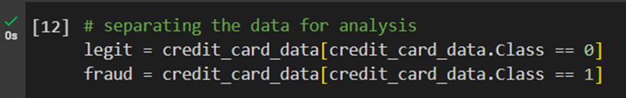
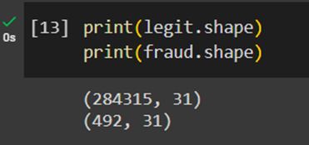
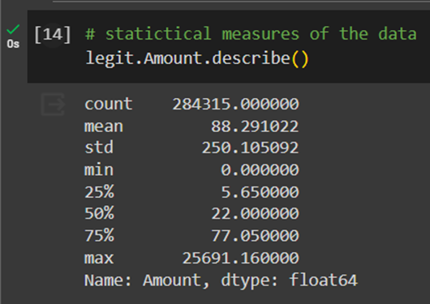
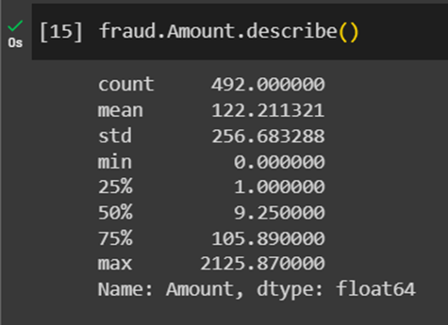
Data Analysis
Separating the data and analyse the statistical properties :

Slide 14
Data Pre-processing
It is vital to identify the minority classes correctly. So model should not be biased to detect only the majority class but should give equal weight or importance towards the minority class too. Here we used Resampling techniques which can deal with this problem. There is no right method or wrong method in this, different techniques work well with different problems.
Resampling:
Resampling Method is a statically method that is used to generate new data points in the dataset by randomly picking data points from the existing dataset. It helps in creating new synthetic datasets for training machine learning models and to estimate the properties of a dataset when the dataset is unknown, difficult to estimate, or when the sample size of the dataset is small.

Slide 15
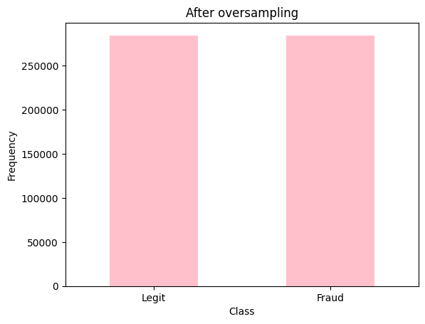
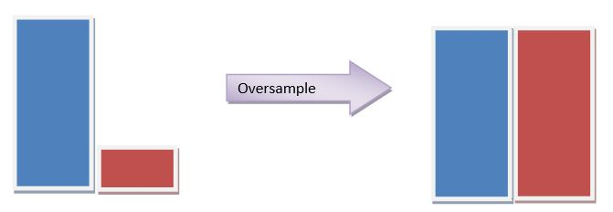
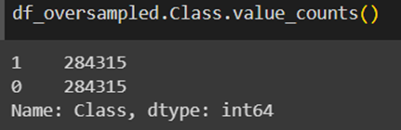
Handling Imbalanced Datasets.
Random Over Sampling: It aims to balance class distribution by randomly increasing minority class examples by replicating them.​

Slide 16
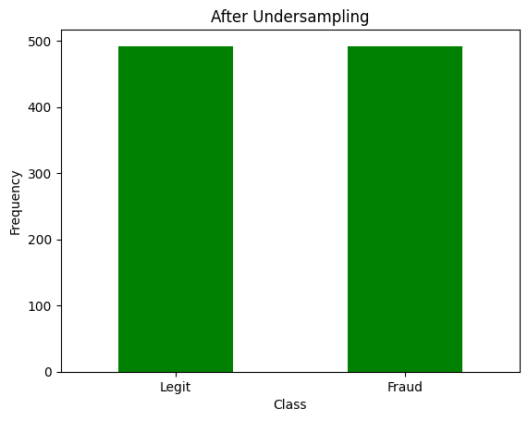
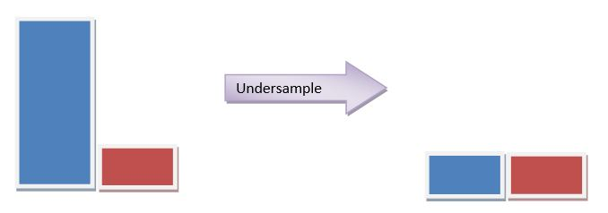
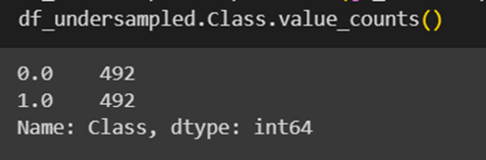
Handling Imbalanced Datasets.
Random Under-sampling:
It aims to balance class distribution by randomly eliminating majority class examples.

Slide 17

Model Training and Testing
Training and Testing Data: To build and evaluate the performance of a machine learning model, we usually break our dataset into two distinct datasets. These two datasets are the training data and test data. Let’s have a closer look at each of these sub-datasets.

Slide 18
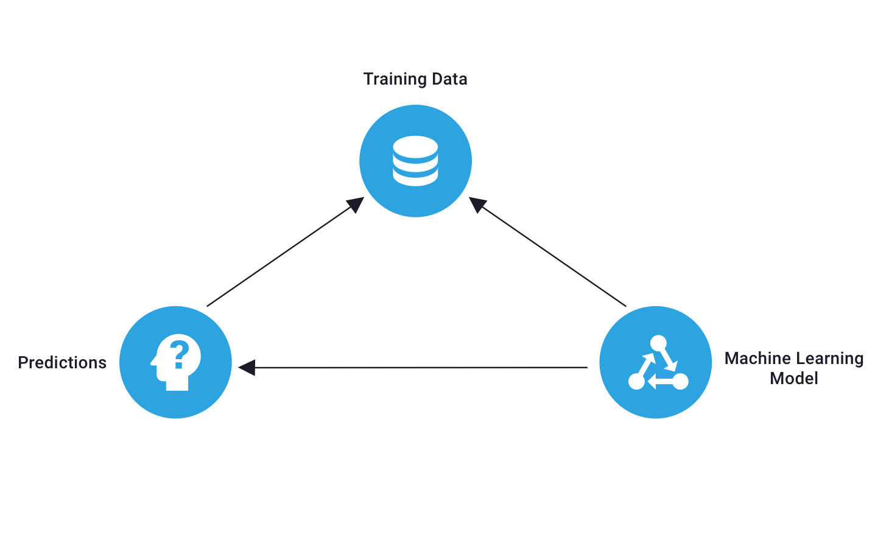
Model Training and Testing
Training Data: Training data are the sub-dataset which we use to train a model. These datasets contain data observations in a particular domain. Algorithms study the hidden patterns and insights which are hidden inside these observations and learn from them. The model will be trained over and over again using the data in the training set machine learning and continue to learn the features of this data. Later we can deploy the trained model and have accurate predictions over new data. These predictions will be based on the learnings from the training dataset.

Slide 19
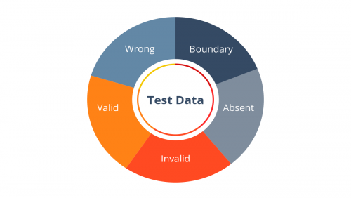
Model Training and Testing
Testing Data: In Machine learning Test data is the sub-dataset that we use to evaluate the performance of a model built using a training dataset. Although we extract Both train and test data from the same dataset, the test dataset should not contain any training dataset data. The purpose of creating a model is to predict unknown results. The test data is used to check the performance, accuracy, and precision of the model created using training data.

Slide 20
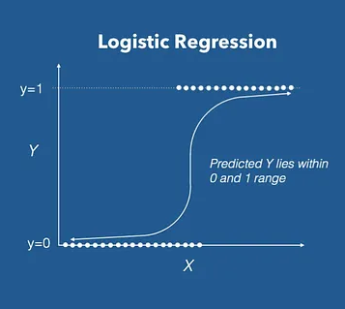
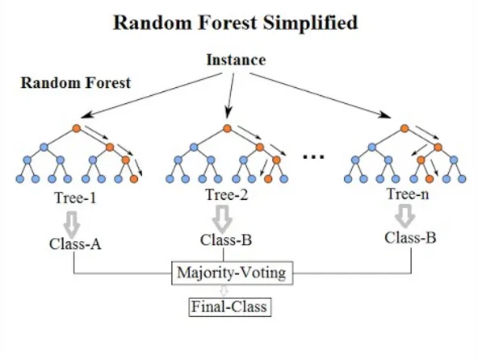
Used Machine Learning Algorithms
Model
Logistic Regression
Random Forest Classifier

Slide 21
Model Training and Testing using Logistic Regression
During the training phase, we use the logistic regression algorithm to build a predictive model for detecting credit card fraud. The training dataset contains historical transactions, both genuine and fraudulent. The algorithm learns from this data, aiming to distinguish between normal and fraudulent activities by adjusting its parameters to minimize prediction errors.
In this testing phase, we calculate performance metrics like accuracy, precision, recall, and F1 score. These metrics help us measure the model's effectiveness in identifying fraudulent transactions while minimizing false positives. We also create a confusion matrix, providing a detailed breakdown of true positives, true negatives, false positives, and false negatives.
If the model meets our desired performance criteria, it can be deployed for real-time credit card fraud detection in operational environments. Further details and discussions on the results are covered in the Results & Discussion section.

Slide 22
Model Training and Testing using Random Forest Classifier
Random Forest is a powerful method that improves prediction accuracy by combining multiple decision trees. It's great for spotting legitimate and fraudulent transactions, handling both numerical and categorical features well.
During training, it builds multiple trees on random data subsets, making diverse splits and reducing overfitting risks. Tuning hyper parameters like the number of trees optimizes performance.
Random Forest naturally assesses feature importance, highlighting key contributors to fraud predictions. Like logistic regression, we can adjust the decision threshold for the desired sensitivity-specificity balance, meeting business requirements.
If it meets criteria, the model can be deployed for real-time credit card fraud detection, offering a scalable and effective solution for financial institutions. More details and discussions are in the Results & Discussion section.

Slide 23


Result and Discussion
In this credit card fraud detection project, we mainly used two machine learning models: Logistic
Regression and Random Forest. The results of the model evaluations, based on accuracy, are as follows:
Logistic Regression: We have performed Logistic regression for two pre-processed data sets. For oversampled dataset we got accuracy on training data 91.8% and testing data we got 91.6%
For under sampled dataset, we got accuracy on training data 92.5% and testing data we got 89.8%

Slide 24


Result and Discussion
Characteristics:
Interpretability: High, as the model provides coefficients indicating the impact of each feature on the
prediction.
Computational Intensity: Low, making it computationally efficient and easy to deploy.
Handling Non-linearity: Limited compared to Random Forest, as it assumes a linear relationship
between features and the log-odds of the response variable.
Robustness to Outliers: Moderately sensitive to outliers due to the linear nature of the decision
boundary.

Slide 25
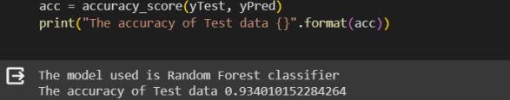
Result and Discussion
Random Forest Classifier: Using Random Forest algorithm we got the accuracy of 93.4%.
Characteristics:
Interpretability: Lower than Logistic Regression due to the ensemble nature, considered as a "black box" model.
Computational Intensity: Higher compared to Logistic Regression, especially for larger datasets, but provides better generalization.
Handling Non-linearity: Better than Logistic Regression, as Random Forest can capture complex nonlinear patterns through decision trees.
Robustness to Outliers: More robust to outliers due to the aggregation of predictions from multiple trees.

Slide 26
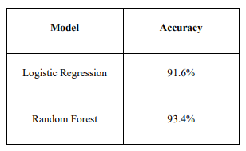
Comparison Summary
Comparing the models, Random Forest has a slightly higher accuracy (93%) than Logistic Regression (91.6%). Logistic Regression is more interpretable and computationally efficient, ideal for scenarios where interpretability and deployment ease matter.
Random Forest shines in capturing non-linear patterns, handling outliers, and managing imbalanced datasets. Choosing between them depends on factors like dataset nature, interpretability needs, computational resources, and fraud detection goals.
In conclusion, both models perform well. The decision on which to deploy should be based on specific requirements and trade-offs relevant to the credit card fraud detection system.

Slide 27

Limitations
Firstly, the dataset, though large with a million samples, represents only a tiny fraction of daily global credit card transactions. More details on its origin, country, and region are needed from the data uploader.
Secondly, the downloaded dataset is clean, lacking incomplete values and with categorical variables converted into numerical ones. Real-life data might be more complex, requiring consideration of additional variables like purchase price ratios, store types, and potential variations in fraud rates across countries.
Lastly, expanding the analysis with more models, such as the random forest, could provide further insights.

Slide 28

Future Scope
One of our Future goals is to increase the accuracy score of our respected models.
We wish to study the other different Machine Learning algorithms and implement the Fraud detection model based on individual Models and compare the accuracy of each model to find the best result
We aim to create a robust system which can detect and inform the fraud instantly to its customer.

Slide 29


