Slide 1

B. P. Poddar Institute of Management and Technology
Department of Computer Science & Engineering
Final Year Project
Topic: Credit Card Fraud Detection System
Group No - 8
NAME | ROLL
Sagar Debnath | 11500120009
Ramesh Das | 11500120010
Shoham Sen | 11500120075
Soudeep Ghosh | 11500120093

Slide 2
Abstract
In the era of cashless Transaction every people use ATM card and credit card for transaction, so the scope of online fraud can increase.
Losses of Billion dollars are caused every year by fraudulent credit card transactions. The design of efficient fraud detection algorithms is key for reducing these losses, and more and more algorithms rely on advanced machine learning techniques to assist fraud investigators.

Slide 3
Introduction
High dependence on internet technology has enjoyed increased credit card transactions.
As credit card transactions become the most prevailing mode of payment for both online and offline transaction, credit card fraud rate also accelerates.
Credit card fraud stands as major problem for world wide financial organizations. Annual loss due to it scales to billions dollar.

Slide 4
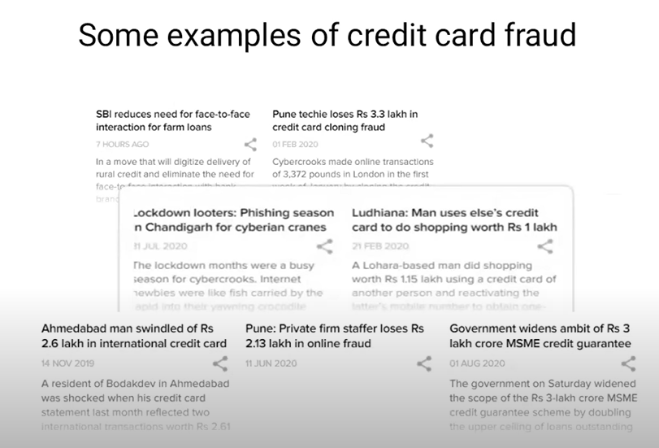

Slide 5
Scope of our Project
Detect the fraudulent transactions
Minimization of credit card fraud
Analysis of different Machine Learning Algorithms
Better Performance and Accuracy

Slide 6
Fraud Detection
Fraud detection is a method which is applicable to many industries including banking and financial sectors, insurances, government agencies, and law enforcement and more. Through the use of sophisticated use of data mining tools, millions of transaction can be searched to spot patterns and detect fraudulent transaction.
Fraud detection is process of identifying fraudulent transactions.
Credit card fraud detection technic used to recognize fraudulent credit card transactions so that customers are not charged for items that they did not purchase.

Slide 7
Technologies To be used
Machine Learning
Machine learning is the scientific study of algorithms and static models that computer system use in order to perform a specific task effetely without using the explicit instruction, relying on patterns and interface instead.
Machine learning algorithms build a mathematical model based on sample data, known as training data in order to make prediction and decisions.

Slide 8
Dataset for credit Card Fraud Detection
The Dataset that is used for credit card fraud detection is derived from the Kaggle.
The dataset contains transactions made by credit cards in September 2013 by European cardholders.
This dataset presents transactions that occurred in two days, where we have 492 frauds out of 284,807 transactions. The dataset is highly unbalanced, the positive class (frauds) account for 0.172% of all transactions.

Slide 9
Motivation and Conclusion
Fraud Detection system have become essential for banks and financial organizations, to minimize their losses.
However, there is a lack of published literature on credit card fraud detection techniques, due to the unavailable credit card transaction dataset for researches.
We want to design a system to detect fraud in credit card transaction. This system is capable of providing most of the essential features required to detect fraudulent and legitimate transactions.
The dataset available on day to day processing may become outdated, it is necessary to update data for effective fraud behavior identification.

