Slide 1

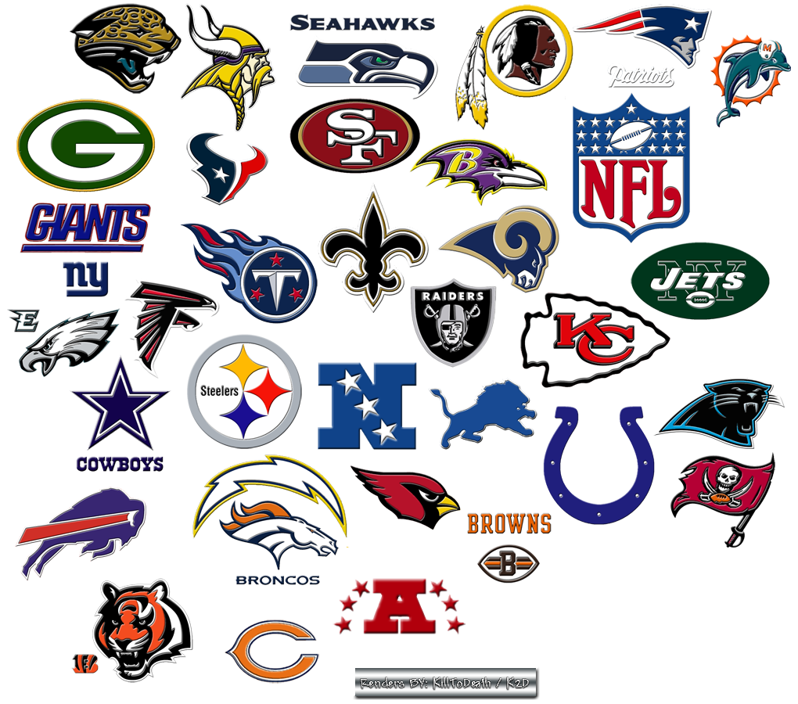
Finding Betting Inefficiencies in the NFL
By: Gavin Wood and Samuel Ouellette

Slide 2
Project Overview
The prompt for this project was to build a model that inefficiencies in the NFL betting market given data from every NFL game played since 1980
The project was completed in Python, but the original codebase was lost due to a hardware failure and is no longer recoverable

Slide 3
Betting on Indoor Games
Favored team wins 63.2% of the time in indoor games
Given that the favored team wins an indoor game, they cover the spread about 69% of the time
If you're going to take the favorite team's money line, chances are, they'll cover the spread
  The odds of covering the spread are about 2.24 times the odds of not covering the spread
Does the degree of the point spread in an indoor game affect whether or not you should pick the favorite team to cover the spread?

Slide 4
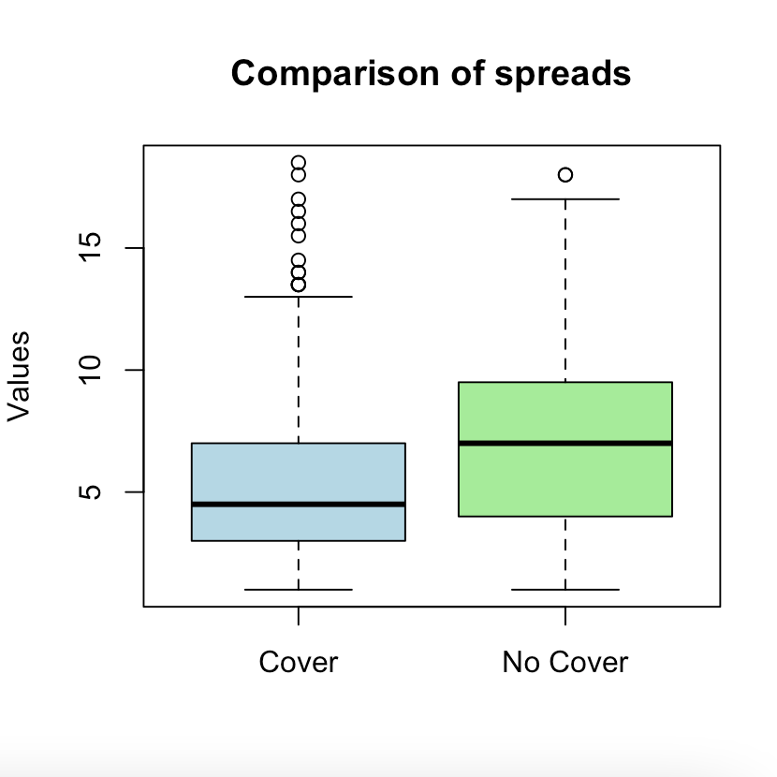
***All data is based on the given the favorite team wins an indoor game
Median of not covering = 7 = Q3 of covering
Median of covering = 4.5
Q1 of not covering = 4
If the spread is more than 7, its two times as likely that the favored winning team won’t cover compared to if they cover
If the spread is less than 4, its about two times as likely that they cover compared to if they don’t cover (46% of data lies below 4 for cover compared to 20.2% of data below 4 for no cover)
Average spread when covered | 5.28
Average spread when NOT covered | 7.19
If the favorite team wins, there is about an equally likely chance that that they cover or don’t cover if the spread is between 4 and 7.
A two-sample Z-test in R concluded that these averages are significantly different.
(p-value=.01338)

Slide 5
Probability of covering between 4.5 and 7 point spread is .25 (q3-median)
Probability of not covering between 4.5 and 7 point spread is .243 (median-25.7th percentile of not covering)
Running a two sample proportion test in R, these are not significantly different
Conclusion from this?
  When the spread is between 4.5 and 7, the chances of covering are about equal to the chances of not covering
  If you want to beat the breakeven point of 52.4%, do not bet on a spread between 4.5 and 7 given that you think the favorite team will win in an indoor game.

Slide 6
Point Spread | Pick to Cover? (F=Favorite, U=Underdog)
X<4 | F (probability is twice as likely compared to not covering)
4<x<7 | NULL (probabilities are equally likely)
X>7 | U (prob of F not covering is twice probability of covering)
75th of not covering is 9.5
9.5 is 88th percentile of covering
Favorite team Twice as likely to not cover compared to cover at 9.5 or above (25% of data>9.5 compared to 12%)
25th percentile of cover is 3
3 is 13th percentile of not covering
About half as likely to cover when spread is 3 or less (25% of data below 3 compared to 13%)

Slide 7
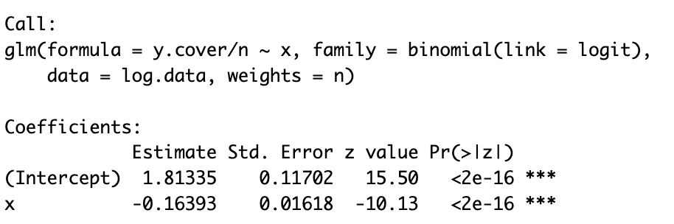
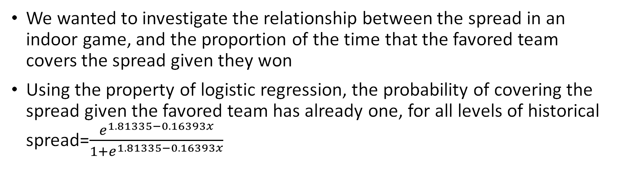
Using Logistic Regression to Model Probabilities
We wanted to investigate the relationship between the spread in an indoor game, and the proportion of the time that the favored team covers the spread given they won
Using the property of logistic regression, the probability of covering the spread given the favored team has already one, for all levels of historical spread=$\frac{e^{1.81335−0.16393x}}{1+e^{1.81335−0.16393x}}$
The odds of the favorite team covering given they won multiply by about 84% (e^-.16) for each 1 increase in the point spread
We did the same process for the probability of not covering given the favorite team had won. The results and interaction are modeled: ---→

Slide 8
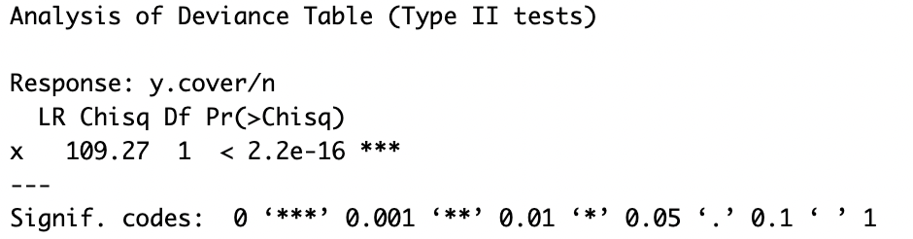
Likelihood Ratio Test on the Model
This allows us to conclude that point spread is significant in determining whether or not a team covers the spread given the favorite wins.

Slide 9
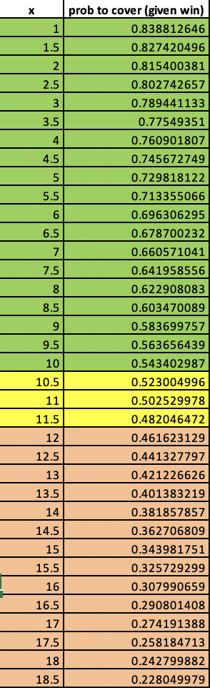
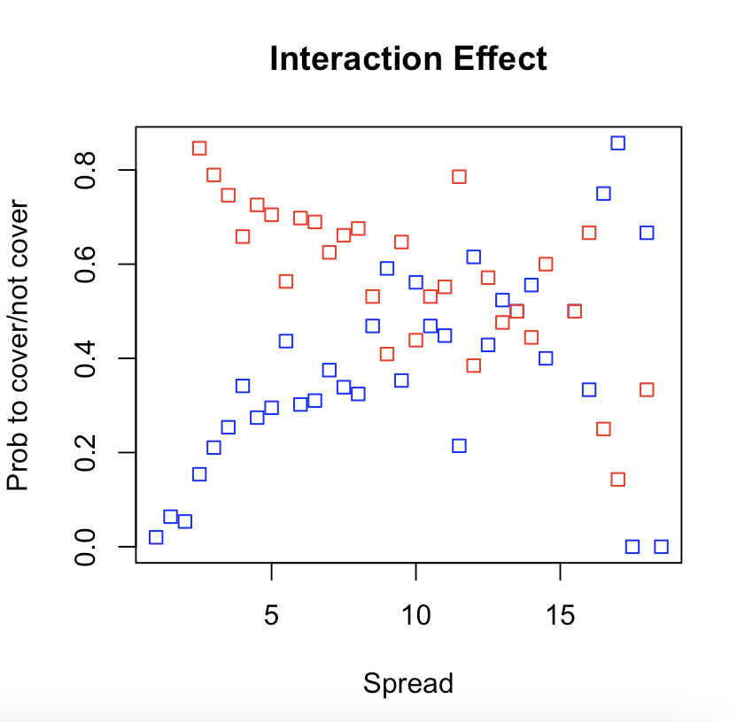
What if you only want to bet the spread and think the favorite team will win?
Given the favorite team wins, they cover the spread more than 52.4% (breakeven) of the time when the spread is less.
If the spread is 10.5-11.5 there is an equally likely chance that the favorite team could cover or not cover given they have one. This is a bet you would not want to make. (too much uncertainty)
If the spread is more than 11.5, you can bet the underdog to cover the spread even if the favorite team wins and succeed more than 52.4% of the time.
The most interaction takes place at about a 50% probability and 11 spread

Slide 10
Comparing: Home Covering % vs Home Win % since 2010
What are we looking for?
Teams that win a lot at home but don't cover often.
Teams that cover despite losing often.
Teams that cover and win extremely often(best of the best).
What do we want to stay away from?
Teams that perform along the trend.
  What does that mean?
    Teams that have an equal chance in both home cover % and home win %. This is significant because if you are making a bet, these teams are basically a coin flip.

Slide 11
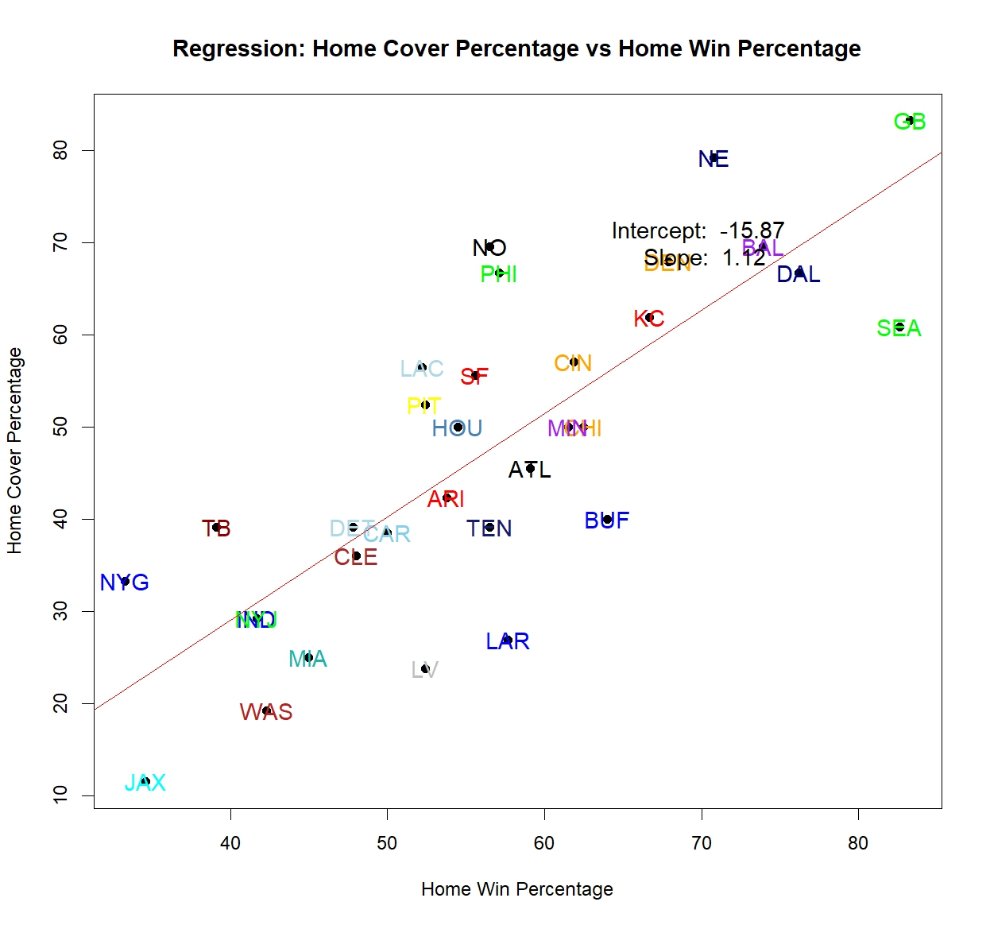
Teams above the horizontal line you want to bet to cover at home
Teams below the horizontal line you want to away team to cover
Team right of vertical line you want to bet to win at home
Team left of vertical line you want to bet to lose at home
Teams in the redzone have too much uncertainty to bet in one direction
If in horizontal but not vertical zone, bet to win or lose but not to cover
Vice versa if in vertical zone but not horizontal
If in both zones, DO NOT BET ON THIS TEAM!!!!

Slide 12
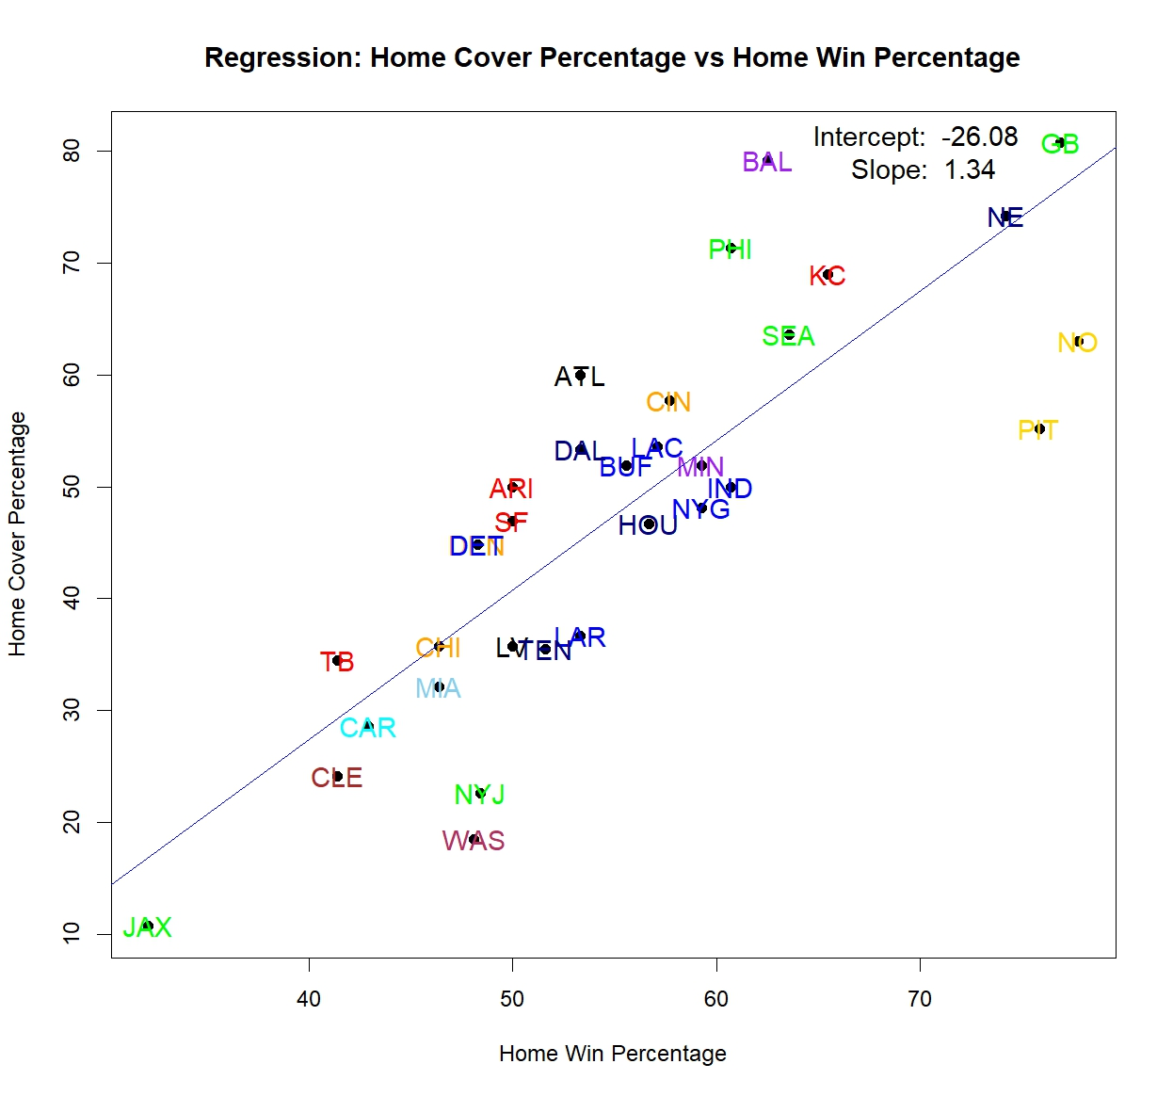
SEPTEMBER OCTOBER

Slide 13
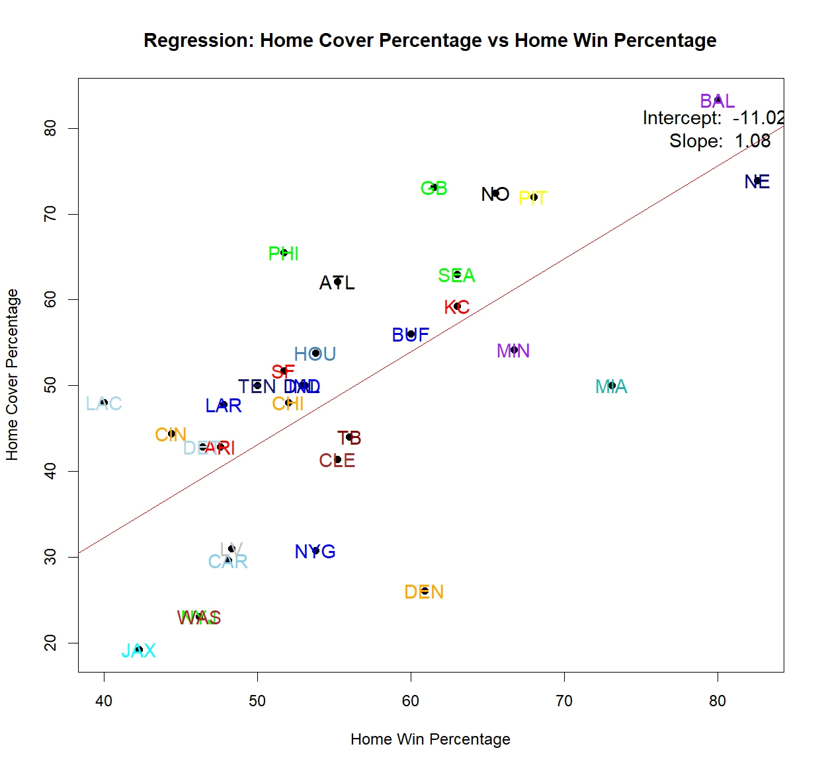
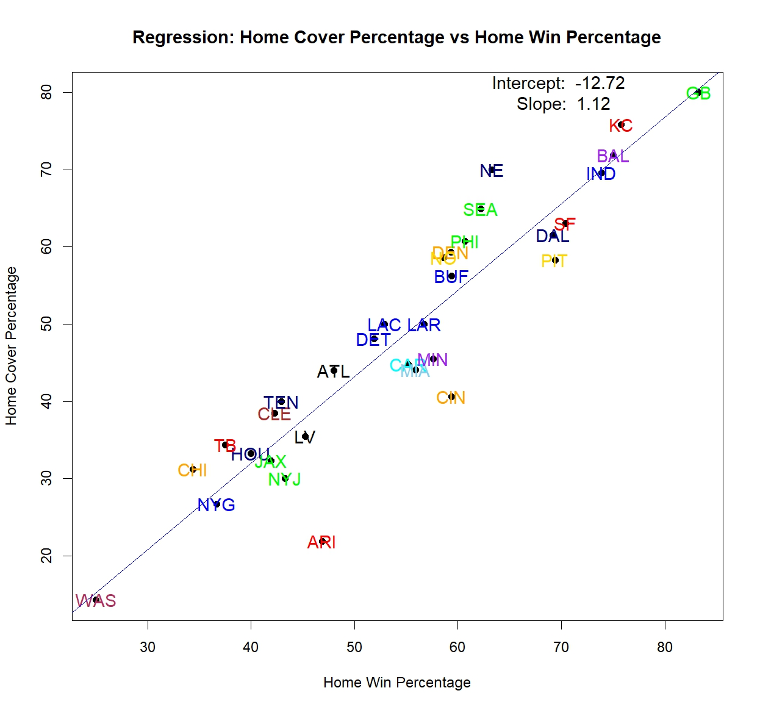
NOVEMBER DECEMBER

Slide 14
What teams do you want to bet on/against in each month?
September:
  New Orleans Saints
  LA Rams
October:
  Washington Commanders
  New York Jets
November:
  Denver Broncos
  Pittsburgh Steelers
December:
  Green Bay Packers
  Kansas Chiefs

Slide 15
What teams do you want to stay away from each month?
September:
  Pittsburgh Steelers
  Houston Texans
October:
  Arizona Cardinals.
  San Francisco 49ers
November:
  Tennessee Titans
  San Francisco 49ers
December:
  LA Chargers
  Detroit Lions

Slide 16
Let the gambling begin!

