Slide 1
Multicasting in WDM and EONs
Agnieszka Musiał and Andre Carvalho

Slide 2
Introduction
Multicasting
WDM - Wavelength Division Multiplexing
EON - Elastic Optical Network

Slide 3
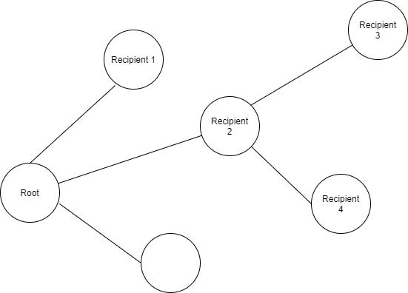
Multicasting
routing scheme from root node to selected receiving nodes
minimum Steiner or spanning tree
different than unicasting to selected nodes

Slide 4
Wavelength Division Multiplexing
technology that increases capacity of optical fibre
light => electromagnetic wave => signal multiplexing
3 types:
normal (WDM), wavelengths 1310 nm and 1550 nm on one fiber
coarse (CWDM), wavelengths 1271 nm to 1611 nm with channel spacing 20 nm
dense (DWDM), wavelengths 1530 nm to 1565 nm with channel spacing 0.8/0.4 nm.
thin film filters used for demultiplexing

Slide 5
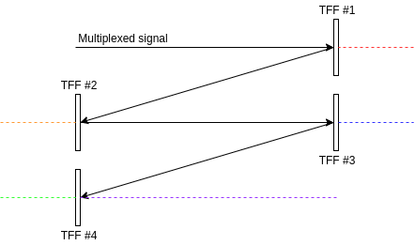
Wavelength Division Multiplexing

Slide 6
Elastic Optical Network
architecture paradigm with spectrum allocation depending on traffic demands
WDM = fixed, EON = flexible
increased channel capacity

Slide 7
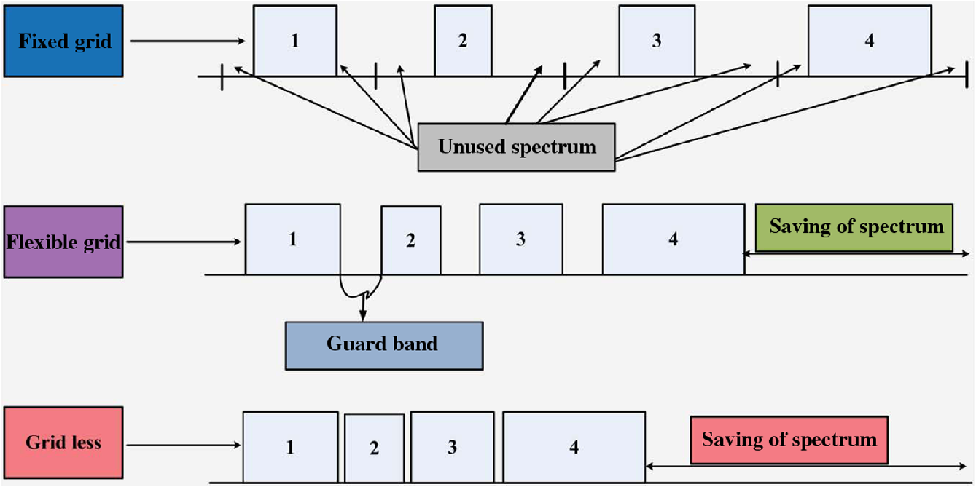
Elastic Optical Network
Fig. 1 Fixed grid, flexible grid, and grid less [1]

Slide 8
References
[1] Yadav Ujjwal, Jaisingh Thangaraj, “Review and analysis of elastic optical network and sliceable bandwidth variable transponder architecture”, Optical Engineering, 57(11), 110802 (2018)
[2] K. Walkowiak, Modeling and Optimization of Computer Networks, Wroclaw University of Technology, 2011

