Slide 1
CSP Networking for Java (JCSP.net)
Jo Aldous (jra@dial.pipex.com)
Jon Foster (jon@jon-foster.co.uk)
Peter Welch (phw@ukc.ac.uk)
Computing Laboratory
University of Kent at Canterbury
ICCS 2002 (Global and Collaborative Computing, 22nd. April, 2002)

Slide 2
Nature has very large numbers of independent agents, interacting with each other in regular and chaotic patterns, at all levels of scale:
… nuclear … human … astronomic ...

Slide 3
JCSP enables the dynamic construction of layered networks of communicating and synchronising processes (CSP/occam):
… natural design within a single JVM

Slide 4
JCSP.net enables the dynamic construction of layered networks of communicating and synchronising processes (CSP/occam):
… with the processes distributed over many JVMs

Slide 5
This Presentation
Introduction to JCSP
  What is it?
  A few details (with examples)
JCSP.net
  Virtual Channels
  Links and Channel Name Server
  Connections (2-way extended transactions)
  Anonymous Network Channels and Connections
  Process Farms and Chains (including Rings)
  User-Defined Brokers (and Scaleable Parallel Servers)
  Remote Process Launching
  Mobile Processes (Agents) / Channel Migration
Summary

Slide 6
JCSP – What is it?
JCSP provides the Java programmer with a process model based upon occam and CSP:
  Layered networks of encapsulated processes;
  Processes communicate using channels:
    One-to-One / Any-to-One / One-to-Any / Any-to-Any
    optional buffering (finite / overwriting / infinite)
    Call Channels / Connections (2-way transactions)
    Barriers / Buckets / CREW locks
The current library offers this only within a single JVM (which may, of course, be multi-processor).
Notes:
Time: 2.00
JCSP
JavaPP
API for concurrency
Based upon extended version of occam implementation of CSP model
Process – Private Data & Algorithms
Channels
Semantics (zero buffered, fully synchronized)
One-to-one
Any-to-one
One-to-any
Call Channels
Notion of layered network

Slide 7
JCSP – a few details
JCSP provides and implements an API for Java giving interfaces and classes corresponding to the fundamental operators and processes of CSP (as well as some higher-level mechanisms built on top of those CSP primitives).
A process is an object of a class implementing:
interface CSProcess {
public void run();
}
The behaviour of the process is determined by the body of its run() method.
Notes:
Just over 1 minute
Interfaces & classes corresponding to the fundamental primitives of CSP

Slide 8
JCSP – a few details
Channels are accessed via two interfaces:
  interface ChannelInput {
  public Object read ();
  }
  interface ChannelOutput {
  public void write (Object obj);
  }
The Parallel class provides the CSP parallel operator.
The Alternative class provides occam-like ALTing (which is a mix of CSP external / internal choice).
CSTimer provides timeout guards for Alternatives.

Slide 9
JCSP Process Structure
class Example implements CSProcess {
}
... public constructors
... public accessors(gets)/mutators(sets)
(only to be used when not running)
... private support methods (part of a run)
... public void run() (process starts here)
... private shared synchronisation objects
(channels etc.)
... private state information

Slide 10
in
SuccInt
out
class SuccInt implements CSProcess {
private final ChannelInputInt in;
private final ChannelOutputInt out;
This is a simple process that adds one to each integer flowing through it.
public SuccInt (ChannelInputInt in,
ChannelOutputInt out) {
this.in = in;
this.out = out;
}
public void run () {
while (true) {
int n = in.read ();
out.write (n + 1);
}
}
}

Slide 11
Final Stage Actuator
reset
panic
in
out
Sample (t)
Monitor (m)
Decide (n)
Actuator (t, m, n)
Sample(t): every t time units, output the latest input (or null if none); the value of t may be reset;
Monitor(m): copy input to output counting nulls - if m nulls occur in a row, send panic message and terminate;
Decide(n): copy non-null input to output and remember last n outputs - convert nulls to a best guess depending on those last n outputs.

Slide 12
reset
panic
in
out
Sample (t)
Monitor (m)
Decide (n)
Actuator (t, m, n)
class Actuator implements CSProcess {
... private state (t, m and n)
... private interface channels
(in, reset, panic and out)
... public constructor
(assign parameters t, m, n, in, reset,
panic and out to the above fields)
... public void run ()
}

Slide 13
reset
panic
in
a
b
out
Sample (t)
Monitor (m)
Decide (n)
Actuator (t, m, n)
public void run ()
final One2OneChannel a = new One2OneChannel ();
final One2OneChannel b = new One2OneChannel ();
new Parallel (
).run ();
new CSProcess[] {
}
new Sample (t, in, reset, a),
new Monitor (m, a, panic, b),
new Decide (n, b, out)
}

Slide 14
ALTing Between Events
Button
event
in
FreezeControl
out
Button is a (GUI widget) process that outputs a ping whenever it’s clicked.
FreezeControl controls a data-stream flowing from its in to out channels. Clicking the Button freezes the data-stream - clicking again resumes it.

Slide 15
ALTing Between Events
event
while (true) {
switch (alt.priSelect ()) {
case EVENT:
event.read ();
event.read ();
break;
case IN:
out.write (in.read ());
break;
}
}
in
FreezeControl
out
No SPIN
final Alternative alt =
new Alternative (
new Guard[] {event, in};
);
final int EVENT = 0, IN = 1;

Slide 16
ALTing Between Events
event
in
SpeedControl
out
The slider (GUI widget) process outputs an integer (0..100) whenever its slider-key is moved.
SpeedControl controls the speed of a data-stream flowing from its in to out channels. Moving the slider-key changes that speed - from frozen (0) to some defined maximum (100).

Slide 17
ALTing Between Events
while (true) {
switch (alt.priSelect ()) {
case EVENT:
int position = event.read ();
while (position == 0) {
position = event.read ();
}
speed = (position*maxSpd)/maxPos
interval = 1000/speed; // ms
timeout = tim.read ();
// fall through
case TIM:
timeout += interval;
tim.setAlarm (timeout);
out.write (in.read ());
break;
}
}
event
in
SpeedControl
out
final CSTimer tim =
new CSTimer ();
final Alternative alt =
new Alternative (
new Guard[] {event, tim};
);
final int EVENT = 0, TIM = 1;
No SPIN

Slide 18
Distributed JCSP
Want to use the same model for concurrent processes whether or not they are on the same machine:
Notes:
40 secs
Why distributed version of JCSP?
Have established JCSP good model
Why not apply same model across network
Virtual channels – same

Slide 19
Distributed JCSP
Want to use the same model for concurrent processes whether or not they are on the same machine:
NETWORK
Processes on different processing nodes communicate via virtual channels.
Notes:
40 secs
Why distributed version of JCSP?
Have established JCSP good model
Why not apply same model across network
Virtual channels – same

Slide 20
Logical Network
Suppose a system contains processes A, B, C, D, E and F, communicating as shown below.
There may be other processes and communication channels (but they are not relevant here).
Suppose we want to distribute these processes over two processors …
A
D
B
E
C
F
Notes:
Takes about 1.20
Distributed JCSP developed by final year undergrads
Implementation by starting up PROCESS NETWORKS separately
Channels registered with CNS
CNS Connects channels with same name
[TALK ABOUT DIAGRAM]
Not transparent – be nice if network could be configured from one place

Slide 21
Physical Network
Suppose we want to distribute these processes over two processors (P and Q, say) …
We could set up separate network links …
Or, since links may be a scarce resource, we could multiplex over a shared link …
A
D
B
E
C
F
P
Q
Notes:
Takes about 1.20
Distributed JCSP developed by final year undergrads
Implementation by starting up PROCESS NETWORKS separately
Channels registered with CNS
CNS Connects channels with same name
[TALK ABOUT DIAGRAM]
Not transparent – be nice if network could be configured from one place

Slide 22
Physical Network
Suppose we want to distribute these processes over two processors (P and Q, say) …
We could set up separate network links …
Or, since links may be a scarce resource, we could multiplex over a shared link …
A
D
B
E
C
F
P
Q
Notes:
Takes about 1.20
Distributed JCSP developed by final year undergrads
Implementation by starting up PROCESS NETWORKS separately
Channels registered with CNS
CNS Connects channels with same name
[TALK ABOUT DIAGRAM]
Not transparent – be nice if network could be configured from one place

Slide 23
JCSP Links
A connection between two processing nodes (JVMs in the context of JCSP) is called a link.
Multiple channels between two nodes may use the same link – data is multiplexed in both directions.
Links can ride on any network infrastructure (TCP/IP, Firewire, 1355, …).
A
D
B
E
C
F
P
link
Q
Notes:
Takes about 1.20
Distributed JCSP developed by final year undergrads
Implementation by starting up PROCESS NETWORKS separately
Channels registered with CNS
CNS Connects channels with same name
[TALK ABOUT DIAGRAM]
Not transparent – be nice if network could be configured from one place

Slide 24
JCSP Links
Each end of a (e.g. TCP/IP) network channel has a network address (e.g. <IP-address, port-number>) and JCSP virtual-channel-number (see below).
JCSP uses the channel-numbers to multiplex and de-multiplex data and acknowledgements.
The JCSP.net programmer sees none of this.
A
97
link
D
42
Tx
Rx
98
B
Rx
Tx
43
E
99
44
C
F
NETWORK (any protocol)
Notes:
Takes about 1.20
Distributed JCSP developed by final year undergrads
Implementation by starting up PROCESS NETWORKS separately
Channels registered with CNS
CNS Connects channels with same name
[TALK ABOUT DIAGRAM]
Not transparent – be nice if network could be configured from one place

Slide 25
JCSP Crossbar
Tx 1
Rx 1
Tx 2
Rx 2
A
! 42
97
B
! 43
98
C
?
99
Notes:
Takes about 1.20
Distributed JCSP developed by final year undergrads
Implementation by starting up PROCESS NETWORKS separately
Channels registered with CNS
CNS Connects channels with same name
[TALK ABOUT DIAGRAM]
Not transparent – be nice if network could be configured from one place

Slide 26
JCSP Links
Each end of a (e.g. TCP/IP) network channel has a network address (e.g. <IP-address, port-number>) and JCSP virtual-channel-number (see below).
JCSP uses the channel-numbers to multiplex and de-multiplex data and acknowledgements.
The JCSP.net programmer sees none of this.
A
97
link
D
42
Tx
Rx
98
B
Rx
Tx
43
E
99
44
C
F
NETWORK (any protocol)
Notes:
Takes about 1.20
Distributed JCSP developed by final year undergrads
Implementation by starting up PROCESS NETWORKS separately
Channels registered with CNS
CNS Connects channels with same name
[TALK ABOUT DIAGRAM]
Not transparent – be nice if network could be configured from one place

Slide 27
JCSP Networks
The JCSP.net programmer just sees this.
Channel synchronisation semantics for network channels are exactly the same as for internal ones.
Buffered network channels can be streamed - i.e. network acks can be saved through windowing.
A
D
B
E
C
F
P
Q
Notes:
Takes about 1.20
Distributed JCSP developed by final year undergrads
Implementation by starting up PROCESS NETWORKS separately
Channels registered with CNS
CNS Connects channels with same name
[TALK ABOUT DIAGRAM]
Not transparent – be nice if network could be configured from one place

Slide 28
JCSP Networks
However, there is one important semantic difference between a network channel and a local channel.
Over local channels, objects are passed by reference (which leads to race hazards if careless).
Over network channels, objects are passed by copying (currently, using Java serialization).
A
D
B
E
C
F
P
Q
Notes:
Takes about 1.20
Distributed JCSP developed by final year undergrads
Implementation by starting up PROCESS NETWORKS separately
Channels registered with CNS
CNS Connects channels with same name
[TALK ABOUT DIAGRAM]
Not transparent – be nice if network could be configured from one place

Slide 29
JCSP Networks
That semantic difference will not impact correctly designed JCSP systems (i.e. those free from race hazards).
With that caveat, JCSP processes are blind as to whether they are connected to local or network channels.
Process B still sees its external channels as ChannelInput / ChannelOutput
B
One other caveat - currently, only Serializable objects are copied over network channels - sorry!
Notes:
Takes about 1.20
Distributed JCSP developed by final year undergrads
Implementation by starting up PROCESS NETWORKS separately
Channels registered with CNS
CNS Connects channels with same name
[TALK ABOUT DIAGRAM]
Not transparent – be nice if network could be configured from one place

Slide 30
Establishing Network Channels
Network channels may be connected by the JCSP Channel Name Server (CNS).
Channel read ends register names with the CNS.
P
Q
“foo”
“foo”,Q,42
42
CNS
???
I want to receive on channel “foo”
NETWORK
Notes:
Takes about 1.20
Distributed JCSP developed by final year undergrads
Implementation by starting up PROCESS NETWORKS separately
Channels registered with CNS
CNS Connects channels with same name
[TALK ABOUT DIAGRAM]
Not transparent – be nice if network could be configured from one place

Slide 31
Establishing Network Channels
Network channels may be connected by the JCSP Channel Name Server (CNS).
Channel read ends register names with the CNS.
Channel write ends ask CNS about names.
P
Q
I want to send on a channel “foo”
“foo”,Q,42
CNS
???
NETWORK
Notes:
Takes about 1.20
Distributed JCSP developed by final year undergrads
Implementation by starting up PROCESS NETWORKS separately
Channels registered with CNS
CNS Connects channels with same name
[TALK ABOUT DIAGRAM]
Not transparent – be nice if network could be configured from one place

Slide 32
Establishing Network Channels
Network channels may be connected by the JCSP Channel Name Server (CNS).
Channel read ends register names with the CNS.
Channel write ends ask CNS about names.
P
Q
“foo”
“foo”,Q,42
CNS
Okay I’ll talk!
And I’ll listen!
NETWORK
Notes:
Takes about 1.20
Distributed JCSP developed by final year undergrads
Implementation by starting up PROCESS NETWORKS separately
Channels registered with CNS
CNS Connects channels with same name
[TALK ABOUT DIAGRAM]
Not transparent – be nice if network could be configured from one place

Slide 33
Using Distributed JCSP
On each machine, do this once:
Node.getInstance().init(); // use default CNS
find
On the CMU machine:
One2NetChannel out = new One2NetChannel ("ukc.foo");
new Producer (out);
“ukc.foo”
Producer
Consumer
out
CMU
UKC

Slide 34
Using Distributed JCSP
On each machine, do this once:
Node.getInstance().init(); // use default CNS
register
On the UKC machine:
Net2OneChannel in = new Net2OneChannel ("ukc.foo");
new Consumer (in);
“ukc.foo”
Producer
Consumer
in
CMU
UKC

Slide 35
Using Distributed JCSP
One2NetChannel out = new One2NetChannel ("ukc.foo");
Named network output channel construction blocks until the name is registered by a reader
Net2OneChannel in = new Net2OneChannel ("ukc.foo");
Named network input channel construction registers the name with the CNS (will fail if already registered)

Slide 36
Using Distributed JCSP
User processes just have to agree on (or find out) names for the channels they will use to communicate.
User processes do not have to know where each other is located (e.g. IP-address / port-number / virtual-channel-number).
“ukc.foo”
Producer
Consumer
CMU
UKC

Slide 37
Network Channels are Any-1
“ukc.foo”
Consumer
UKC
i.e. there can be any number of networked writers
Producer
Producer
CMU
UCB

Slide 38
Net-Any Channels
“ukc.foo”
in
Net2AnyChannel in =
new Net2AnyChannel (
"ukc.foo"
);
new Parallel (
new CSProcess[] {
new Consumer1 (in),
new Consumer2 (in),
new Consumer2 (in)
}
).run ();
Consumer1
Consumer3
Consumer2
UKC
i.e. within a node, there can be any number of readers

Slide 39
Any-Net Channels
out
“ukc.foo”
Any2NetChannel out =
new Any2NetChannel (
"ukc.foo"
);
new Parallel (
new CSProcess[] {
new Producer1 (out),
new Producer2 (out),
new Producer3 (out)
}
).run ();
Producer1
Producer3
Producer2
CMU
i.e. within a node, there can be any number of writers

Slide 40
Connections (two-way channels)
find
On the CMU machine:
One2NetConnection out = new One2NetConnection ("ukc.bar");
new Client (out);
register
On the UKC machine:
Net2OneConnection in = new Net2OneConnection ("ukc.bar");
new Server (in);
“ukc.bar”
Client
Server
out
in
CMU
UKC

Slide 41
Connections (two-way channels)
Connection channels have client and server interfaces (rather than writer and reader ones):
interface ConnectionClient {
public void request (Object o); // write
public Object reply (); // read
public boolean stillOPen (); // check?
}

Slide 42
Connections (two-way channels)
Connection channels have client and server interfaces (rather than writer and reader ones):
interface ConnectionServer {
public Object request (); // read
public void reply (Object o); // write & close
public void reply ( // write &
Object o, boolean keepOpen // maybe close
);
}

Slide 43
Connections (extended rendezvous)
out.request (data);
answer = out.reply ();
... work out followUp
out.request (followUp);
... more ping/pong
answer = out.reply ();
data = in.request ();
... work out answer
in.reply (answer, true);
followUp = in.request ();
... more ping/pong
in.reply (answer);
“ukc.bar”
Client
Server
out
in
CMU
UKC

Slide 44
Network Connections are Any-1
“ukc.bar”
Server
UKC
i.e. there can be any number of networked clients
Client
Client
CMU
UCB

Slide 45
Connections (two-way channels)
Connections allow extended two-way client–server communication (from any number of clients).
Without them, two-way network communications would be tedious to set up. The server would have to construct two named (input) channels: one for the opening messages and the other for follow-ups; the clients would have to create individual named (input) channels for replies. The server would have to find all its client reply channels (outputs).
With them, only one name is needed. The server constructs a (server) connection and each client constructs a (client) connection - with same name.

Slide 46
Connections (extended rendezvous)
Connections allow extended two-way client–server communication (from any number of clients).
A connection is not open until the first reply has been received (to the first request).
Once a connection is opened, only the client that opened it can interact with the server until the connection is closed.
Following an request, a client must commit to a reply (i.e. no intervening synchronisations) .
A client may have several servers open at the same time - but only if they are opened in a sequence honoured by all clients … else deadlock will occur!

Slide 47
Connections (extended rendezvous)
Connections allow extended two-way client–server communication (from any number of clients).
The connection protocol:
request (reply+ request)* reply
is self-synchronising across the network - no extra acknowledgements are needed.
For completeness, JCSP provides connection channels for local networks (One2OneConnection, Any2OneConnection, etc.).

Slide 48
Net-Any Connections
“ukc.bar”
in
Net2AnyConnection in =
new Net2AnyConnection (
"ukc.bar"
);
new Parallel (
new CSProcess[] {
new Server1 (in),
new Server2 (in),
new Server2 (in)
}
).run ();
Server1
Server3
Server2
UKC
i.e. within a node, there can be any number of servers

Slide 49
Any-Net Connections
out
“ukc.bar”
Any2NetConnection out =
new Any2NetConnection (
"ukc.bar"
);
new Parallel (
new CSProcess[] {
new Client1 (out),
new Client2 (out),
new Client3 (out)
}
).run ();
Client1
Client3
Client2
CMU
i.e. within a node, there can be any number of clients

Slide 50
Net-One Connections are ALTable
“ukc.bar0”
in0
“ukc.bar1”
in1
Server
Freeze
“ukc.bar2”
in2
“ukc.foo”
in
UKC
The Server process can ALT over its 3 networked server connections, its networked input channel and its local input channel.

Slide 51
Anonymous Channels
Network channels may be connected by the JCSP Channel Name Server (CNS) …
… but they don’t have to be!
A network channel can be created (always by the inputter) without registering a name with the CNS:
Net2OneChannel in = new Net2OneChannel (); // no name!
Remote processes cannot, of course, find it for themselves …
but you can tell your friends …

Slide 52
Anonymous Channels
Location information (<IP-address, port-number, virtual-channel-number>) is held within the constructed network channel. This is the data registered with the CNS - if we had given it a name.
Extract that information:
Net2OneChannel in = new Net2OneChannel (); // no name!
NetChannelLocation inLocation = in.getLocation ();
The information can be distributed using existing (network) channels to those you trust:
toMyFriend.write (inLocation);
// remember your friend may distribute it further ...

Slide 53
Anonymous Channels
Your friend inputs the location information (of your unregistered channel) via an existing channel:
NetChannelLocation outLocation =
(NetChannelLocation) fromMyFriend.read ();
And can then construct her end of the channel:
One2NetChannel out = new One2NetChannel (outLocation);
The One2NetChannel constructor has been given the information it would have got from the CNS (had it been given a registered name to resolve).
You and your friends can now communicate over the unregistered channel.

Slide 54
Anonymous Connections
These work in exactly the same way as anonymous channels … and are possibly more useful …
“ukc.bar”
Server1
Server3
Client
Client
Server2
CMU
UCB
UKC

Slide 55
Anonymous Connections
Right now, only one client and one server can be doing business at a time over the shared connection.
“ukc.bar”
Server1
Server3
Client
Client
Server2
CMU
UCB
UKC

Slide 56
Anonymous Connections
But that business could be: “gimme a connection” (client) & “OK - here’s a private one” (server) …
“ukc.bar”
Server1
Server3
Client
Client
Server2
CMU
UCB
UKC

Slide 57
Anonymous Connections
So, the registered connection is only used to let a client and server find each other …
“ukc.bar”
Server1
Server3
Client
Client
Server2
CMU
UCB
UKC

Slide 58
Anonymous Connections
The real client-server work is now conducted over dedicated (unregistered) connections - in parallel.
“ukc.bar”
Server1
Server3
Client
Client
Server2
CMU
UCB
UKC

Slide 59
Anonymous Connections
After the client-server transaction has finished the server deletes the special connections.
“ukc.bar”
Server1
Server3
Client
Client
Server2
CMU
UCB
UKC

Slide 60
CNS registered
User-Defined Brokers
“jcsp://broker.ukc.ac.uk”
s
roll-your-own broker
If you want a matching service more sophisticated than the given CNS, simply build what you want as the server for your CNS registered connection. Anyone finding that can use your new broker.

Slide 61
CNS registered
User-Defined Brokers
“jcsp://broker.ukc.ac.uk”
s
s
s
Broker1
Broker2
upstream broker
c
c
s
c
c
Manager
s
s
downstream brokers
for example ...
UKC

Slide 62
CNS registered
User-Defined Brokers
“jcsp://broker.ukc.ac.uk”
s
s
s
Broker1
Broker2
upstream broker
c
c
s
c
c
Manager
s
s
downstream brokers
CREW-shared data
UKC

Slide 63
CNS registered
User-Defined Brokers
“jcsp://broker.ukc.ac.uk”
s
broker rolled
upstream broker
One node of a continuously changing network of brokers.
c
c
s
s
downstream brokers
UKC

Slide 64
Process Farming
“jcsp://farmer.myrtle.ukc.ac.uk”
Farmer
...
Harvester
“jcsp://harvester.myrtle.ukc.ac.uk”
myrtle

Slide 65
Process Chaining
final int MY_ID = ... ;
final int N_NODES = ... ;
final int NEXT_ID = ((MY_ID + 1) % N_NODES;
Net2OneChannel in = new Net2OneChannel ("node-" + MY_ID);
Net2OneChannel out = new Net2OneChannel ("node-" + NEXT_ID);
new WorkProcess (MY_ID, N_NODES, in, out).run ();
...
OK – so long as each worker knows the length of the chain and its place in it.

Slide 66
Process Chaining
“jcsp://chainer.myrtle.ukc.ac.uk”
Chainer
myrtle
...
A volunteer worker won't know this! But it can make its own network input channel anonymously and send its location to someone who does …

Slide 67
Process Chaining
“jcsp://chainer2.myrtle.ukc.ac.uk”
Chainer2
myrtle
...
It’s slightly easier if each node makes two network input channels – so that its control line is different from its data line from the chain …

Slide 68
Ring worker code
One2NetChannel toChainer =
= new One2NetChannel ("jcsp://chainer.myrtle.ukc.ac.uk");
Net2OneChannel in = new Net2OneChannel ();
NetChannelLocation inLocation = in.getLocation ();
toChainer.write (inLocation);
NetChannelLocation outLocation = (NetChannelLocation) in.read ();
One2NetChannel out = new One2NetChannel (outLocation);
int[] info = (int[]) in.read (); // wait for ring sync
final int MY_ID = info[0]; // (optional)
final int N_NODES = info[1]; // (optional)
info[0]++;
if (info[0] < info[1]) out.write (info); // pass on ring sync
new WorkProcess (MY_ID, N_NODES, in, out).run ();

Slide 69
final int N_NODES = ... ;
Chainer (ringer) code
Net2OneChannel fromWorkers =
= new Net2OneChannel ("jcsp://chainer.myrtle.ukc.ac.uk");
NetChannelLocation lastL =
(NetChannelLocation) fromWorkers (read);
One2NetChannel lastC = new One2NetChannel (lastL);
for (int nWorkers = 1; nWorkers < N_NODES; nWorkers++) {
}
NetChannelLocation nextL =
(NetChannelLocation) fromWorkers (read);
One2NetChannel nextC = new One2NetChannel (nextL);
nextC.write (lastL);
lastL = nextL;
lastC.write (lastL); // completes the network ring
lastC.write (new int[] {0, N_NODES}); // final ring synchronisation

Slide 70
Process Chaining
“jcsp://chainer2.myrtle.ukc.ac.uk”
Chainer2
myrtle
...
It’s slightly easier if each node makes two network input channels – so that its control line is different from its data line from the chain …

Slide 71
Example Applications
Process Farming
All ‘embarassingly parallel’ ones, ray tracing, Mandelbrot, travelling salesman (needs dynamic control though), …
Process Chaining
All space-division system modelling, n-body simulations, SORs, cellular automata, … (some need bi-directional chains/rings)

Slide 72
SOR – red/black checker pointing
where
= black
and
= red

Slide 73
SOR – red/black checker pointing
This needs a two-way chain to exchange information on boundary regions being looked after by each worker …
...

Slide 74
SOR – red/black checker pointing
Also, a global sum-of-changes (found by each node) has to be computed each cycle to resolve halting criteria. This is speeded-up by connecting the nodes into a tree (so that adds and communications can take place in parallel).

Slide 75
Travelling Salesman Problem
Basically a process farm …
but when better lower bounds arrive, they must be communicated to all concerned workers.
“jcsp://tsp.myrtle.ukc.ac.uk”
Master
myrtle
...

Slide 76
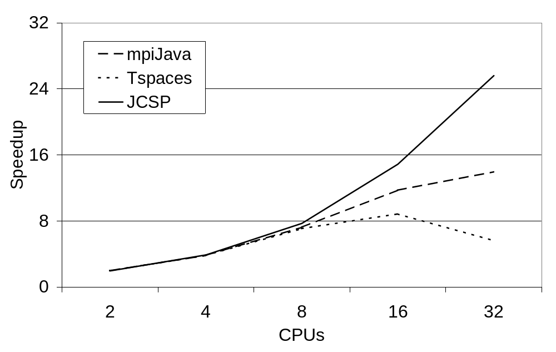
The n-Body benchmark (n = 10000)

Slide 77
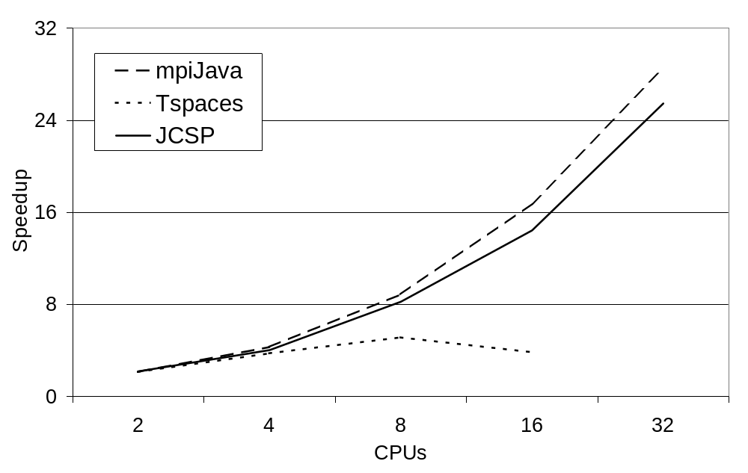
The SOR benchmark (7000 x 7000 matrix)

Slide 78
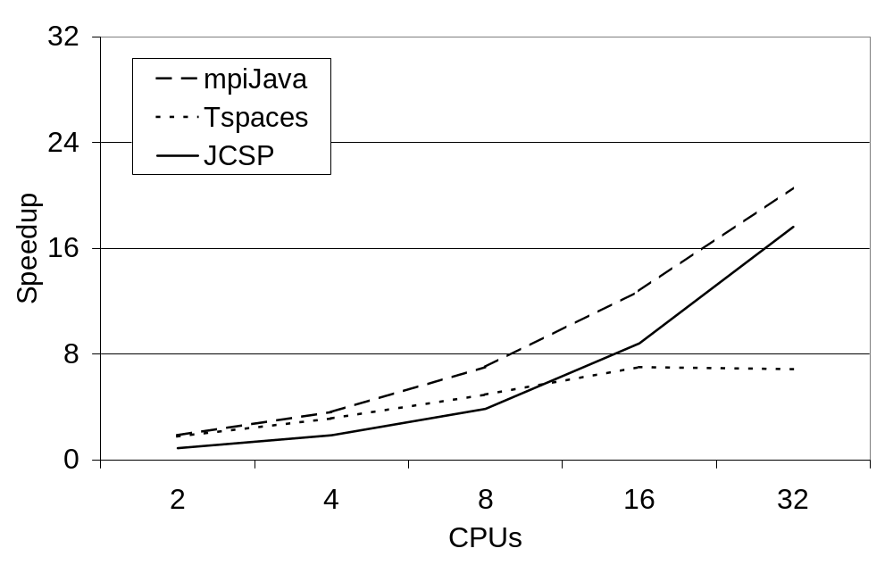
The Travelling Salesman Problem (15 cities)

Slide 79
Travelling Salesman Problem
“jcsp://tsp.myrtle.ukc.ac.uk”
Master
myrtle
...
Currently, workers report newly discovered shorter paths back to the master (who maintains the global shortest). If master receives a better one, it broadcasts back to workers.

Slide 80
Travelling Salesman Problem
“jcsp://tsp.myrtle.ukc.ac.uk”
Master
myrtle
...
Massive swamping of network links in the early stages.
Also, generation of garbage currently provokes garbage collector – and clobbers cache on dual-processor nodes.

Slide 81
Travelling Salesman Problem
“jcsp://tsp.myrtle.ukc.ac.uk”
Master
myrtle
...
Eliminate the broadcasting – control against swamping – stop generating garbage … ☺ ☺ ☺

Slide 82
Travelling Salesman Problem
“jcsp://tsp.myrtle.ukc.ac.uk”
Master
myrtle
...
Global minimum maintained in ring (made with one-place overwriting channel buffers) … easy!!!

Slide 83
Networked Class Loading
By default, objects sent across a networked channel (or connection) use Java serialization.
This means the receiving JVM is expected to be able to load (or already have loaded) the class files needed for its received objects.
However, JCSP networked channels/connections can be set to communicate those class files automatically (if the receiver can’t find them locally).
Machine nodes cache those class files locally in case they themselves need to forward them.

Slide 84
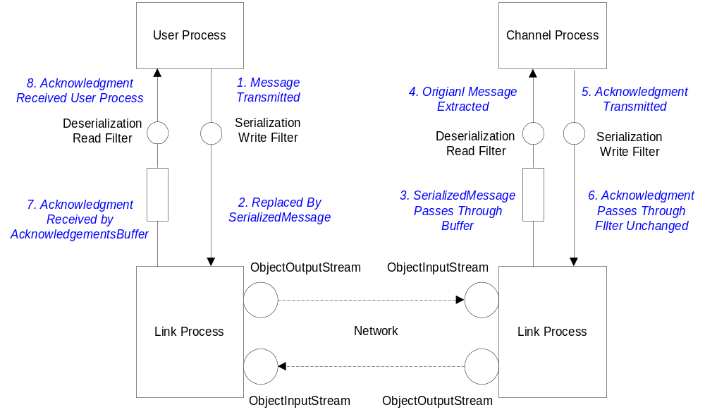
Networked Class Loading

Slide 85
Remote Process Launching
Example: UKC offers a simple worker farm …
Clients grab available workers …
“ukc.workers”
Worker
Worker
Client
Client
Worker
CMU
UCB
UKC

Slide 86
Remote Process Launching
Work work = new Work (); // CSProcess
out.request (work);
work = (Work) out.reply ();
client code
CSProcess work = (CSProcess) in.request ();
work.run ();
in.reply (work);
worker code
Work class file automatically downloaded
Client
Worker

Slide 87
Mobile Processes (Agents)
“ukc.agent.007”
in
a
b
c
UKC

Slide 88
Mobile Processes (Agents)
“ukc.agent.007”
in
a
b
c
UKC

Slide 89
Mobile Processes (Agents)
“ukc.agent.007”
in
a
b
c
UKC

Slide 90
Mobile Processes (Agents)
while (running) {
Bond james = (Bond) in.read ();
james.plugin (a, b, c);
james.run ();
NetChannelLocation escapeRoute =
james.getNextLocation ();
One2NetChannel escape =
new One2NetChannel (escapeRoute);
running = james.getNuke ();
escape.write (james);
escape.disconnect ();
}
in
a
b
c
local 007 controller

Slide 91
Mobile Processes (Agents)
while (running) {
Bond james = (Bond) in.read ();
james.plugin (a, b, c);
james.run ();
NetChannelLocation escapeRoute =
james.getNextLocation ();
One2NetChannel escape =
new One2NetChannel (escapeRoute);
running = james.getNuke ();
escape.write (james);
escape.disconnect ();
}
in
a
b
c
local 007 controller

Slide 92
Mobile Processes (Agents)
while (running) {
Bond james = (Bond) in.read ();
james.plugin (a, b, c);
james.run ();
NetChannelLocation escapeRoute =
james.getNextLocation ();
One2NetChannel escape =
new One2NetChannel (escapeRoute);
running = james.getNuke ();
escape.write (james);
escape.disconnect ();
}
in
a
b
c
local 007 controller

Slide 93
Mobile Processes (Agents)
while (running) {
Bond james = (Bond) in.read ();
james.plugin (a, b, c);
james.run ();
NetChannelLocation escapeRoute =
james.getNextLocation ();
One2NetChannel escape =
new One2NetChannel (escapeRoute);
running = james.getNuke ();
escape.write (james);
escape.disconnect ();
}
in
a
b
c
local 007 controller

Slide 94
Mobile Processes (Agents)
while (running) {
Bond james = (Bond) in.read ();
james.plugin (a, b, c);
james.run ();
NetChannelLocation escapeRoute =
james.getNextLocation ();
One2NetChannel escape =
new One2NetChannel (escapeRoute);
running = james.getNuke ();
escape.write (james);
escape.disconnect ();
}
in
a
b
c
local 007 controller

Slide 95
Mobile Processes (Agents)
while (running) {
Bond james = (Bond) in.read ();
james.plugin (a, b, c);
james.run ();
NetChannelLocation escapeRoute =
james.getNextLocation ();
One2NetChannel escape =
new One2NetChannel (escapeRoute);
running = james.getNuke ();
escape.write (james);
escape.disconnect ();
}
in
a
b
c
local 007 controller

Slide 96
Mobile Processes (Agents)
while (running) {
Bond james = (Bond) in.read ();
james.plugin (a, b, c);
james.run ();
NetChannelLocation escapeRoute =
james.getNextLocation ();
One2NetChannel escape =
new One2NetChannel (escapeRoute);
running = james.getNuke ();
escape.write (james);
escape.disconnect ();
}
in
a
b
c
local 007 controller

Slide 97
Mobile Network Channels
Channel ends may be moved around a network.
This is potentially dangerous as we are changing network topology, which may introduce deadlock - considerable care must be taken.
There is nothing special to do to migrate channel write-ends. Network channels are naturally any-one. All that is needed is to communicate the CNS channel name (or NetChannelLocation) to the new writer process.
Migrating channel read-ends securely requires a special protocol …
Notes:
Takes about 1.20
Distributed JCSP developed by final year undergrads
Implementation by starting up PROCESS NETWORKS separately
Channels registered with CNS
CNS Connects channels with same name
[TALK ABOUT DIAGRAM]
Not transparent – be nice if network could be configured from one place

Slide 98
Mobile Network Channels
Consider a process, x, on node Q, currently servicing the CNS-registered channel “foo”.
It wants to pass on this responsibility to a (willing) process, y, in node R, with whom it is in contact.
Q
R
“foo”
x
y
P0
P1
Notes:
Takes about 1.20
Distributed JCSP developed by final year undergrads
Implementation by starting up PROCESS NETWORKS separately
Channels registered with CNS
CNS Connects channels with same name
[TALK ABOUT DIAGRAM]
Not transparent – be nice if network could be configured from one place

Slide 99
Mobile Network Channels
Processes writing to “foo” are to be unaware of this channel migration.
Q
R
“foo”
“foo”
x
y
P0
P1
Notes:
Takes about 1.20
Distributed JCSP developed by final year undergrads
Implementation by starting up PROCESS NETWORKS separately
Channels registered with CNS
CNS Connects channels with same name
[TALK ABOUT DIAGRAM]
Not transparent – be nice if network could be configured from one place

Slide 100
Mobile Network Channels
Processes writing to “foo” are to be unaware of this channel migration.
Q
R
“foo”
x
y
P0
P1
Notes:
Takes about 1.20
Distributed JCSP developed by final year undergrads
Implementation by starting up PROCESS NETWORKS separately
Channels registered with CNS
CNS Connects channels with same name
[TALK ABOUT DIAGRAM]
Not transparent – be nice if network could be configured from one place

Slide 101
Mobile Network Channels
Let’s get back to the initial state (“foo” being serviced by x on node Q).
Let’s show the network …
and the CNS …
Q
R
“foo”
“foo”,Q,42
x
y
42
CNS
P1
NETWORK
Notes:
Takes about 1.20
Distributed JCSP developed by final year undergrads
Implementation by starting up PROCESS NETWORKS separately
Channels registered with CNS
CNS Connects channels with same name
[TALK ABOUT DIAGRAM]
Not transparent – be nice if network could be configured from one place

Slide 102
Mobile Network Channels
First, process x freezes the name “foo” on the CNS …
Q
R
“foo”
“foo”,Q,42
x
y
“foo”
42
CNS
P1
???
NETWORK
Notes:
Takes about 1.20
Distributed JCSP developed by final year undergrads
Implementation by starting up PROCESS NETWORKS separately
Channels registered with CNS
CNS Connects channels with same name
[TALK ABOUT DIAGRAM]
Not transparent – be nice if network could be configured from one place

Slide 103
Mobile Network Channels
First, process x freezes the name “foo” on the CNS …
The CNS returns an unfreeze key to process X …
Q
R
“foo”,Q,42
x
y
“foo”
42
CNS
P1
NETWORK
Notes:
Takes about 1.20
Distributed JCSP developed by final year undergrads
Implementation by starting up PROCESS NETWORKS separately
Channels registered with CNS
CNS Connects channels with same name
[TALK ABOUT DIAGRAM]
Not transparent – be nice if network could be configured from one place

Slide 104
Mobile Network Channels
The CNS no longer resolves “foo” for new writers and also disallows new registrations of the name.
The network channel is deleted from processor Q.
Q
R
“foo”,Q,42
x
y
“foo”
42
CNS
P1
NETWORK
NETWORK
Notes:
Takes about 1.20
Distributed JCSP developed by final year undergrads
Implementation by starting up PROCESS NETWORKS separately
Channels registered with CNS
CNS Connects channels with same name
[TALK ABOUT DIAGRAM]
Not transparent – be nice if network could be configured from one place

Slide 105
Mobile Network Channels
The network channel is deleted from processor Q.
Any pending and future messages for that channel (42) on Q are bounced (NetChannelIndexException).
Q
R
“foo”
x
y
CNS
P1
NETWORK
Notes:
Takes about 1.20
Distributed JCSP developed by final year undergrads
Implementation by starting up PROCESS NETWORKS separately
Channels registered with CNS
CNS Connects channels with same name
[TALK ABOUT DIAGRAM]
Not transparent – be nice if network could be configured from one place

Slide 106
Mobile Network Channels
The write() method at P1 handles that bounce by appeal to the CNS for the new location of “foo”.
This will not succeed until …
Q
R
“foo”
x
y
CNS
P1
NETWORK
Notes:
Takes about 1.20
Distributed JCSP developed by final year undergrads
Implementation by starting up PROCESS NETWORKS separately
Channels registered with CNS
CNS Connects channels with same name
[TALK ABOUT DIAGRAM]
Not transparent – be nice if network could be configured from one place

Slide 107
Mobile Network Channels
… process x (on node Q) passes on the channel name (“foo”) and CNS unfreeze key …
Q
R
“foo”
x
y
CNS
P1
NETWORK
Notes:
Takes about 1.20
Distributed JCSP developed by final year undergrads
Implementation by starting up PROCESS NETWORKS separately
Channels registered with CNS
CNS Connects channels with same name
[TALK ABOUT DIAGRAM]
Not transparent – be nice if network could be configured from one place

Slide 108
Mobile Network Channels
… process x (on node Q) passes on the channel name (“foo”) and CNS unfreeze key …
… and the receiver (process y on R) unlocks the name “foo” (using the key) and re-registers it.
Q
R
“foo”
x
y
“foo”,R,99
99
CNS
P1
???
NETWORK
Notes:
Takes about 1.20
Distributed JCSP developed by final year undergrads
Implementation by starting up PROCESS NETWORKS separately
Channels registered with CNS
CNS Connects channels with same name
[TALK ABOUT DIAGRAM]
Not transparent – be nice if network could be configured from one place

Slide 109
Mobile Network Channels
… and the receiver (process y on R) unlocks the name “foo” (using the key) and re-registers it.
The write() method at P1 now hears back from the CNS the new location of “foo” …
Q
R
x
“foo”
y
“foo”
“foo”,R,99
CNS
P1
NETWORK
Notes:
Takes about 1.20
Distributed JCSP developed by final year undergrads
Implementation by starting up PROCESS NETWORKS separately
Channels registered with CNS
CNS Connects channels with same name
[TALK ABOUT DIAGRAM]
Not transparent – be nice if network could be configured from one place

Slide 110
Mobile Network Channels
… and resends the message that was bounced.
The writing process(es) at P1 (and elsewhere) are unaware of the migration.
“foo”
Q
R
“foo”,R,99
x
y
CNS
P1
NETWORK
Notes:
Takes about 1.20
Distributed JCSP developed by final year undergrads
Implementation by starting up PROCESS NETWORKS separately
Channels registered with CNS
CNS Connects channels with same name
[TALK ABOUT DIAGRAM]
Not transparent – be nice if network could be configured from one place

Slide 111
Mobile Network Channels
… and resends the message that was bounced.
The writing process(es) at P1 (and elsewhere) are unaware of the migration.
“foo”
Q
R
x
y
P0
P1
Notes:
Takes about 1.20
Distributed JCSP developed by final year undergrads
Implementation by starting up PROCESS NETWORKS separately
Channels registered with CNS
CNS Connects channels with same name
[TALK ABOUT DIAGRAM]
Not transparent – be nice if network could be configured from one place

Slide 112
Mobile Network Connections
Connection ends may be moved around a network.
This is potentially dangerous as we are changing network topology, which may introduce deadlock - considerable care must be taken.
There is nothing special to do to migrate connection client-ends. Network connections are naturally any-one. All that is needed is to communicate the CNS connection name (or NetConnectionLocation) to the new writer process.
Migrating server-ends safely requires a special protocol … the same as for channel write-ends.
Notes:
Takes about 1.20
Distributed JCSP developed by final year undergrads
Implementation by starting up PROCESS NETWORKS separately
Channels registered with CNS
CNS Connects channels with same name
[TALK ABOUT DIAGRAM]
Not transparent – be nice if network could be configured from one place

Slide 113
Summary
JCSP.net enables virtual channel communication between processes on separate machines (JVMs).
Application channels/connections between machines are set up (and taken down) dynamically.
Channels/connections are multiplexed over links.
Links can be developed for any network protocol and plugged into the JCSP.net infrastructure.
No central management – peer-to-peer connections (bootstrapped off a basic Channel Name Server).
Brokers for user-definable matching services are easy to set up as ordinary application servers.

Slide 114
Summary
Processes can migrate between processors (with classes loaded dynamically as necessary) – hence mobile agents, worker farms, grid computation …
JCSP.net provides exactly the same (CSP/occam) concurrency model for networked systems as JCSP provides within each physical node of that system.
Network logic is independent of physical distribution (or even whether it is distributed).
Major emphasis on simplicity – both in setting up application networks and in reasoning about them.
Lot’s of fun to be had – but still some work to do.

Slide 115
Acknowledgements
The application slides (71- 80 inclusive) report joint work with Brian Vinter of the Department of Mathematics and Computer Science, University of Southern Denmark, Odense, Denmark - <vinter@imada.sdu.dk>
These results are reported in: “Cluster Computing and JCSP Networking”, B.Vinter and P.H.Welch, in ‘Communicating Process Architectures 2002’, vol. 60 Concurrent Systems Engineering, pp. 203-222, IOS Press, Amsterdam, September 2002.

Slide 116
URLs
CSP
www.comlab.ox.ac.uk/archive/csp.html
JCSP
www.cs.ukc.ac.uk/projects/ofa/jcsp/
CTJ
www.rt.el.utwente.nl/javapp/
KRoC
www.cs.ukc.ac.uk/projects/ofa/kroc/
java-threads@ukc.ac.uk
www.cs.ukc.ac.uk/projects/ofa/java-threads/
WoTUG
wotug.ukc.ac.uk/

Slide 117
Stop Press
JCSP Networking Edition
JCSP.net
www.quickstone.com

