Slide 1
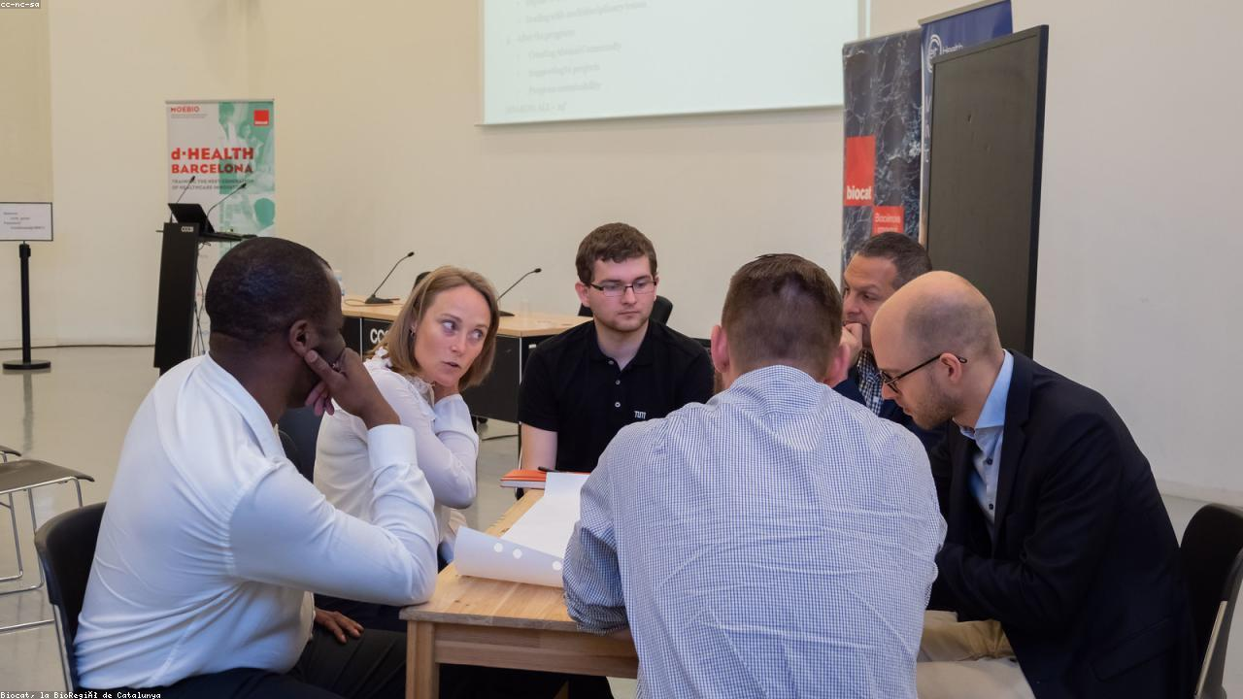
REVOLUTIONIZING HEALTHCARE WITH MACHINE LEARNING
1

Slide 2

Understanding Machine Learning in Healthcare
-> Data-driven insights for better decisions
-> Automating complex analysis tasks
-> Predictive capabilities for proactive care
2

Slide 3

The Evolving Landscape: Healthcare Challenges
-> Rising costs and resource constraints
-> Increasing data volume and complexity
-> Need for personalized treatment plans
-> Early disease detection limitations
3

Slide 4

Machine Learning: A Powerful Solution
-> Optimizing resource allocation and operations
-> Extracting actionable insights from big data
-> Enabling precision medicine and tailored therapies
-> Improving diagnostic accuracy and speed
4

Slide 5
Key Applications of ML in Healthcare
Point 1
Point 2
Point 3
Point 4
Predictive Analytics for Disease Outbreaks
Personalized Treatment Plans & Drug Discovery
Enhanced Medical Imaging Analysis
Streamlined Administrative Processes
5

Slide 6
Implementing ML: A Strategic Roadmap
Data Collection & Integration
Model Development & Training
Validation & Deployment
Monitoring & Continuous Improvement
6

Slide 7
Traditional vs. ML-Driven Healthcare
-> Reactive vs. Proactive Care
-> General vs. Personalized Treatments
-> Manual Analysis vs. Automated Insights
-> Limited Data vs. Big Data Utilization
7

Slide 8

The Impact: Transforming Patient Outcomes
-> Improved Diagnostic Accuracy
-> Reduced Healthcare Costs
-> Enhanced Patient Safety
-> Accelerated Medical Research
8

Slide 9
Our Vision: A Smarter, Healthier Future
Empowering Healthcare with Intelligent Systems for Unprecedented Progress
9

Slide 10

EMBRACE THE FUTURE OF HEALTHCARE
10

