Slide 1
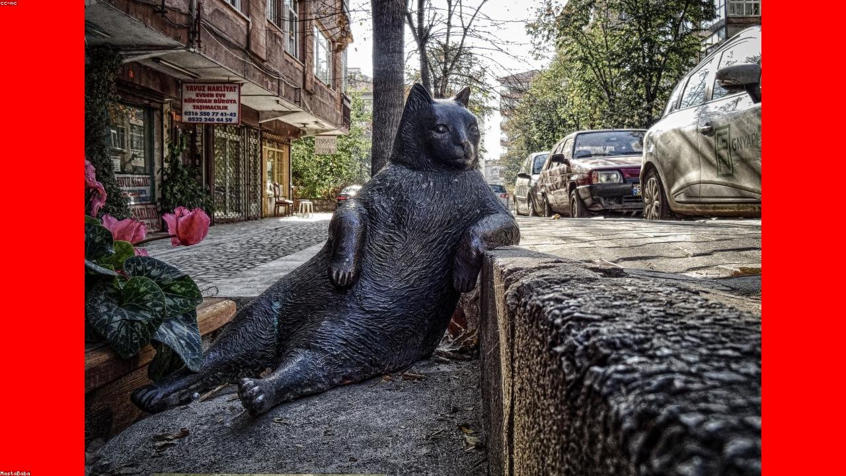
THE GOLDEN OPPORTUNITY: PREMIUM MANGO MILKSHAKES
Tapping into a rapidly growing market with a beloved classic.
1

Slide 2
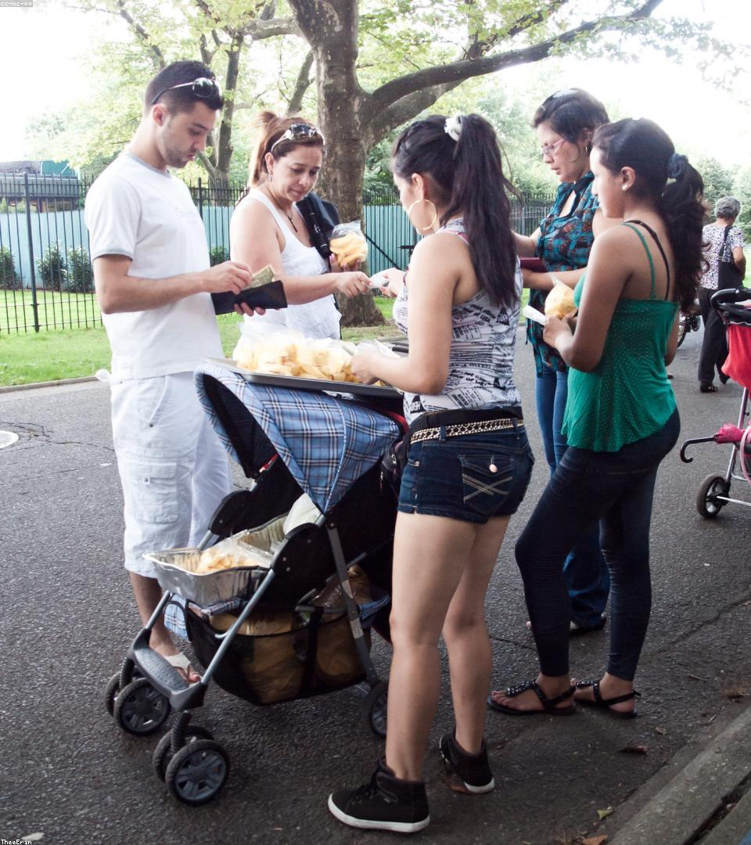
Defining Premium: Quality from Source to Sip
-> Finest Alphonso mangoes, hand-picked at peak ripeness.
-> Pure, natural ingredients with no artificial additives.
-> Creamy, rich texture achieved through expert blending.
-> Consistent taste and superior sensory experience.
2

Slide 3

The Gap in the Market: Unmet Demand for Quality
-> Lack of truly premium, natural mango milkshake options.
-> Inconsistent quality and artificial flavors dominate.
-> Limited availability in high-end retail and foodservice.
-> Consumers seeking healthier, authentic beverage choices.
3

Slide 4
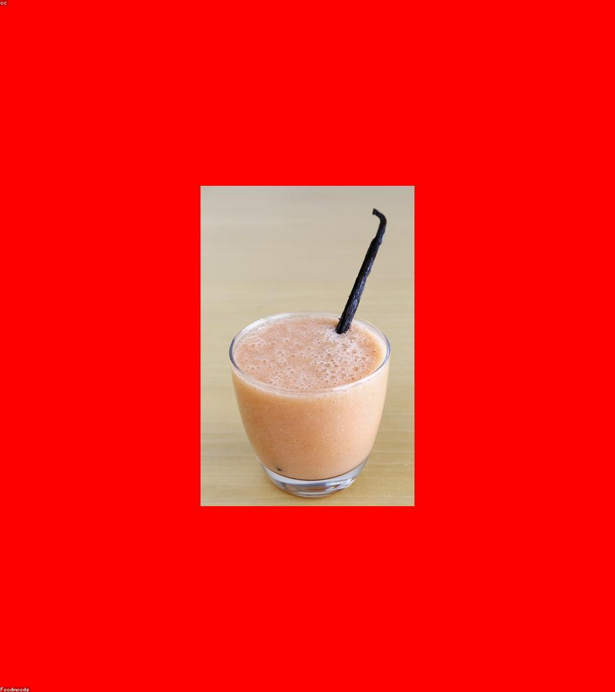
Our Solution: The Authentic Mango Milkshake Experience
-> Crafted with 100% natural ingredients and real fruit.
-> Proprietary blending process ensures unparalleled smoothness.
-> Designed for discerning palates and health-conscious consumers.
-> Sustainable sourcing and ethical production practices.
4

Slide 5
From Orchard to Consumer: Our Quality Process
Strategic Sourcing: Partnering with top mango farms.
Rigorous Selection: Hand-picking and quality checks.
Artisanal Production: Small-batch blending for consistency.
Sustainable Packaging: Eco-friendly and brand-aligned.
Efficient Distribution: Reaching markets fresh and fast.
5

Slide 6
Key Differentiators: Why We Stand Out
Premium Ingredients
Unmatched Taste
Health & Wellness
Brand Appeal
Only the best mangoes.
Rich, authentic, and refreshing.
No artificial additives.
Luxury positioning, strong identity.
6

Slide 7
Our Premium Offering vs. Standard Market Options
-> Ingredients: Real Alphonso Mangoes vs. Artificial Flavors
-> Additives: 100% Natural vs. Added Sugars & Preservatives
-> Quality: Consistent & Premium vs. Variable & Mass-Produced
-> Price Point: Premium vs. Budget
-> Target Market: Discerning Consumers vs. Broad Market
7

Slide 8
Go-to-Market Strategy & Expansion
Phase 1: Pilot Launch in key urban centers.
Phase 2: Expand to premium retail chains & cafes.
Phase 3: E-commerce integration and direct-to-consumer.
Phase 4: International market exploration.
8

Slide 9
Our Vision: Becoming the Gold Standard
To be the undisputed leader in premium fruit-based beverages, starting with the iconic mango milkshake.
9

Slide 10
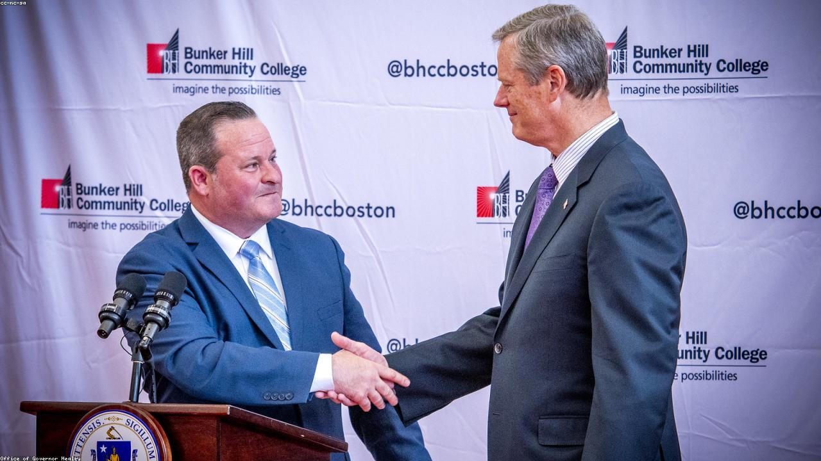
INVEST IN THE TASTE OF SUCCESS
Join us in bringing the world's finest mango milkshake to a global audience.
10

