Slide 1

INTRODUCING OUR PREMIUM MANGO MILKSHAKE!
1

Slide 2
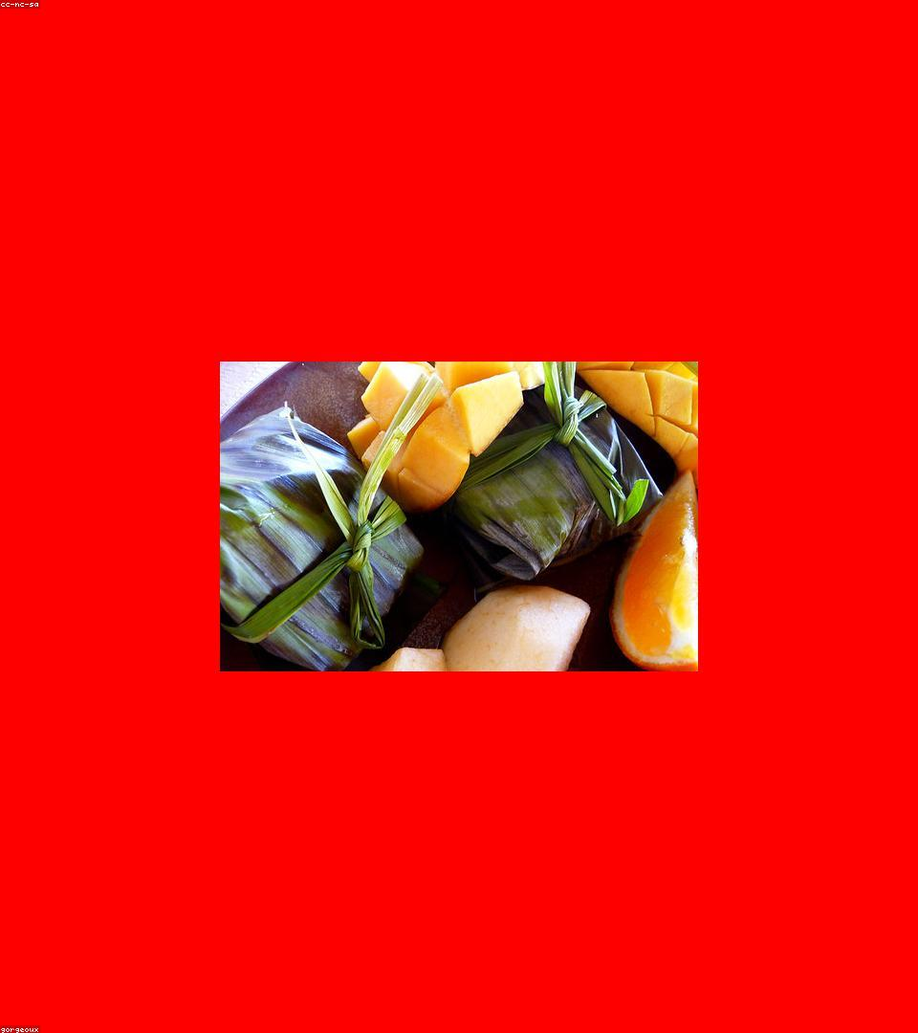
Experience Unrivaled Quality & Taste
-> Crafted with hand-picked, ripe Alphonso mangoes for authentic flavor.
-> Made with real dairy milk, ensuring a rich and creamy texture.
-> No artificial flavors or colors, just pure, natural goodness.
-> Perfectly balanced sweetness, appealing to diverse palates.
2

Slide 3
Finest Ingredients for Superior Flavor
Alphonso Mangoes
Fresh Dairy Milk
Natural Sweetener
Ice
Sweet, aromatic, and rich in color.
Creamy base for a smooth texture.
Just enough to enhance mango's taste.
Blended to perfection for a refreshing chill.
3

Slide 4
Our Journey: From Mango to Milkshake
Mango Selection: Hand-picking ripe Alphonso man...
Pulp Extraction: Gently extracting the sweet ma...
Blending Perfection: Mixing pulp, milk, and nat...
Quality Assurance: Rigorous testing for taste a...
Bottling & Sealing: Freshness locked in for con...
4

Slide 5

Who Will Love Our Mango Milkshake?
-> Health-conscious adults seeking natural, wholesome treats.
-> Families desiring delicious and refreshing options for kids.
-> Young professionals looking for convenient, premium beverages.
-> Consumers craving authentic tropical fruit experiences.
5

Slide 6
Why Choose Our Premium Mango Milkshake?
-> Our Milkshake: Real Alphonso Mangoes, Creamy Dairy, Natur...
-> Competitors: Artificial Flavors, Powder Mixes, Watery Tex...
-> Our Milkshake: Rich, Authentic Tropical Taste, Smooth Con...
-> Competitors: Generic Sweetness, Thin Mouthfeel, Unnatural...
6

Slide 7
Be Part of the Tropical Sensation!
Bring the taste of sunshine and premium quality to your shelves, de...
7

Slide 8
Partner With Us Today!
-> Schedule a tasting session for your team.
-> Discuss custom order sizes and delivery options.
-> Access our marketing support materials.
-> Bring the premium mango milkshake to your customers!
8

