Slide 1

TASTE THE TROPICS: MANGO MILKSHAKE!
1

Slide 2
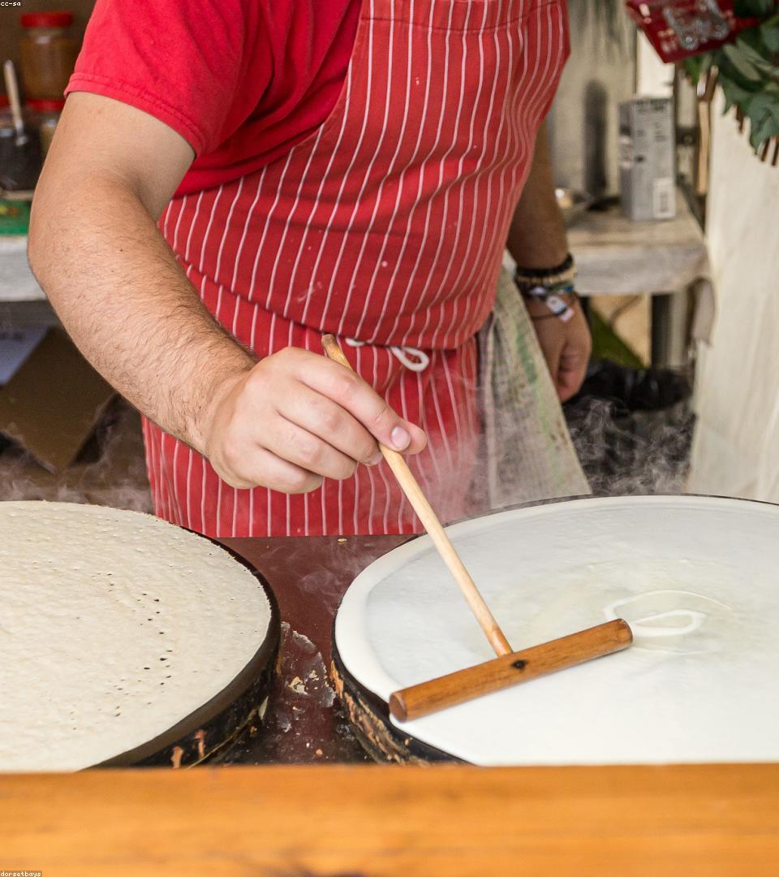
Crafted Perfection: Real Mango Goodness
-> Made with 100% real, ripe Alphonso mangoes.
-> Creamy, smooth texture for a luxurious drinking experience.
-> No artificial flavors or colors; simply natural deliciousness.
-> A refreshing treat, perfect for any time of day.
2

Slide 3
Tapping into a Growing Consumer Base
Health-Conscious
Dessert Lovers
On-the-Go
Natural ingredients appeal to mindful consumers.
A delicious, convenient alternative to traditional desserts.
Perfect for busy lifestyles seeking quick, tasty options.
3

Slide 4
Careful Sourcing, Expert Craftsmanship
Step 1: Hand-Picked Mangoes - Only the finest f...
Step 2: Gentle Processing - Preserving natural ...
Step 3: Quality Control - Rigorous checks at ev...
Step 4: Sustainable Packaging - Eco-friendly an...
4

Slide 5
Boost Your Store's Sales and Reputation!
5

Slide 6

A Symphony of Sweet, Tangy, and Smooth
-> Sweetness: Naturally rich from sun-ripened mangoes.
-> Tang: A subtle, refreshing zest that balances the sweetness.
-> Smoothness: Velvety texture glides effortlessly.
-> Refreshing: A cool, invigorating taste perfect for any palate.
6

Slide 7

Eye-Catching Design, Eco-Conscious Ch...
-> Modern Aesthetics: Stands out on crowded shelves.
-> Recyclable Materials: Appeals to environmentally aware consumers.
-> Convenient Size: Perfect for individual servings.
-> Secure Seal: Ensures freshness and prevents leaks.
7

Slide 8

READY FOR SWEET SUCCESS? CONNECT!
8

