Slide 1
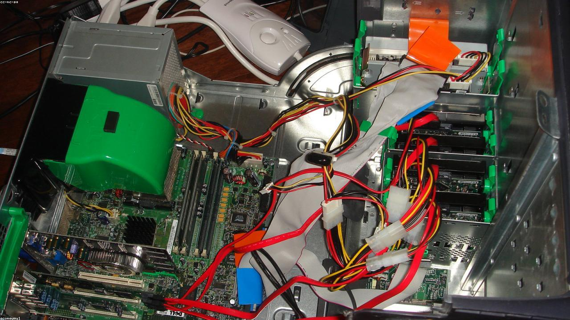
PYTHON: A JOURNEY IN PROGRAMMING
From humble beginnings to global impact.
1

Slide 2

Python's Guiding Design Principles
-> Readability counts: Clean, understandable code.
-> Explicit is better: Clear and unambiguous.
-> Simple is better: Easier to comprehend.
-> Practicality beats purity: Focus on utility.
2

Slide 3
Key Milestones in Python's Evolution
1991: Guido releases Python 0.9.0.
2000: Python 2.0 introduces list comprehensions.
2008: Python 3.0 (Py3k) brings major changes.
Today: Thriving ecosystem, continuous innovation.
3

