Slide 1
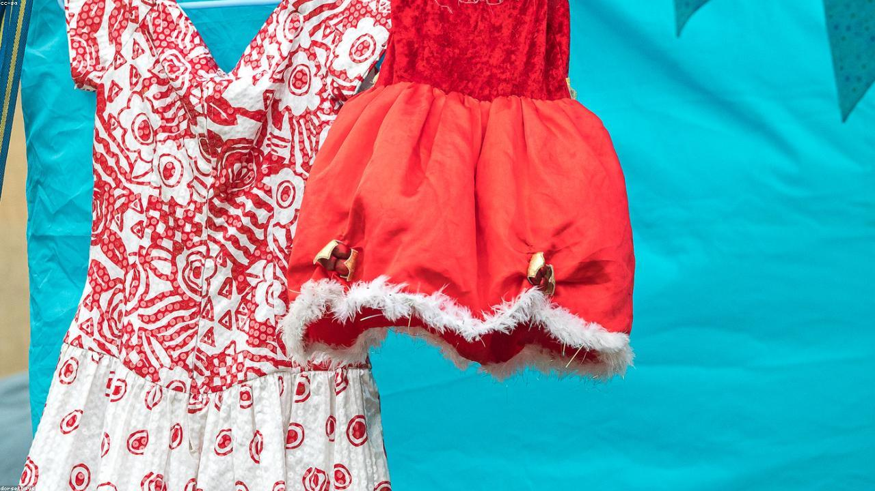
THE ART OF MILKSHAKES
Crafting delightful frozen beverages for everyone.
1

Slide 2
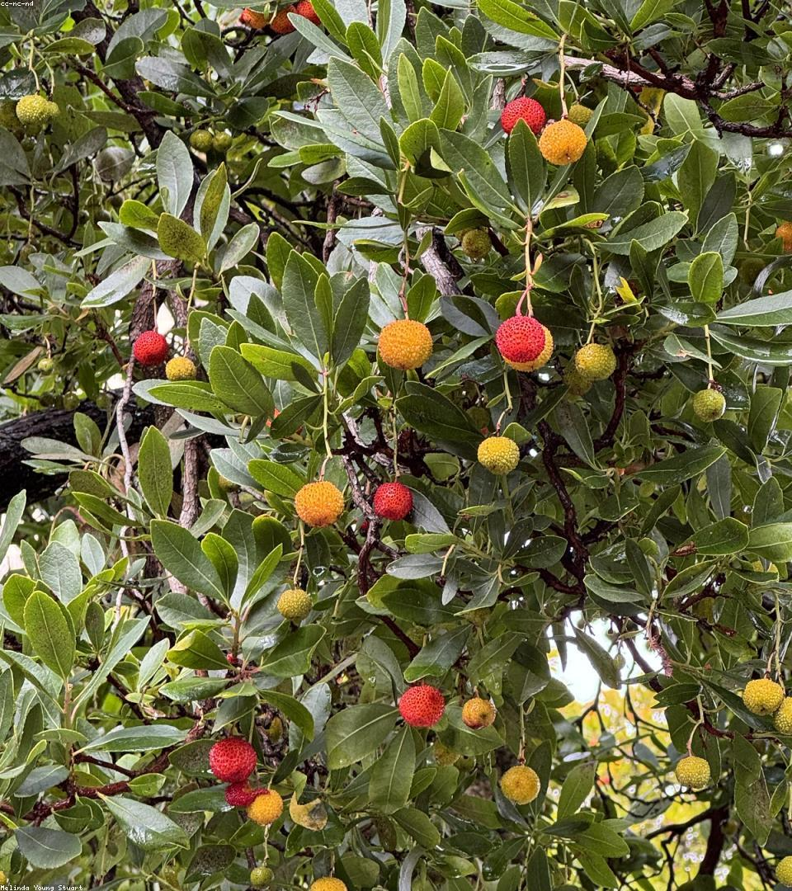
Key Elements of a Perfect Milkshake
-> Quality Ingredients: Fresh milk, premium ice cream, natural flavors.
-> Optimal Consistency: Smooth, thick, and perfectly chilled texture.
-> Creative Combinations: Unique flavors and delightful toppings.
2

Slide 3
Crafting Your Ideal Milkshake
Gather: Milk, ice cream, flavorings, and desire...
Combine: Blend ingredients in a high-speed blen...
Serve: Pour into a glass, add toppings, and enj...
3

Slide 4
Diverse Milkshake Creations
Classic Vanilla
Chocolate Dream
Fruity Berry
Coffee Buzz
Timeless, rich, and wonderfully creamy.
Decadent, smooth, and deeply satisfying.
Refreshing blend of fresh seasonal berries.
Energetic kick with a smooth, sweet finish.
4

Slide 5
The Future of Milkshakes
Innovating classic treats for modern palates.
5

