Slide 1
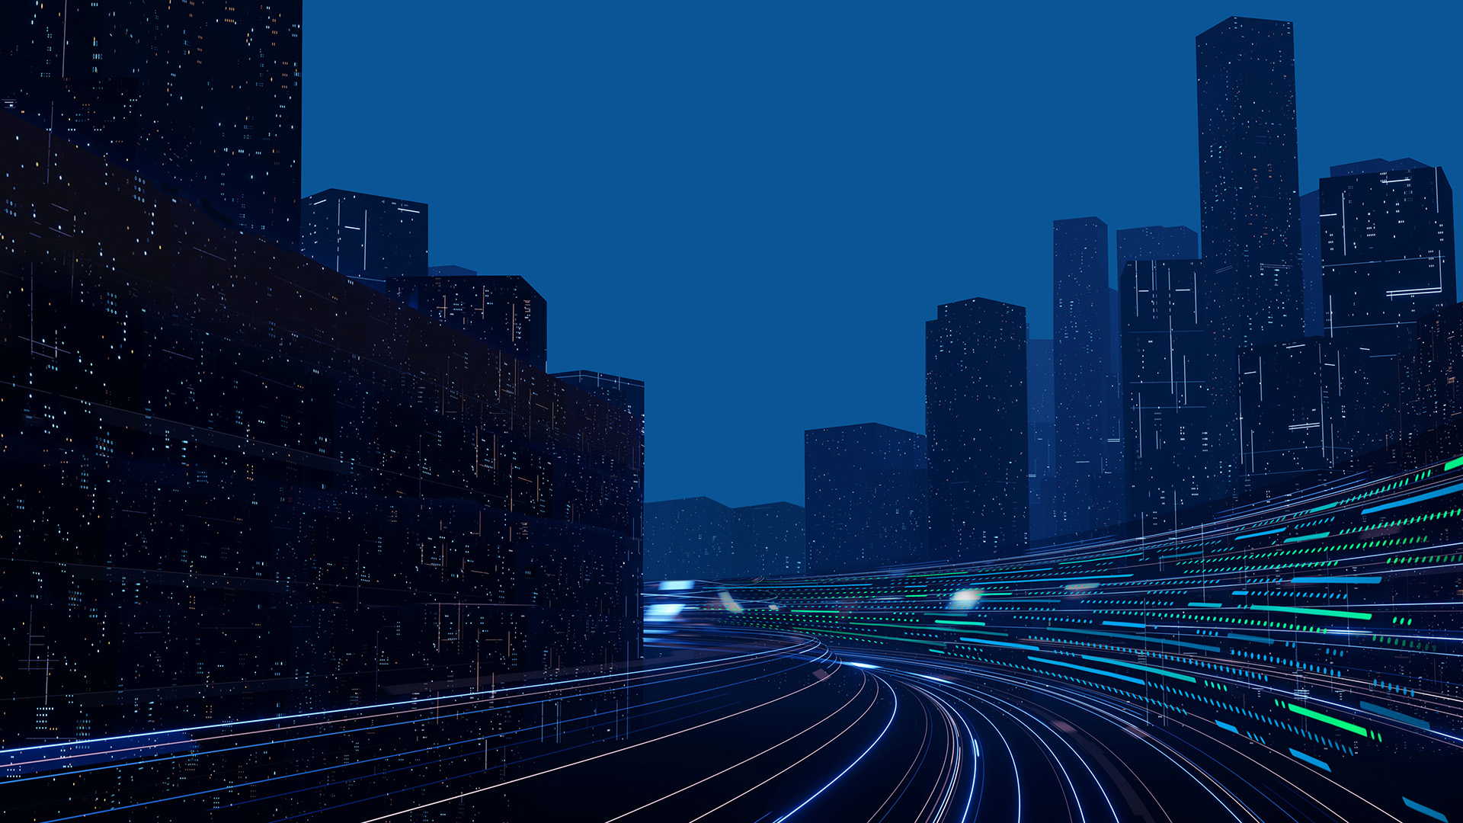

One Layer Custom RCWA Solver Results
Sougata Bhunia
/08/2026
Chroma ATE Inc.
CONFIDENTIAL

Slide 2
Contents
Project Roadmap and Planning
Need of this Work
Theoretical Background
How our solver works
Results
Features of our Solver
Next Steps

Slide 3
2-Month Plan
: Internship roadmap
WEEKS 1–2
WEEKS 3–4
WEEKS 5–6
WEEKS 7–8
TODAY: AUG 24
DONE
1
DONE
2
IN PROGRESS
3
PLANNED
4
RCWA Foundations + Thin-Film Solver
Adding More Flexibility of Solver
Validation for Trench structure
2D Patterned-Layer Validation
Maxwell's eqs, TMM & S-matrix theory from first principles
Multi layer thin-film solver built
Validated vs. commercial (KLA) solver
Applied Azimuth Angle for Sample Surface
Set Incident Light Polarization – Now only Linear Polarization
Validate with KLA Solver
Write script for making trench structure in Python
Cross-check vs. Commercial RCWA
Improve Accuracy
Write script for making Via, Pillar structure in Python
Cross-check vs. Commercial RCWA
Improve complexity and robustness

Slide 4
RESULTS

Slide 5
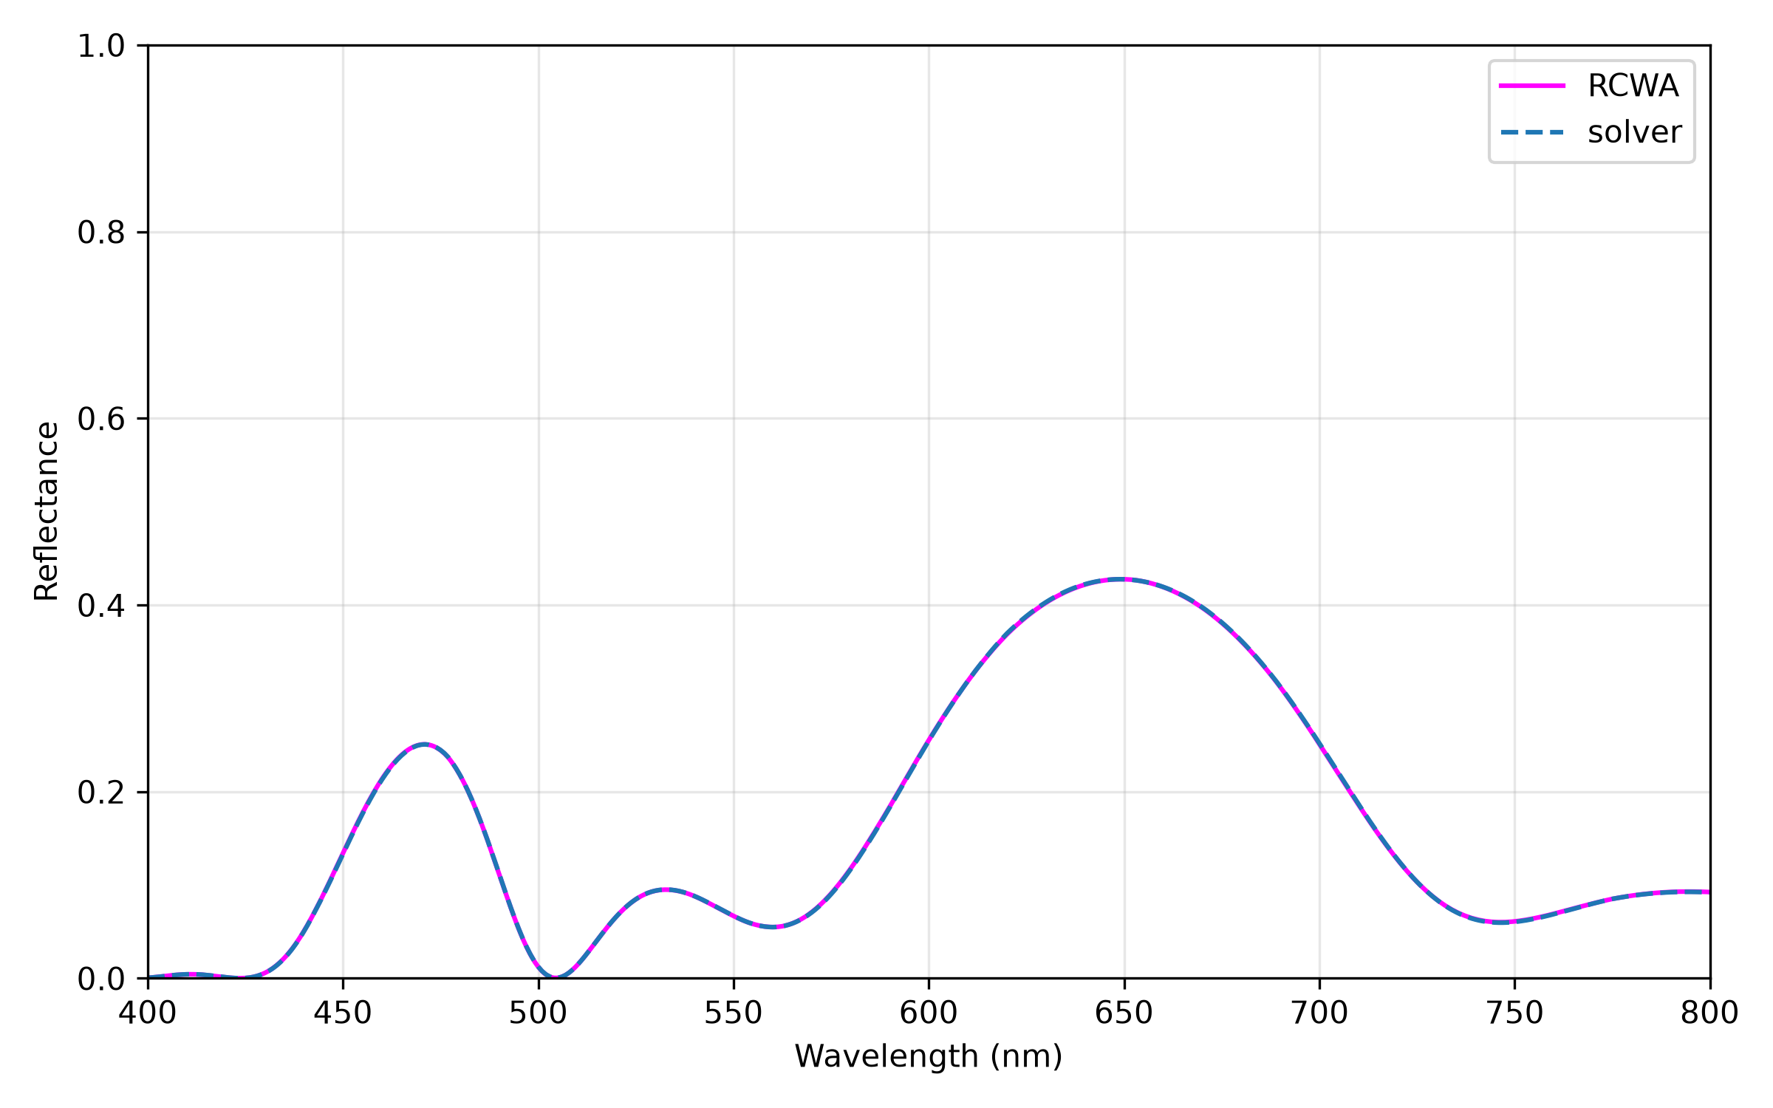






Results
Light Incident
200 n$m$
Si$O_{2}$
300 n$m$
SiO
10 n$m$
Ni
500 n$m$
Si$O_{2}$
Infinite
Si

Slide 6
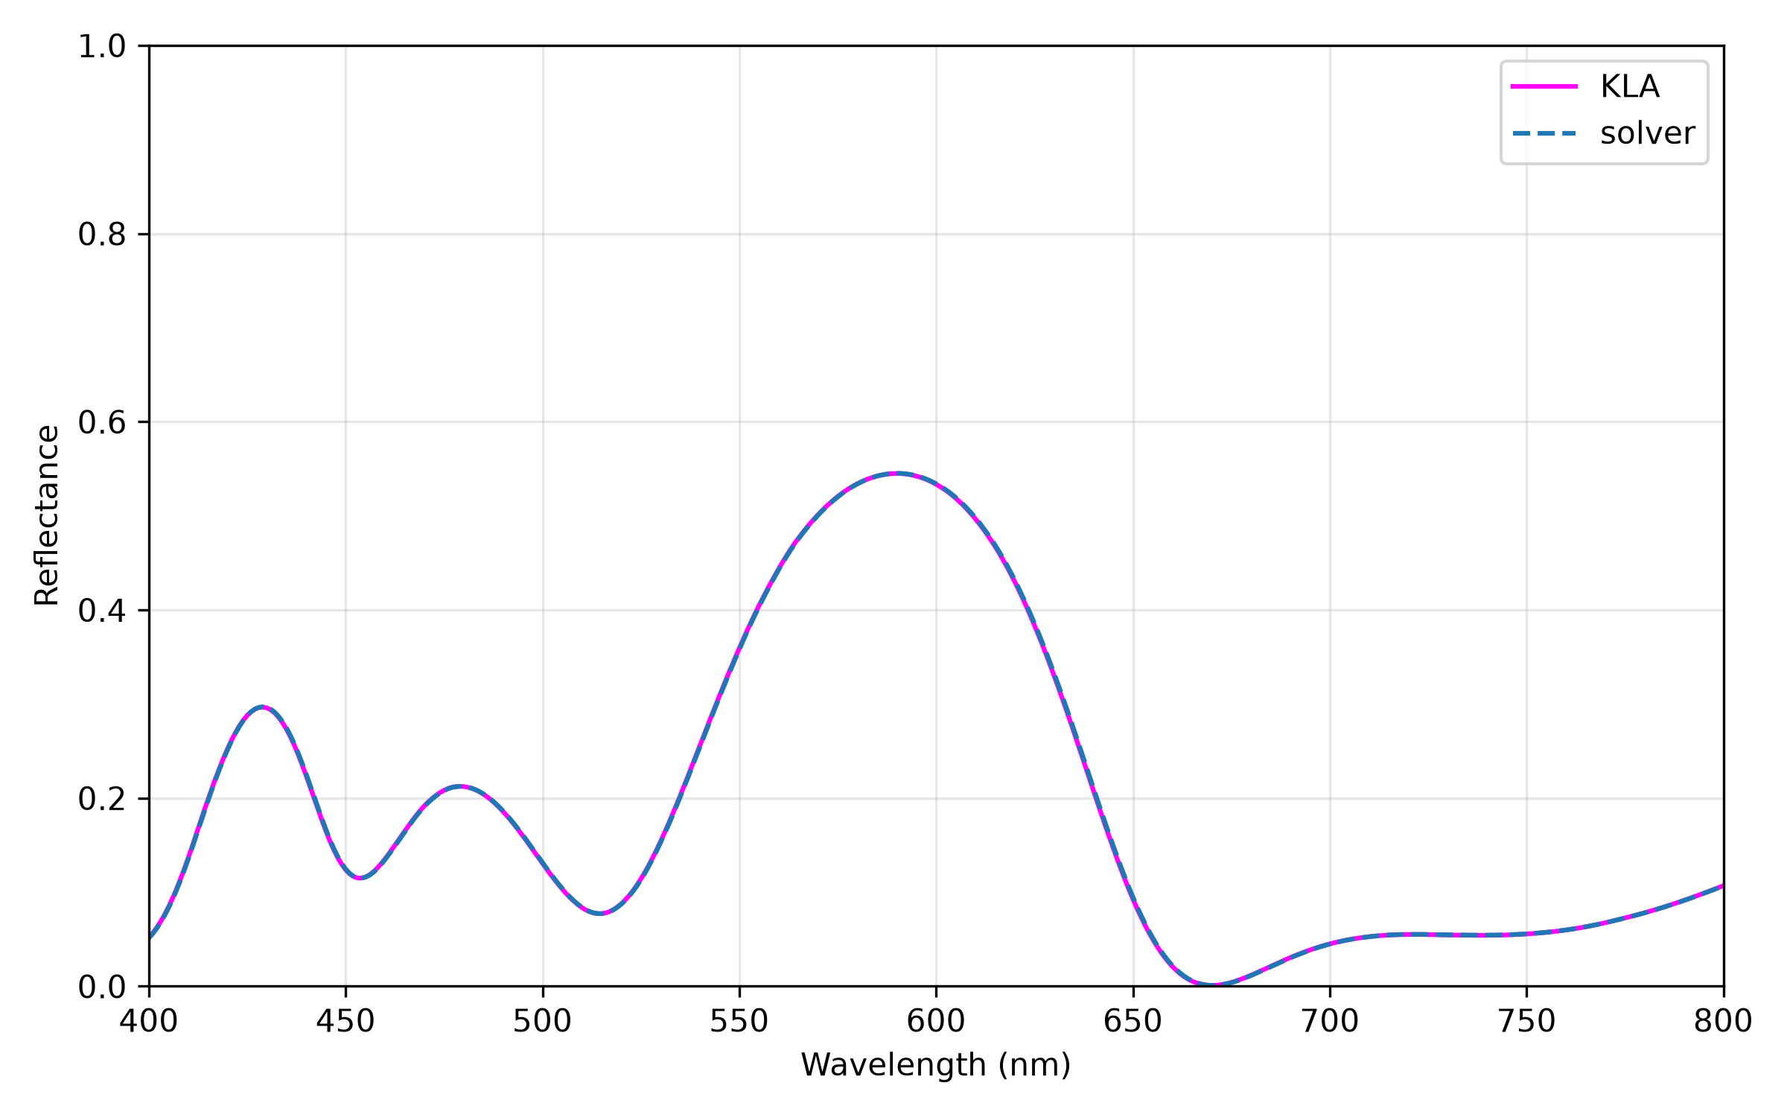

Results
Light Incident
$${45}^{0}$$
200 n$m$
Si$O_{2}$
300 n$m$
SiO
10 n$m$
Ni
500 n$m$
Si$O_{2}$
Infinite
Si

Slide 7
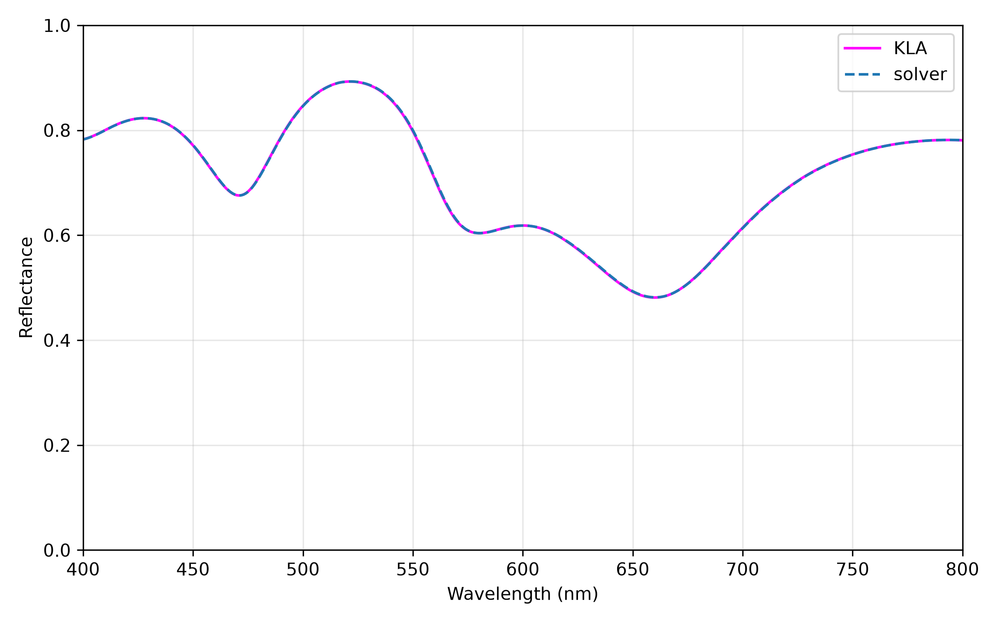

Results
Light Incident
$${85}^{0}$$
200 n$m$
Si$O_{2}$
300 n$m$
SiO
10 n$m$
Ni
500 n$m$
Si$O_{2}$
Infinite
Si

Slide 8
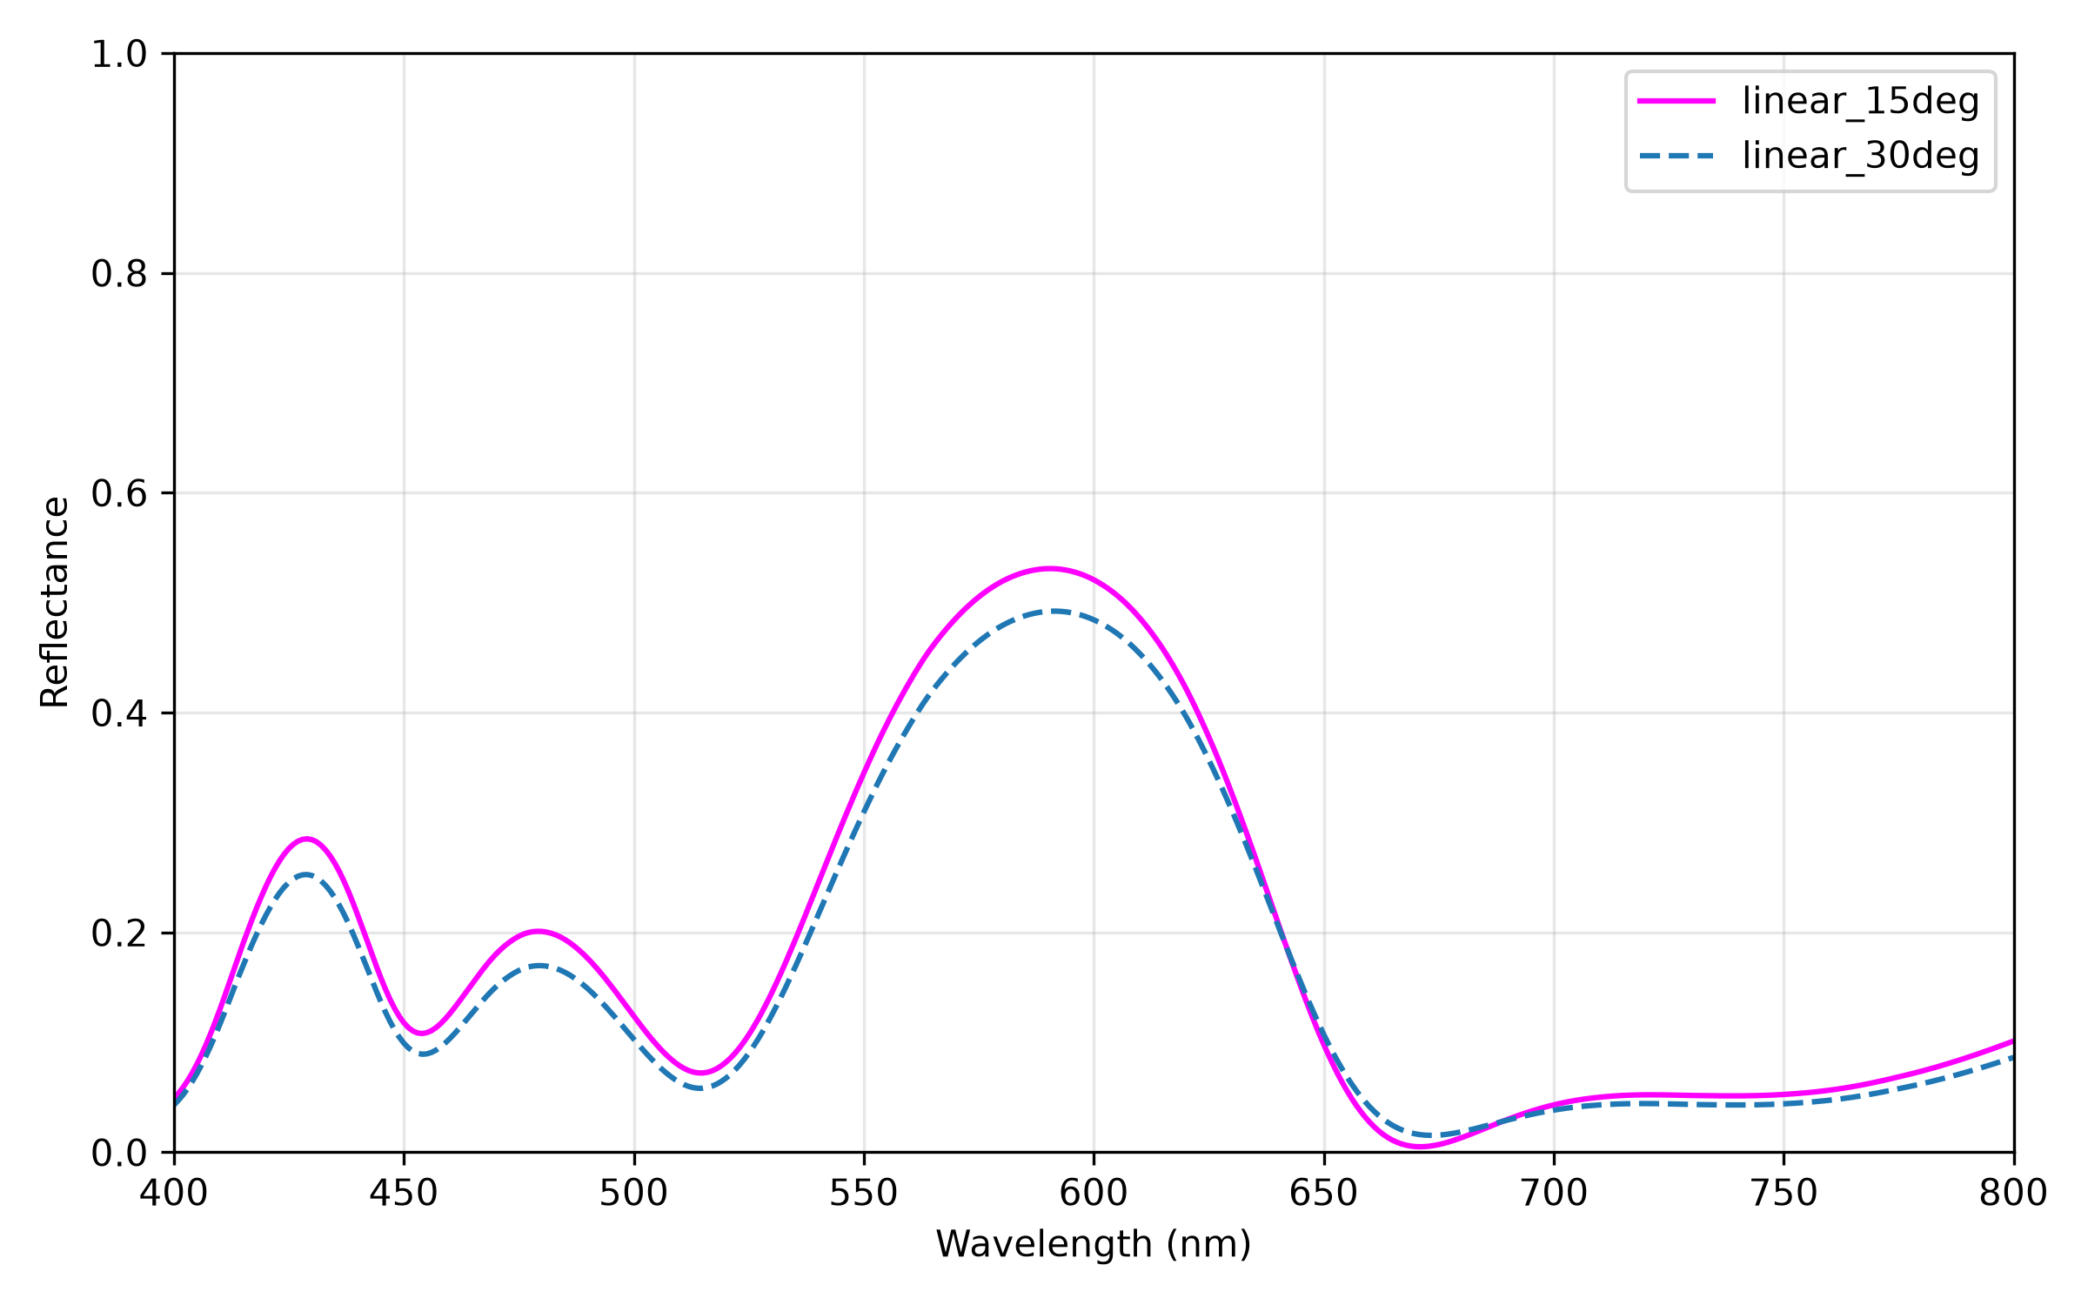
Results
Light Incident
$${45}^{0}$$
200 n$m$
Si$O_{2}$
300 n$m$
SiO
10 n$m$
Ni
500 n$m$
Si$O_{2}$
Infinite
Si

Slide 9

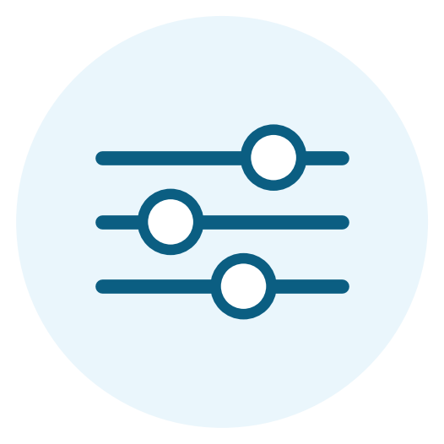
Features
Cross-validated against multiple independent oracles, not just “trust us.”
We own and can extend the exact math, not just the inputs.
Full control of our setup :
We can use any Material Layers and any Thickness
We can use any Material as Substrate
We can change Incident Angle

Slide 10






Next Steps
Applied Azimuth Angle
Set Incident Light Polarization – Circular and Elliptical
Apply in High range of Wavelength
Increase Incident Angle and resolve remaining numerical issues
Light Incident
50 n$m$
Ti$O_{2}$
400 n$m$
Si
50 n$m$
Si$O_{2}$
5$00 µm$
Ni

Slide 11
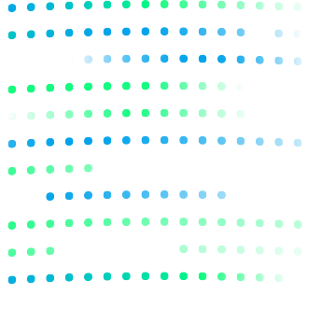

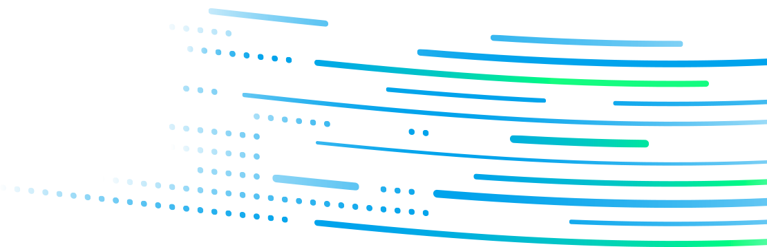
Thank you
Thank You
Copyright © 2026 Chroma ATE Inc. All rights reserved.
Notes:
That's where things stand at the two-week mark. Thin-film multilayer solver: built, validated, done. Patterned 2D-layer work: underway, honestly scoped as the higher-risk stretch goal. Happy to take any questions.

