Slide 1
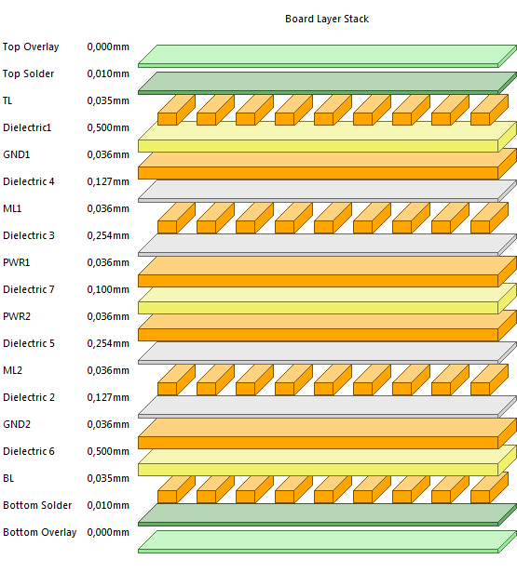
Stack up Proposal
Top & bottom Layers:
Impedance Control: - 100 Ω Differential -/+ 20%
- 50 Ω Single Ended -/+ 10%
PCB Thickness:
2,2 mm

