Slide 1
Communication Skills

Slide 2
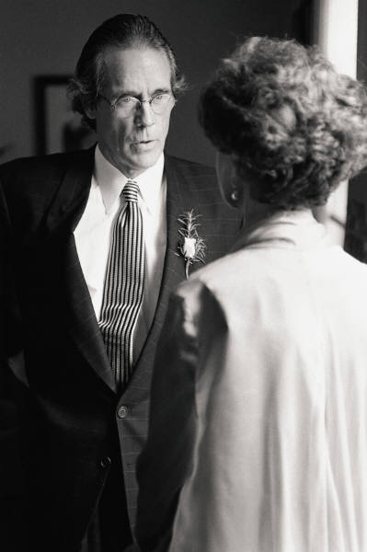
Communication Skills
Overview:
Communication skills are a critical element in delivering effective training.
Trainers must be able to use a variety of communication techniques in order to create an environment that enables participants to engage actively in the learning process.

Slide 3
Objectives
  Describe reasons that communication fails
  List and discuss strategies to enhance communication
  Paraphrase and summarize conversations
  Use appropriate questioning techniques to lead discussions and to assist learning

Slide 4
What are the most common ways we communicate?
Visual Images
Spoken Word
Written Word
Body Language

Slide 5
All communication methods are important in training but our emphasis will be upon the spoken word... since
70 % or all our communication efforts are:
misunderstood, misinterpreted, rejected, disliked, distorted, or not heard (in the same language, same culture)!
70%

Slide 6
The Goals of Communications:

Slide 7
Communication is the process of sending and receiving information among people…
Feedback
SENDER
RECEIVER
receiver
sender

Slide 8
All messages do not reach the receiver due to “distortion”
Feedback
Sender
Receiver
Distortion

Slide 9
What causes distortion or the barriers to understanding/listening?
Perceptions
Language
Semantics
Personal Interests
Emotions
Inflections
Environment – noise
Preconceived notions/expectations
Wordiness
Attention span
Physical hearing problem
Speed of thought
Notes:
See handout “Barriers to Verbal Communication” for elaboration

Slide 10
How can we improve our listening skills?
Eliminate distractions
Concentrate
Focus on the speaker
Maintain an open mind
Look for nonverbal cues
Do not react to emotive words
Ask questions
Sit so you can see & hear
Avoid prejudices
Take notes
Ask for clarification

Slide 11
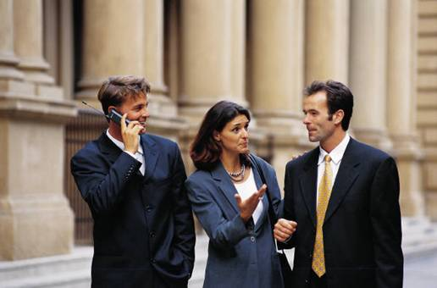
Listening…the other side of communication
Too many people see communication as merely speaking.
Messages must be received as well as sent.
A good question to ask yourself is, are you really listening or simply waiting for your turn to talk?
If you are thinking about your reply before the other person has finished, then you are not listening!
Notes:
See Handout “ Aids to Effective Listening” for further information.

Slide 12
How can we improve our listening & facilitation skills?
SUMMARIZING
Pulling together the main points of a speaker
PARAPHRASING
Restating what another has said in your own words
QUESTIONING
Challenging participants to tackle & solve
problems

Slide 13
Practice your questioning skills…
Rephrase the following closed questions to make them open-ended:
Are you feeling tired now?
Isn’t today a nice day?
Was the last activity useful?
Is there anything bothering you?
So everything is fine, then?
Notes:
What tires you out?
What kind of weather are we having today?
How was the last activity useful?
Tell me what is on your mind.
Why are you looking so happy?

Slide 14
Other questioning techniques include:
Direct questions: asked of a particular individual – allows you to initiate control – good for re-directing discussion from excessive talkers.
Return questions: puts the question back to the questioner or group – “What do you think about that?”
General overview questions: used to initiate a discussion or set up a thoughtful exercise – “How would you respond to the situation?”
Hypothetical questions: tests the responder’s problem-solving ability by posing a hypothetical situation – “If you had an unlimited budget, what would you fund?”
Notes:
See handout “Questioning Techniques” for more ideas.

Slide 15
Watzlawick, Beavin, and Jackson (1967)
Five Axioms of Communication
One cannot not communicate.
Every communication has a content and a relationship aspect such that the latter defines the former and is therefore meta communication.
Every communication sequence is defined by the way the interact ants punctuate communication events.
Interpersonal contacts are digital and analog
Communication relationships are either symmetrical or complementary.

Slide 16
Other helpful techniques to foster communication (both verbal and non-verbal)…
Nod Your Head
Repeat the last
word or two of the
prior speaker
Maintain eye
contact
Keep an open
body position
Repeat a sentence
or part of one
Make encouraging
statements

