Slide 1
PLANNING
AND
STRUCTURING

Slide 2
For some people it can be a very daunting task to make a presentation or to speak in front of the public. It is true that some people are naturally talented and expert at the art of public speaking, but through effective preparation anyone can prepare and deliver a successful speech. This presentation will guide us on how to master the skill of speaking effectively.

Slide 3
Planning
Occasion
Audience
Purpose
Thesis
Material

Slide 4
OCCASION
Available facilities : venue, seating, lighting, projection facilities.
Time : time of the day and the duration of the talk.
Context : Effect of team members, recent happenings in company.
Occasion dictates the content, the duration, the tone and the expectations of the audience from the speech.

Slide 5

AUDIENCE
Adapt your speech to your audience
Insight into the positions, personal preferences, demographic characteristics, knowledge, aim and attitudes of your audience helps immensely.
Internal/External to organization or a combination.
May well turn out to be the deciding factor between an effective presentation and an ineffective one.
Size of the group

Slide 6
PURPOSE
General purpose : to inform, persuade or entertain.
Specific purpose : the four W’s–who, what, when and where.
Example:
I want everyone in this group to make a presentation next week in the lecture hall.
The objective should be clear to you if it is to be clear to your audience.

Slide 7

THESIS
The central or core idea of the presentation, a single statement that summarizes your message.
Reveals the exact purpose of the presentation.
To avoid confusion.
Different from the purpose statement. Instead of explicitly revealing the purpose, informs the audience of the purpose lying beneath the thesis statement.

Slide 8
MATERIAL
Develop information to elaborate thesis
Research in order to collect material
Consulting company records, statistics, publications.
Conducting surveys and interviews.
Contacting external organizations for information.

Slide 9
STRUCTURING
A well-organized presentation makes messages more comprehensible.
Presentation should have following format:
  Introduction
  Main body
  Conclusion
Main text of the speech needs organizing.
The body can be organized in six basic patterns.

Slide 10
PATTERNS
Depends on the topic and purpose of your speech.
Chronological Pattern
Points are arranged in the way they occurred or were observed.
Spatial Pattern
Organizes material according to how it is put together or located physically.
Topical Pattern
Topic is divided into some logical themes or categories.

Slide 11
Cause and Effect Pattern
Either causes first and then the effects or vice versa.
Problem and Solution Pattern
Used in persuasive speaking to compel the listener to have a change of opinion.
Climactic Pattern
Content is arranged on the basis of importance starting from the least important.

Slide 12
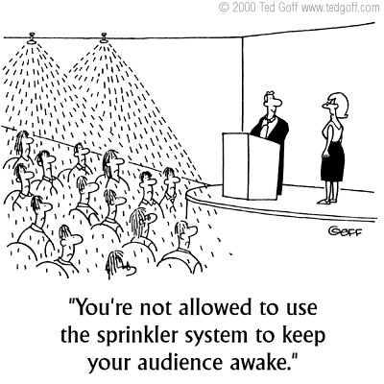
A BORING PRESENTATION

