Slide 1
INDIANA WESLEYAN UNIVERSITY • AIML-501
NEURAL NETWORK
COMPONENTS
Structure, functions, and practical experimentation
with TensorFlow Neural Network Playground
Portfolio Artifact | Workshop 2.4
Prepared by Soujanya Pasumarthi
01 / 12

Slide 2
PURPOSE AND LEARNING OUTCOMES
From neural-network theory to visible model behavior
This artifact defines the required components and connects them to observations from hands-on model training.
01
02
03
DEFINE
ILLUSTRATE
EXPERIMENT
Explain layers, neurons, weights, activation functions, loss functions, and optimization algorithms.
Trace information from input features through hidden layers to an output prediction.
Change features, noise, activation, and architecture to observe model behavior.
EXPERIMENTAL LENS
TensorFlow Playground was used to train classification networks on the Circle and XOR datasets. The captured experiments demonstrate how changes in network structure, activation function, learning rate, and noise affect the model's learned decision boundary and its reported training and test loss.
AIML-501 | MODEL DEVELOPMENT | WORKSHOP 2.4
02 / 12

Slide 3
NETWORK ARCHITECTURE
How information moves through a neural network
Forward propagation transforms input features into an output through weighted connections and activation functions.
INPUT LAYER
HIDDEN LAYERS
OUTPUT LAYER
x₁
x₂
ŷ
x₁²
x₂²
Input features
Weighted sums + activation
Predicted class
The number of hidden layers and neurons is a design choice. Connections carry learned weights; the output represents the model’s prediction.
AIML-501 | MODEL DEVELOPMENT | WORKSHOP 2.4
03 / 12

Slide 4
CORE COMPONENTS • PART 1
Layers, neurons, and weights
These elements define the network’s structure and how signals are combined.
A simplified fully connected network
Layers
Groups of neurons arranged by role: input, one or more hidden layers, and output.
Neurons
Computational units that receive values, combine them, apply an activation, and pass a result forward.
Weights
Learnable numerical parameters on connections. Training adjusts weights to reduce prediction error.
Input
Hidden
Output
More connections increase capacity, but do not guarantee better generalization.
AIML-501 | MODEL DEVELOPMENT | WORKSHOP 2.4
04 / 12

Slide 5
CORE COMPONENTS • PART 2
Activation functions introduce nonlinearity
Without nonlinear activations, stacking linear layers remains equivalent to a linear transformation.
ReLU
Linear activation
f(x) = max(0, x)
Negative values become zero; positive values pass through.
f(x) = x
The input passes through unchanged; no nonlinearity is added.
NONLINEAR
LINEAR
Activation choice affects the boundary the model can learn.
AIML-501 | MODEL DEVELOPMENT | WORKSHOP 2.4
05 / 12

Slide 6
CORE COMPONENTS • PART 3
Loss functions and optimization algorithms
A model learns by measuring prediction error and updating its parameters to reduce that error.
PREDICTION
LOSS
GRADIENT
UPDATE
ŷ = model(x)
L(y, ŷ)
∇L(w)
w ← w − α∇L
Network produces an output.
Compare prediction with target.
Estimate how weights affect loss.
Adjust weights using a learning rate.
LOSS FUNCTION
OPTIMIZATION ALGORITHM
Quantifies the mismatch between predicted and actual values. The training objective is to minimize this quantity.
Uses gradients to update weights. Gradient descent and adaptive methods such as Adam are common examples.
Training loss is measured on training data; test loss evaluates performance on held-out data.
AIML-501 | MODEL DEVELOPMENT | WORKSHOP 2.4
06 / 12

Slide 7
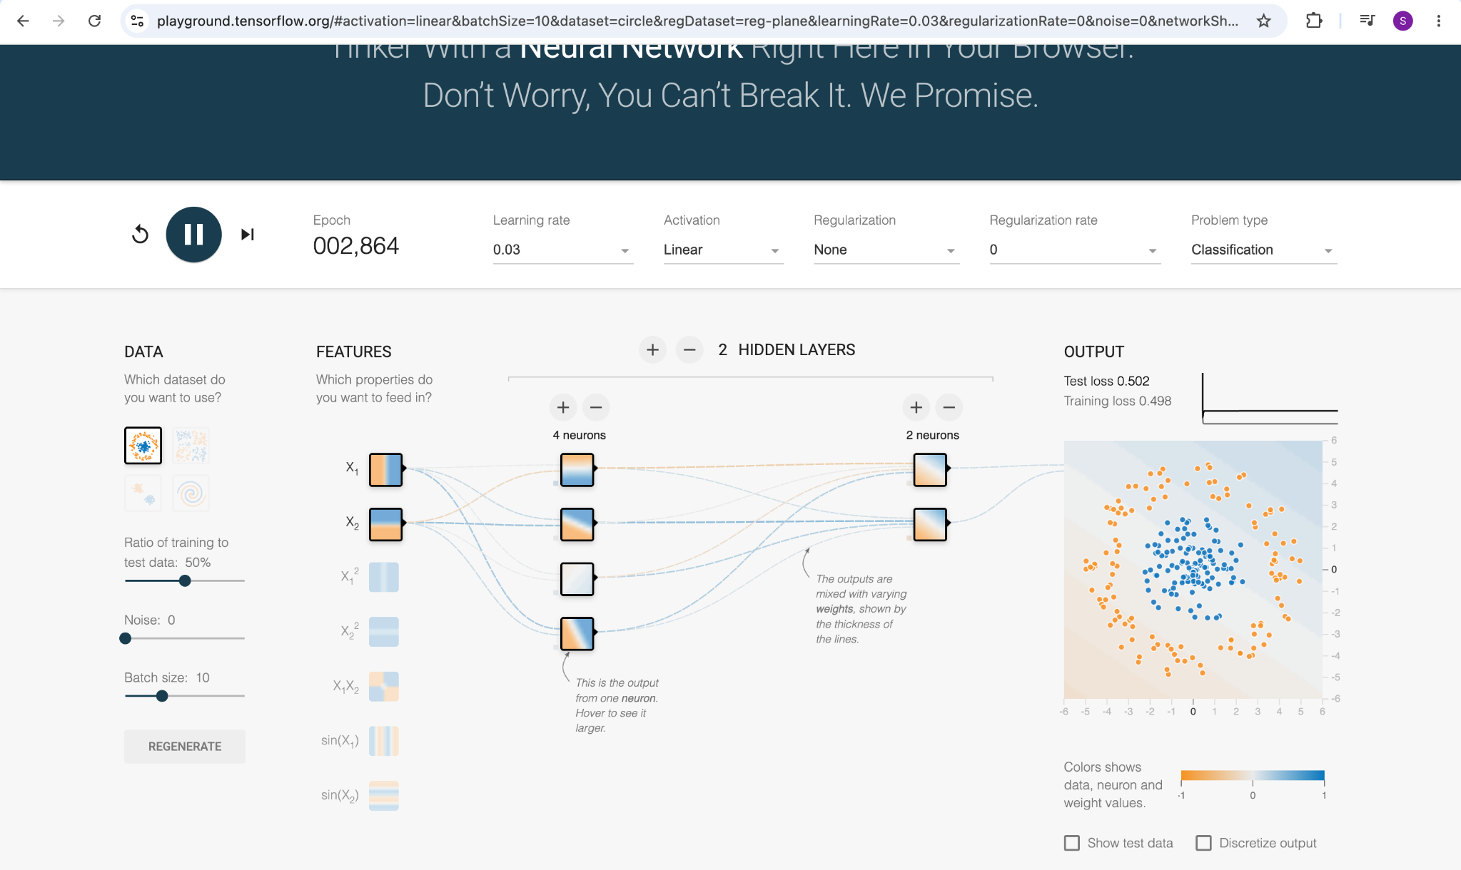
PRACTICAL EXPLORATION • SETUP
TensorFlow Playground: experimental environment
The interface exposes data, features, hidden-layer design, activation, regularization, and training behavior.
What was controlled?
Dataset
Circle classification.
Features
x₁, x₂ and optional engineered terms.
Network
Hidden layers and neuron counts.
Training
Learning rate, activation, noise, regularization.
Screenshot shows the initial Playground configuration; loss values are specific to this run and epoch.
AIML-501 | MODEL DEVELOPMENT | WORKSHOP 2.4
07 / 12

Slide 8
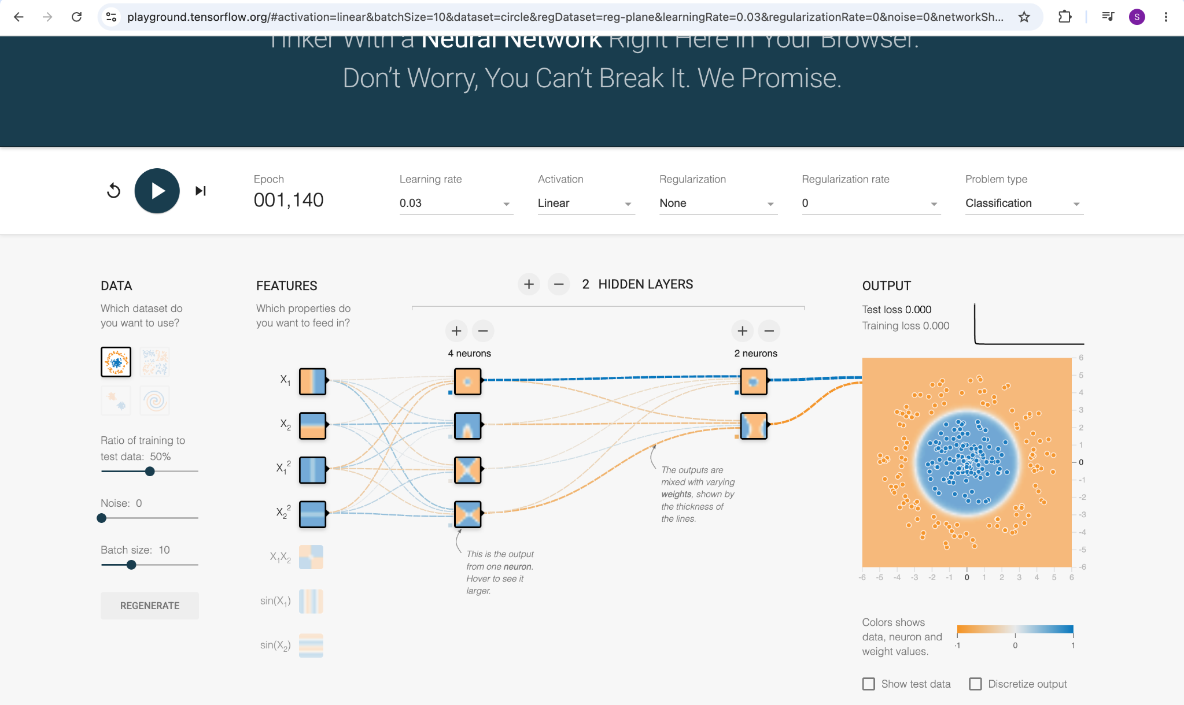
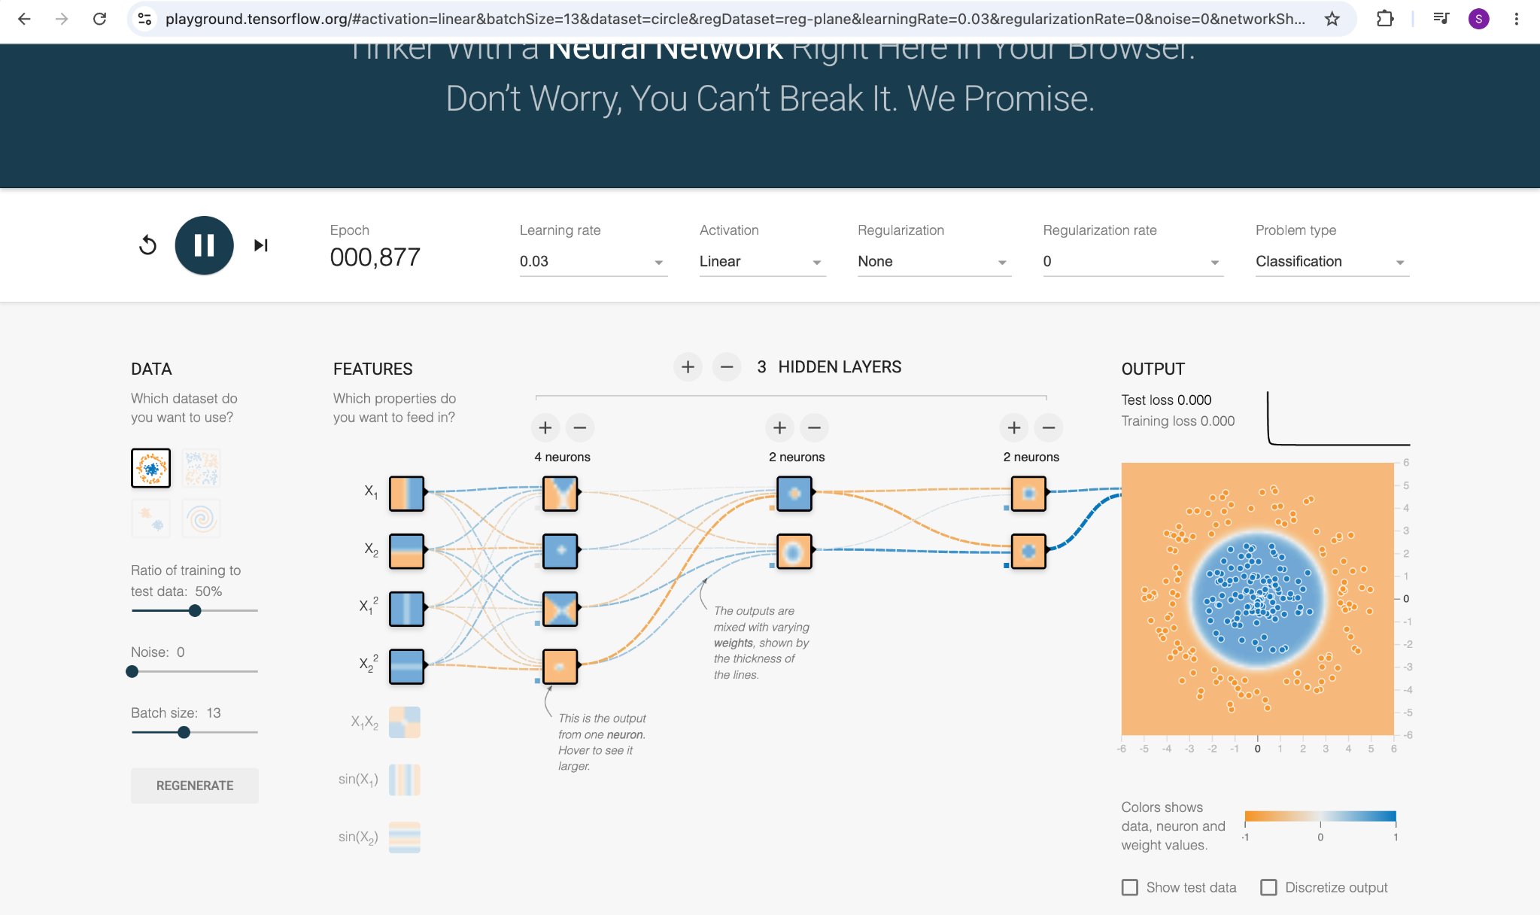
PRACTICAL EXPLORATION • FEATURE AND ARCHITECTURE
Input representation and network structure matter
The supplied runs show that engineered features and layer configuration affect how the network represents the circle pattern.
Squared inputs (x₁², x₂²) add radial information that can help represent a circular boundary.
Changing layer and neuron counts changes capacity; this screenshot is an early training state.
AIML-501 | MODEL DEVELOPMENT | WORKSHOP 2.4
08 / 12

Slide 9
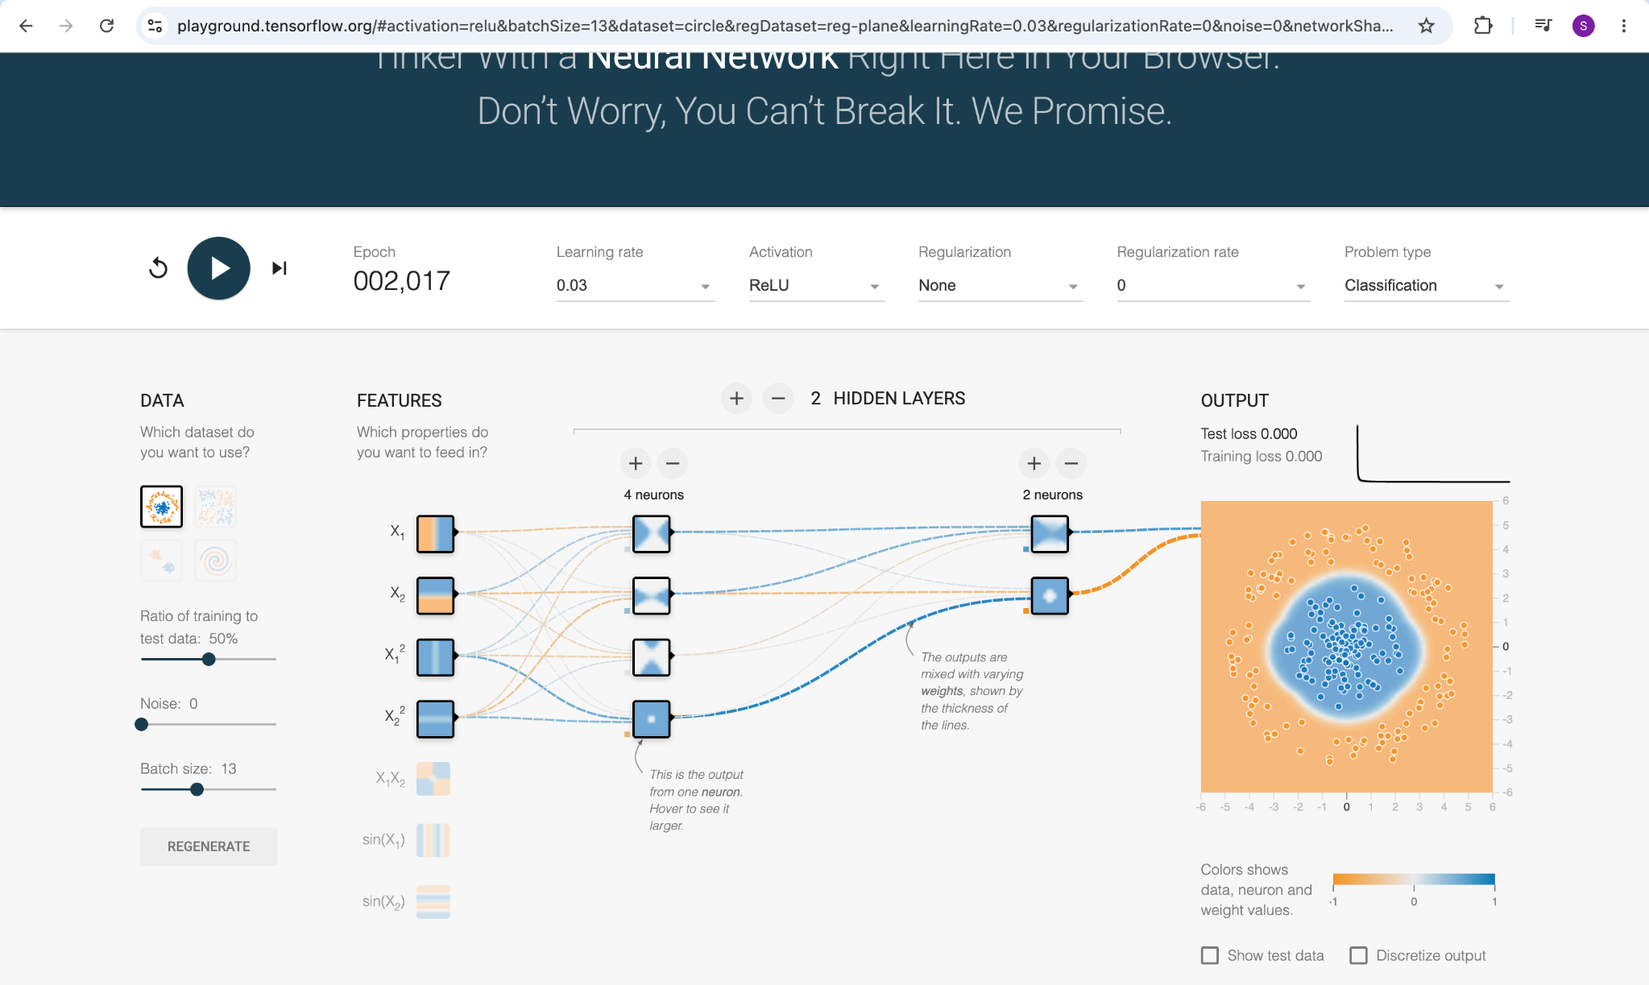
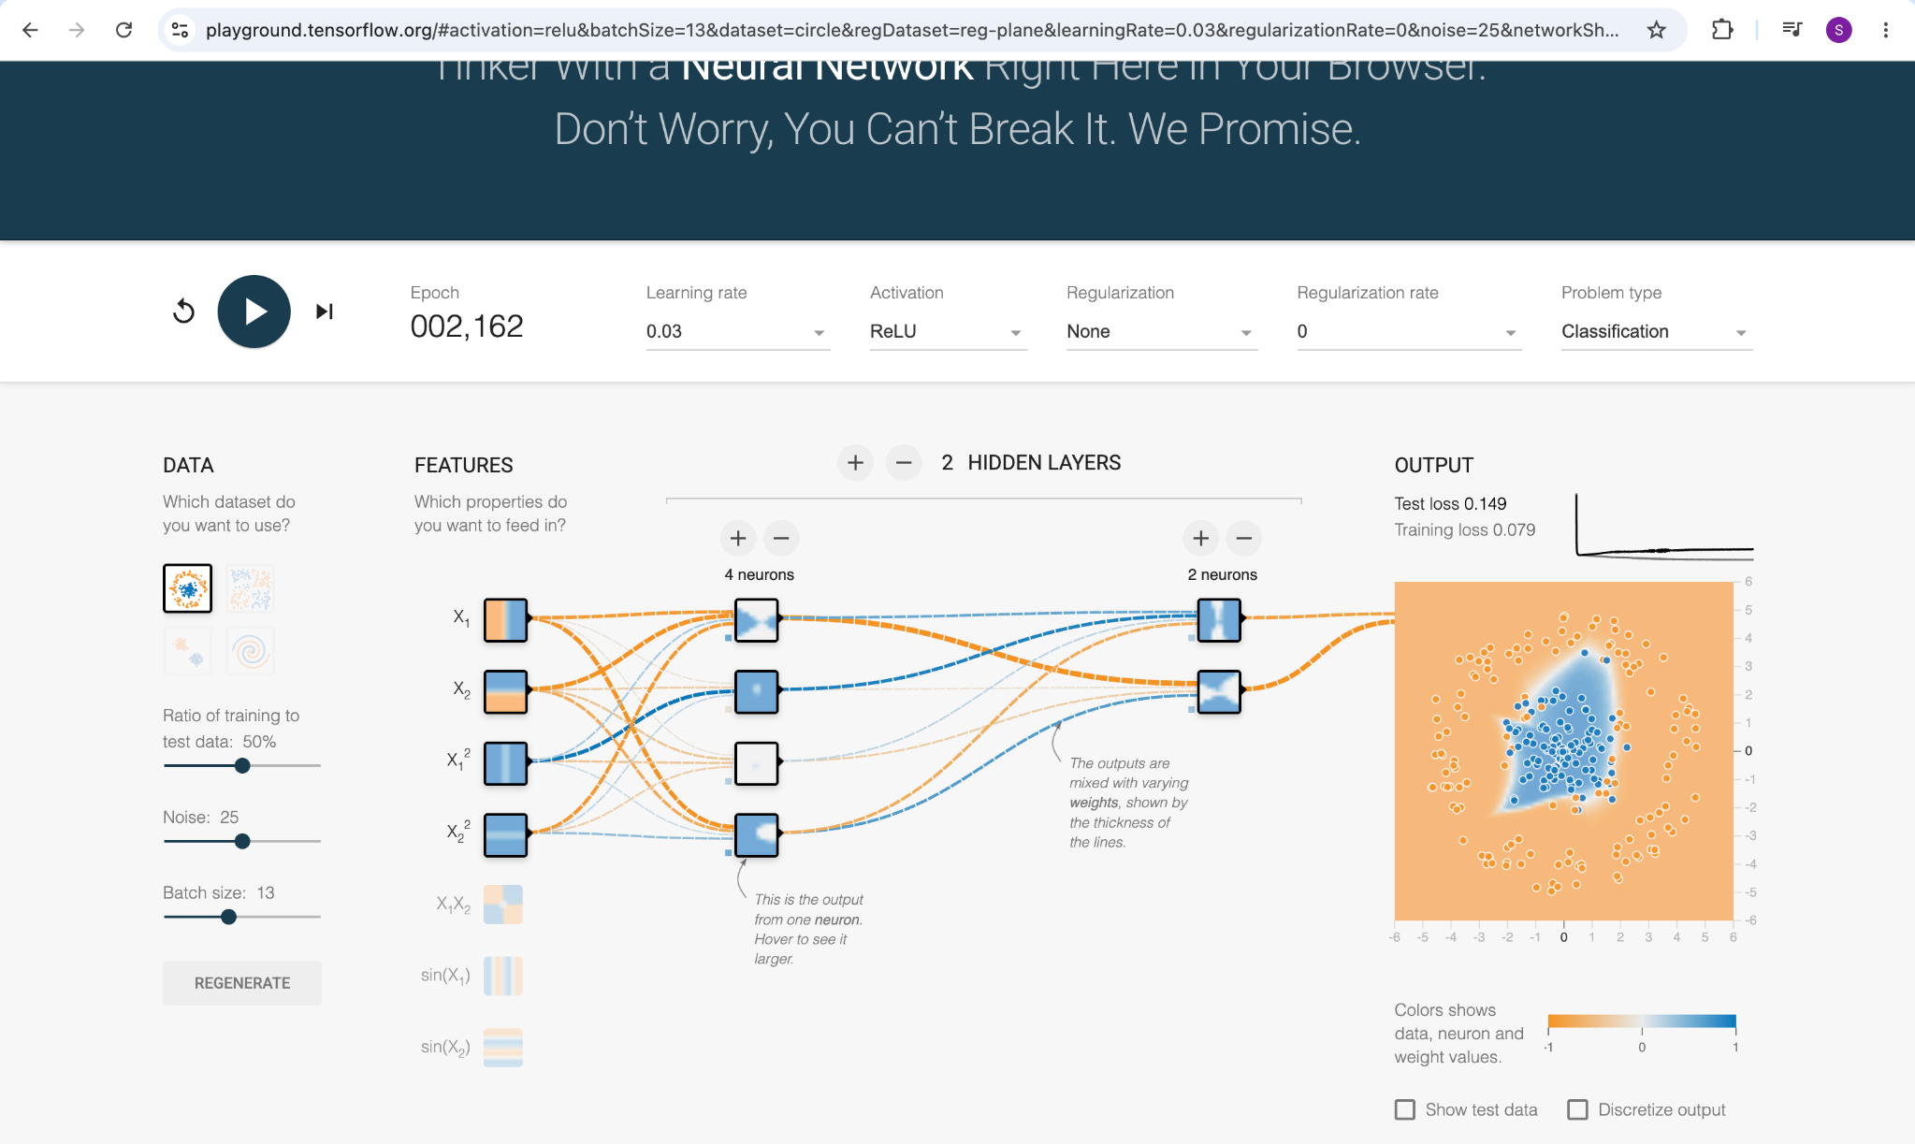
PRACTICAL EXPLORATION • DATA QUALITY
Noise makes classification more difficult
Compare the two ReLU runs with learning rate 0.03 and the same two-hidden-layer layout; the noise setting differs.
NOISE = 0
Test loss 0.000 | Training loss 0.000
NOISE = 25
Test loss 0.149 | Training loss 0.079
Observation: with noise added, the learned boundary is less clean and displayed losses are higher.
AIML-501 | MODEL DEVELOPMENT | WORKSHOP 2.4
09 / 12

Slide 10
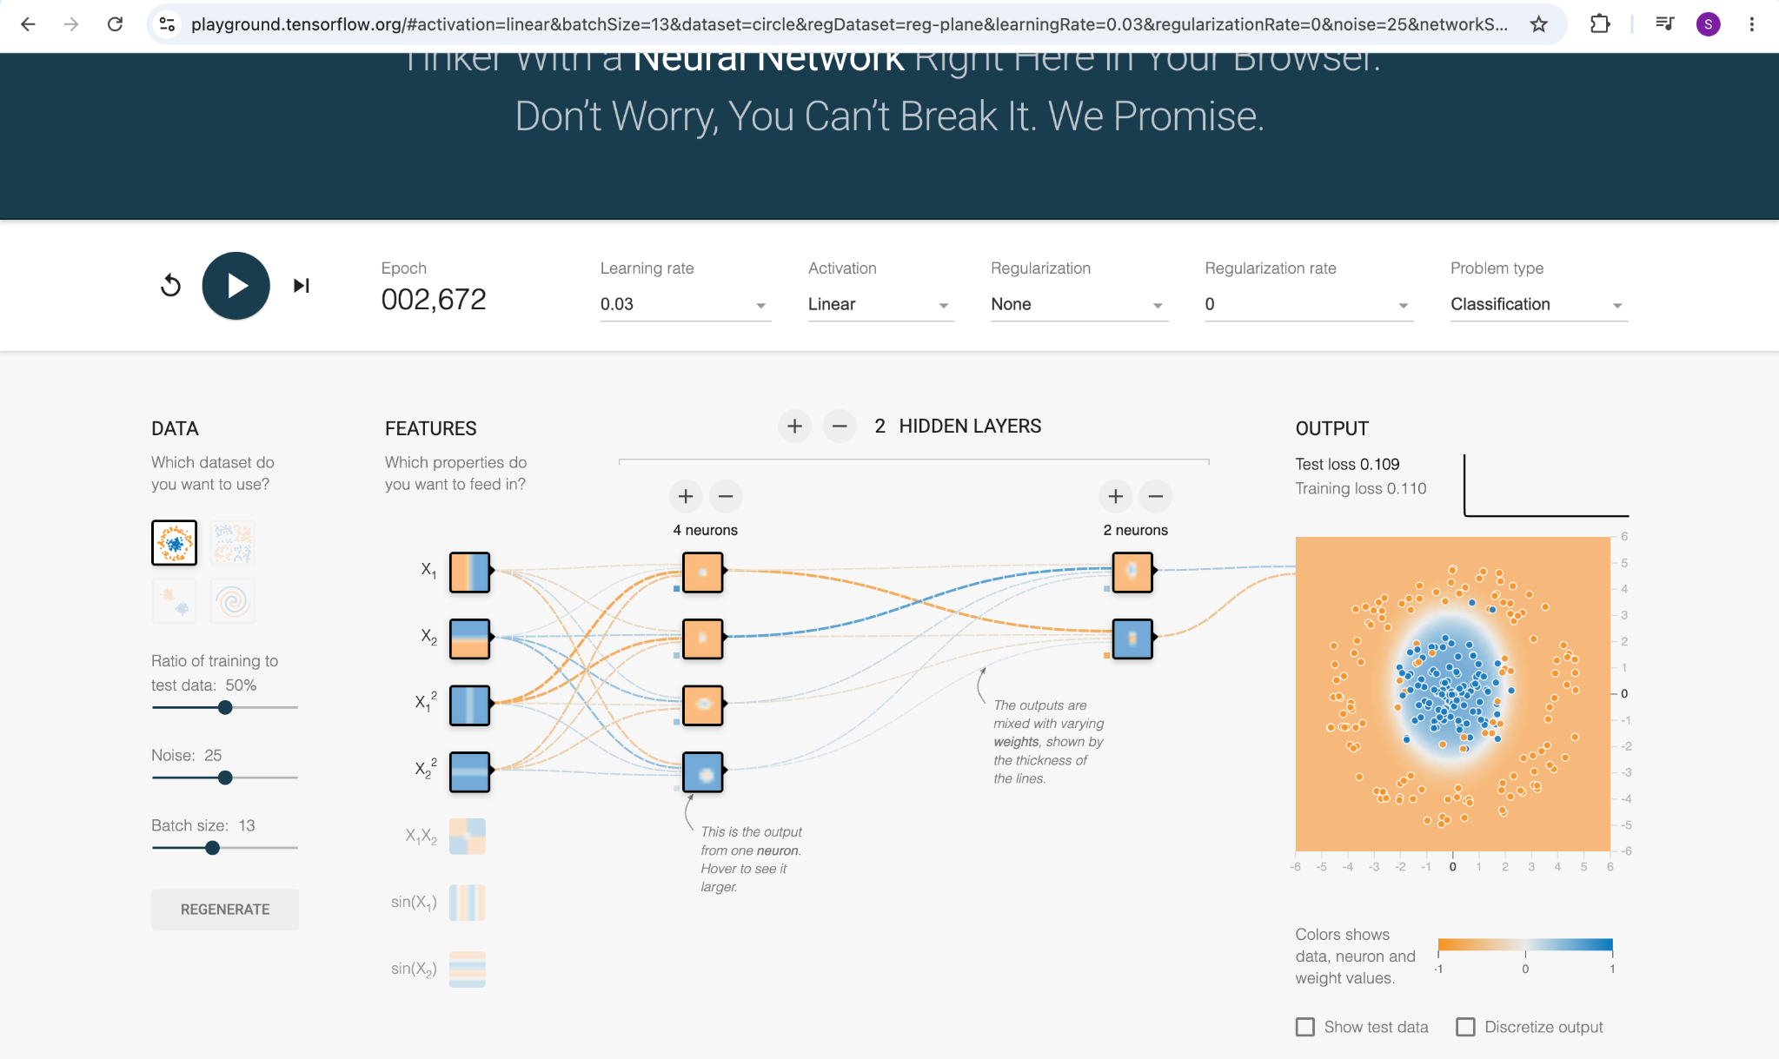
PRACTICAL EXPLORATION • ACTIVATION
ReLU and Linear produce different learned boundaries
These screenshots use the circle dataset with noise 25, learning rate 0.03, and the same displayed network layout.
ReLU
Test 0.149 | Train 0.079
LINEAR
Test 0.109 | Train 0.110
A single run does not prove Linear is generally better; repeated trials under controlled conditions would be needed.
AIML-501 | MODEL DEVELOPMENT | WORKSHOP 2.4
10 / 12

Slide 11
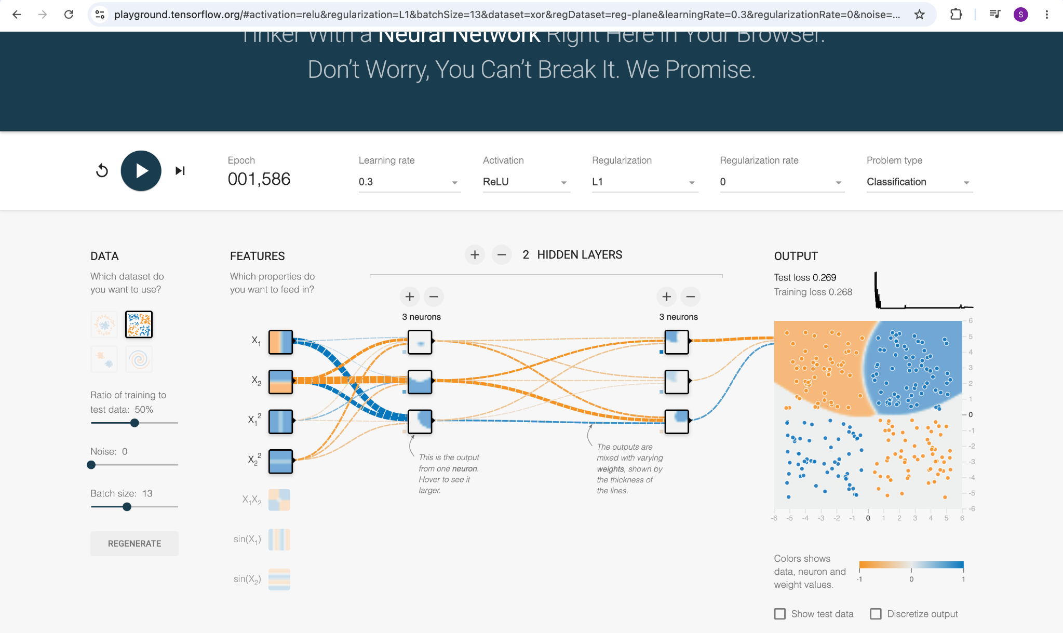
PRACTICAL EXPLORATION • SEPARATE DATASET
A separate example: XOR classification
This screenshot uses the XOR dataset, not the circle dataset; it illustrates a different classification pattern.
XOR run
Test loss 0.269
Training loss 0.268
The XOR pattern is not separable by a single straight decision boundary. Hidden units can combine inputs to form a nonlinear classification region.
Interpretation is limited to the settings and epoch shown.
AIML-501 | MODEL DEVELOPMENT | WORKSHOP 2.4
11 / 12

Slide 12
CONCLUSION
Key insights from the neural-network experiments
Visualizing the network made the relationship between model structure, training choices, and classification behavior easier to interpret.
STRUCTURE
Layers organize computation; neurons transform inputs; weights determine connection strength.
LEARNING
Activation functions shape what patterns can be represented; loss measures error; optimization updates weights.
DATA
Feature representation and noise influence how clearly classes can be separated.
EVALUATION
Training and test loss provide complementary views; compare controlled runs and avoid conclusions from one trial.
AIML-501 | MODEL DEVELOPMENT | WORKSHOP 2.4
12 / 12

