Slide 1
OOPS CONCEPTS ENCAPSULATION

Slide 2

OVERVIEW: 1. What is Encapsulation? 2.Steps 3. . Real time examples 4. Sample Code 5. Benefits

Slide 3
WHAT IS ENCAPSULATION???
Encapsulation in Java is a mechanism of wrapping the data (variables) and code acting on the data (methods) together as a single unit. In encapsulation, the variables of a class will be hidden from other classes, and can be accessed only through the methods of their current class. Therefore, it is also known as data hiding.

Slide 4
Steps to achieve Encapsulation:
Declare the variables of a class as private.
Provide public setter and getter methods to modify and view the variables values.

Slide 5
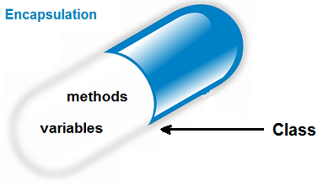

Real Time Examples
Main medicine enclosed in a capsule.
Engine, gear system etc., are hidden.

Slide 6
Sample Code
public class EncapTest
{
private String name;
private String idNum;
private int age;
public int getAge()
{
return age;
}
public String getName()
{
return name;
}
public String getIdNum()
{
return idNum;
}
public void setAge( int newAge)
{
age = newAge;
}
public void setName(String newName)
{
name = newName;
}
public void setIdNum( String newId)
{
IdNum = newId;
}
}

Slide 7
public class RunEncap
{
public static void main(String args[])
{
EncapTest encap = new EncapTest();
encap.setName("James");
encap.setAge(20);
encap.setIdNum("12343ms");
System.out.print("Name : " + encap.getName() + " Age : " + encap.getAge());
}
}

Slide 8
Output
Name : James Age : 20

Slide 9
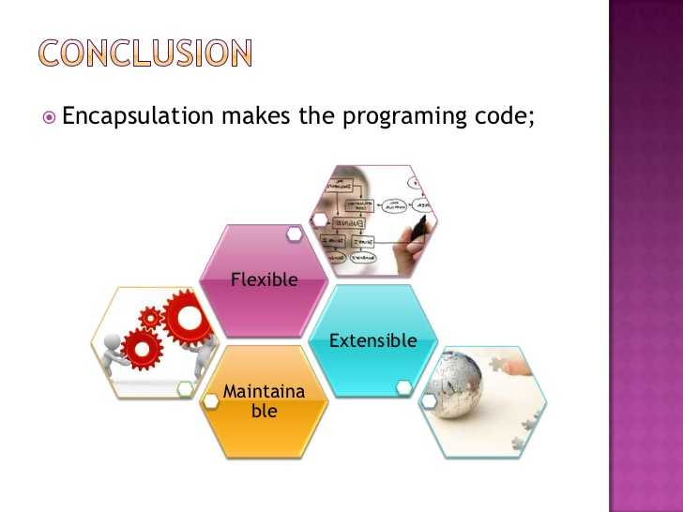
Benefits of Encapsulation

Slide 10
THANK YOU

