Slide 1
Multi-agent legal companion
for law students.
By team Dream Driven Devs
Team Members:
Sai Ramya Lanka
Soujanya Errabaka
Bhagyasri Chintharla
Chandana Pogula

Slide 2
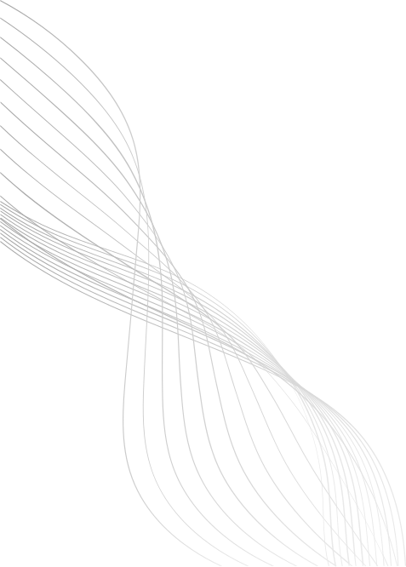
PROBLEM STATEMENT
Law students often face challenges in finding credible legal sources, summarizing complex academic documents, understanding within context, and managing their research files. These difficulties can slow down their learning process and impact the quality of their legal research.
01

Slide 3
SYSTEM ARCHITECTURE
Multi-Agent Architecture
Contextual Agent (Memory Agent): Understands and rephrases questions using chat context.
PaperAnalysis Agent: Extracts and summarizes PDFs.
ArgumentResearch Agent : Finds and verifies academic sources.
Keyword Generator (Enhanced query generation)
Source Crawler (Multi database academic search)
Citation Chainer (Quality control, deduplication and Validate ISSN)
Relevance based reranking (TF-IDF Vectorization)
Ai powered categorization.
Extract Argument Agent
03

Slide 4
Tech Stack:
Multi-agent orchestration
Python (PyPDF2)
LLM (Gemini, Ollama)
APIs: DOAJ, CrossRef
Frontend: HTML, CSS, JS
Database: SQLite (session + history)

Slide 5
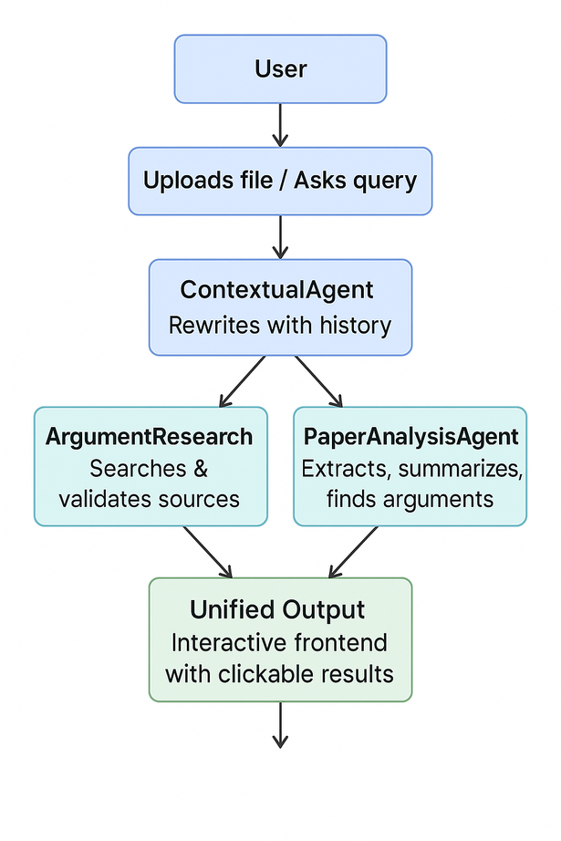
WORK FLOW
The user uploads a document or asks a question, which is refined using chat history. The system searches verified academic sources and extracts summaries and arguments from documents. Results are shown in an interactive, context-aware chat with clickable sources and arguments.
04

Slide 6
DATABASE MANAGEMENT
Uses an SQLite database to manage:
Users
Sessions
Chat history
Uploaded papers
It handles automatic session management, so users can return later and continue where they left off.
05

Slide 7
SOURCE RESEARCH
This part focuses on finding trustworthy academic sources:
Uses CrossRef and DOAJ APIs.
Validates ISSNs using the official checksum formula to ensure authenticity.
Tags sources as supporting, contradicting, or neutral.
Only returns sources that have valid ISSNs.
06

Slide 8
Reranking System (Multi-Stage Process)
Method: TF-IDF Cosine Similarity
Process:
Combines title, abstract, journal, and authors into single text
Vectorizes query and all source texts using Tfidf Vectorizer
Calculates cosine similarity between query and each source
Adds title relevance bonus (30% weight)
Sorts by combined similarity + bonus scoresaragraph text

Slide 9
SOLUTION OVERVIEW
An AI-powered multi-agent legal research assistant that:
Finds ISSN-verified academic sources
Summarizes papers and extracts arguments
Maintains context-aware chat across sessions
Supports file uploads and interactive research
02

Slide 10
IMPACT ANALYSIS
This system helps law students quickly find trustworthy legal sources and academic papers with verified ISSNs. It extracts and summarizes complex legal documents, making it easier to understand key arguments. By remembering conversation context, it offers smarter, relevant help throughout research. The user-friendly design supports multiple file types and saves time, helping students build stronger legal arguments efficiently and confidently.
07

Slide 11
CONCLUSION
This system helps law students find reliable sources, summarize legal papers, and keep track of research context easily. By using trusted databases and validating ISSNs, it ensures credible information. The user-friendly design and multi-agent setup make legal research faster and more effective, supporting students in building strong arguments.
08

Slide 12

THANK YOU
10

