Slide 1
Numerical Linear Algebra & Parallel Computing
Mohammed VI Polytechnic University

Slide 2
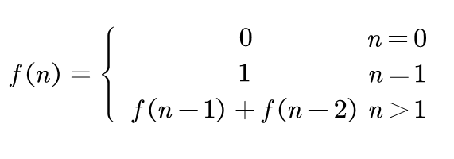
Fibonacci
Fibonacci Sequence
0, 1, 1, 2, 3, 5, 8, 13, 21, 34, ...

Slide 3
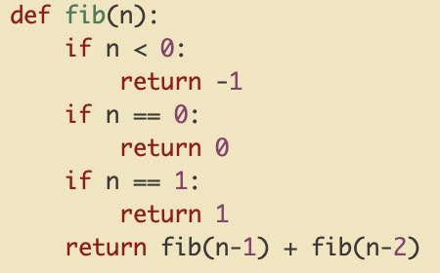
Fibonacci
Naive method

Slide 4
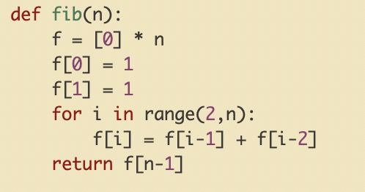
Fibonacci
iterative method

Slide 5
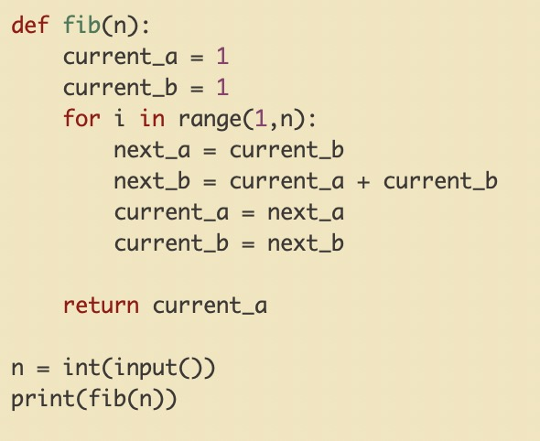
Fibonacci
iterative method (constant space)

Slide 6

Fibonacci
iterative method (constant space) matrix form
$\left[\begin{matrix} & \\ & \end{matrix}\right] ∗\begin{matrix}current_a \\ current_b\end{matrix}$ = $\begin{matrix}next_a \\ next_b\end{matrix}$

Slide 7
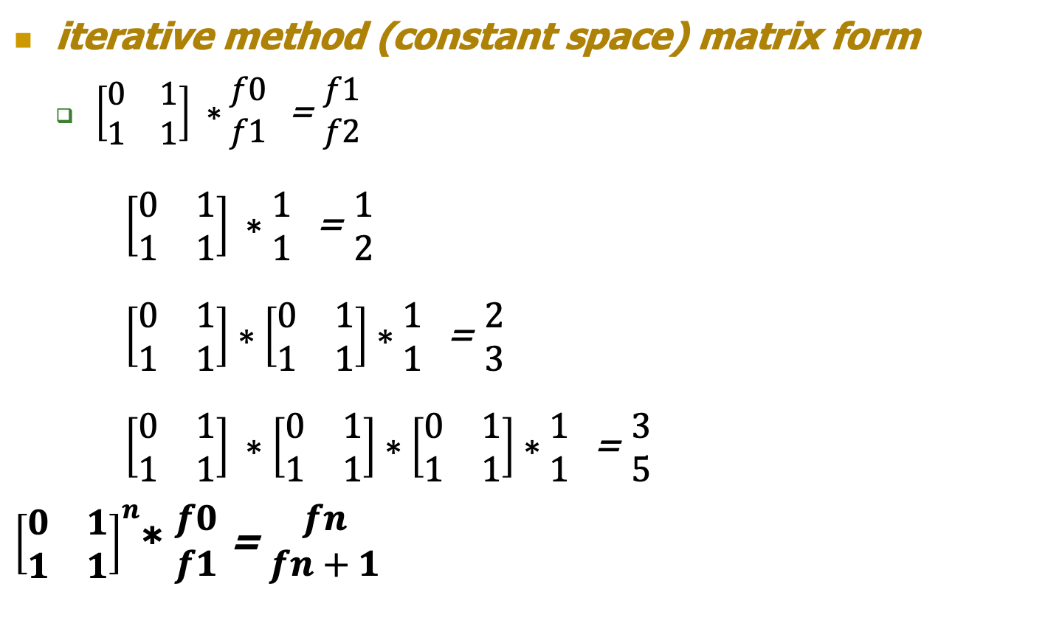
Fibonacci
iterative method (constant space) matrix form
$\left[\begin{matrix}0 & 1 \\ 1 & 1\end{matrix}\right] ∗\begin{matrix}f0 \\ f1\end{matrix}$ = $\begin{matrix}f1 \\ f2\end{matrix}$
$\left[\begin{matrix}0 & 1 \\ 1 & 1\end{matrix}\right] ∗\begin{matrix}1 \\ 1\end{matrix}$ = $\begin{matrix}1 \\ 2\end{matrix}$
$\left[\begin{matrix}0 & 1 \\ 1 & 1\end{matrix}\right]∗\left[\begin{matrix}0 & 1 \\ 1 & 1\end{matrix}\right]∗\begin{matrix}1 \\ 1\end{matrix}$ = $\begin{matrix}2 \\ 3\end{matrix}$
$\left[\begin{matrix}0 & 1 \\ 1 & 1\end{matrix}\right] ∗\left[\begin{matrix}0 & 1 \\ 1 & 1\end{matrix}\right]∗\left[\begin{matrix}0 & 1 \\ 1 & 1\end{matrix}\right]∗\begin{matrix}1 \\ 1\end{matrix}$ = $\begin{matrix}3 \\ 5\end{matrix}$
${\left[\begin{matrix}0 & 1 \\ 1 & 1\end{matrix}\right]}^{n}$* $\begin{matrix}f0 \\ f1\end{matrix}$ = $\begin{matrix}fn \\ fn+1\end{matrix}$

Slide 8
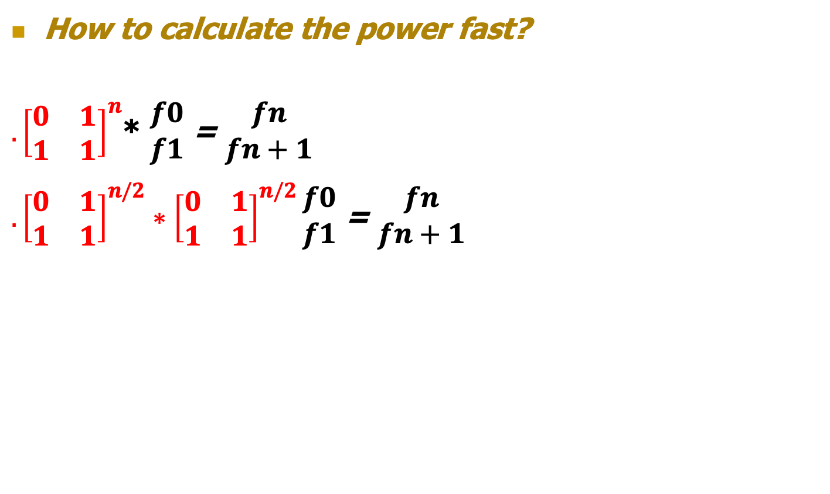
Fibonacci
How to calculate the power fast?
${. \left[\begin{matrix}0 & 1 \\ 1 & 1\end{matrix}\right]}^{n}$* $\begin{matrix}f0 \\ f1\end{matrix}$ = $\begin{matrix}fn \\ fn+1\end{matrix}$
${. \left[\begin{matrix}0 & 1 \\ 1 & 1\end{matrix}\right]}^{n/2} ∗{\left[\begin{matrix}0 & 1 \\ 1 & 1\end{matrix}\right]}^{n/2}\begin{matrix}f0 \\ f1\end{matrix}$ = $\begin{matrix}fn \\ fn+1\end{matrix}$

Slide 9

Fibonacci
What if
$f\left(n\right)= \sum_{j=max⁡(0, n−1000)}^{j<n}{f(j)}$
$f\left(1000\right)=f\left(0\right)+f\left(1\right)+f\left(2\right)+ …+f\left(999\right)$
$f\left(n\right)= {\left(\begin{matrix}01 & ⋯ & 00 \\ ⋮ & 01 & ⋮ \\ 11 & ⋯ & 11\end{matrix}\right)}^{n}$* $\begin{matrix}f(0) \\ ⋮ \\ f(999)\end{matrix}$ = $\begin{matrix}f(n) \\ ⋮ \\ f(n+999)\end{matrix}$

