Slide 1
Predicting Changes in Exchange Rates and Comparing Predictions of Different Machine Learning
Methods
Dogukan Bagci
Goksu Sankal
Patrick Linnanen
Soukaïna Mahboub Mehboub
Xue Liu

Slide 2
What is the main goal?
We want to predict the future exchange rates based on the current and past rates.
To help brokers and businesses make better decisions in crisis situations.
To help governments to control cash flow and international transactions, and avoid crime like money laundering.

Slide 3
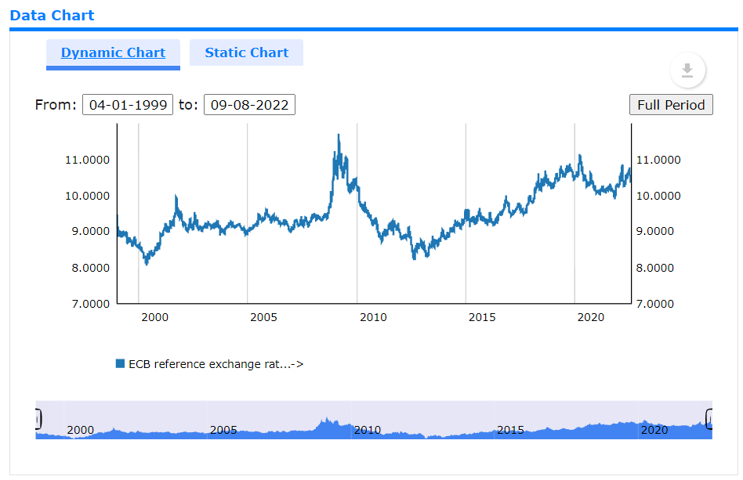
What is our Dataset?
Our data points are the exchange rates from a specific day
(04/01/1999 - 08/08/2022)
Nordic Currencies and USD
6048 Data Points
From them we have as features the exchange rates (from 1999-2020) from at most a year before the date.
For our label we have chosen a specific exchange rate (from 2020-2022) of EUR to SEK
We got our data from the European Central Bank (https://sdw.ecb.europa.eu/)

Slide 4
Candidate Models
Model 1: Multiple Linear Regression
Justification: Multiple Variables to be better armed against fluctuations
Python class: Linear Regression
Challenges: Critical Events
Model 2: Huber Regression
Justification: Being robust to outliers
Python class: HuberRegressor
Challenges: Critical Events

Slide 5
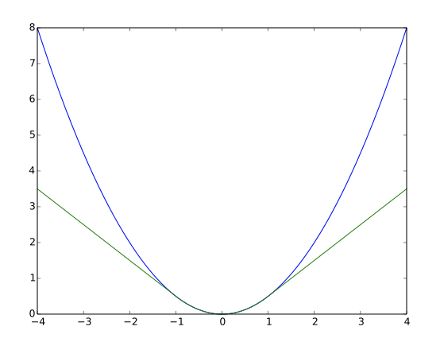
Loss
We will compare the performance of at least the Squared Error Loss (blue) and the Huber Error Loss (green) in predicting exchange rate changes.
As benchmark we use the last two years’ worth of data to validate the performance of the model in a very unpredictable economical situation.

